Slide 1
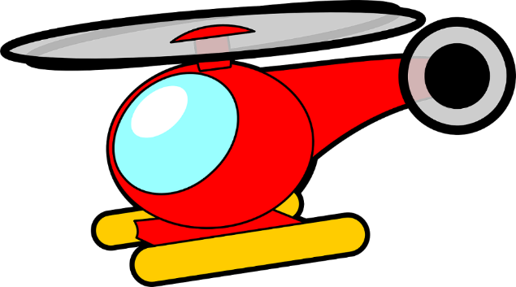
Rubber Band Helicopter
A thrilling project to make a flying rubber band helicopter

Slide 2
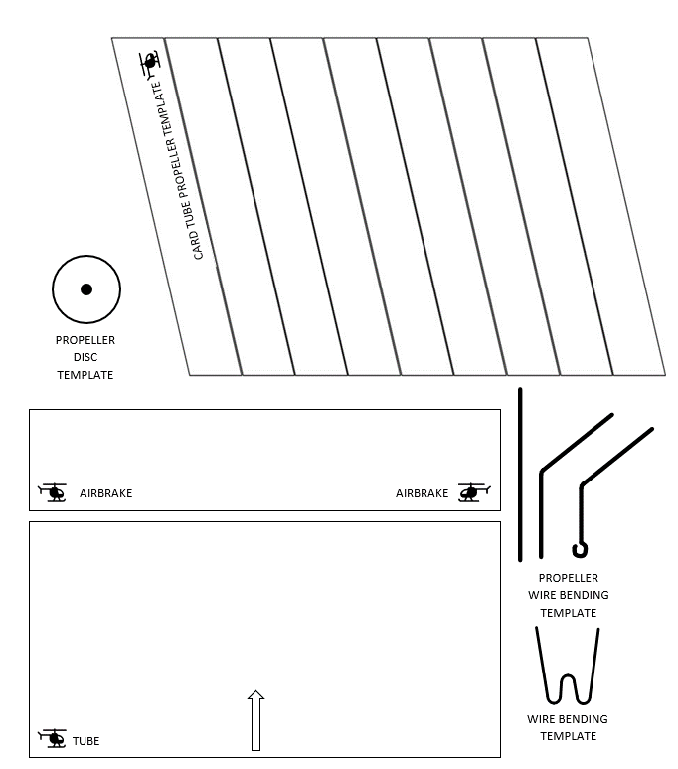
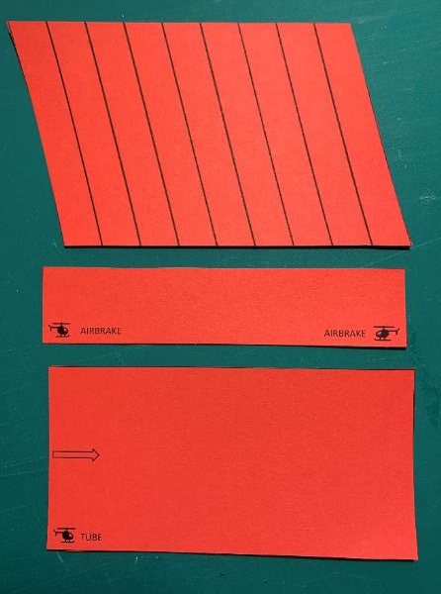
Handout
Carefully cut out the parts from the sheet

Slide 3
Step 1 – Make the tube
Roll the tube template around a pencil
Use sticky tape on the edge of the template to make it stay round
Remove the pencil

Slide 4
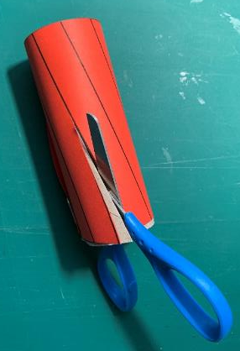
Step 2 – Cut out the propeller
Wrap the propeller template around the card tube
Hold in place with paperclips
Carefully cut a propeller
Use a sharp pencil and eraser to make a hole

Slide 5
Step 3 – Propeller wire bending 1
Straighten out a paperclip
Cut it with pliers, to the size of the template
Bend the wire using to follow the template, using your hands
Use pliers to make a small hook

Slide 6
Step 4 – Propeller wire bending 2
Straighten out a paperclip
Bend the wire to follow the template
Make a W
Use pliers to cut the ends

Slide 7
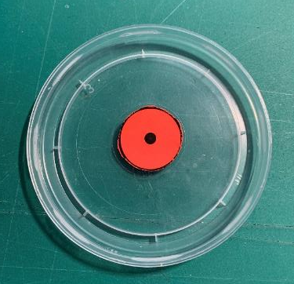
Step 5 – Propeller disc
Use a glue stick to attach the disc to yoghurt pot top
Carefully cut out with scissors
Carefully use a sharp point to make a hole
Use a skewer to make the hole larger

Slide 8
Step 6 – Propeller assembly 1
Attach the disc to the wire hook
Attach the bead to the wire hook
Bend the wire

Slide 9
Step 7 – Propeller assembly 2
5 mm
Put hook through centre hole
Bend the wire with pliers
Cut off wire with pliers to leave 5 mm
Bend the wire with pliers to hold the propeller

Slide 10
Step 8 – Rubber band assembly
Put the rubber band on the W wire
Use a wire/crochet needle to pull the rubber band through the tube
The W wire sits at the bottom of the tube

Slide 11
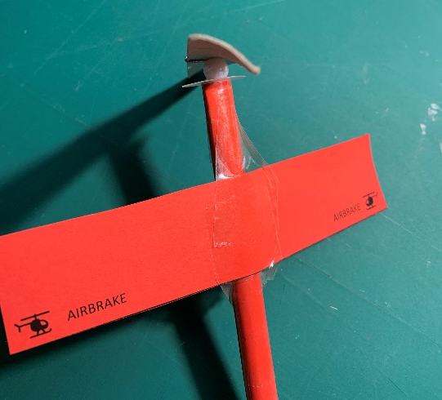
Step 9 – Propeller and airbrake
Connect the propeller to the rubber band
Measure 30 mm from the top of the tube
Attach the airbrake with sticky tape
30 mm

Slide 12
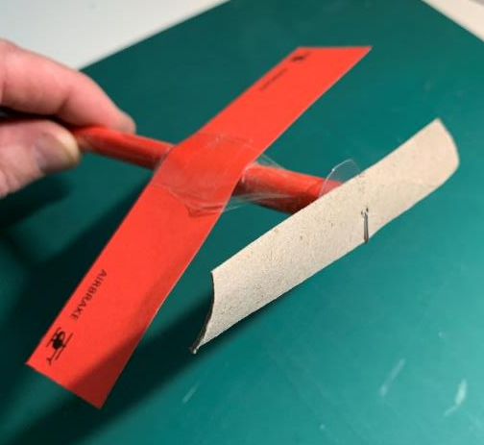
Step 10 – Test flight!
Wind the propeller anti-clockwise, about 50 turns.
Hold vertical and let go of the propeller
How high will it fly?

