Slide 1
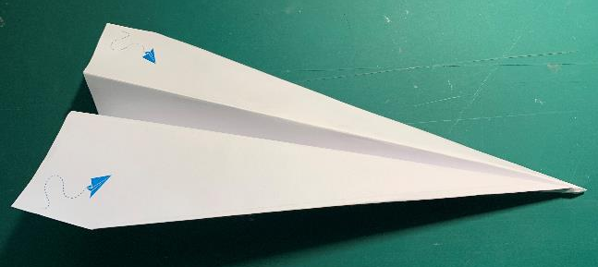
Paper aeroplane design
Making a paper plane and
finding out how far it can fly

Slide 2
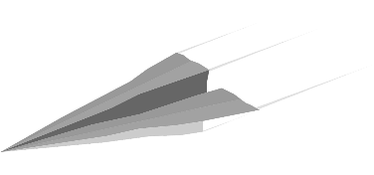
Aerodynamics
Drag – the friction between the plane and the air, slowing the plane down
Gravity – the force that causes the plane to go down
Lift – the force that causes to plane to go up
Thrust – the force that propels the plane
LIFT
DRAG
THRUST
GRAVITY

Slide 3
Step 1 - Lets fold!
Follow the numerical order
Fold and hide each number
Take your time
Make sure the creases are flat

Slide 4
Step 2 – Fold 2 and 3

Slide 5
Step 3 – Fold 4 and 5

Slide 6
Step 4 – Fold 6 and 7

Slide 7
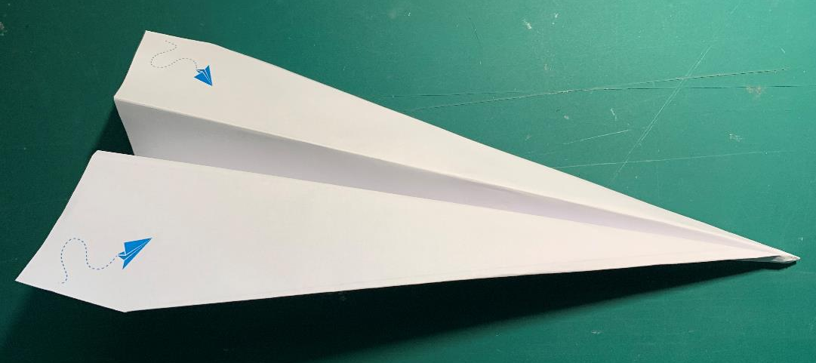
Step 5 – Ready to fly!

Slide 8
Step 6 – Testing
If you throw the aeroplane hard and fast (this is thrust) what happens?
If you throw the aeroplane gently, how does the flight differ?
How far does the aeroplane fly?
How long (in time) before the aeroplane lands on the ground?

