Slide 1
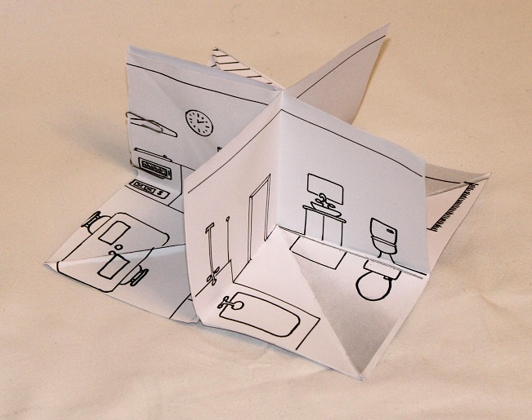
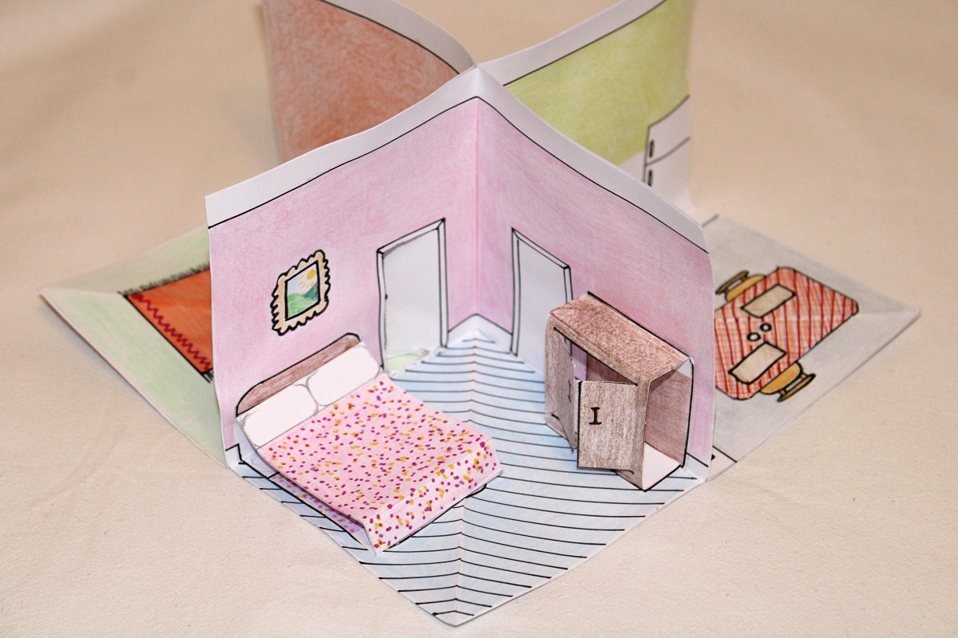
Paper House
An activity to make a four-room paper house

Slide 2
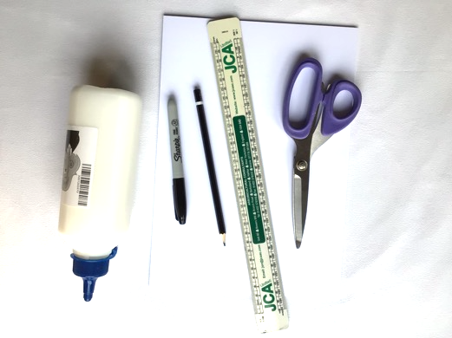
Resources
You will need:
Scissors
Paper or Card
Glue
Ruler
Pens or paint

Slide 3
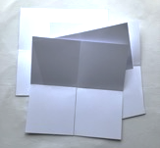
Step 1 – Cut out the 4 rooms of your house
Carefully cut paper or card into squares
Fold each square into quarters

Slide 4
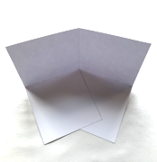
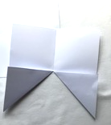
Step 2
Cut along one line of fold into the middle of your square
Fold two squares into triangles as shown in the middle picture then fold back out flat
each piece should be able to stand up as shown in the last picture
Repeat steps 1 and 2 a total of 4 times

Slide 5
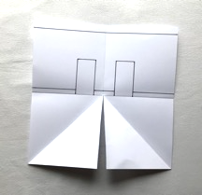
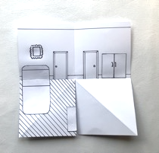
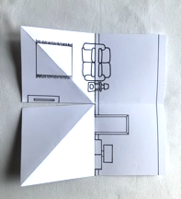
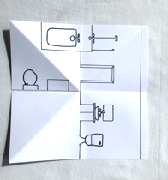
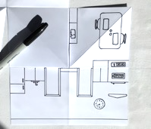
Step 3 – Design your house
Choose which rooms you want in your house
Draw your doors in first
Draw the furniture you would like – televisions, beds, sofas, baths etc.
Draw the floor on one of the bottom squares only
Top tip: if you want to make the doors open, make sure they line up with the door the room that will be next door

Slide 6
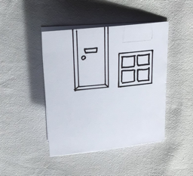
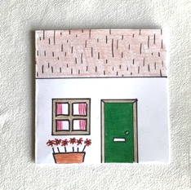
Step 4 – Make the house front
Cut a square the same size as step 1, then cut in half
Draw on the features you can see from outside - a front door, windows, roof etc.
Add colour if you want to

Slide 7
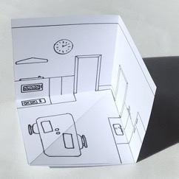
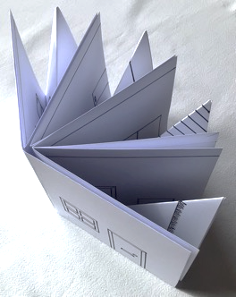
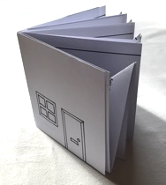
Step 5 – Construct your house
Fold the floor area of each room over the blank square and glue carefully in place, as in the first picture. Allow the glue to dry.
When dry, gently fold each room flat by pushing up the fold in the floor
Once folded, stick the rooms together by gluing three sets of walls to each other
Fold the whole house flat (like a book) then glue the house front in place

Slide 8
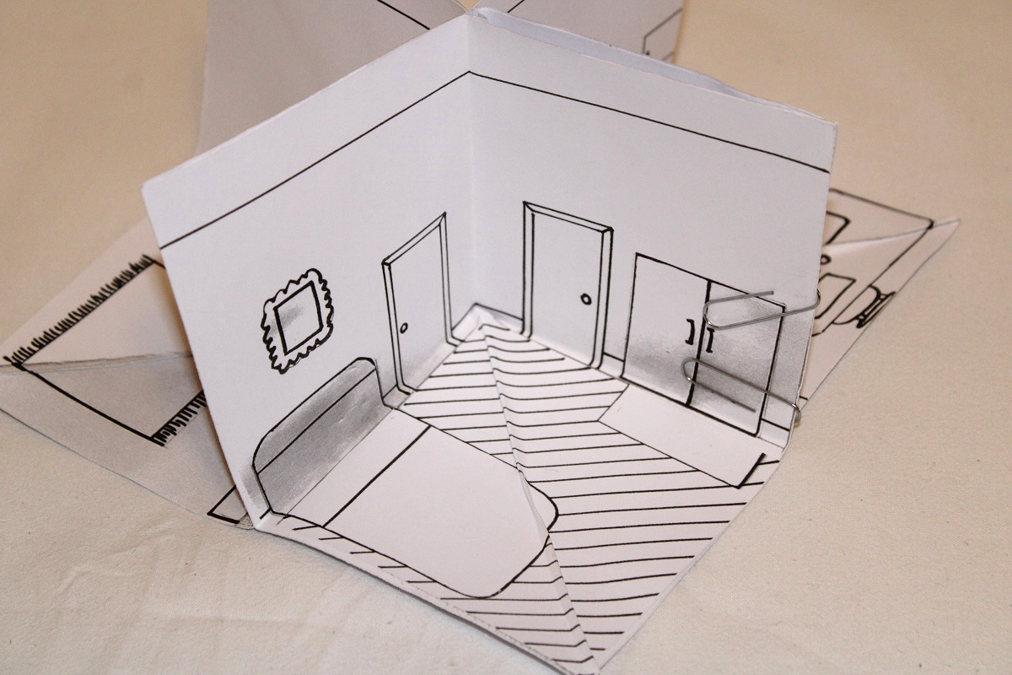
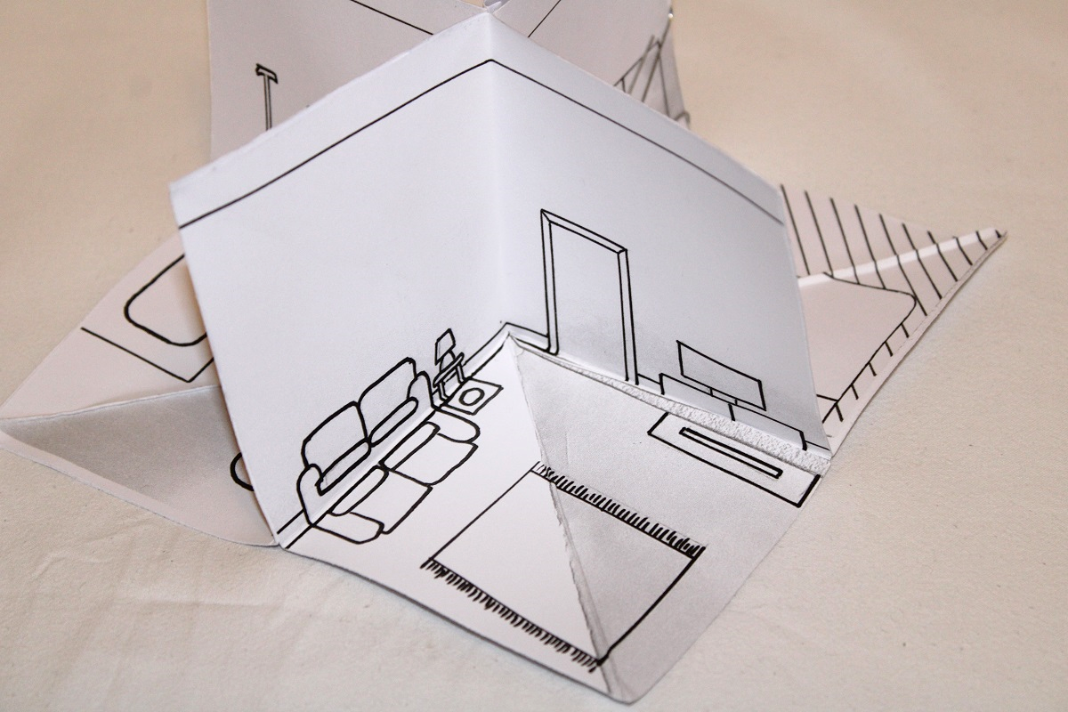
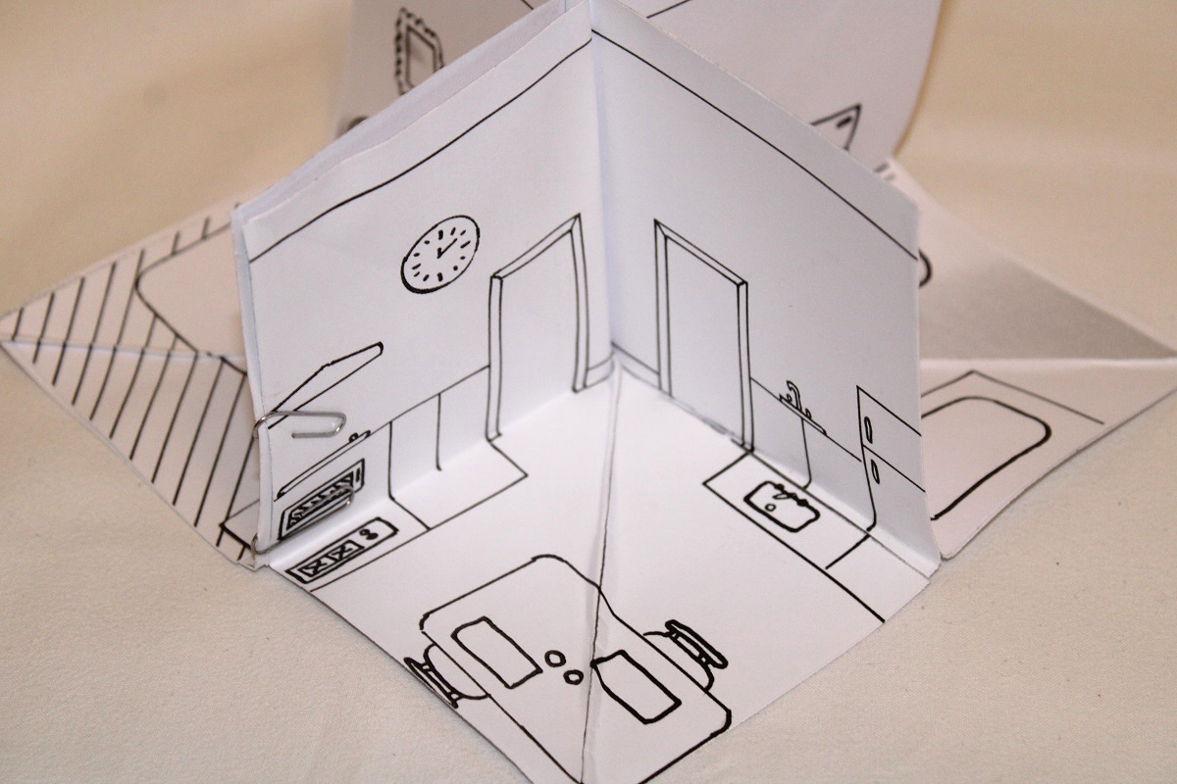
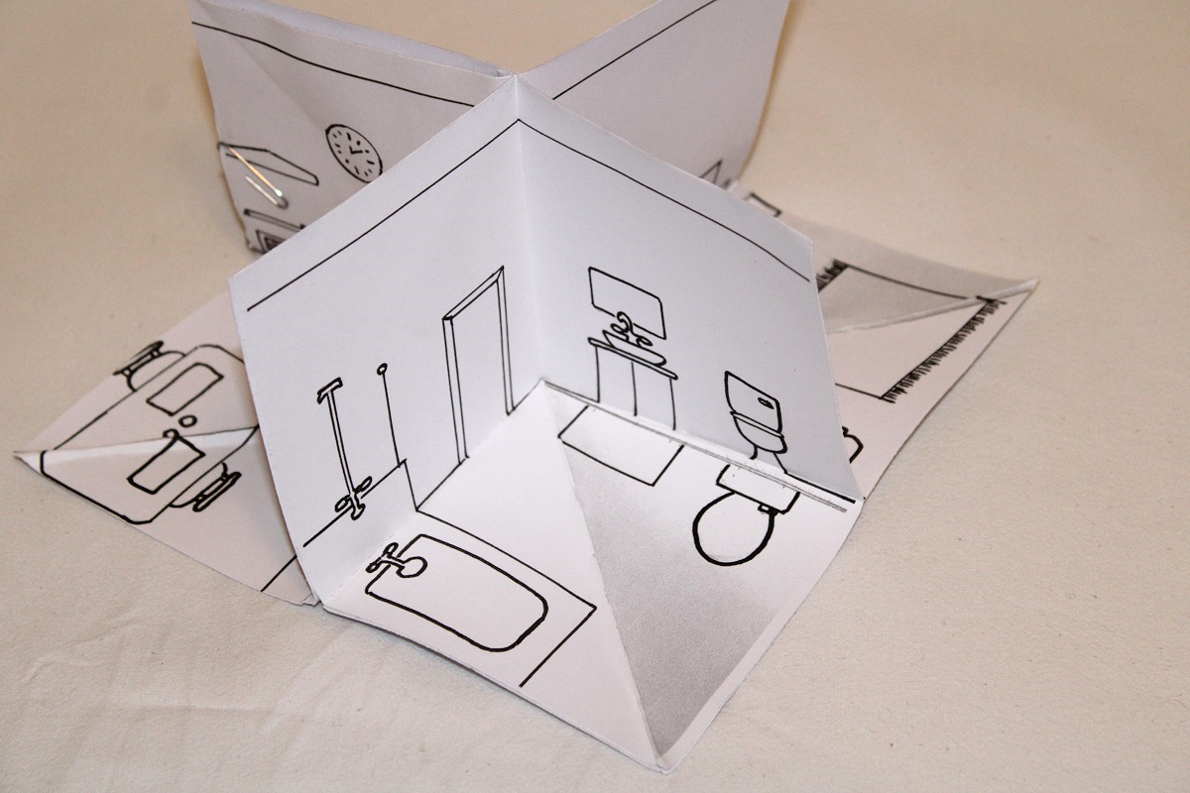
Example of a Finished House

Slide 9
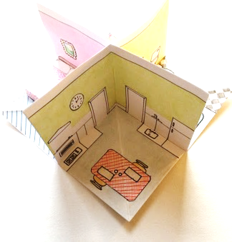
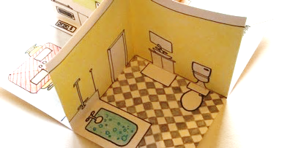
Extension – Option 1 – Add Colour
At step 3 you can add colour - what would you like in your house?

Slide 10
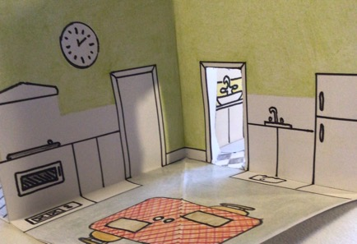
Extension – Option 2 - Opening Doors
Customise your house with doors that open (get an adult to cut them out for you, then fold the doors open)

Slide 11
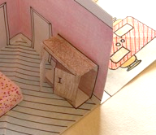
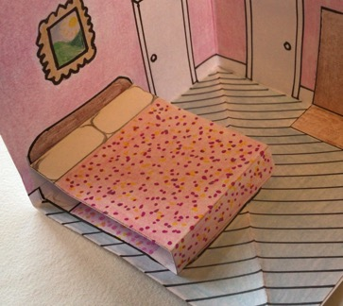
Extension – Option 3 - Add Pop-up Furniture
You can make pop-up furniture from pieces of card
These will fold down when you close the room
The next two slides show you how to make a bed and a wardrobe
You can use the same approach to make sofas and tables
When positioning the pop-ups, stick them to a wall or only one triangle on the floor

Slide 12
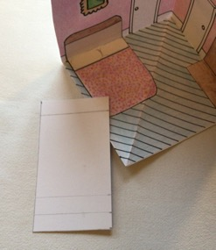
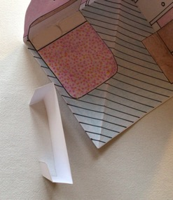
Extension – Option 3 – Bed
Cut out a rectangle of paper or card
Make three folds as pictured
Add colour and details
Glue in place at the top and bottom of the bed along the folds, press flat and fold room shut, allow to dry

Slide 13
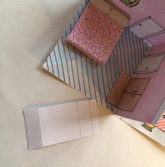
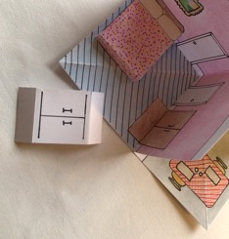
Extension – Option 3 – Wardrobe
Cut out a rectangle of paper or card
Make three folds as pictured
Add colour and details, cut out doors and fold so they open
Glue in place at the top and bottom of the wardrobe along the folds, press flat and fold room closed, allow to dry
––

Slide 14
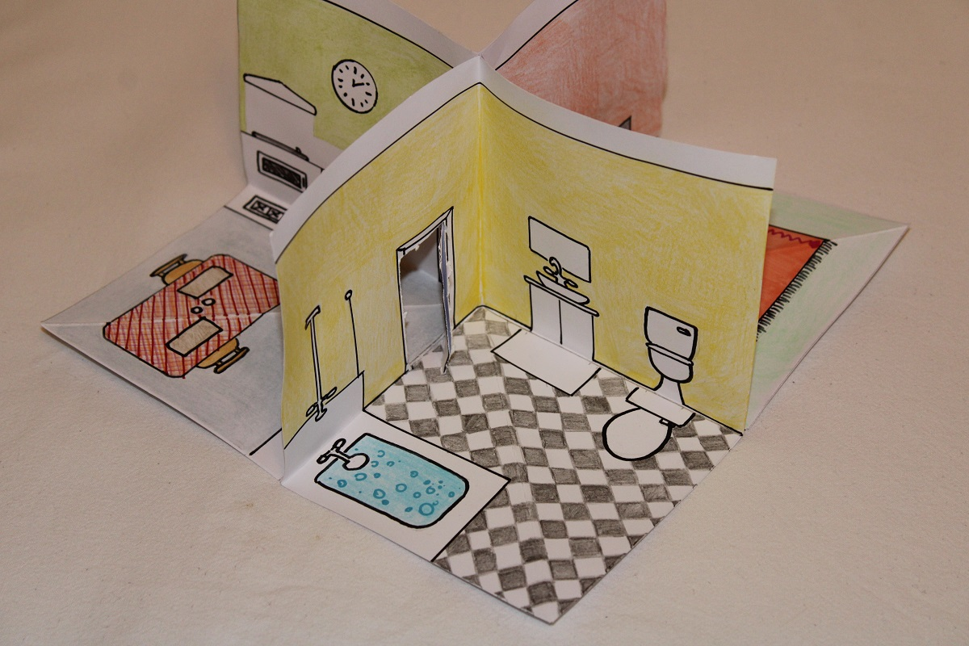
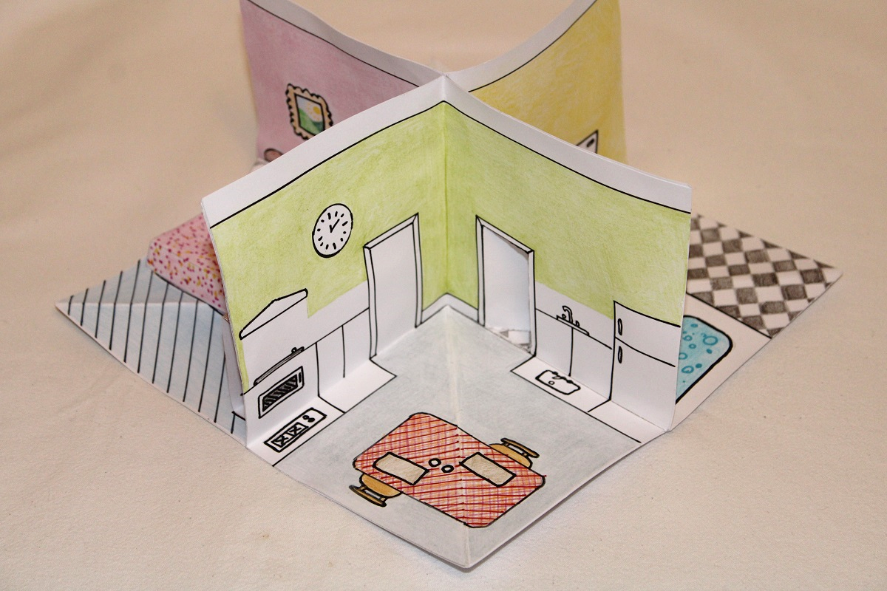
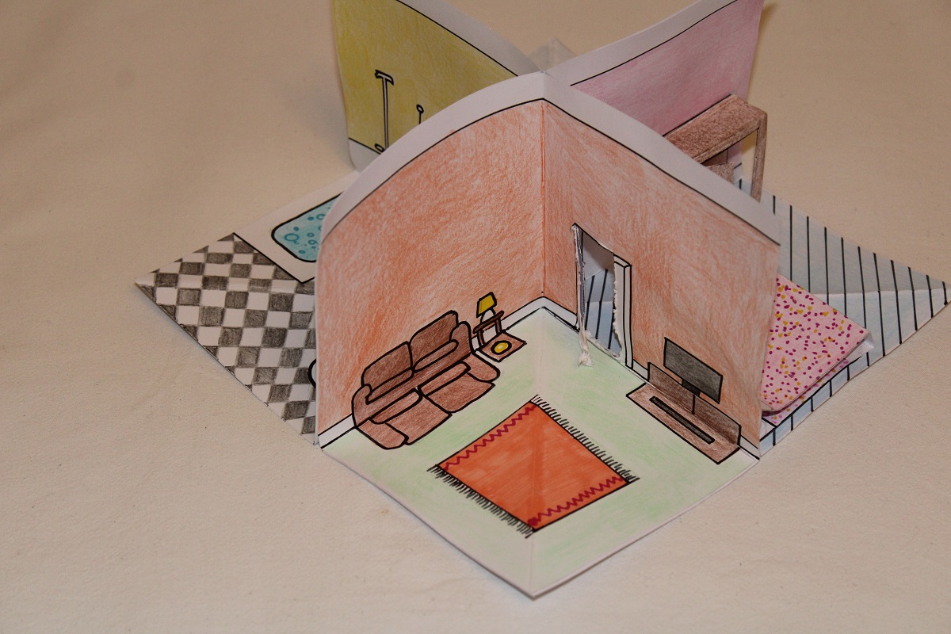
Example of a Finished House with Colour

Slide 15
Extension
You can also make people or animals to live in your house!

