Slide 1
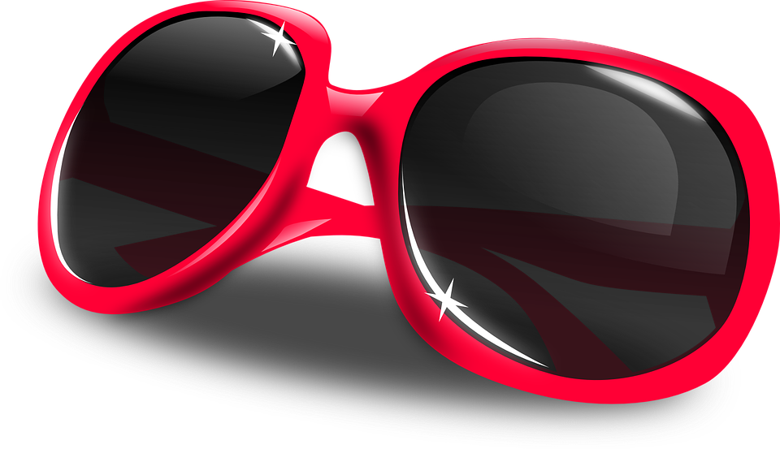
Sunglasses of the future
Designing a new pair of futuristic and sustainable sunglasses

Slide 2
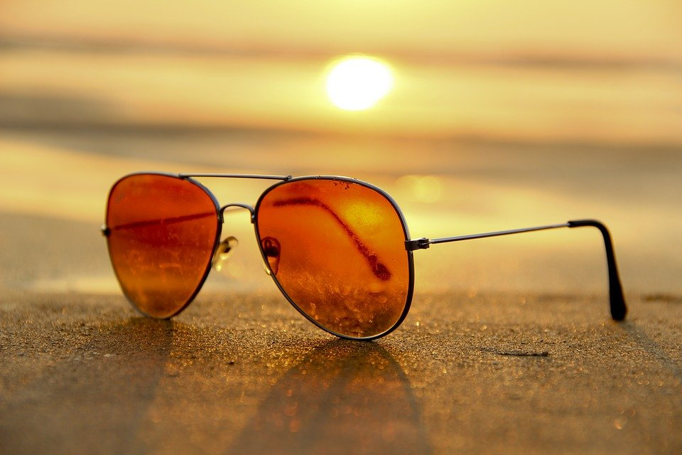
What is the purpose of sunglasses?
Notes:
Discuss with learners the purpose of sunglasses. For example, their functional purpose (e.g. to protect eyes from the effects of the sun, make vision easier in sunny conditions) and aesthetic purpose (e.g. fashion, style, use of shape and colour). What might the requirements/purpose of sunglasses be in the future? How could they be improved in terms of their functionality, aesthetics and sustainability?

Slide 3
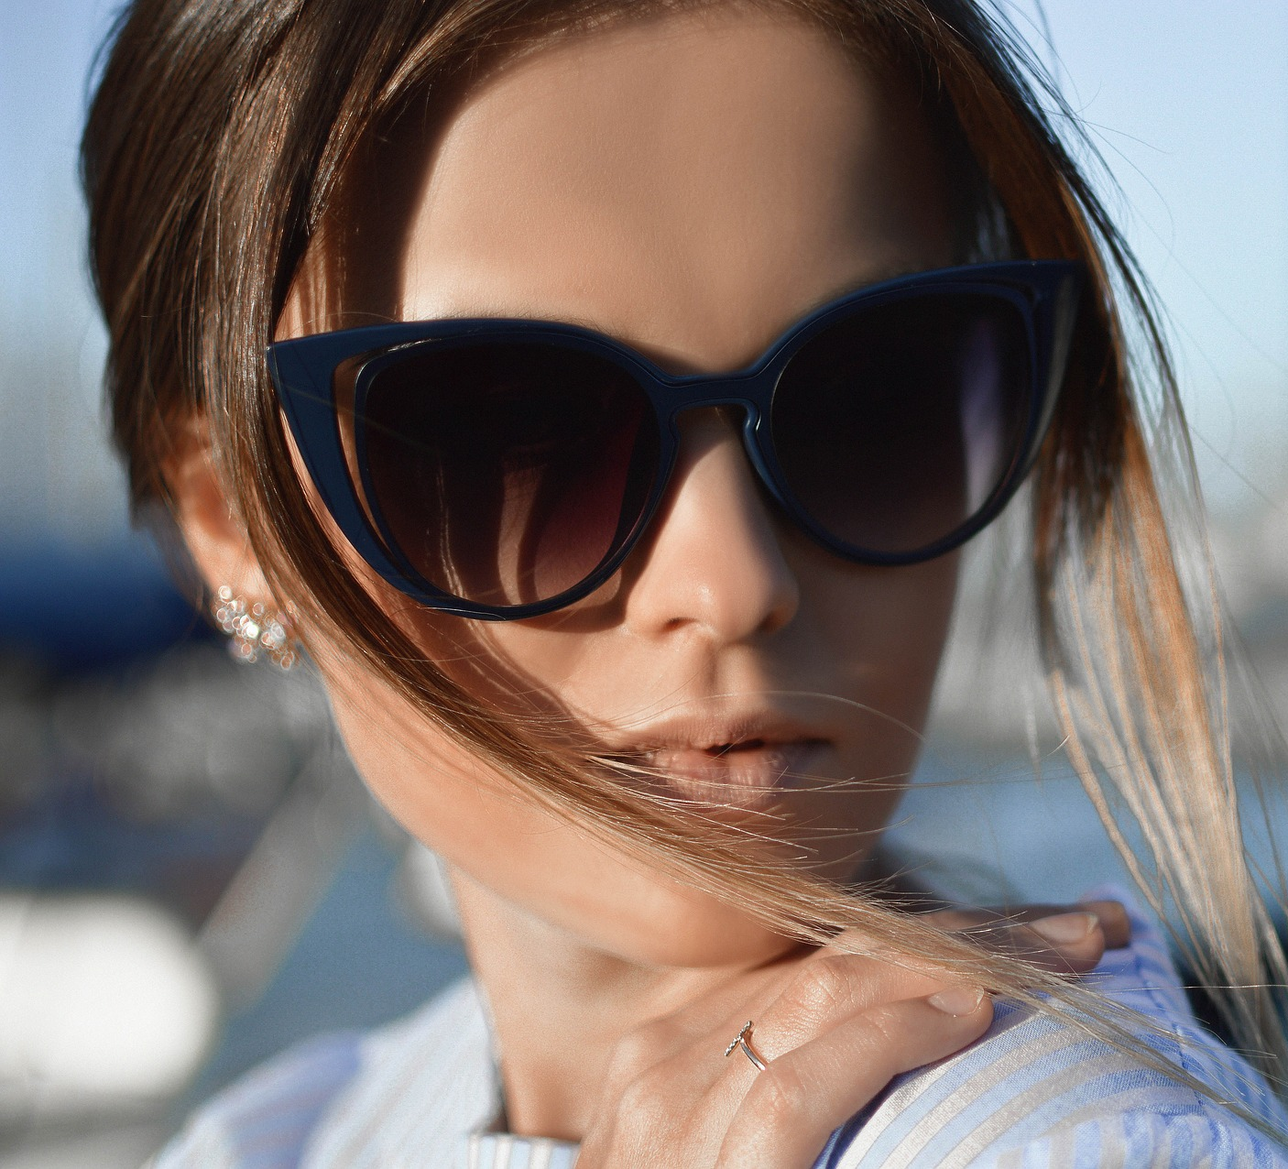
The design challenge
Situation
Sunglasses protect the wearer from the potentially harmful effects of UV light from the sun. They are also seen as a stylish fashion accessory.
Design Brief
Your task is to design a pair of sunglasses for the future. Your design must make use of new and/or future technologies. It must also be made from sustainable, plastic free materials.
Notes:
The design must meet the needs of the design brief and criteria shown on the following slide. Learners should sketch their ideas and annotate them to show how they meet these requirements. Encourage them to be creative!

Slide 4
Specification
Your design must meet the following design criteria. It must:
Protect the eyes from harmful effects of UV light from the sun
Be made from plastic free, sustainable materials
Make use of augmented reality and other new technologies
Be aesthetically pleasing to young professional adults
Notes:
Discuss the design criteria with learners and the meaning of the key terms. Augmented reality is the use of technology to enhance the viewing experience with computer generated information. For example, information about different shops and their products when walking down a high street, or the destinations and departure times of trains at each platform of a station. As young adults often see sunglasses as a fashion accessory it is important that the aesthetics are considered in addition to the functional requirements. Discuss the issues surrounding plastic waste and the importance of reducing this.

Slide 5
Future Sunglasses Design
Use this space to sketch your idea for your product.
Don’t forget to annotate your design to show how it meets the design criteria!
Notes about design:
Notes:
This slide can be handed out for learners to use when producing their design, or they can use blank paper. They must annotate their design to show how it meets the needs of the design brief and design criteria. As an extension they could make a model of their design, or create a more detailed design specification with additional criteria that must be taken into account within the design. If learners have access to CAD software they could use this to produce a 3D model of their design.

Slide 6
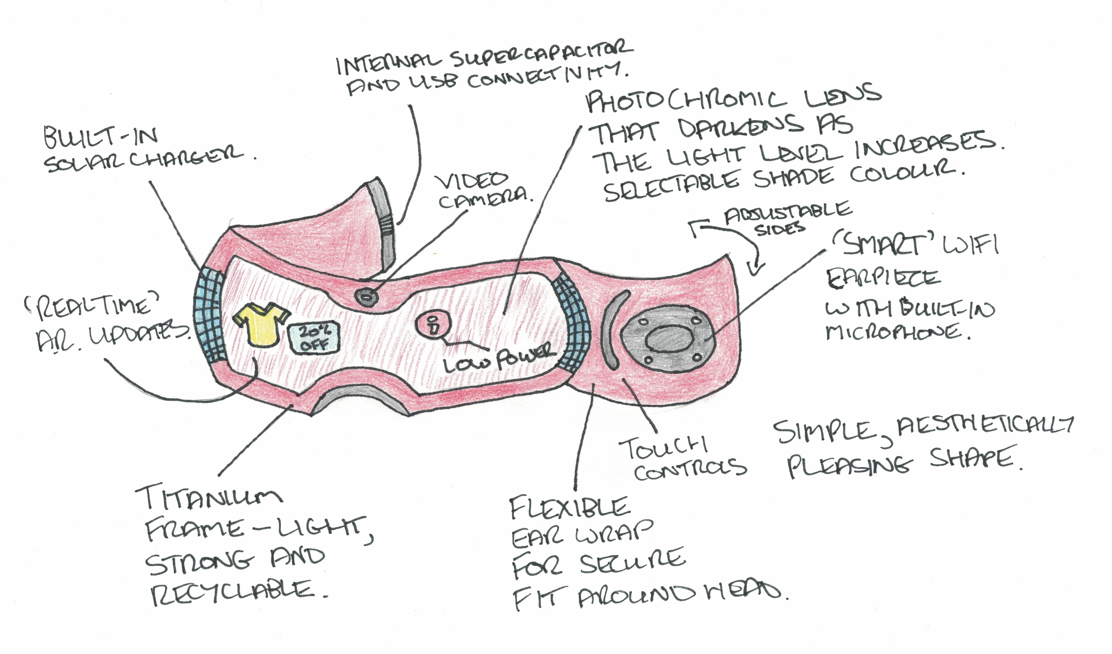
Future Sunglasses Design - Example
Use this space to sketch your idea for your product.
Don’t forget to annotate your design to show how it meets the design criteria!
Notes about design:
Uses a supercapacitor as the power supply to reduce battery waste. This is charged by the built in solar panels or USB connection.
Frame made from titanium – no plastics used.
Built in ‘smart’ voice and speaker capability for playing music, getting directions etc.
Provides real time AR updates such as shop prices and offers.
Photochromic lens adjusts darkness automatically or can be controlled using touch controls.
Simple aesthetic style.
Notes:
This is an example of an annotated sketch of a design with supporting notes.

