Slide 1
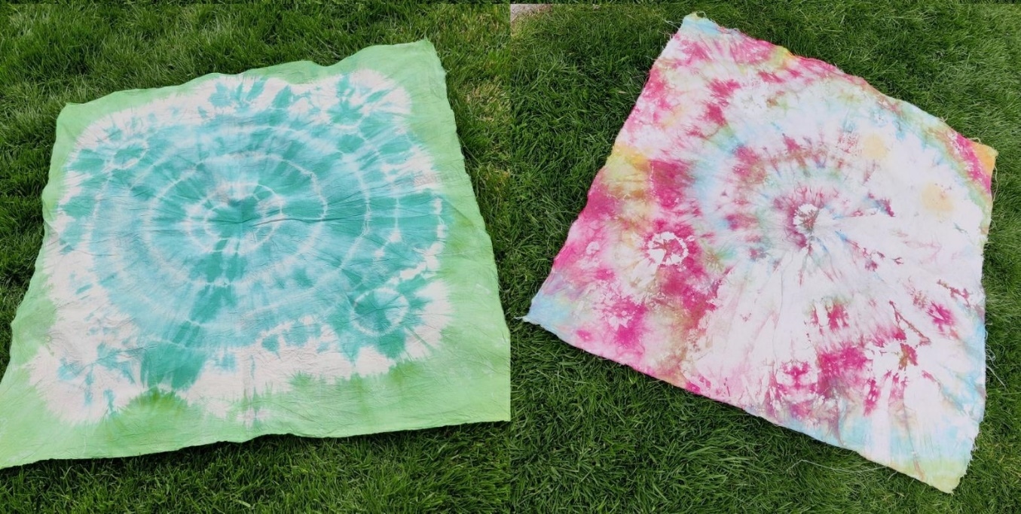
Tie dyeing a picnic blanket
Creating a design on a picnic blanket by tie dyeing

Slide 2
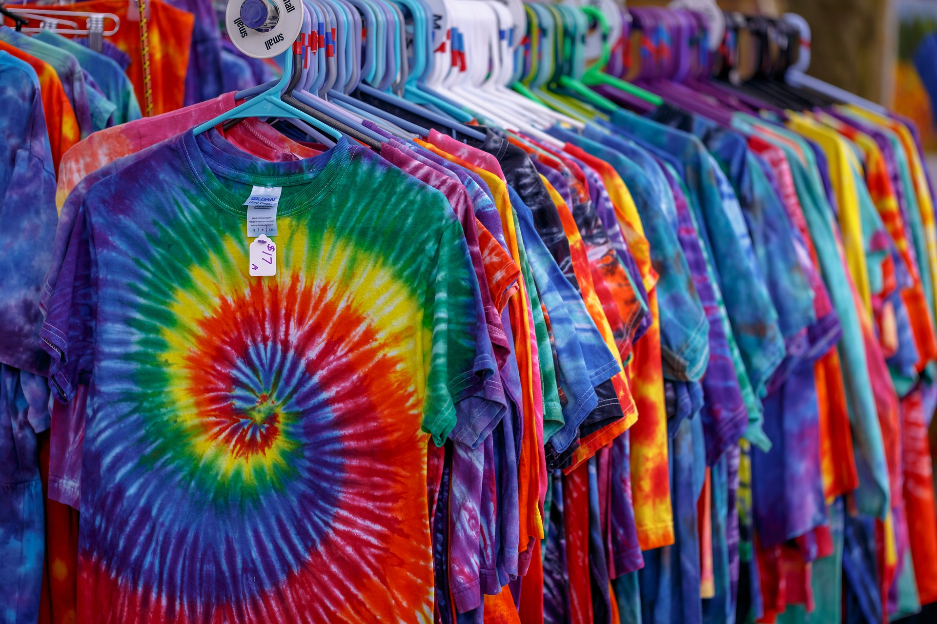
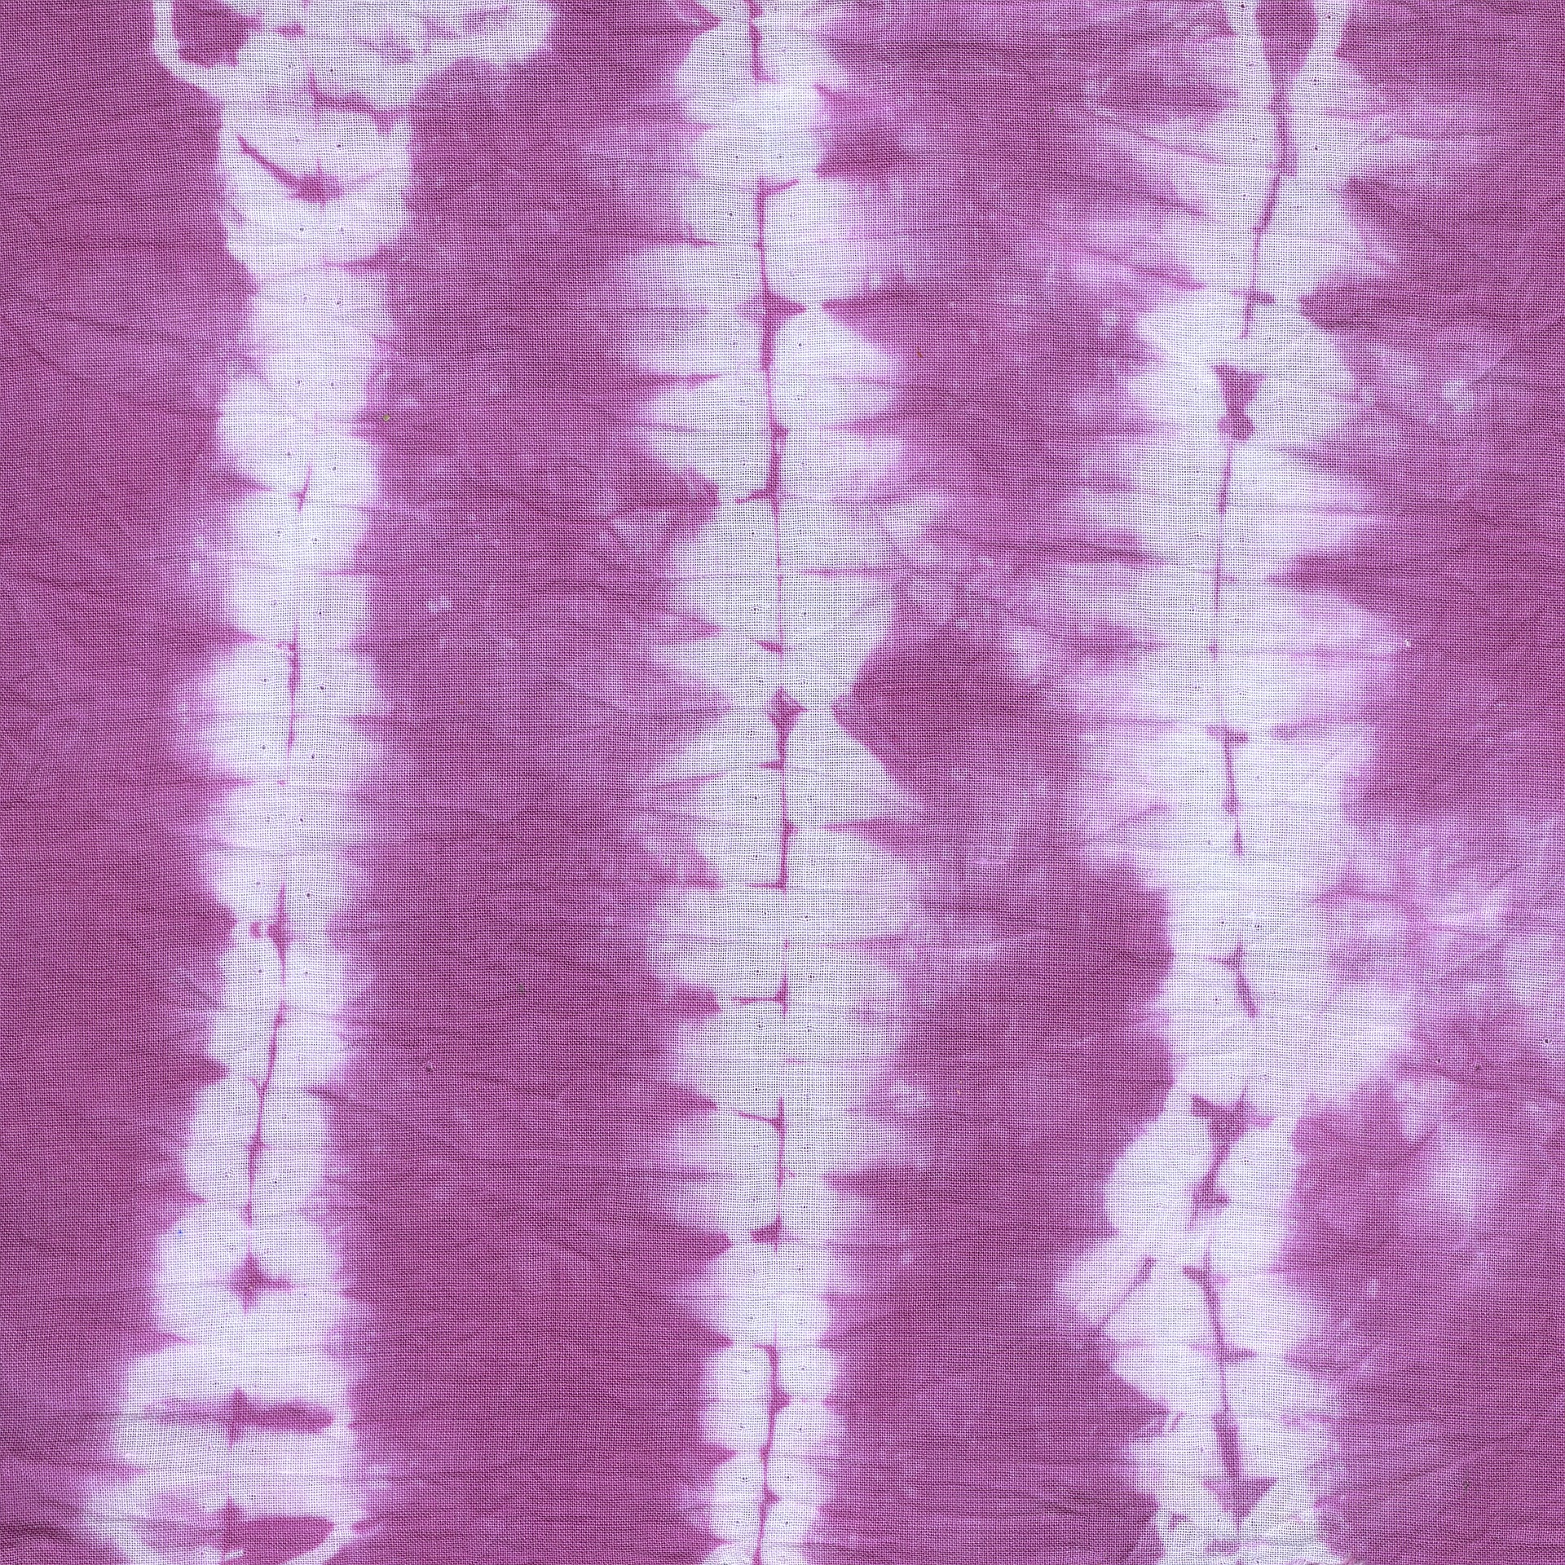
What is Tie Dyeing?
The process of tying and dyeing a piece of fabric or cloth, which is a knit or woven fabric
Tie dyed products are usually made of cotton and make use of bright colours
Notes:
Learners could write their own definition in their exercise books.

Slide 3
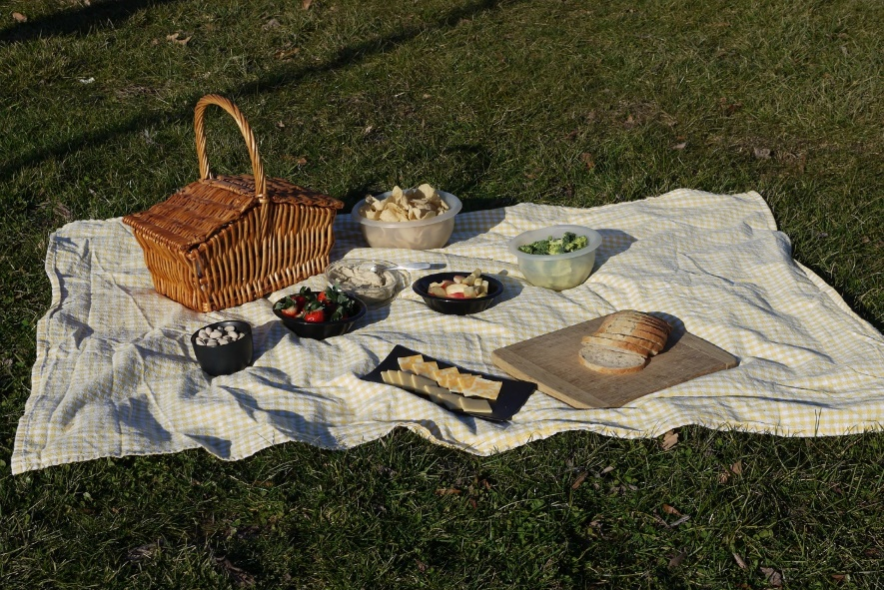
Creating your own tie dyed picnic blanket
You need to consider:
The final pattern you want to create
The colour of fabric
The colours of dye to be used
Notes:
Learners could also consider the size and shape of the picnic blanket, or a set size of fabric could be pre-cut for them to use.

Slide 4
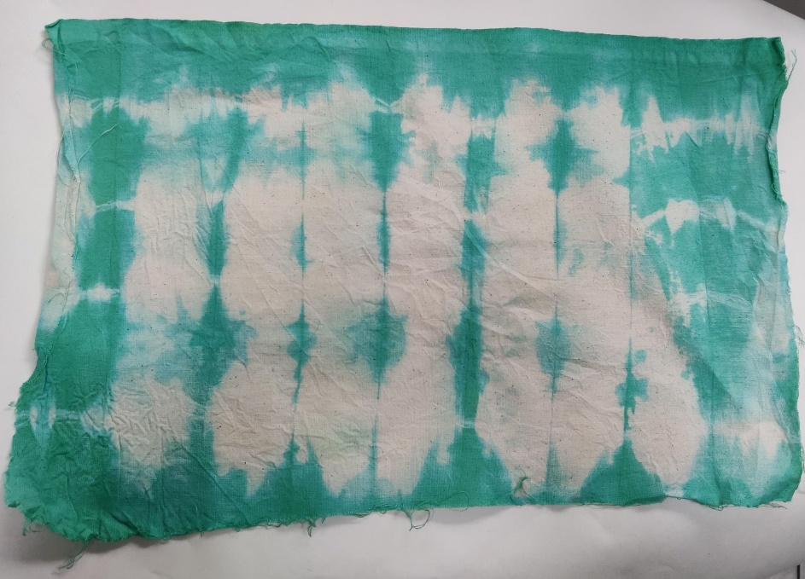
Sample 1 - Folding
Notes:
Start at one end, fold the material like a fan, secure with string/elastic bands.
Can dye using one colour, or with each segment a different colour.

Slide 5
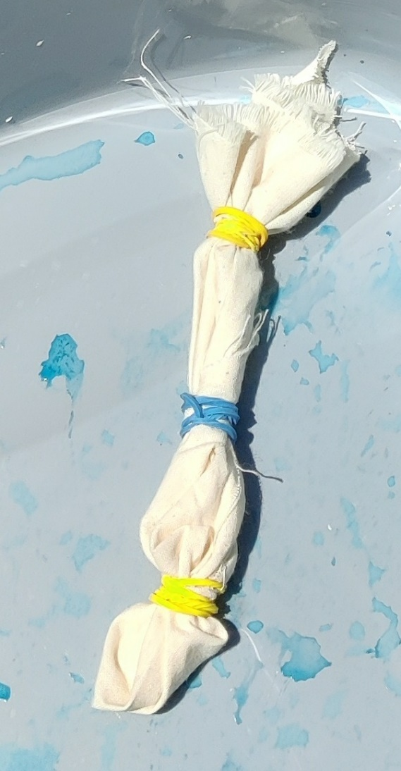
Sample 2 - Bulls eye
Notes:
Pinch the fabric in the middle, or where you would like the middle of the pattern. Pull up the material and place rubber bands tightly around the material, as close or as far apart as you wish.
Keep the fabric damp/re-apply dye if the design is bulky.

Slide 6
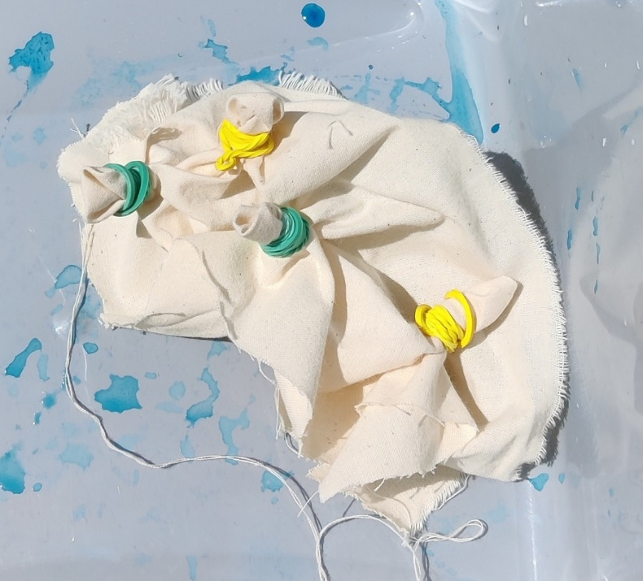
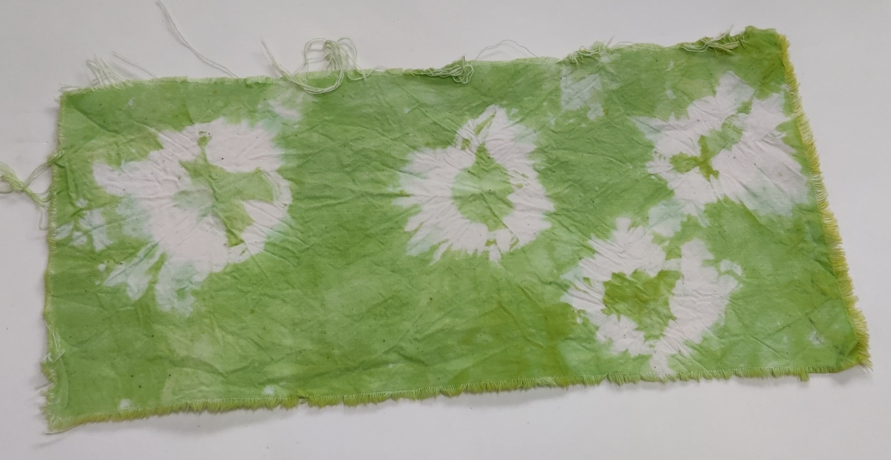
Sample 3 - Knotting
Notes:
Pull up the area of material where you want the knot, secure with the elastic band. Repeat as required.

Slide 7
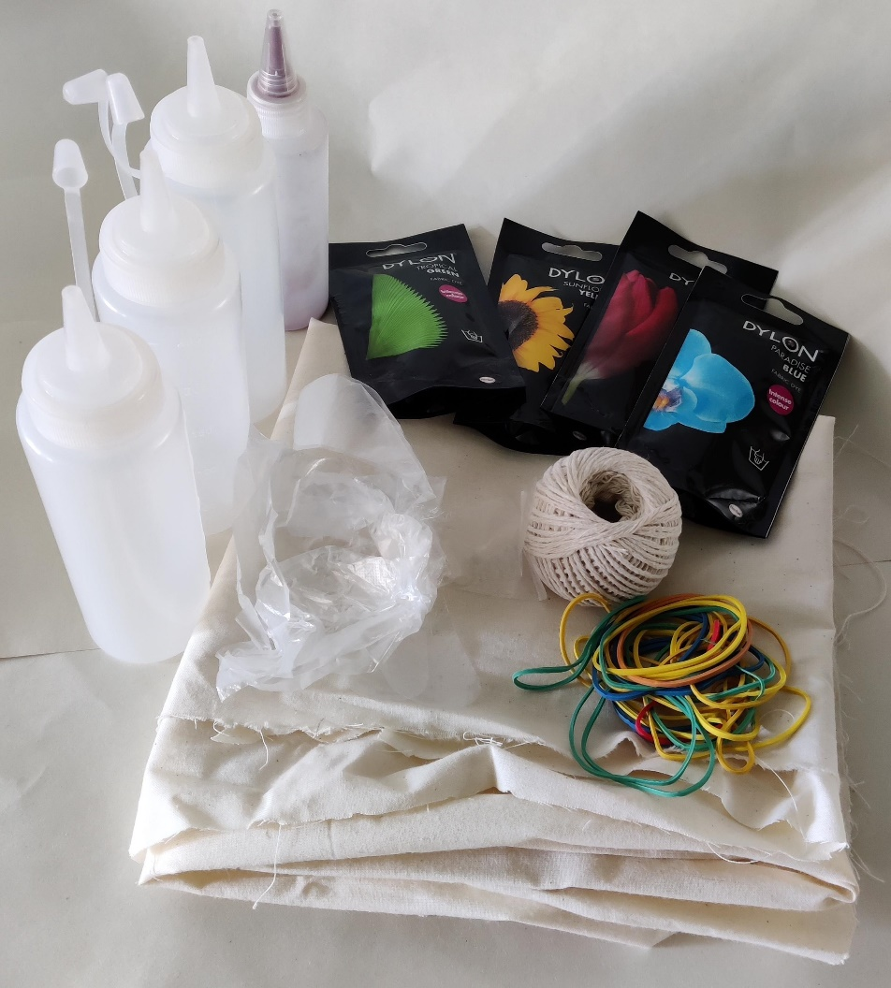
Resources
Fabric
Squeezy bottles
Fabric dye
Elastic bands/string
Plastic gloves
Notes:
Additional equipment:
Salt
Washing up bowl
Material used is calico and sized 900 x 900 mm.
The sizing can be altered according to the resources available. The average picnic blanket on the high street is 1500 x 2000 mm, but this may be too large for general classroom work.

Slide 8
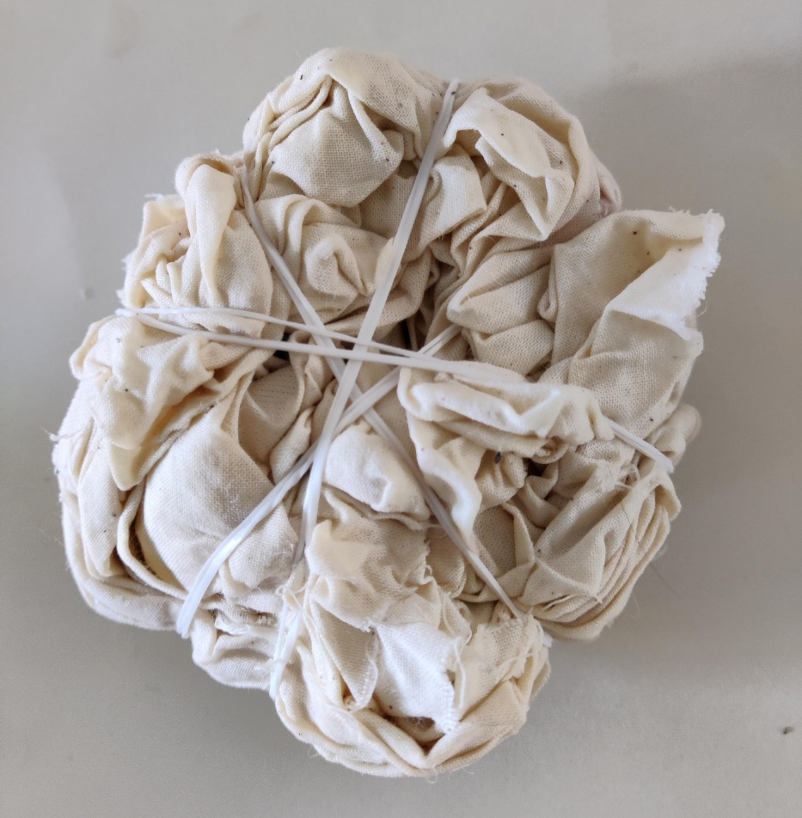
Step 1
Create the pattern on the fabric using the elastic bands/string
The example is a mixture of knotting and swirl
Notes:
Use sample and example slides to provide inspiration. Make sure the material is damp before the dye is applied.

Slide 9
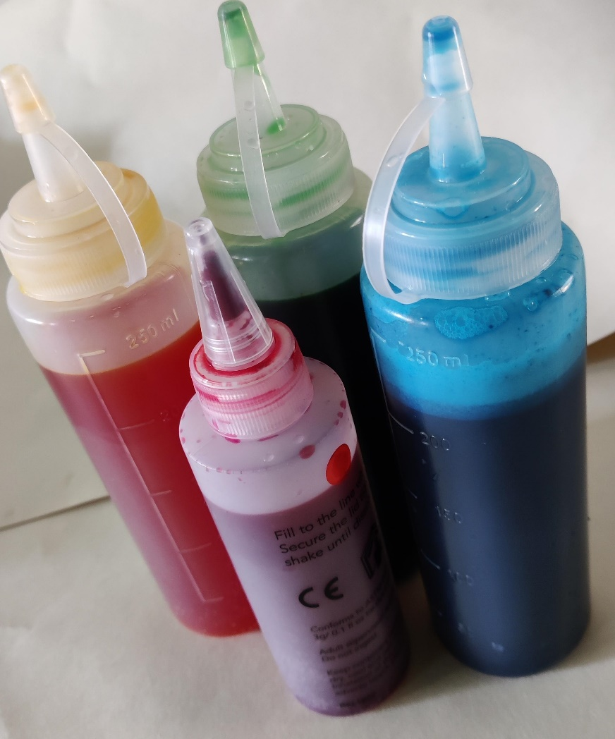
Step 2
Make up the dye according to the instructions
Notes:
This example uses a readily available general fabric dye with salt and warm water.
Wear gloves when handling the dyes as it can stain the skin and other materials.
Make sure the material is damp before the dye is added.

Slide 10
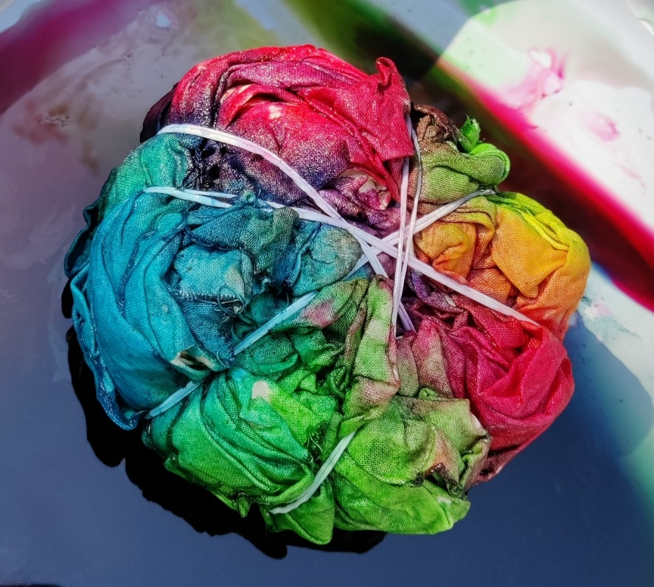
Step 3
Add dye to the fabric from the bottles
Note: Flip over the material and add the same dye shades to the same sections
Leave the material to soak for 6 to 8 hours
Notes:
For colour intensity, reapply dye as required, especially if using a thick material.
If using just one colour, leave in the container to soak.

Slide 11
Step 4
Rinse the material in cool water
Wash separately in a washing machine
Notes:
Wear gloves when handling the material, as hands and other materials can be stained. An iron can be used if available to remove creases.

Slide 12
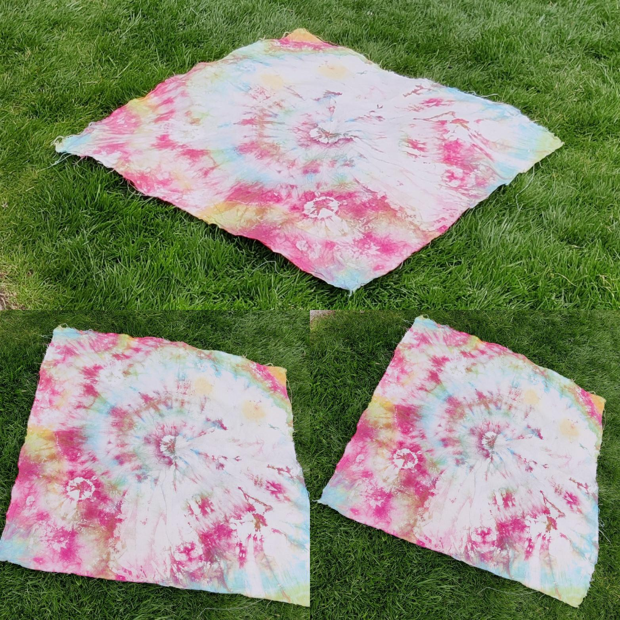
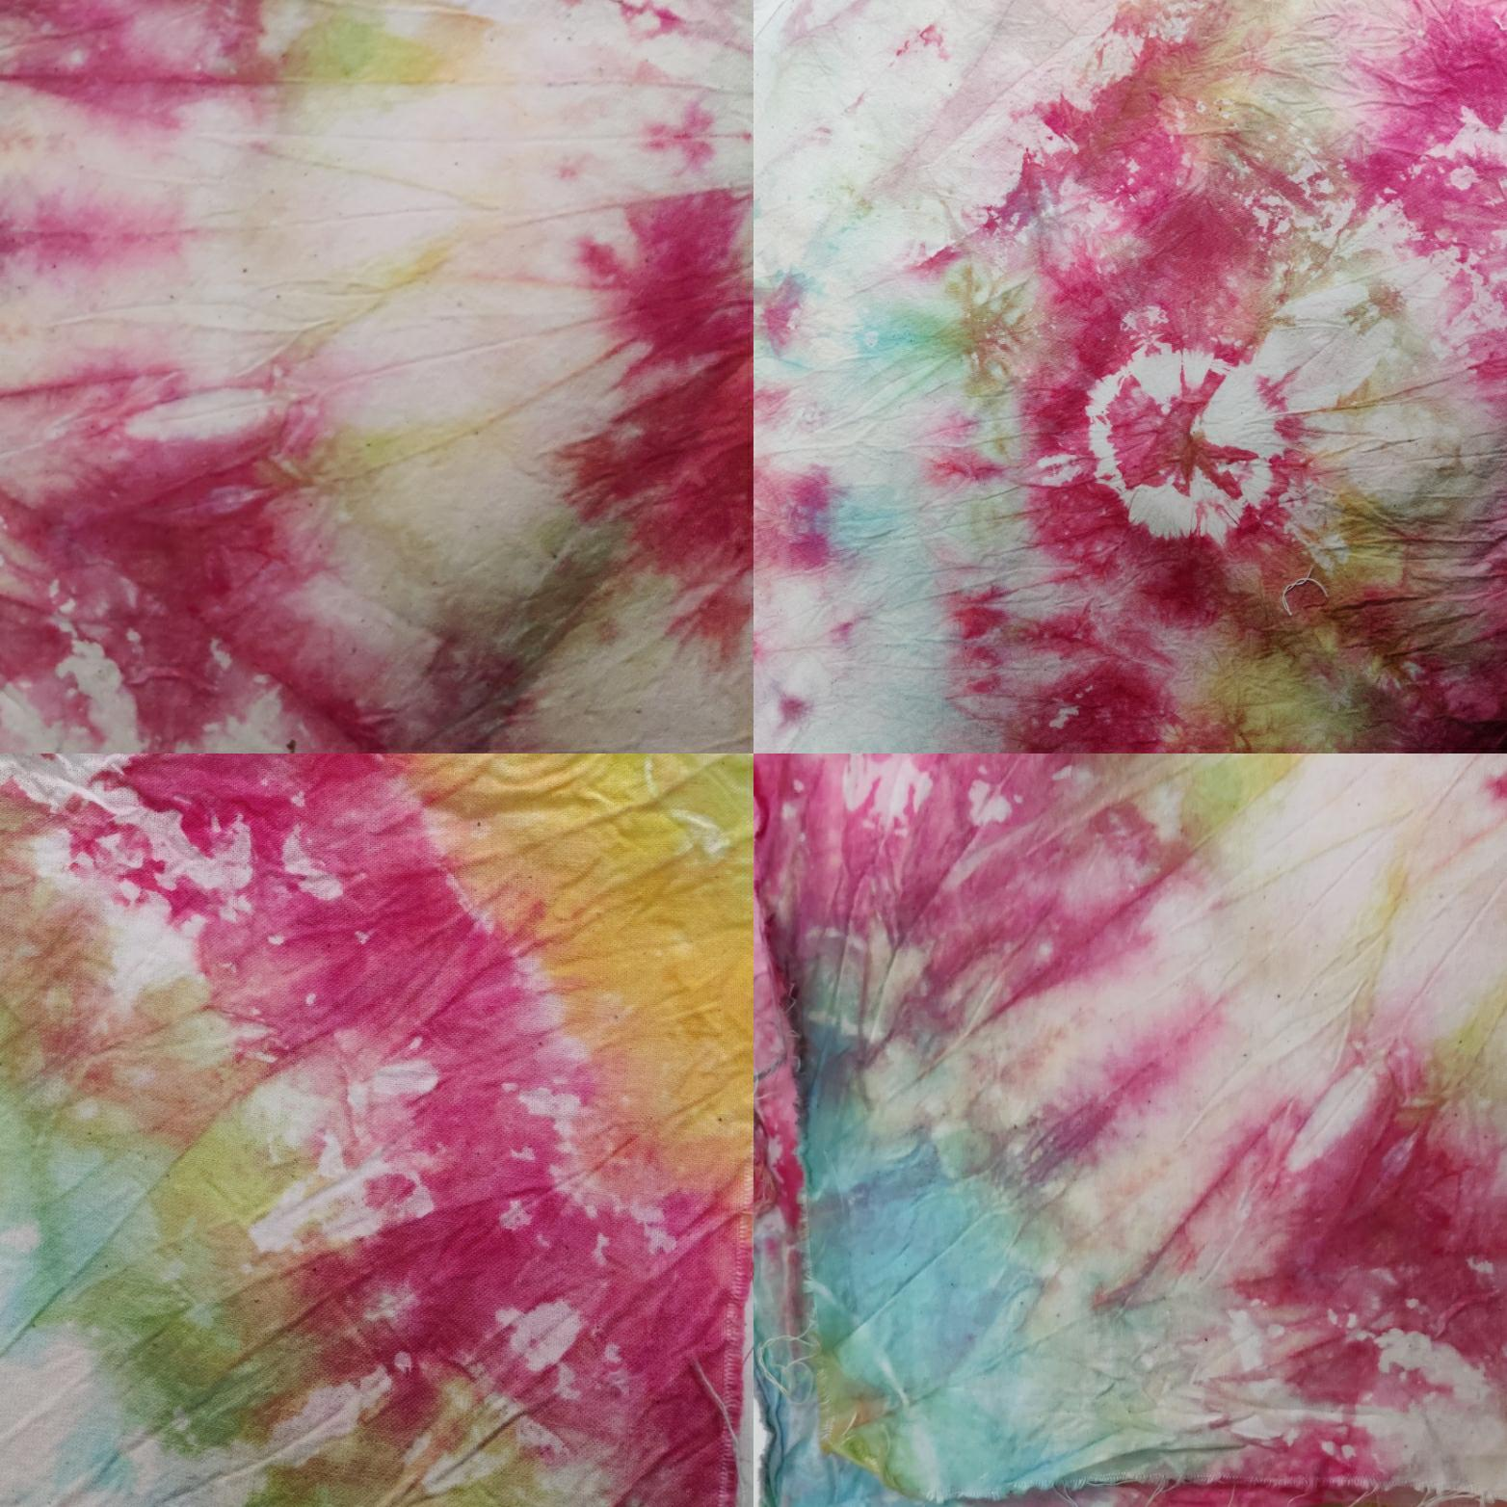
Examples of tie dyed blankets
Notes:
Final example 1 – multi coloured using knots and swirl

Slide 13
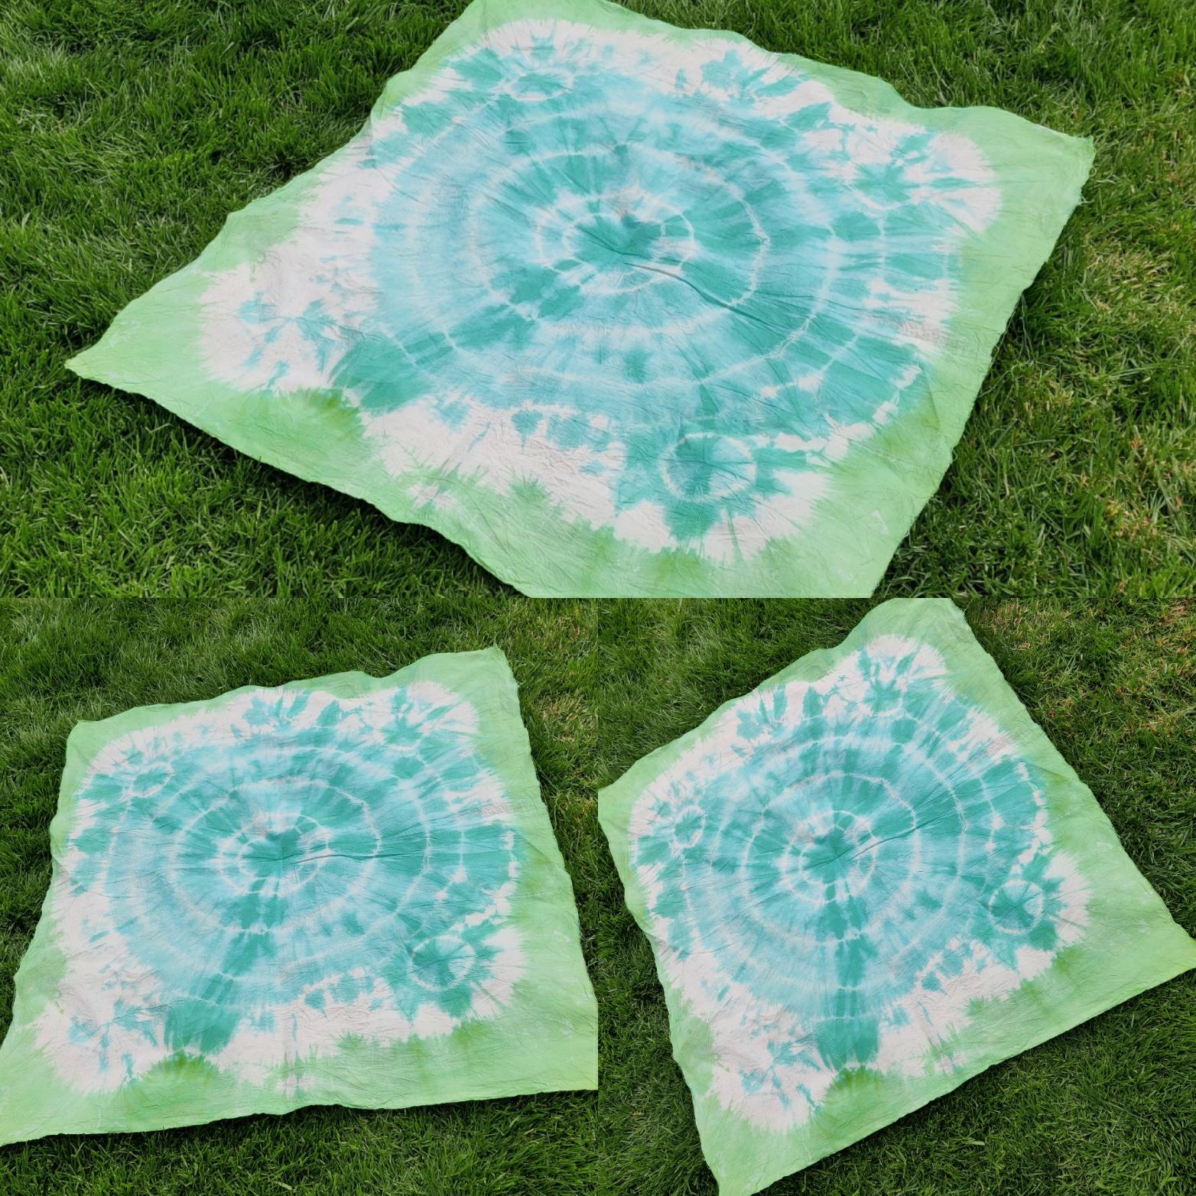
Examples of tie dyed blankets
Notes:
Final example 2 – a knot in each corner then made into a bulls eye, loose end green, main area blue.

Slide 14
Extension
Picnic blankets often go onto damp grass. How could you make the blanket waterproof?
What could be added to the blanket to make it more appealing?
Design a range of accessories to compliment your blanket
What other textile products could you tie die?

