Slide 1
Zip line challenge
Designing and making a zip line for a toy

Slide 2
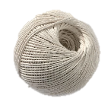
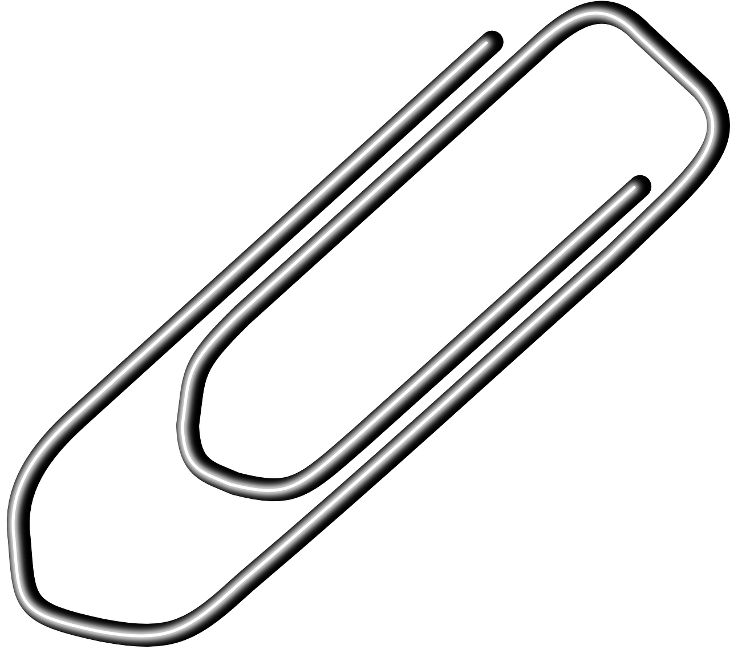
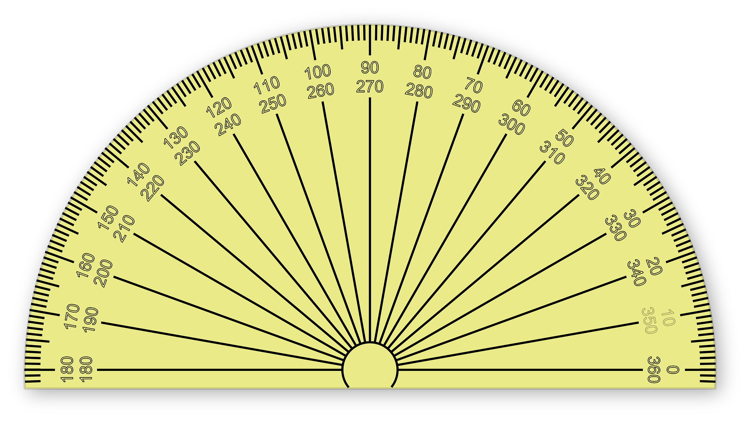
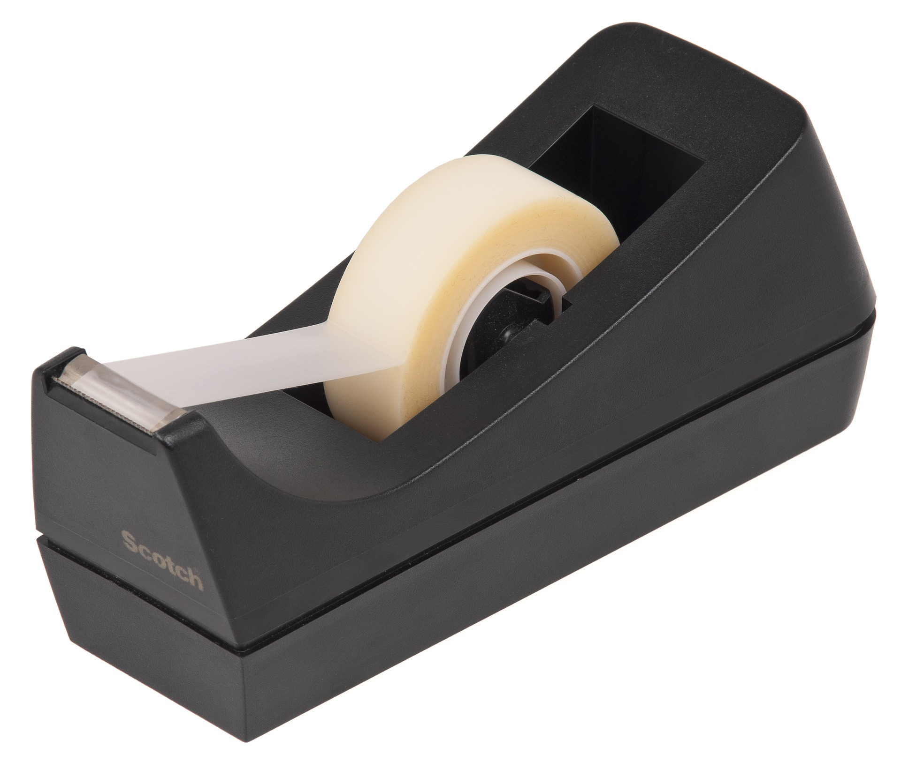
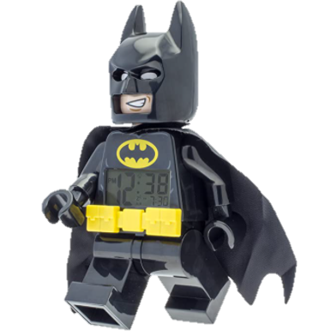
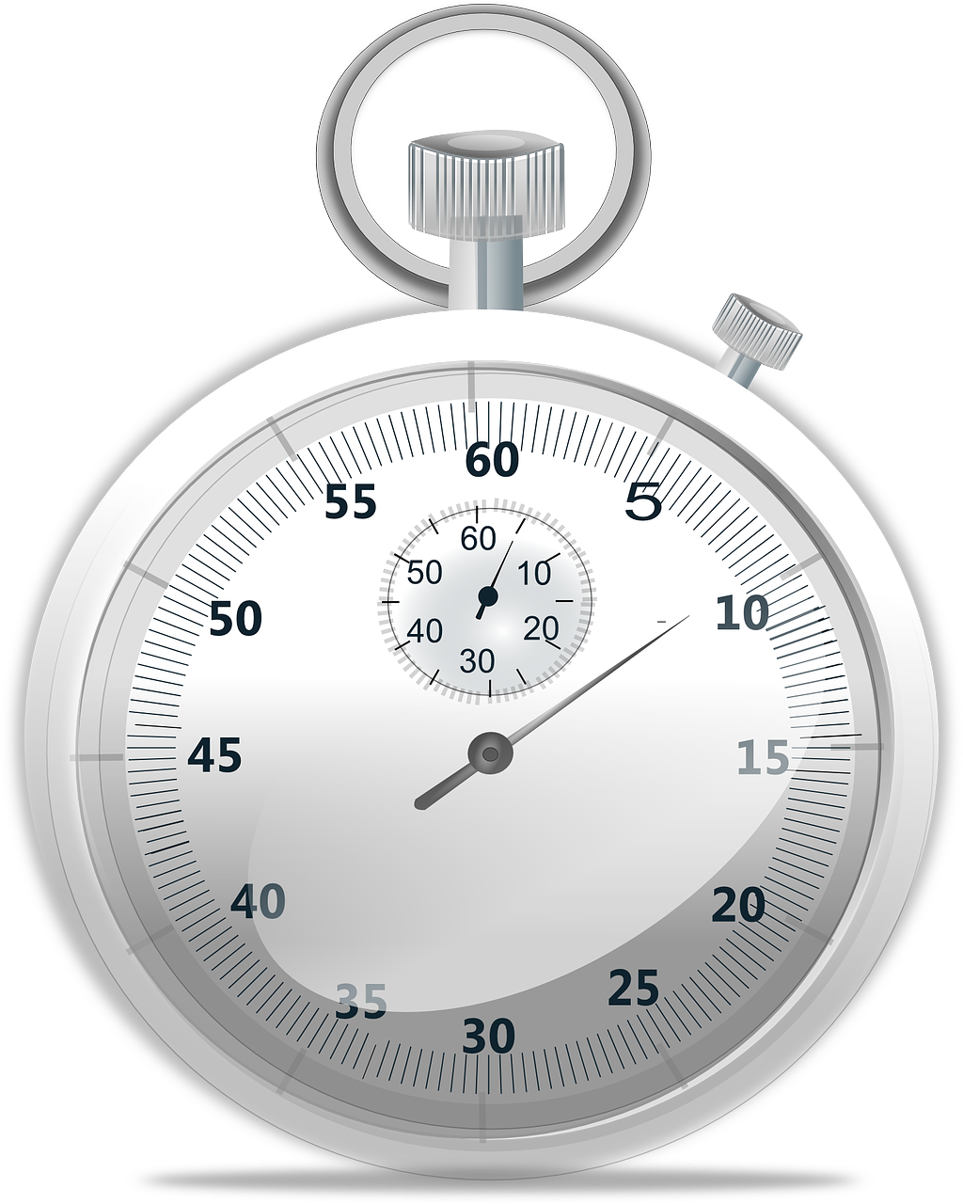
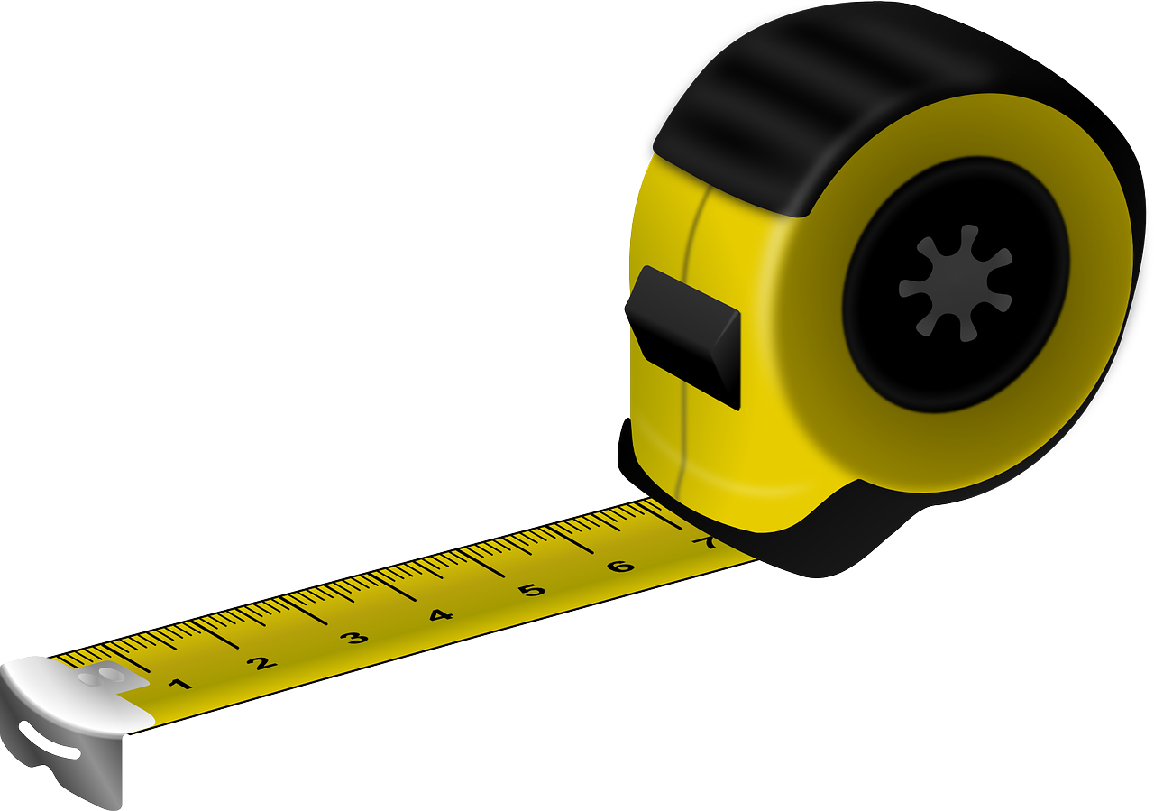
Resources
You will need:
String or thin rope: 10m should be enough
A paper clip or some stiff wire
Sticky tape
A tape measure or ruler
A protractor
A passenger for your zip line
A stopwatch or a stopwatch app on your phone
Somewhere to experiment!
Notes:
The passenger does not have to be a superhero or made from plastic construction blocks! It can be any small figure or toy or any small, unbreakable object.

Slide 3
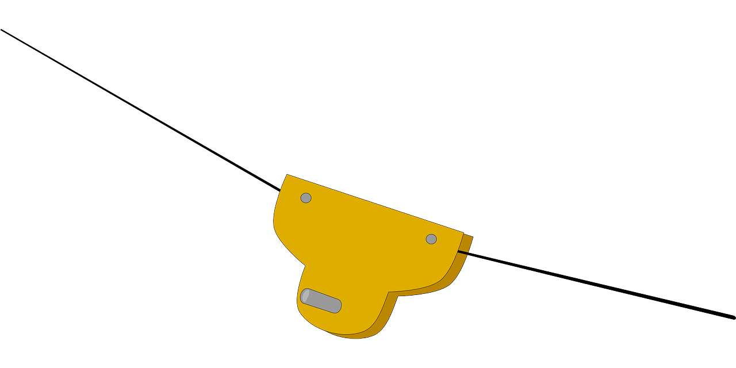
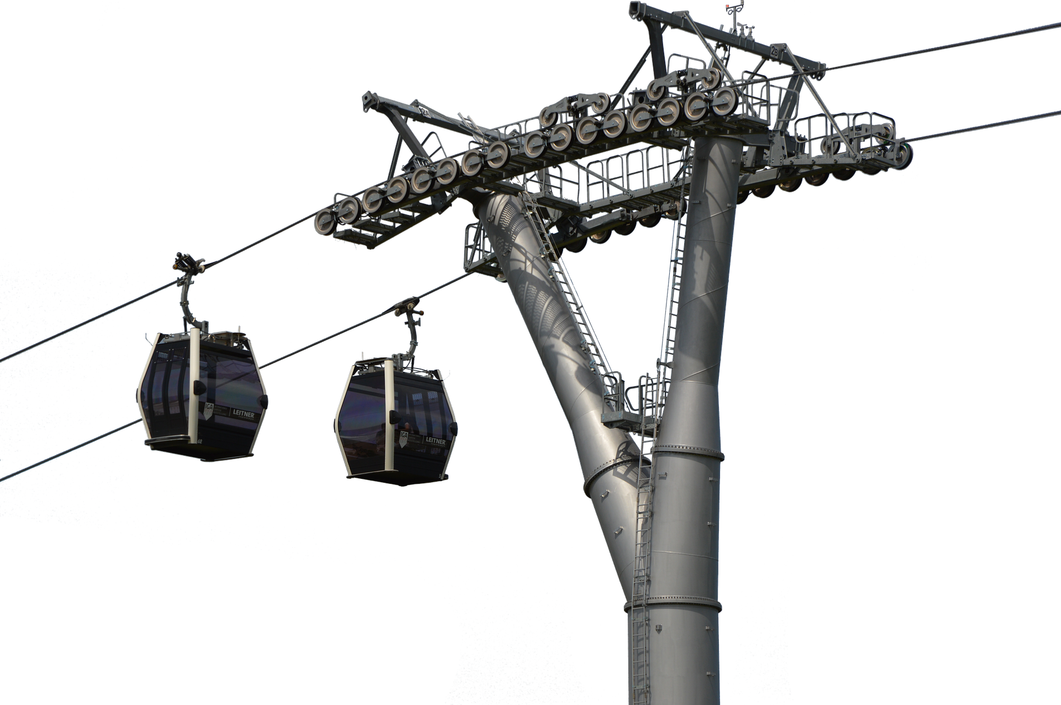
Introduction
Zip lines are becoming a common sight at theme parks and attractions across the world.
They use very clever engineering to keep the passengers safe and still have a great time.
They use cables like cable cars and ski lifts, but no motor – the users move due to gravity.

Slide 4




The Science
Gravity pulls things on our planet down towards the centre of the Earth.
It has existed as long as the universe – but was ‘discovered’ by Sir Isaac Newton in 1687.
Something sliding down a zip line will be pulled from the top to the bottom.
The energy gained by being ‘at the top’ will be turned into speed as the object slides down.
However - some of the energy will be turned into heat or noise, as friction tries to slow the object down.
Notes:
The image is Sir Isaac Newton, watching an apple fall from a tree

Slide 5
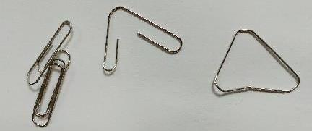
Step 1 – Making the harness
Friction is the force that stops things sliding easily. Friction is your enemy! The ‘passenger’ needs to be able to slide well down the zip line.
Make a harness for your passenger out of the paper clip or wire.
The triangle shape means the passenger won’t slip sideways.
Fasten your passenger to the harness safely using sticky tape.

Slide 6

Step 2 – Attaching the start of the zip line
Find a place where you can attach one end of the zip line high up. This is called an ‘anchor point’.
  You could use a tree or fence post outside.
  The top of a wardrobe or a desk works too.
The anchor point needs to be high enough to give a good steep angle on the zip line, but not so high that you need to climb to get up there.
Attach the string or rope to the anchor point – it needs to be very secure so that it doesn’t slip. You could tie it round something, put weights on it or use sticky tape.

Slide 7
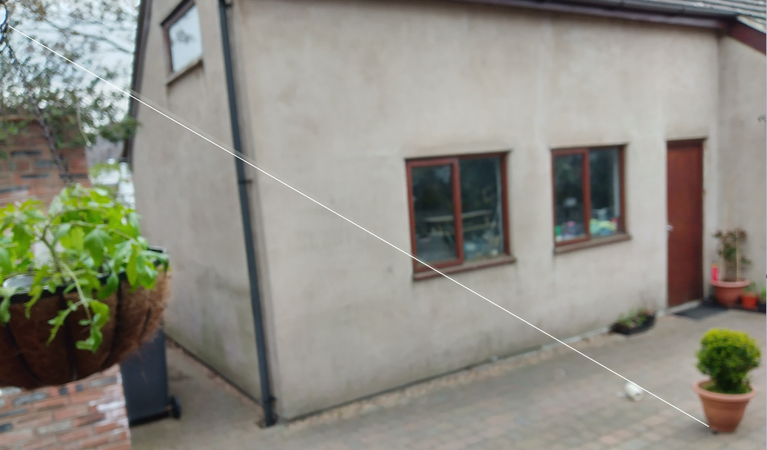
Step 3 – Attaching the bottom of the zip line
Pass the string through the harness on your passenger.
Now find somewhere to attach the bottom end of the zip line.
It needs to give a good angle to the string (line) so that your passenger can slide down under the force of gravity - but not too steep, or the passenger will just fall down the string and crash. That would be no fun at all.
You will need to adjust the end of the line so trap it under something like a chair leg, a rock or a heavy book. The line needs to be tight.

Slide 8
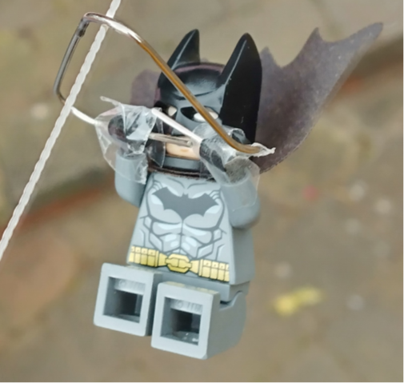
Step 4 – Trial run
Try the Zip line to make sure it works. Take your passenger to the top and let go.
If the passenger ‘stalls’ on the line stops before the bottom:
  If the string is too slack, tighten the ends.
  If the string is too rough and there is too much friction, increase the slope.
Make your improvement to be ready for testing.

Slide 9
Step 5 – Testing
Measure the angle of your zip line using the protractor (or calculate the angle using Maths!).
Bring your passenger to the top of the zip line.
Using the stopwatch, time how long your passenger takes to get from the top to the bottom.
Make a table and write down the time and the angle.
Repeat the test with different angles. How does the angle affect the time?
Test | Angle, degrees | Time, seconds
1
2
3
4
5

Slide 10
Extension Activities
Can you make a zip line that takes exactly 15 seconds to run?
Can you try a bigger, heavier passenger? How does the weight of the passenger affect the time? What is the heaviest passenger that you can use?
Can you try working out the angle from the height and length? (For this one see calculating the angle on the next slide).

Slide 11
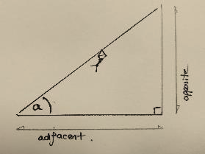
Calculating the angle
Working out angles is easy if you know about trigonometry!
We can measure two sides: the opposite (height) and adjacent (distance across the floor).
SOHCAHTOA tells us we must use tangent.
Find the angle from your calculator using:
tan⁻¹ (opposite / adjacent) = angle
The angle can be written into your notes to see what is the most effective angle for the line.

