Slide 1
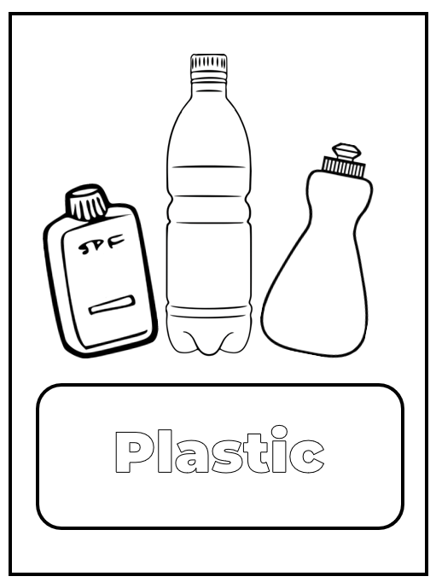
How much plastic?!
Working out how much plastic we use in a year

Slide 2
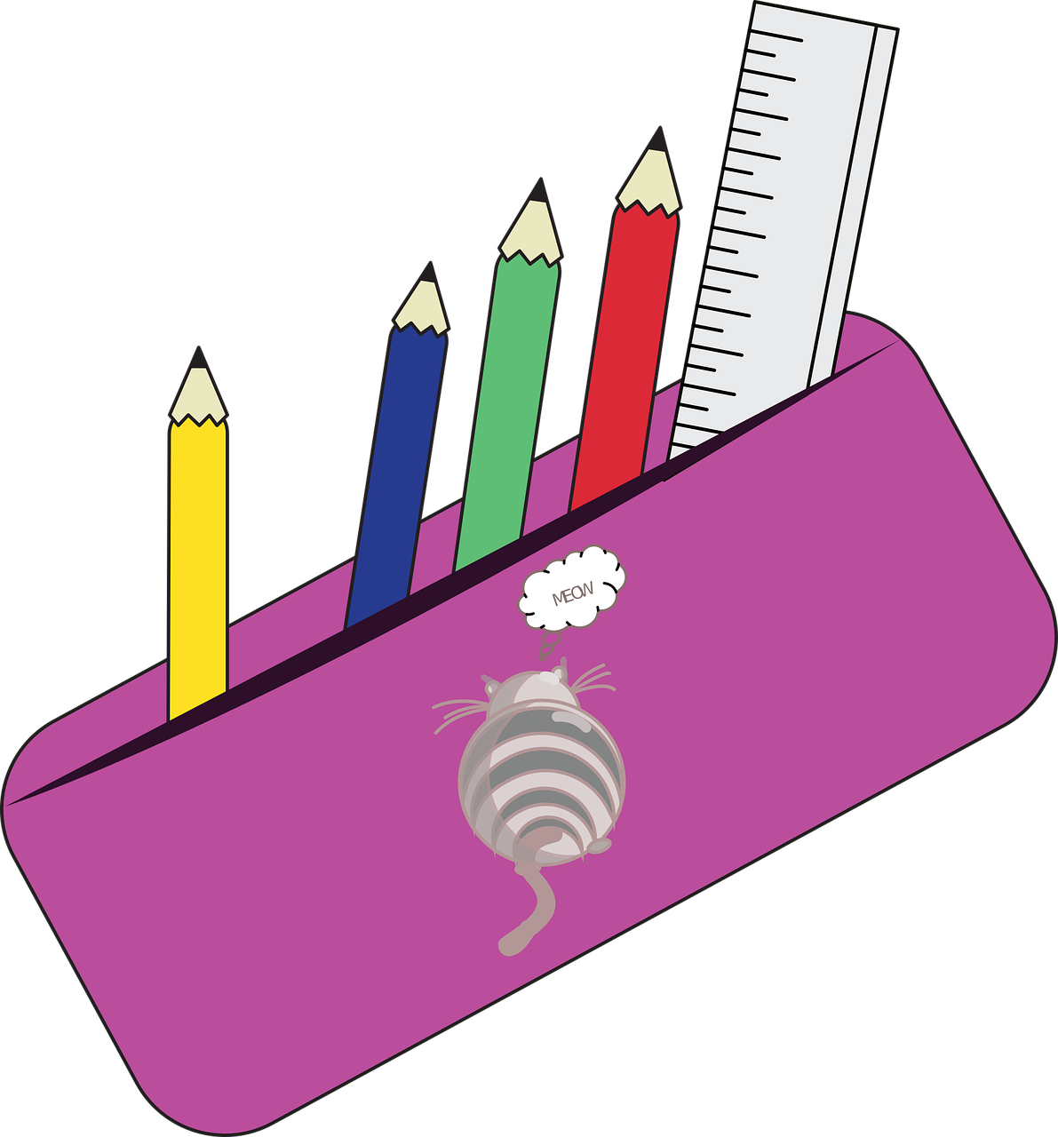
Plastic – how much is used in a day?
For one school day, make a list of anything you use that is plastic
Start from waking up
Finish when going to bed
Include food packaging, drinks bottles– anything plastic that would be thrown away
You could also list plastic that isn’t thrown away – like the cases on electronic products or chair seats – everything plastic!

Slide 3
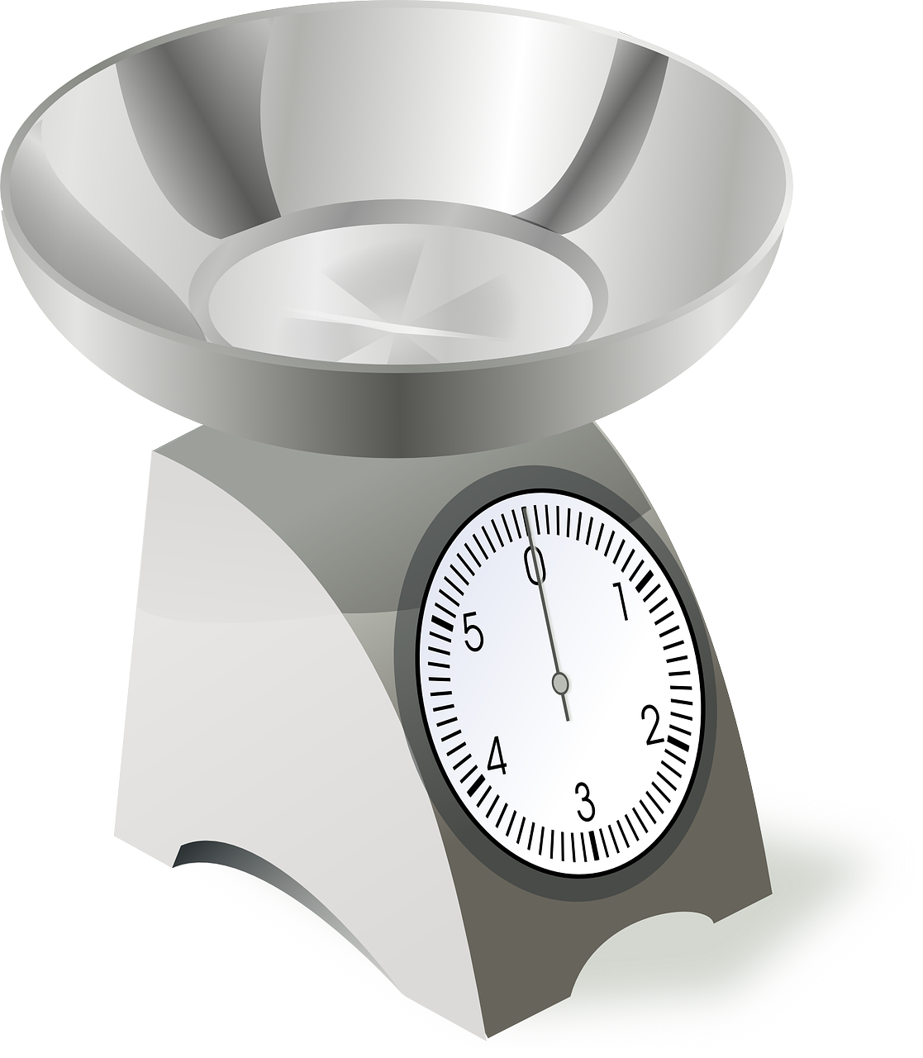
Weigh the plastic
Collect examples of the plastic on the daily list
Weigh these examples
Write down the weight in grams
Work out the total weight of plastic used for one day

Slide 4
Plastic used over time
Change the daily weight in g to kg by dividing by 1000
Weekly use:
Multiply the daily weight total by 7
Monthly use:
Multiply the daily weight total by 31
Yearly use:
Multiply the daily weight total by 365

Slide 5
How can you reduce the plastic?
What alternatives could you use?
My Lunch

