Slide 1
Monitoring home energy usage with the micro:bit
Developing the Programmable System

Slide 2
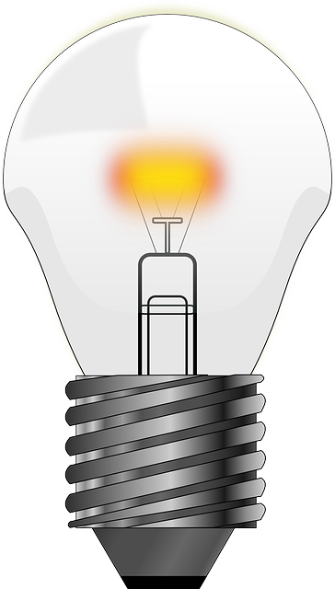
Design Brief
Situation
Reducing energy usage in the home saves money, increases energy security and reduces the need to burn unsustainable fossil fuels. The first step in doing this is monitoring how much energy is used each day.
Brief
Using the micro:bit, develop a prototype for a home energy usage monitoring system that will inform people how long they leave their lights and/or heating on during the day. Your system must use suitable input sensors to collect the data needed.
Notes:
Share this brief with the students if not already done from the starter activity.

Slide 3
Systems Diagram
INPUT
PROCESS
OUTPUT
Light
Sensor
Processor
LED
Screen
Light
Time Information
Temperature Sensor
A systems or block diagram shows the layout of the system to be created. The blocks represent the physical parts of the system and the arrows represent signals.
Heat
Notes:
A block or systems diagram shows a possible basic layout of the system. Can be used as an example of how the students may plan out their own system.

Slide 4
Design Criteria
The proposed system must:
Be programmable using the micro:bit.
Use suitable sensors to detect when how long heating and lighting are left on for during the day.
Calculate the time that the heating and/or lighting is on for at home during the day.
Use the micro:bit’s LED screen, or another suitable output device to display this information.

Slide 5
Time to Develop your Program!
Your device must be programmed.
Your program must meet the needs of the design brief and the design criteria.
You can program your micro:bit using either the JavaScript Blocks Editor or Python Editor.
An example program written in each has been given to help get you started.
Go to www.microbit.org/code to begin!

Slide 6
Example Program – JavaScript Blocks Editor
Go to www.microbit.org/code and open the JavaScript Blocks Editor.
Drag the file microbit-energyuse-jsb.hex onto the work area.
This program will display the amount of time that a sensor attached to pin 0 is ‘high’.
Test it, download it and experiment with how it works!
Notes:
Share this example program with learners to help them. Lower ability learners or those lacking programming confidence could start by writing or experimenting with this program first. They could then adapt and develop it. A PDF handout showing the program is available and can be handed out to learners.

Slide 7
Example Program
– Python Editor
Go to www.microbit.org/code and open the Python Editor.
Drag the file energyuse.py onto the work area.
This program will display the amount of time that a sensor attached to pin 0 is ‘high’.
Test it, download it and experiment with how it works!
Notes:
Share this example program with learners to help them. Lower ability learners or those lacking programming confidence could start by writing or experimenting with this program first. They could then adapt and develop it. A PDF handout showing the program is available and can be handed out to learners.

