Slide 1
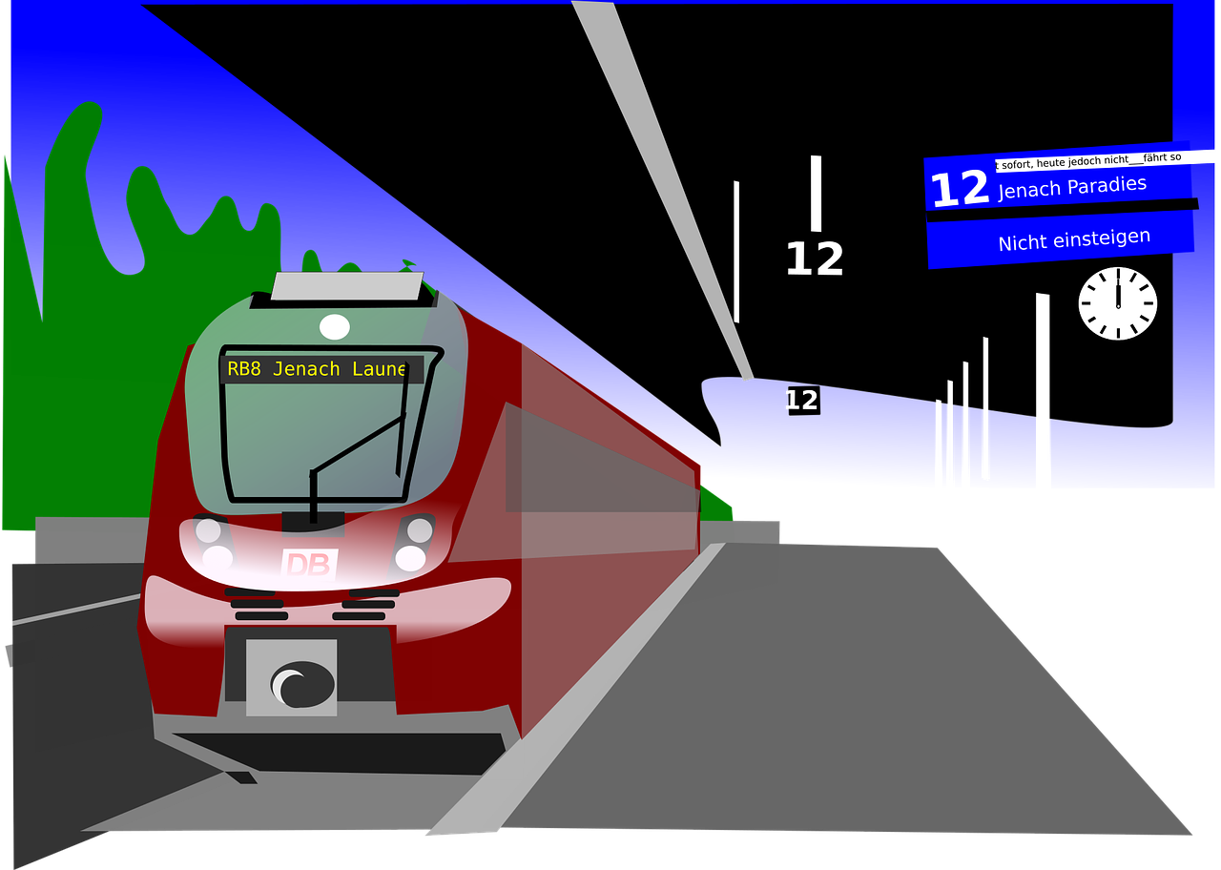
Station Hunt
12 EDINBURGH
BOARDING
EDINBURGH
NR
A maths-based challenge to find stations on the rail network based on their journey times

Slide 2
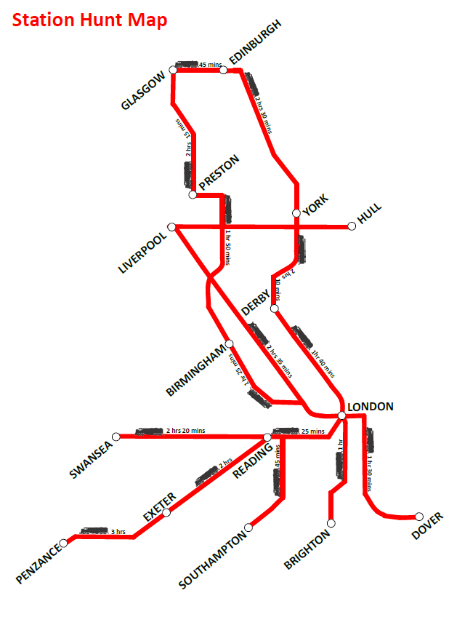
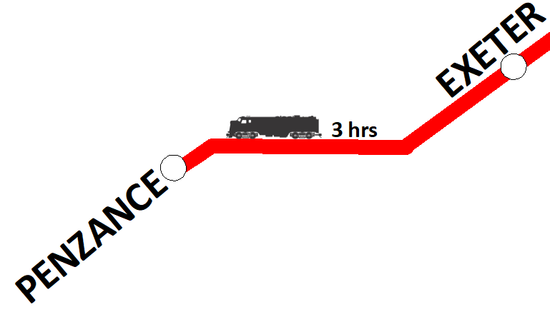
Station Hunt Map
Find the stations on the map
Identify each journey time
For example, Penzance to Exeter is 3 hrs
Notes:
Any statistics or data on transport speeds used in this presentation is solely for the purpose of this activity and may not be an accurate reflection of actual current times

Slide 3
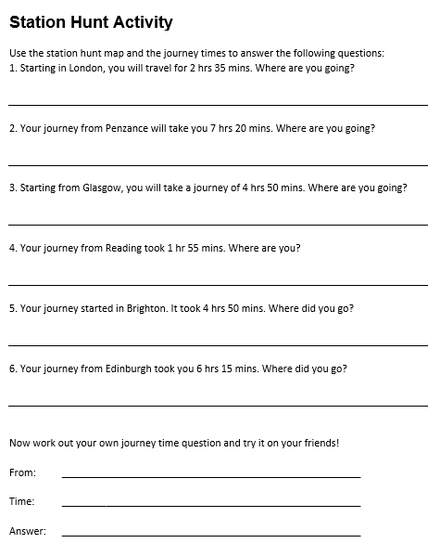
Station Hunt Activity
Complete the activity sheet
Use the journey times to find the destination station
Follow the tracks and add up the journey time
Enjoy the trip!

