Slide 1
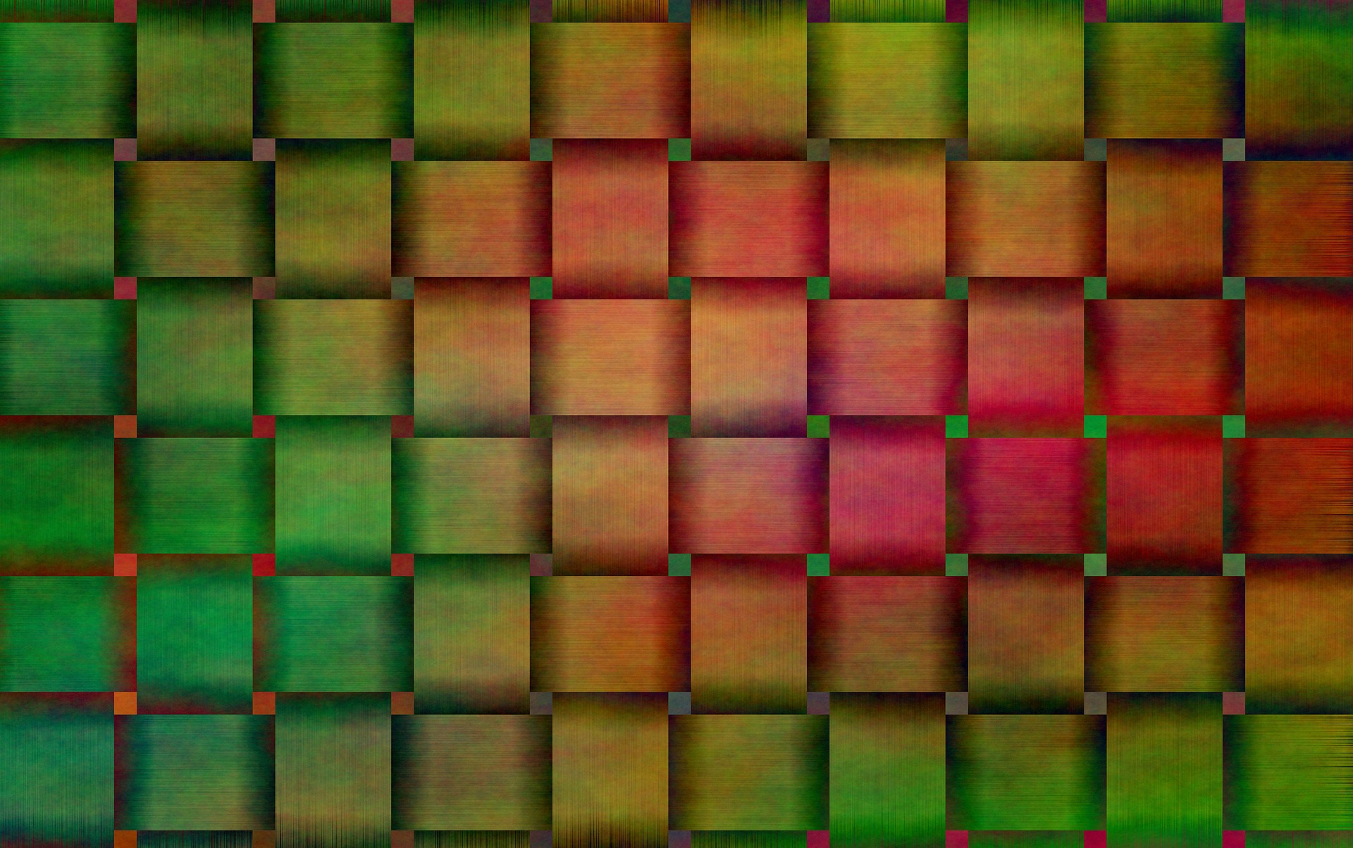
3D shapes from 2D drawings: Nets

Slide 2
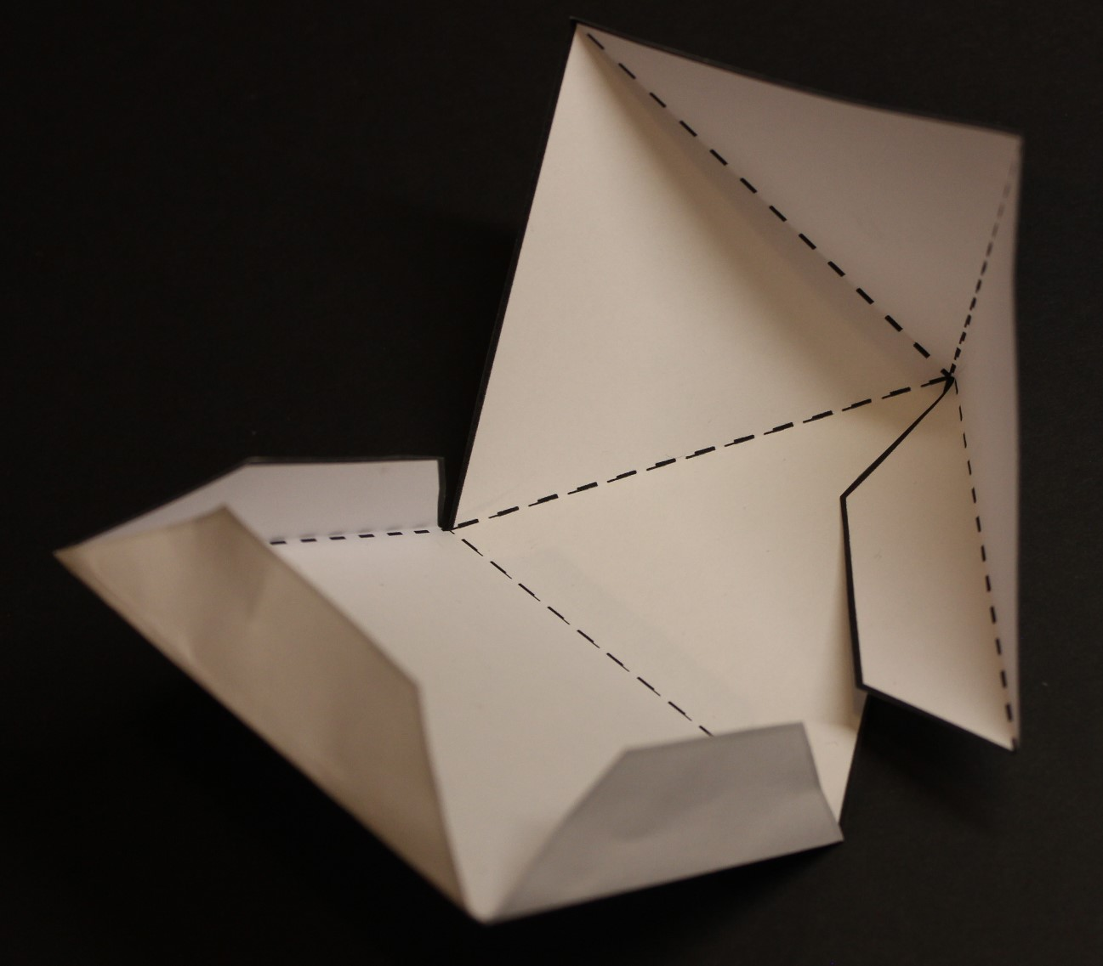
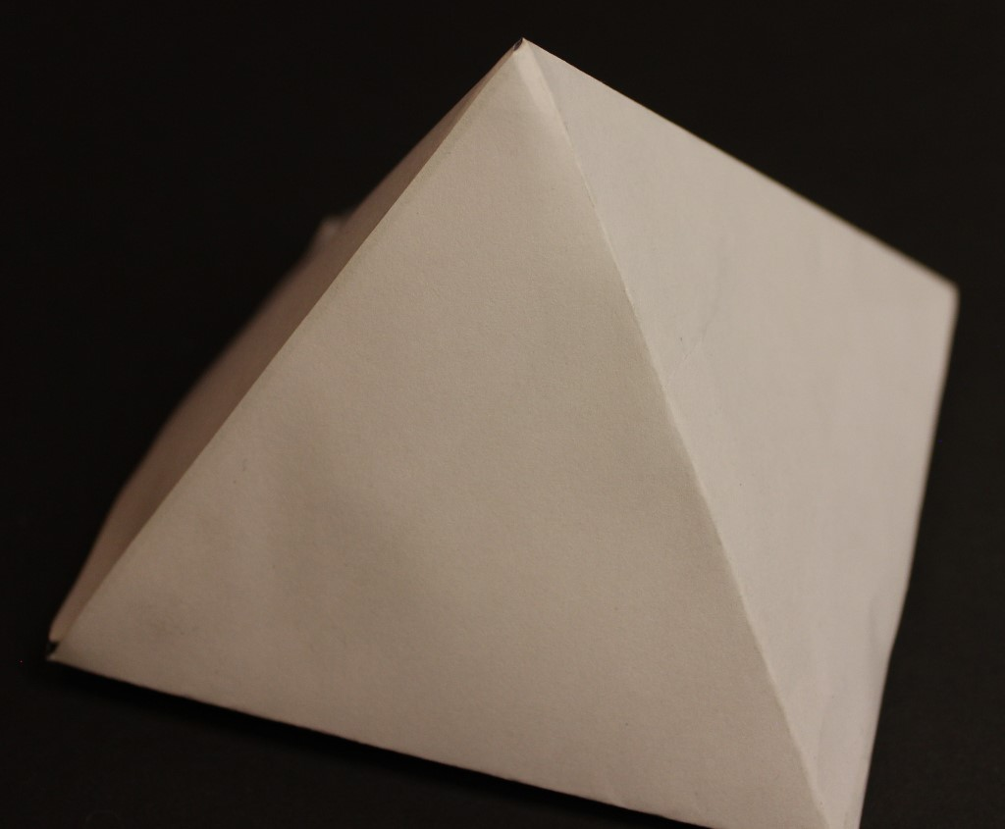
Making a Pyramid
tab
Cut out the outline of the net
Fold the net along the dotted lines (so the dotted lines are on the inside of the fold)
Put glue on the tabs and assemble the pyramid
fold line
cut line

Slide 3
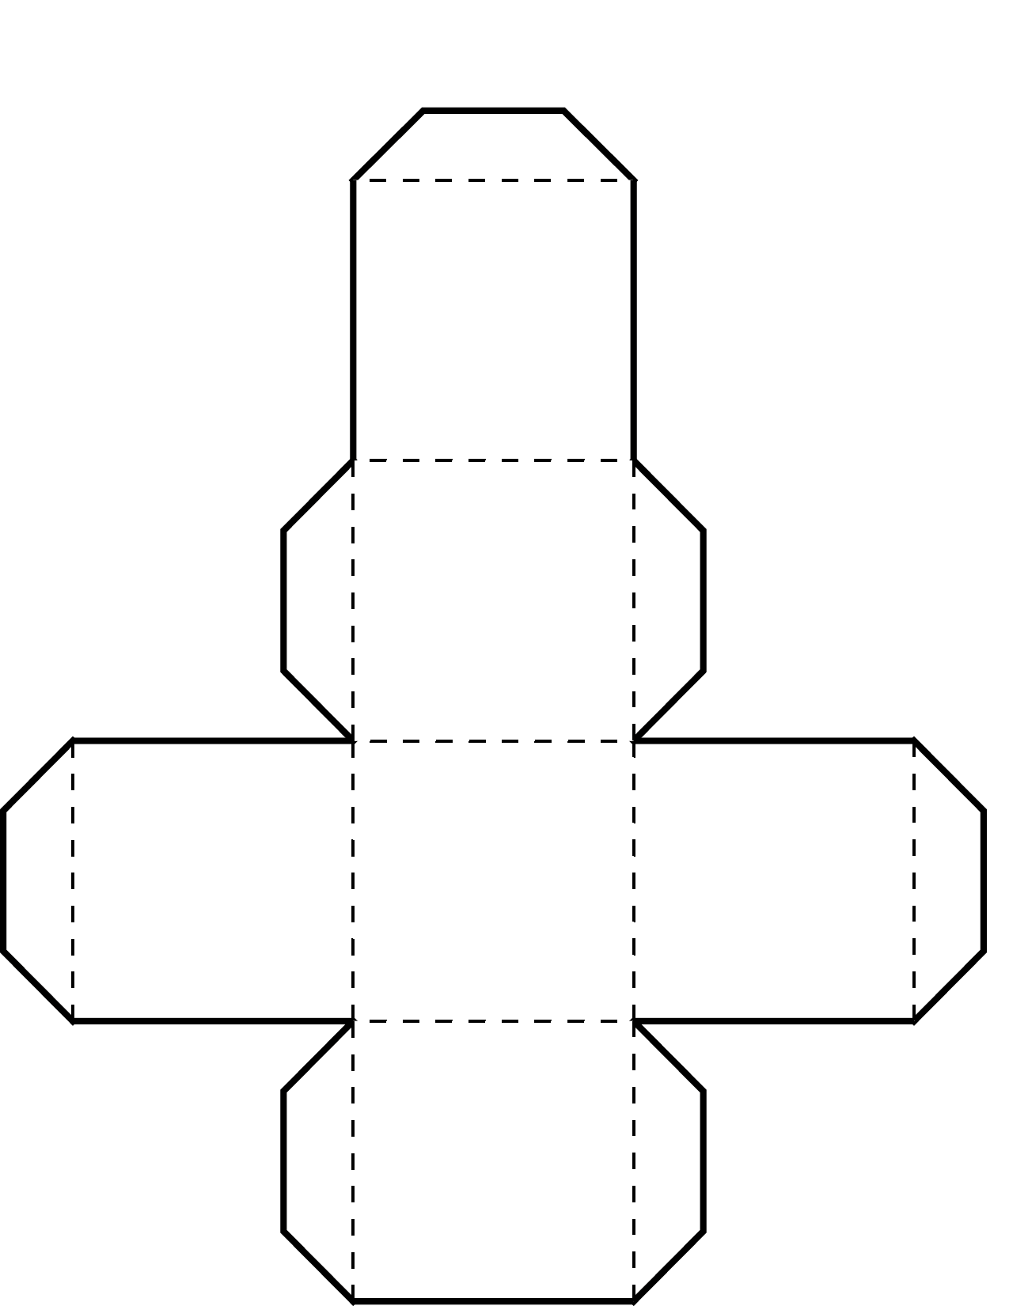
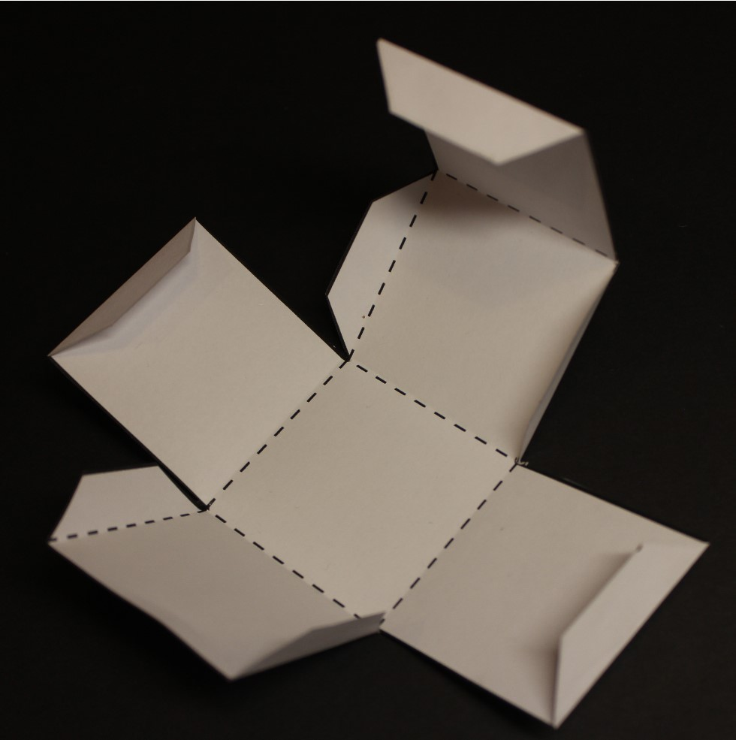
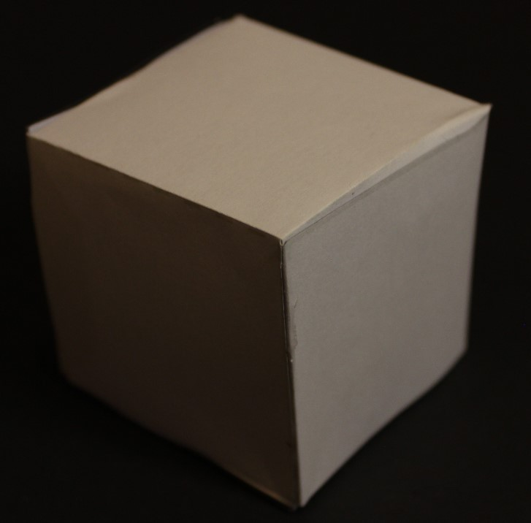
Making a Cube
fold line
tab
Cut out the outline of the net
Fold the net along the dotted lines (so the dotted lines are on the inside of the fold)
Put glue on the tabs and assemble the cube
cut line

Slide 4
Now Try This…
Can you create the net for a cylinder?
What about a hexagon-shaped box?
Or the net for the shape of a lorry? Or the shape of a sofa?

