Slide 1
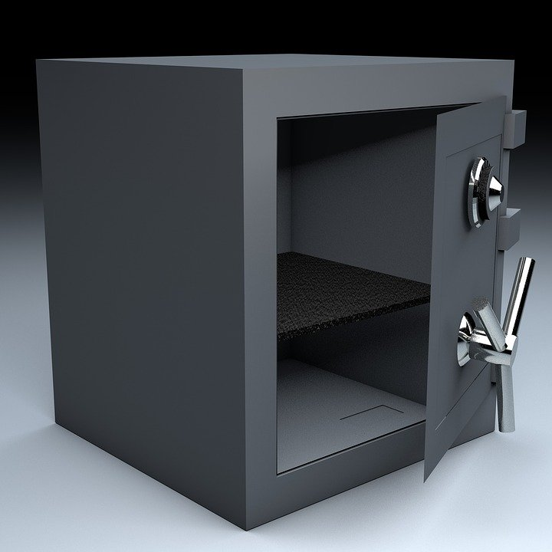
Addition and subtraction
Can you crack the code to open the safe?

Slide 2
Crack the safe code!
You will be given three problems.
Each will give you one of the two digit numbers needed to open the safe.
You must get all three right to crack the code!
Are you ready?!

Slide 4
Problem 1
What is 102 – 7?
ANSWER = 95
Notes:
These are example addition and subtraction problems based on typical key stage 2 learning. Learners can work out the problems in pairs or as individuals. For lower ability pupils the teacher may wish to take them through the solutions to the problems one step at a time. If the teacher wishes to repeat the exercise several times or use with a different abilities and/or year groups then the problems can be changed as required. Learners should have access to paper or exercise books to write down their working as needed.

Slide 5
Problem 2
600 - = 580
What is the missing number?
ANSWER = 20
Notes:
These are example addition and subtraction problems based on typical key stage 2 learning. Learners can work out the problems in pairs or as individuals. For lower ability pupils the teacher may wish to take them through the solutions to the problems one step at a time. If the teacher wishes to repeat the exercise several times or use with a different abilities and/or year groups then the problems can be changed as required. Learners should have access to paper or exercise books to write down their working as needed.

Slide 6
Problem 3
327 + = 365
What is the missing number?
ANSWER = 38
Notes:
These are example addition and subtraction problems based on typical key stage 2 learning. Learners can work out the problems in pairs or as individuals. For lower ability pupils the teacher may wish to take them through the solutions to the problems one step at a time. If the teacher wishes to repeat the exercise several times or use with a different abilities and/or year groups then the problems can be changed as required. Learners should have access to paper or exercise books to write down their working as needed.

Slide 7
Well done! You cracked the code!
95
20
38
Notes:
Learners who successfully crack the code could be given a prize ‘from the safe’.

