Slide 1
Spaghetti bridge
A competition to build the tallest structure

Slide 2
Rules for using Glue Guns
Always treat a glue gun as if it is hot
When not being used, always stand the glue gun up
Always use a board underneath what you are gluing
Only one person can use a glue gun at a time
Never touch anything with the hot end except for what is being glued
Never touch the glue – it could still be hot

Slide 3
Now try this…
You have 20 minutes to build a bridge from spaghetti.
The bridge must reach over a gap of 15 cm.
You can only use 15 pieces of spaghetti – you can break some of it into smaller lengths if you need to.
This is a competition – the bridge that can support the strongest load at its centre wins.

Slide 4
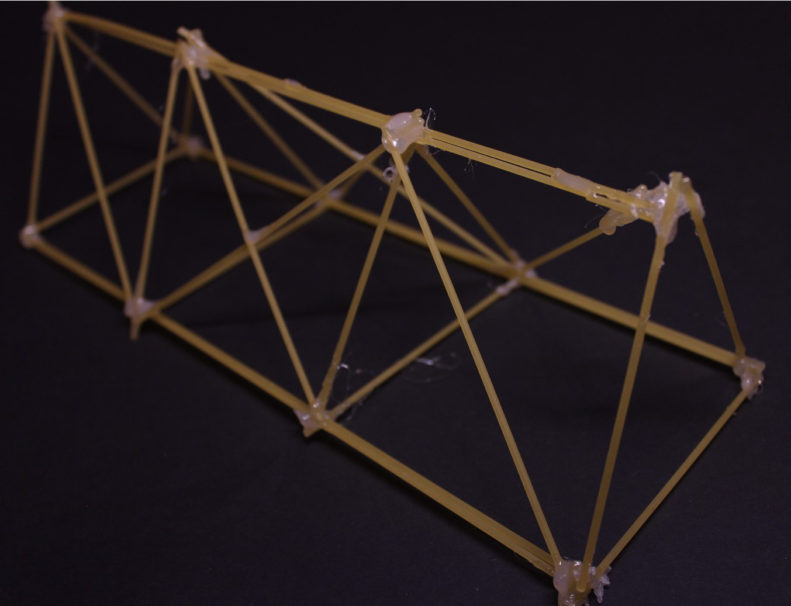
Example of a Pupils Winning Bridge

