Slide 1
Spaghetti tower – strengthening structures
A competition to build the tallest structure

Slide 2
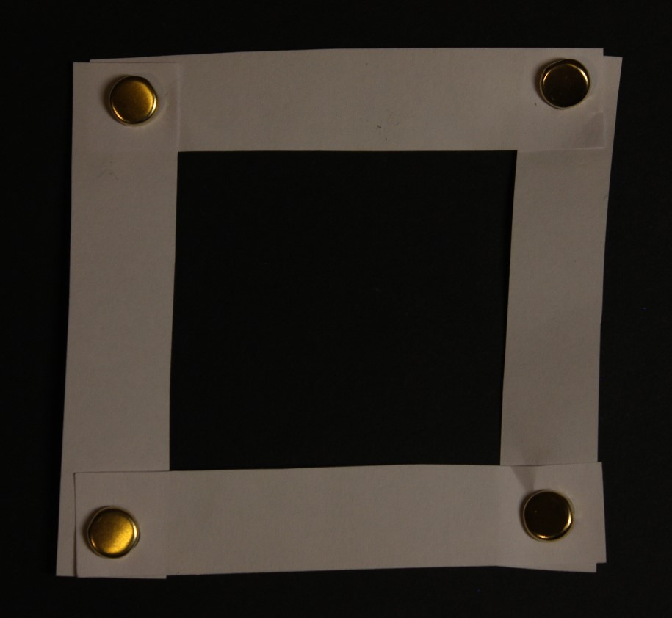
Structures
Build this square from card and four fasteners.
As a structure its not very strong – if you press the top, it will collapse.
fastener
Can you add one more piece of card and stop it collapsing?

Slide 3
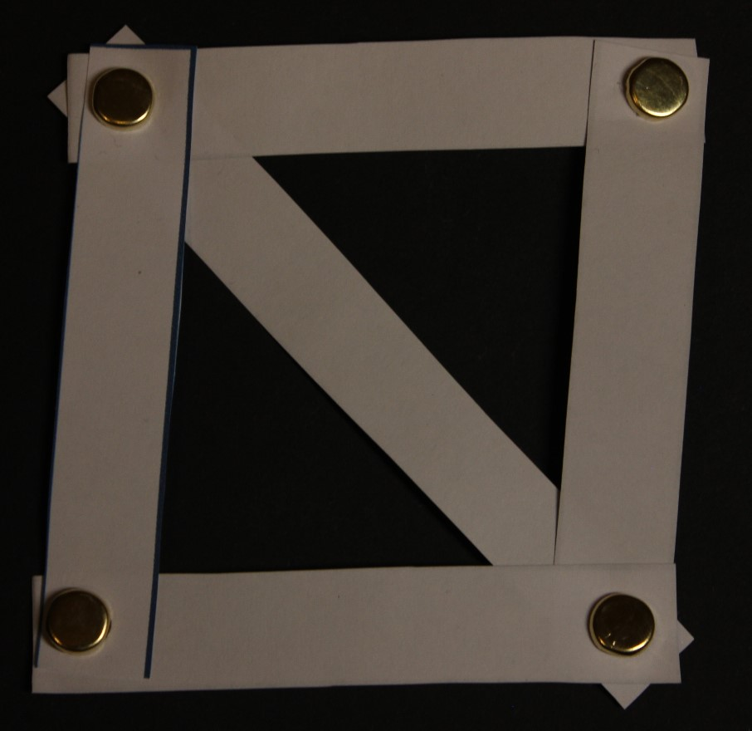
How to Make a Structure Stronger
Creating triangles makes the structure much stronger.
Triangles are used for reinforcement in many products, such as bridges and aircraft frames.

Slide 4
Rules for using Glue Guns
Always treat a glue gun as if it is hot.
When not being used, always stand the glue gun up.
Always use a board underneath what you are gluing.
Only one person can use a glue gun at a time.
Never touch anything with the hot end except for what is being glued.
Never touch the glue – it could still be hot.

Slide 5
Now try this…
You have 15 minutes to build a structure from spaghetti.
The structure must be free standing – that means nothing else can support it.
You can only use 12 pieces of spaghetti – you can break some of it into smaller lengths if you need to.
This is a competition – the tallest structure wins.

Slide 6
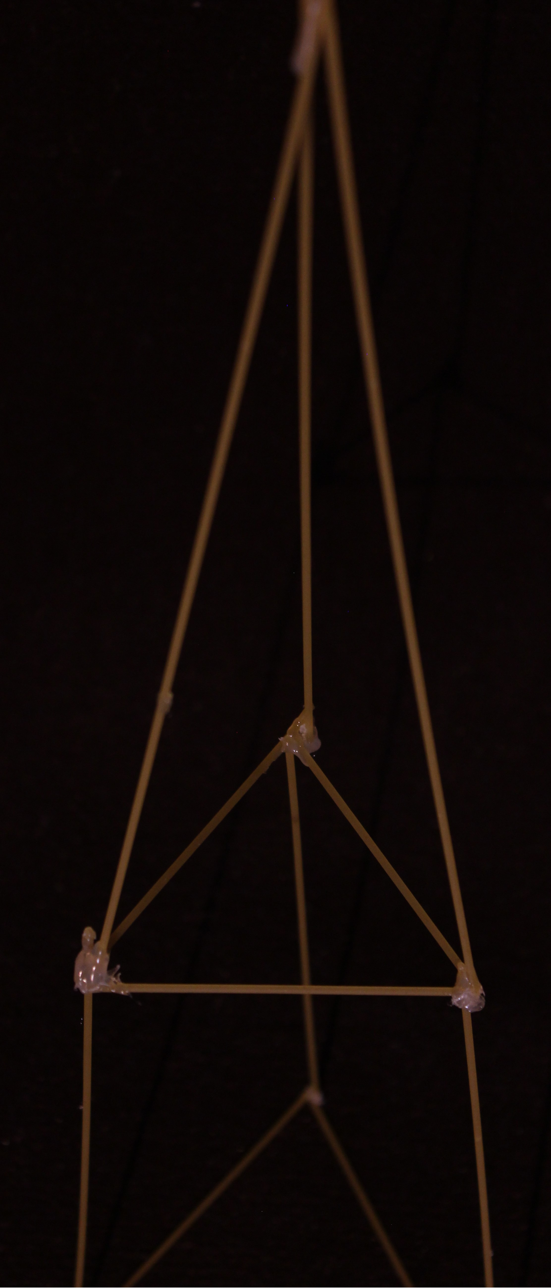
Example of
a Pupils
Winning
Structure
Close up showing triangles

Slide 7
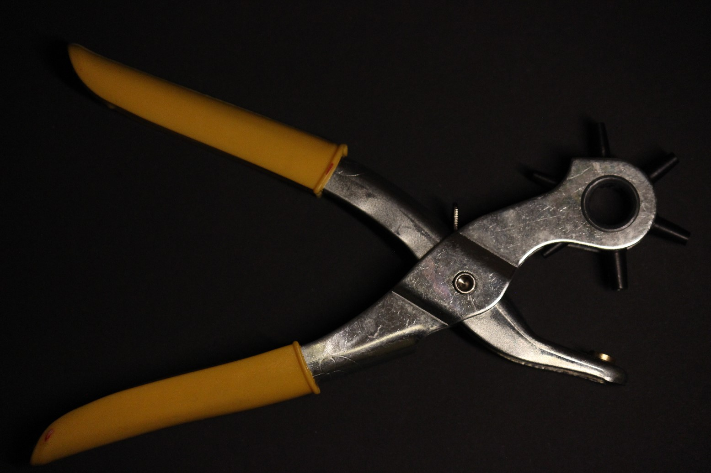
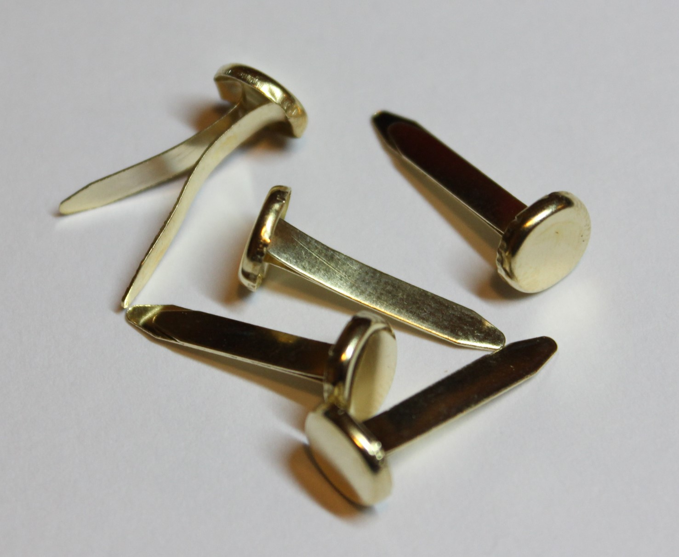
Additional Images for Reference
Single hole punch
Fasteners

