Slide 1



Create your own Christmas emoji
Designing an emoji that reflects the festive season

Slide 2
Create your own Christmas emoji
Stay safe
Whether you are a scientist researching a new medicine or an engineer solving climate change, safety always comes first. An adult must always be around and supervising when doing this activity. You are responsible for:
ensuring that any equipment used for this activity is in good working condition
behaving sensibly and following any safety instructions so as not to hurt or injure yourself or others
Please note that in the absence of any negligence or other breach of duty by us, this activity is carried out at your own risk. It is important to take extra care at the stages marked with this symbol: ⚠

Slide 3
Introduction
Your task is to design a festive emoji
It must use the theme of the festive season
It must be simple and clear - even when it is really small!
Be creative!

Slide 4
Resources
You will need:
A round coin (such as a two pence or ten pence coin)
Paper
Coloured pens or pencils
A fine-liner pen
A mug to draw large circles
Notes:
Teacher should provide as appropriate.

Slide 5

Step 1 – Thinking about the festive season
Write a list of your favourite things about the festive season
What images do these things make you think about?
Notes:
Instead of a list, learners could produce a spider chart or mind map.

Slide 6
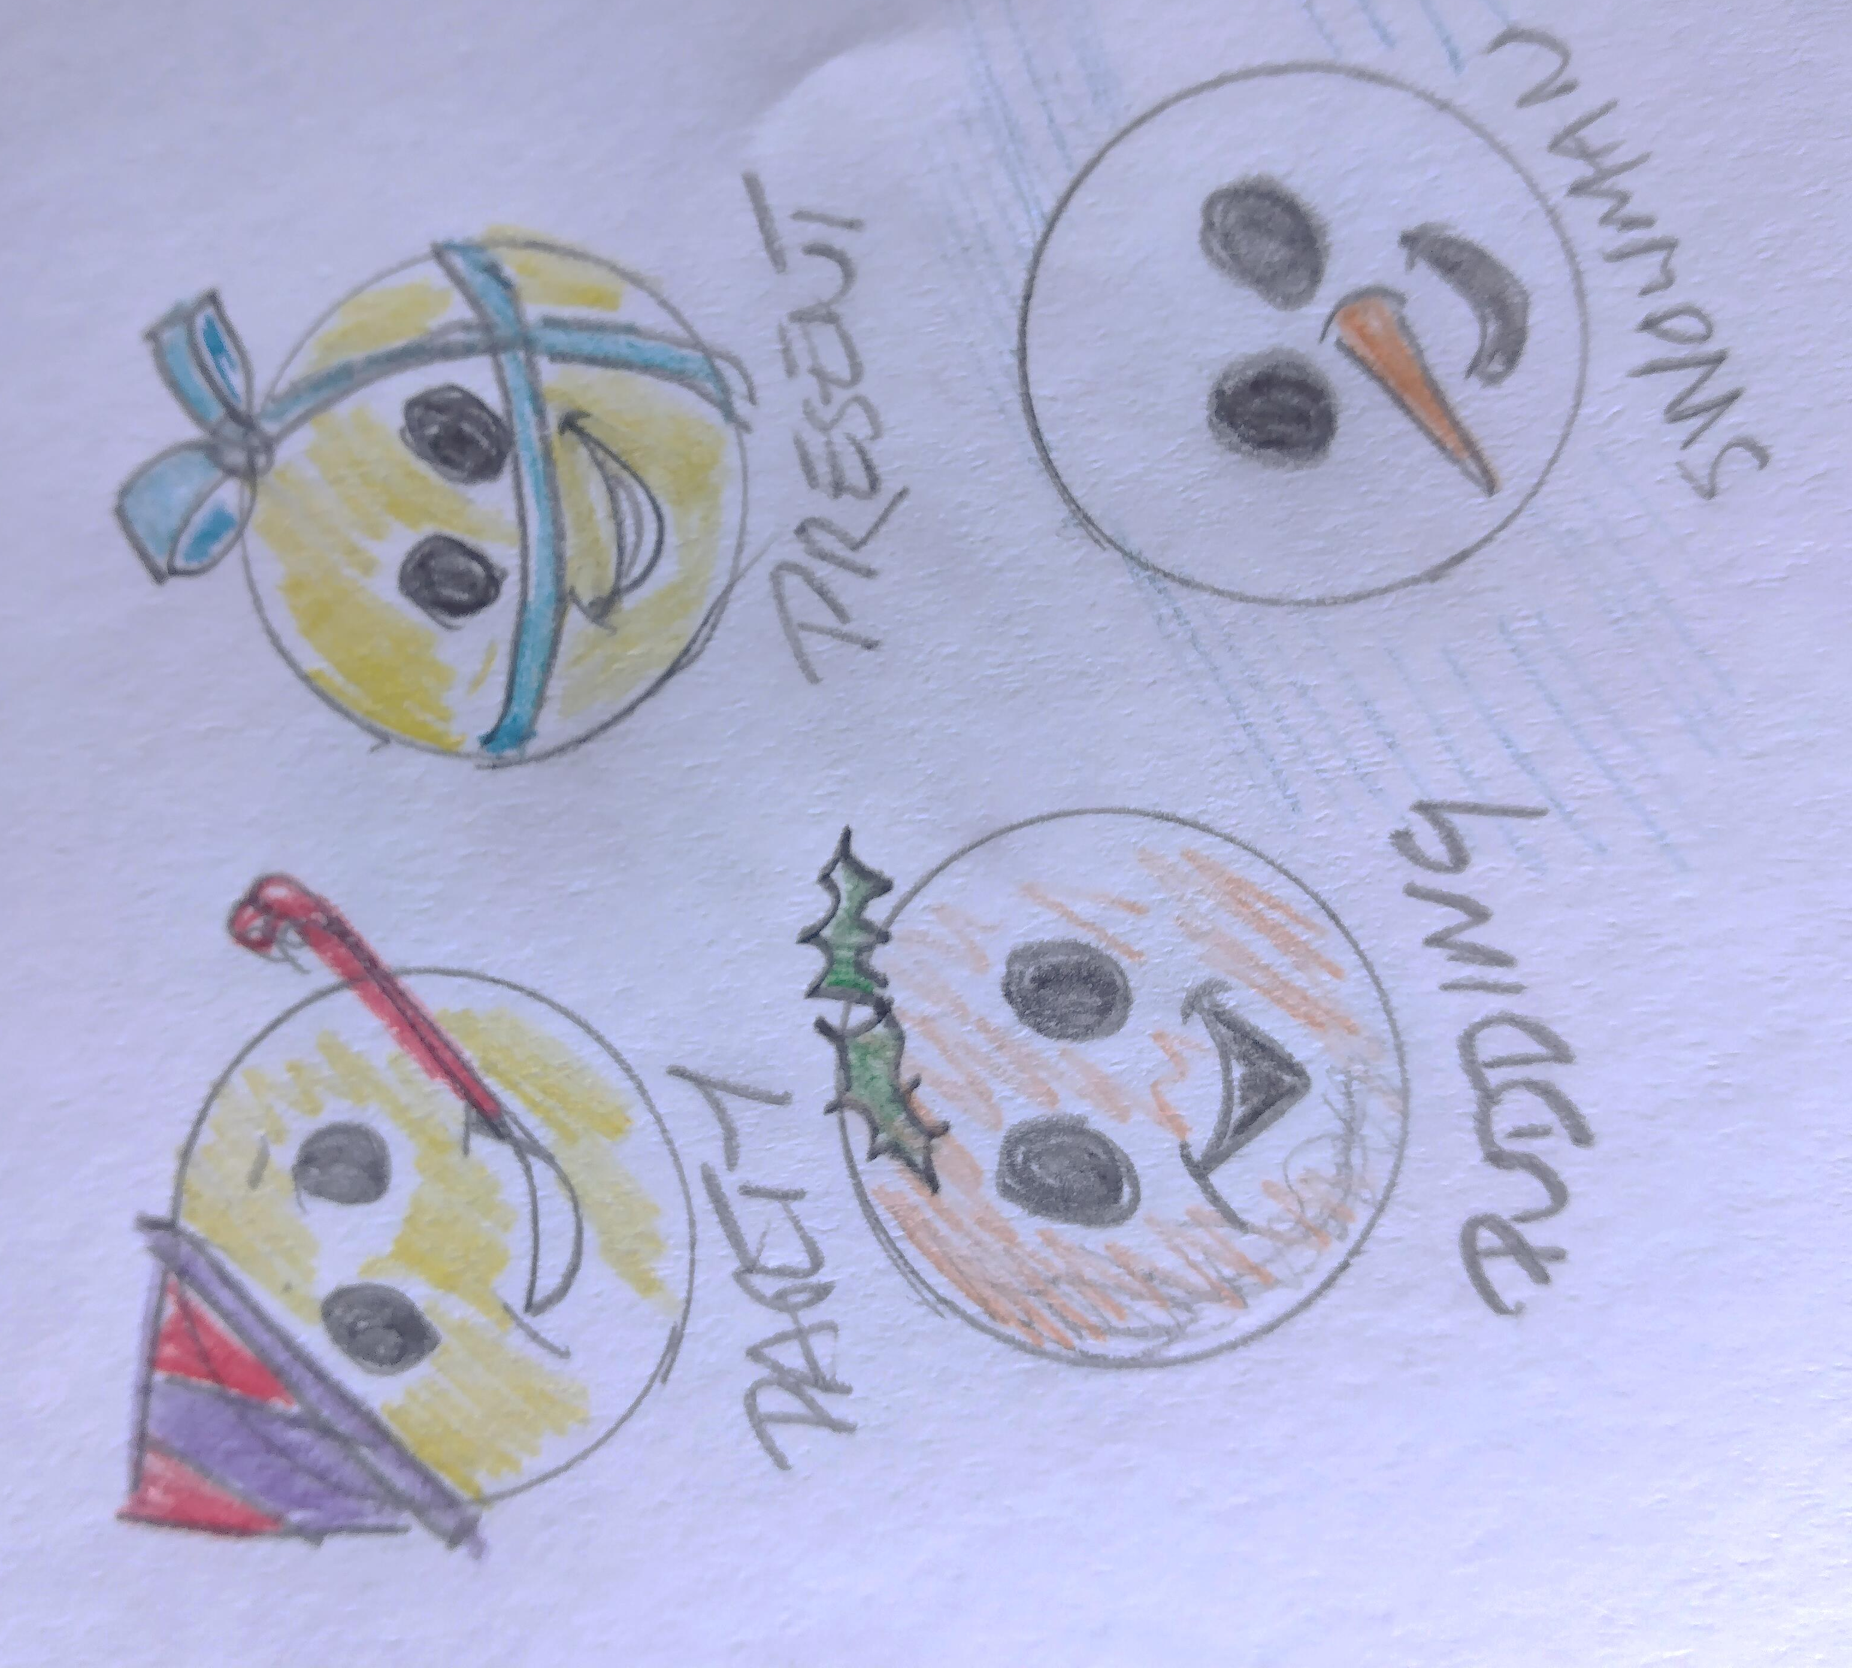
Step 2 – Trying out ideas
Draw circles on your paper
Try out different ideas on each circle
Try different shapes - not all emojis are circles!

Slide 7
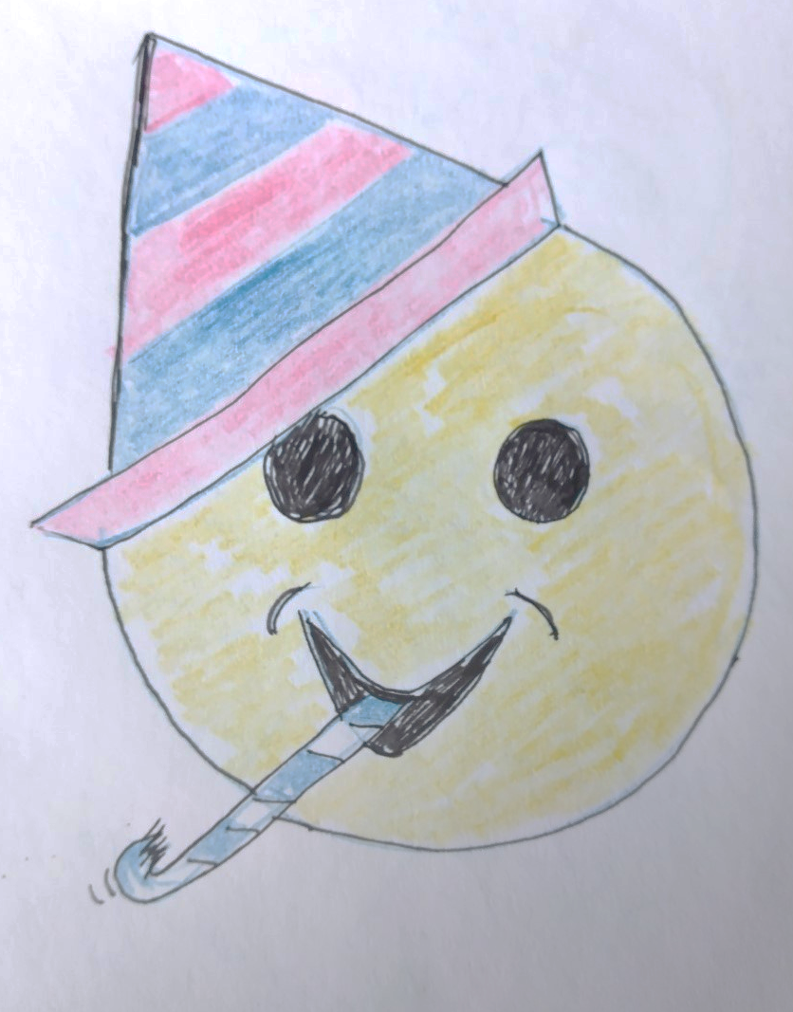
Step 3 – Final idea
Choose your best idea
Draw a large, final version of it
Add colour
Show it to your friends and teacher - ask them what they think it means

Slide 8
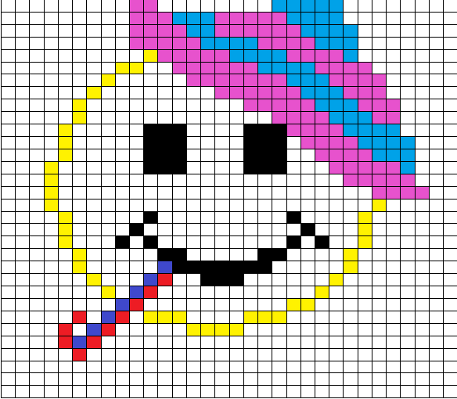
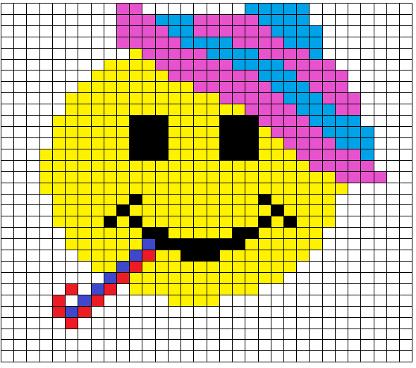
Step 4 – Development/Extension
Draw your idea using pixels, on graph paper
Try to make it fit in as few squares as you can
Each square can only be ONE colour
Notes:
If you don’t have graph paper print out the next slide to use instead.

Slide 9
Drawing grid

Slide 10
Reflection and plenary
Show your final idea to your friends or teacher to see if they understand it
A good emoji is clear and bright. How well do you think you did with yours?

