Slide 1
Gift tokens
Making a book of Christmas gift tokens

Slide 2
Christmas gift tokens
Stay safe
Whether you are a scientist researching a new medicine or an engineer solving climate change, safety always comes first. An adult must always be around and supervising when doing this activity. You are responsible for:
ensuring that any equipment used for this activity is in good working condition
behaving sensibly and following any safety instructions so as not to hurt or injure yourself or others
Please note that in the absence of any negligence or other breach of duty by us, this activity is carried out at your own risk. It is important to take extra care at the stages marked with this symbol: ⚠

Slide 3
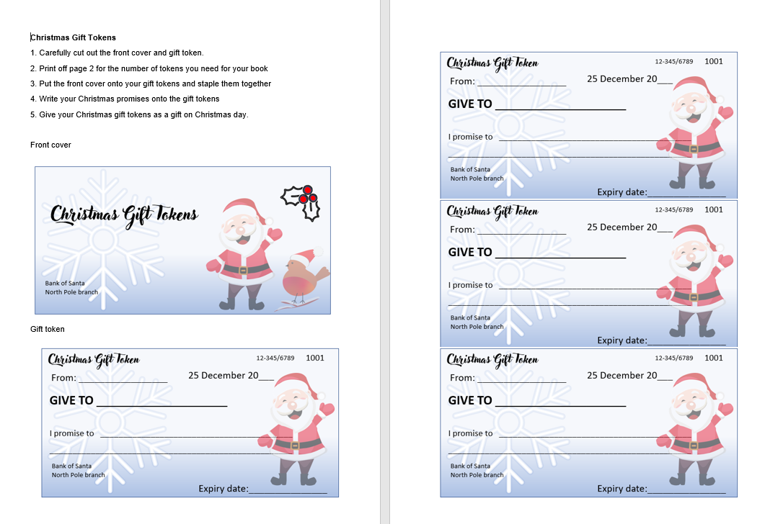
Step 1 – Activity handout
Print off the front cover and as many tokens as you need

Slide 4
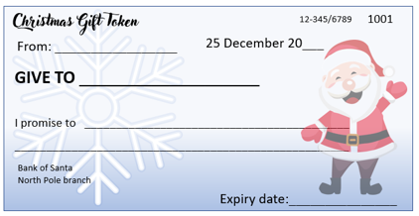
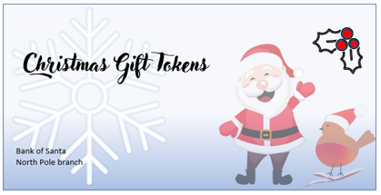
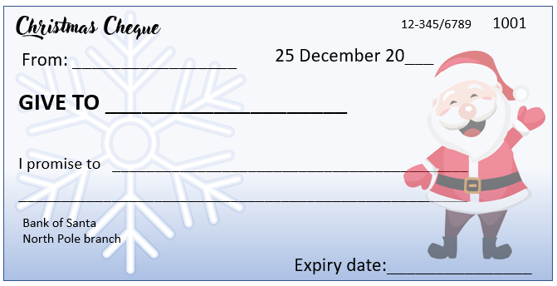
Step 2 – Make your book of gift tokens
Put the front cover on top of the tokens
Staple together ⚠
STAPLE

Slide 5
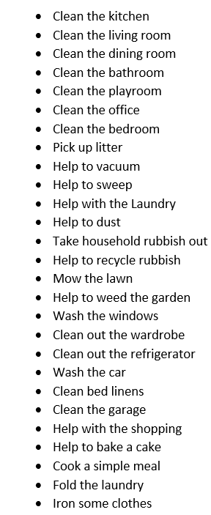
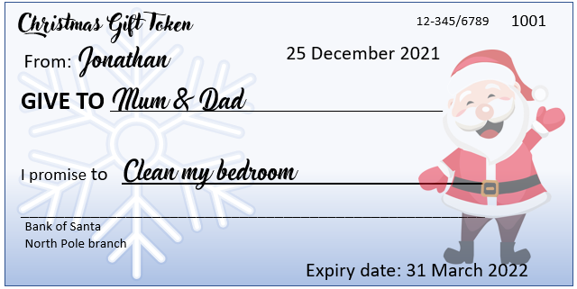
Step 3 – Add your promises
Check the activity sheet for Christmas promises
Write your promises on the tokens

