Slide 1
Exploding Snowman
Making an exploding snowman using bicarbonate and vinegar
Notes:
Stay safe
Whether you are a scientist researching a new medicine or an engineer solving climate change, safety always comes first. An adult must always be around when doing this activity, and please note that this is carried out at your own risk. It is important to take extra care at the stages marked with this symbol: ⚠

Slide 2
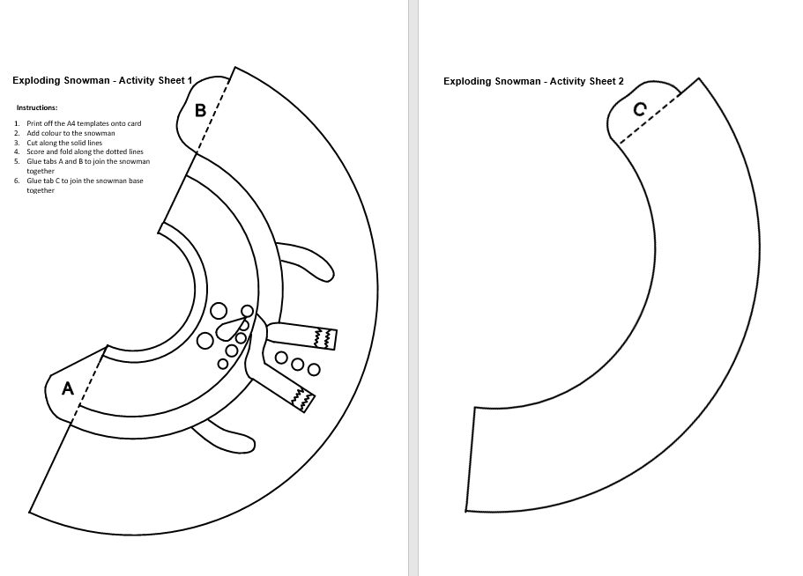
Step 1
Add colour to the snowman template

Slide 3
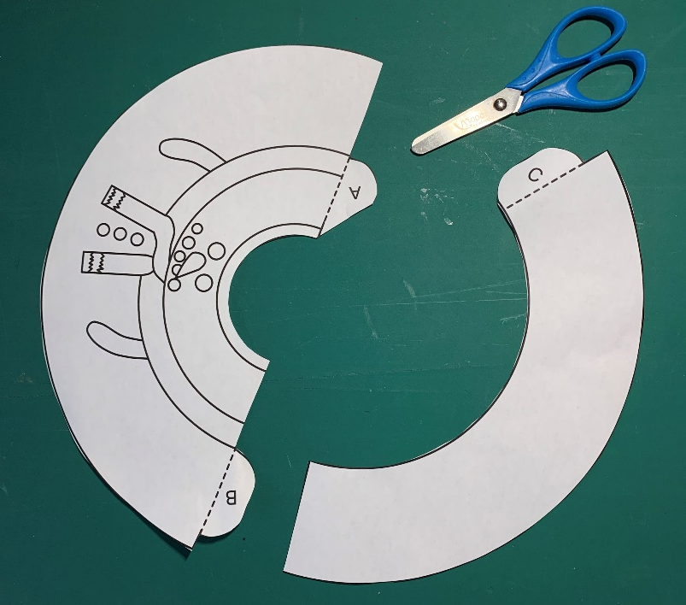
Step 2 – Cut and glue
Cut out the template on the solid lines
Fold the tables on the dotted lines
Put glue on tabs A, B and C
⚠

Slide 4
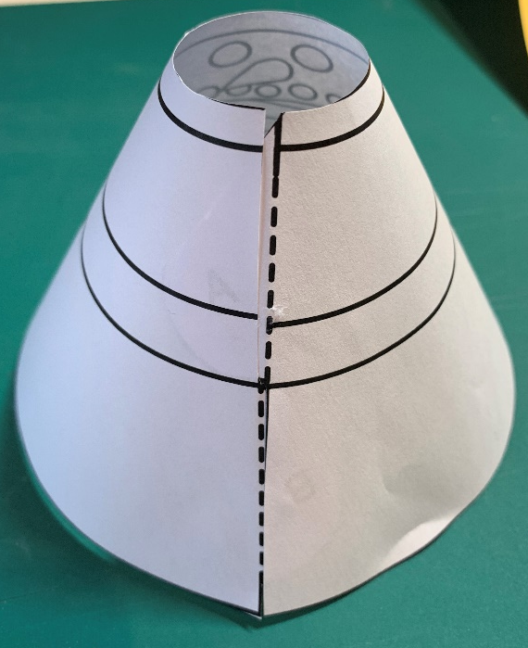
Step 3 – Shape the snowman
Join the snowman together - stick tabs A and B
Join the base together - stick tab C
⚠

Slide 5
Step 4 – Make the snowman
Turn the base around and place over a 50 g container
Place the snowman on top of the base

Slide 6
Step 5 – Make the mixture
Mix one tbsp each of bicarbonate and washing up liquid
Add two tbsps of water and mix
Pour the mixture into a 50 g container
⚠

Slide 7
Step 6 – Exploding snowman
Place the snowman on the container
Mix one tbsp of food colouring with a third of a cup of vinegar (80 ml)
Add mixture to the bottle
Watch the snowman explode!
⚠

