Slide 1
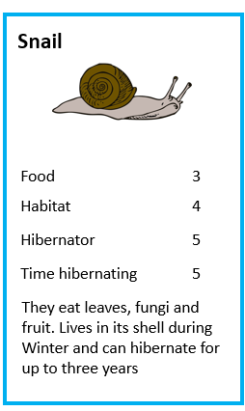
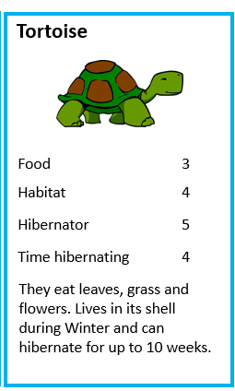
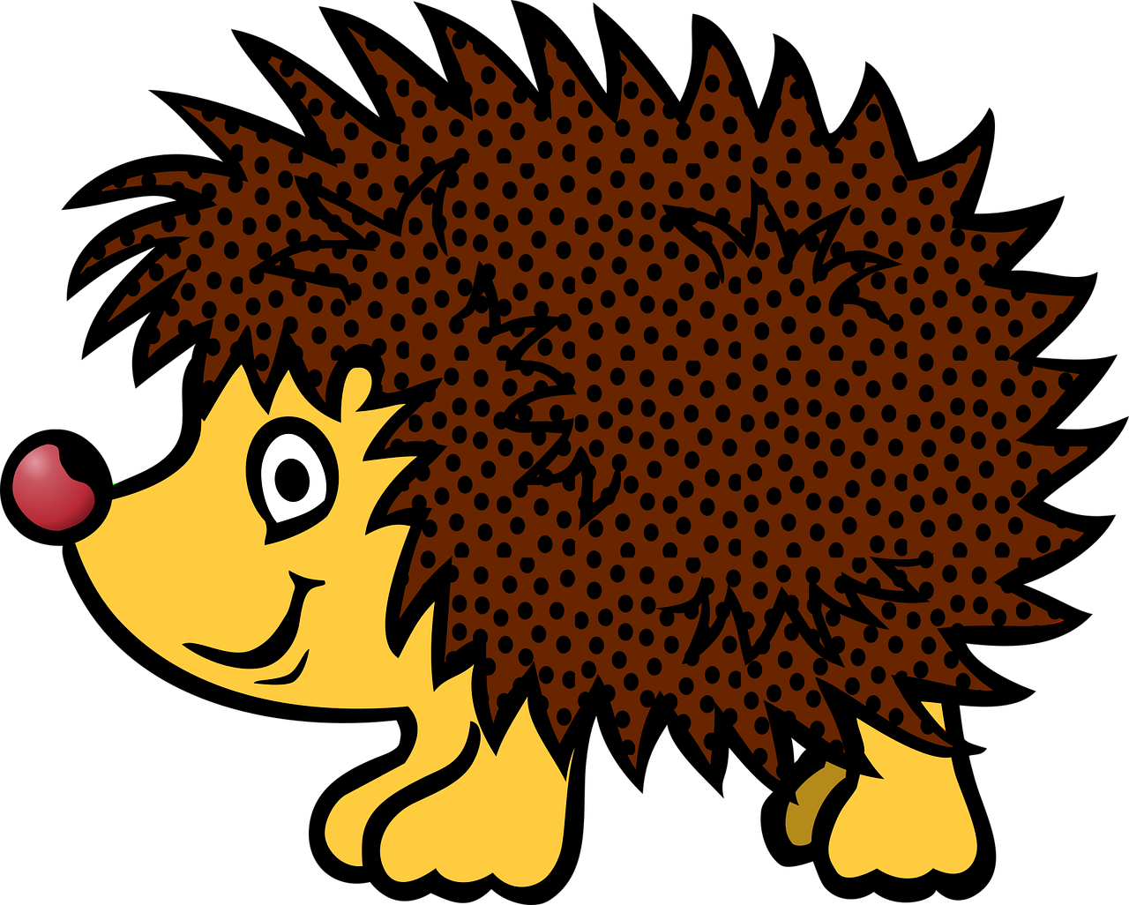
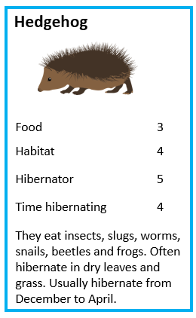
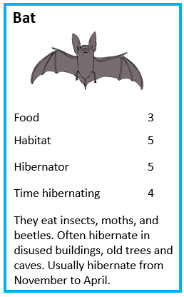
Animals that hibernate
Card activity about animals that hibernate over the winter

Slide 2
Animals that hibernate
Stay safe
Whether you are a scientist researching a new medicine or an engineer solving climate change, safety always comes first. An adult must always be around and supervising when doing this activity. You are responsible for:
ensuring that any equipment used for this activity is in good working condition
behaving sensibly and following any safety instructions so as not to hurt or injure yourself or others
Please note that in the absence of any negligence or other breach of duty by us, this activity is carried out at your own risk. It is important to take extra care at the stages marked with this symbol: ⚠

Slide 3
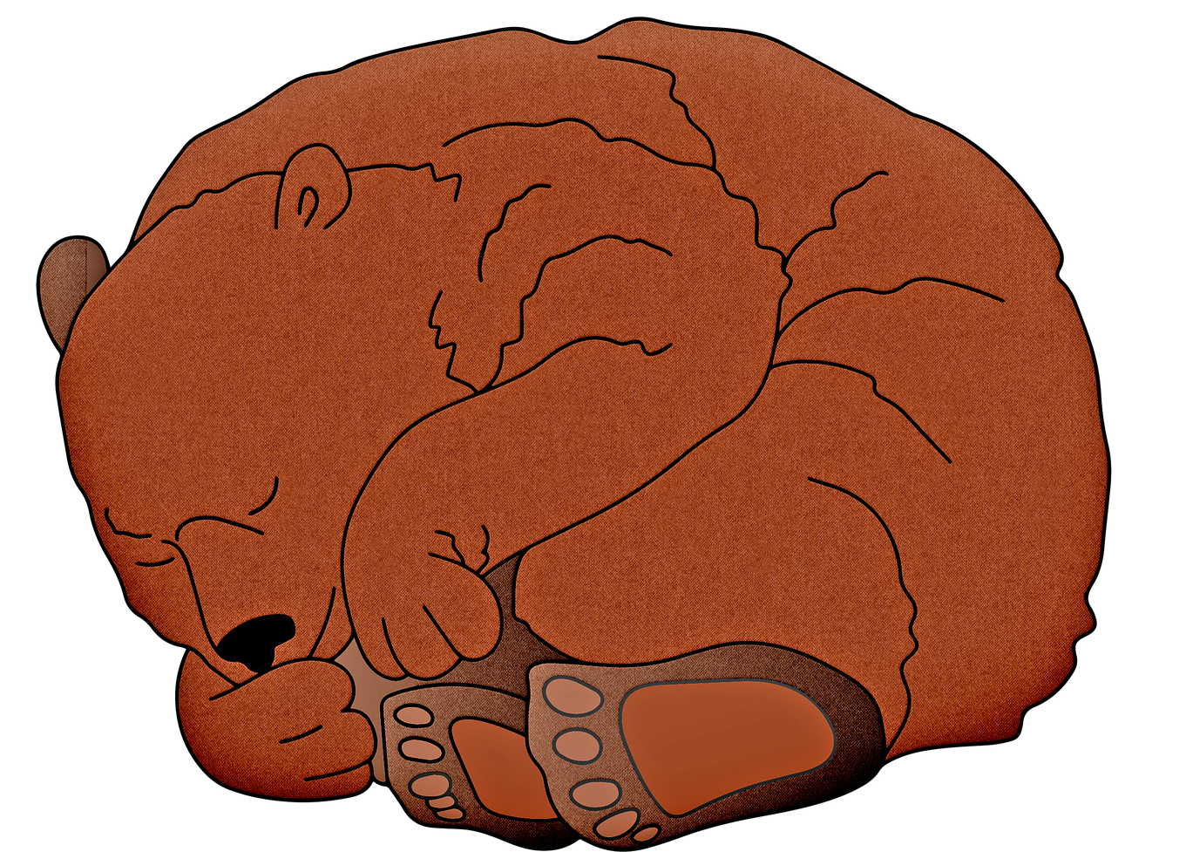
What is hibernation?
Hibernation is the way animals survive the winter cold
They collect food in the warm months because it is hard to find food in winter
They fall into a deep sleep in a safe place

Slide 4
Hibernation - card activity
Aim of the activity: win all the cards!
Deal out the cards
Hold the cards to see the top card only
The dealer reads out an item e.g. habitat 5
The other players read out the same item
The player with higher value wins the other cards
The winning player from that hand then reads out an item on their next card – and so on.
The player with all the cards at the end wins the game!
Notes:
Learners can work in pairs or small groups.

Slide 5
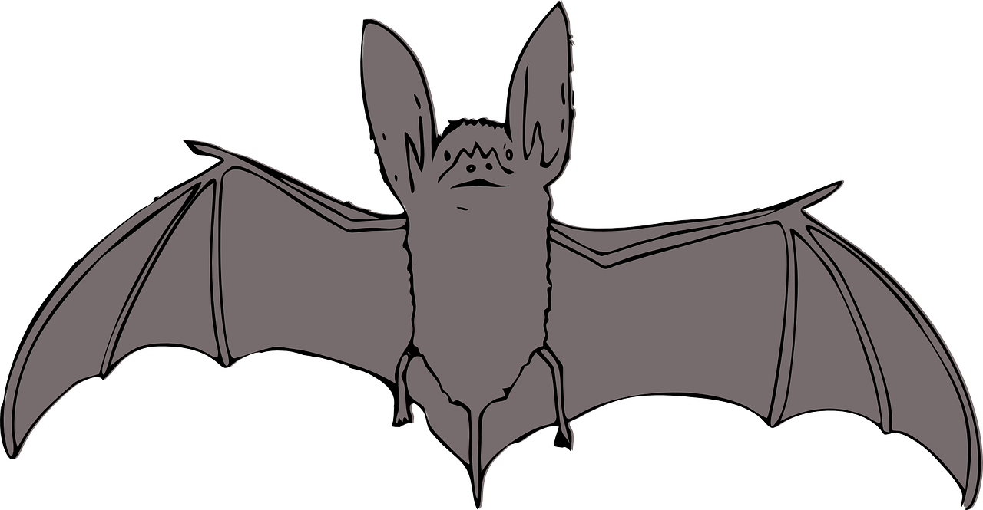
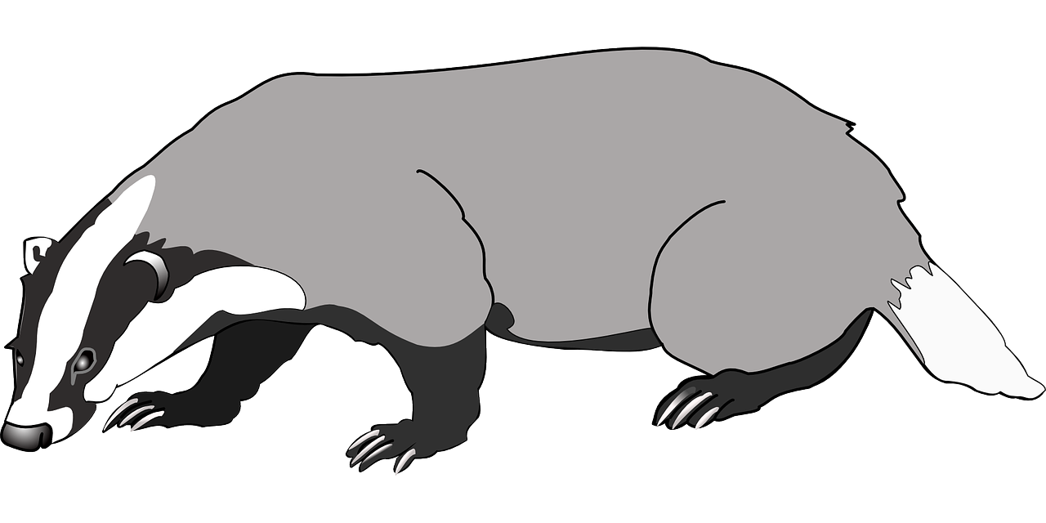
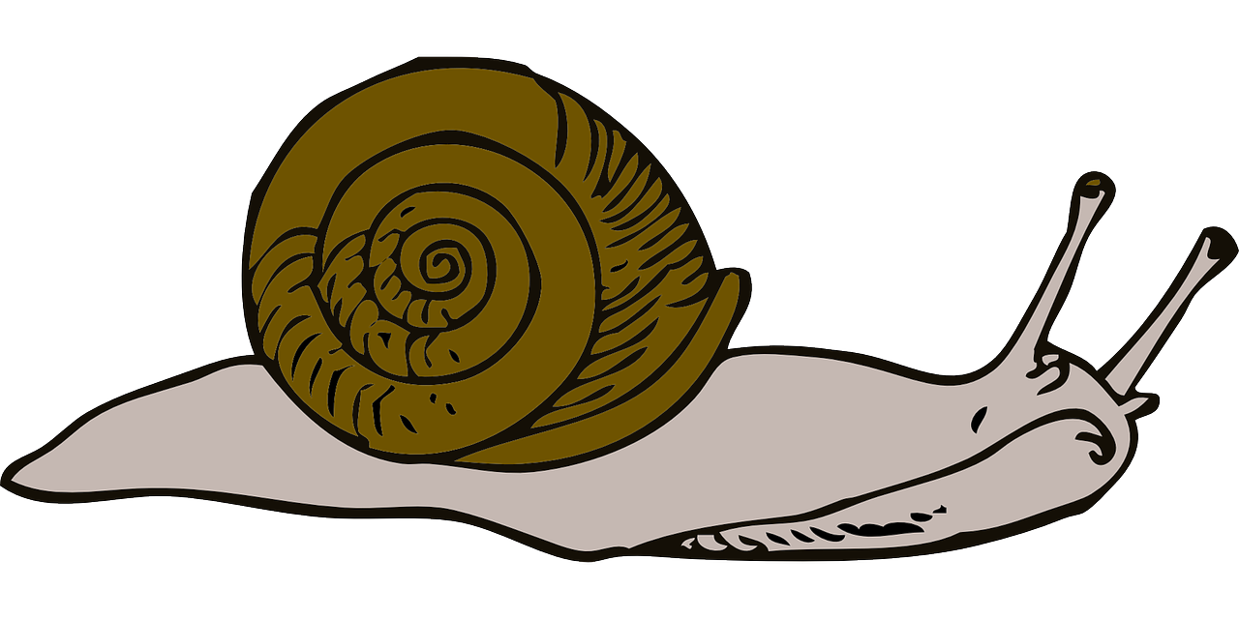
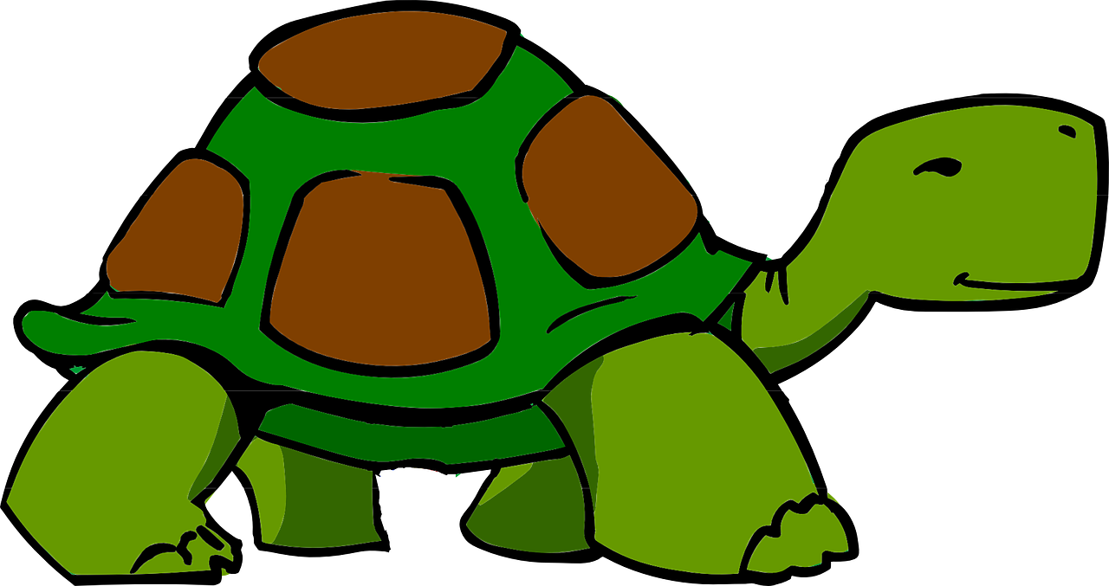
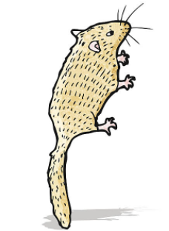
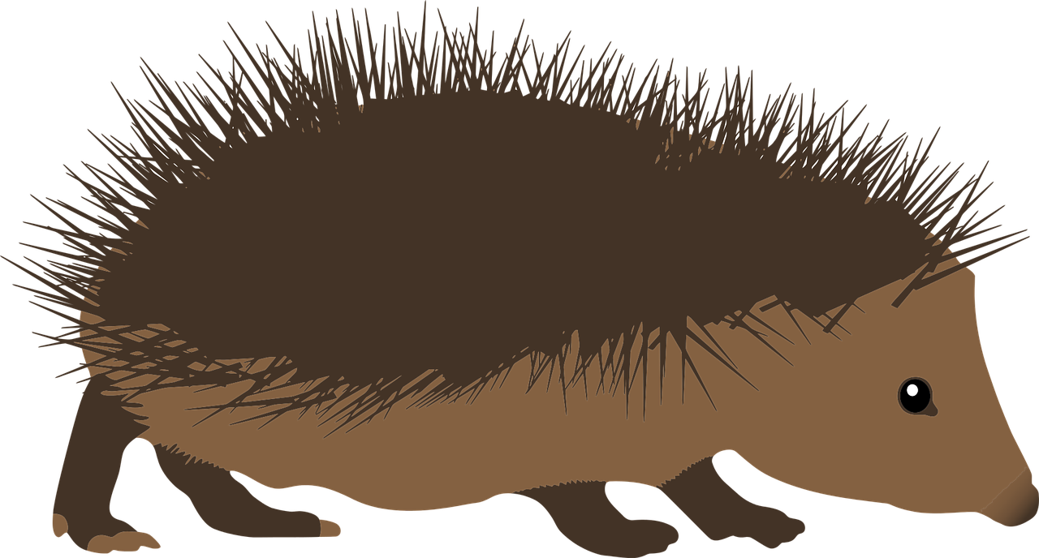
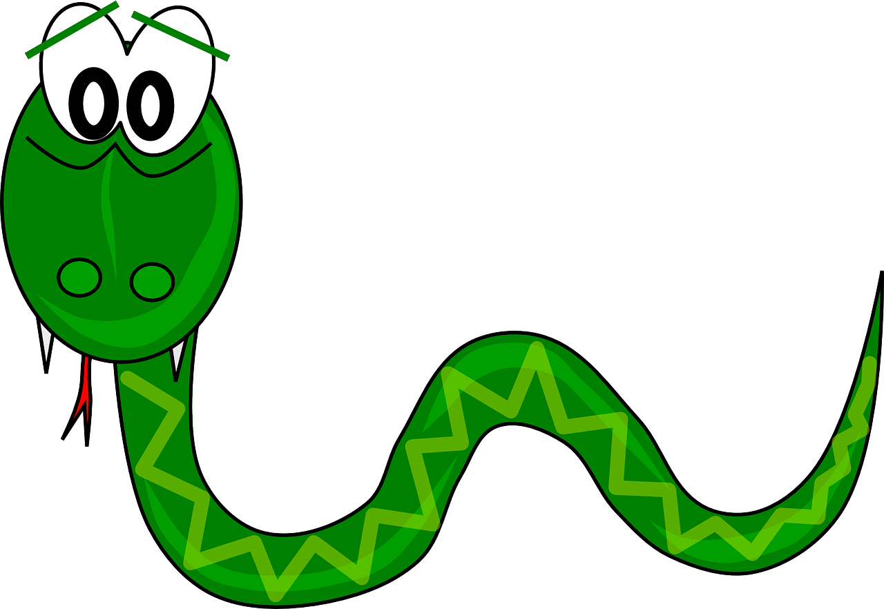
Hibernation - Cards
Bat
Badger
Snail
Tortoise
Size | 2
Amount of food eaten | 2
Time hibernating | 4
eat insects, moths, and beetles hibernate in disused buildings, old trees and caves hibernate from November to April
Size | 3
Amount of food eaten | 4
Time hibernating | 0
eat insects, small animals, worms, fungi and fruit live in woodland and farmland do not hibernate
Size | 0
Amount of food eaten | 1
Time hibernating | 5
eat leaves, fungi and fruit lives in its shell during winter can hibernate for up to three years
Size | 2
Amount of food eaten | 2
Time hibernating | 2
eat leaves, grass and flowers lives in its shell during winter hibernates for up to ten weeks
Hedgehog
Snake - Adder
Bear
Size | 3
Amount of food eaten | 3
Time hibernating | 4
eat insects, slugs, beetles snails and frogs hibernate in dry leaves and grass hibernate from December to April
Size | 1
Amount of food eaten | 2
Time hibernating | 4
eat small mammals such as mice and voles live in woodland and grassland hibernate from October to March
Size | 1
Amount of food eaten | 2
Time hibernating | 4
eat insects, flowers, fruit and nuts hibernate rolled up in a small ball on the ground in leaves hibernate from October to April
Size | 4
Amount of food eaten | 4
Time hibernating | 4
eat grass, roots, insects and berries hibernate in caves or digs a den hibernate from October to April
Dormouse

Slide 6
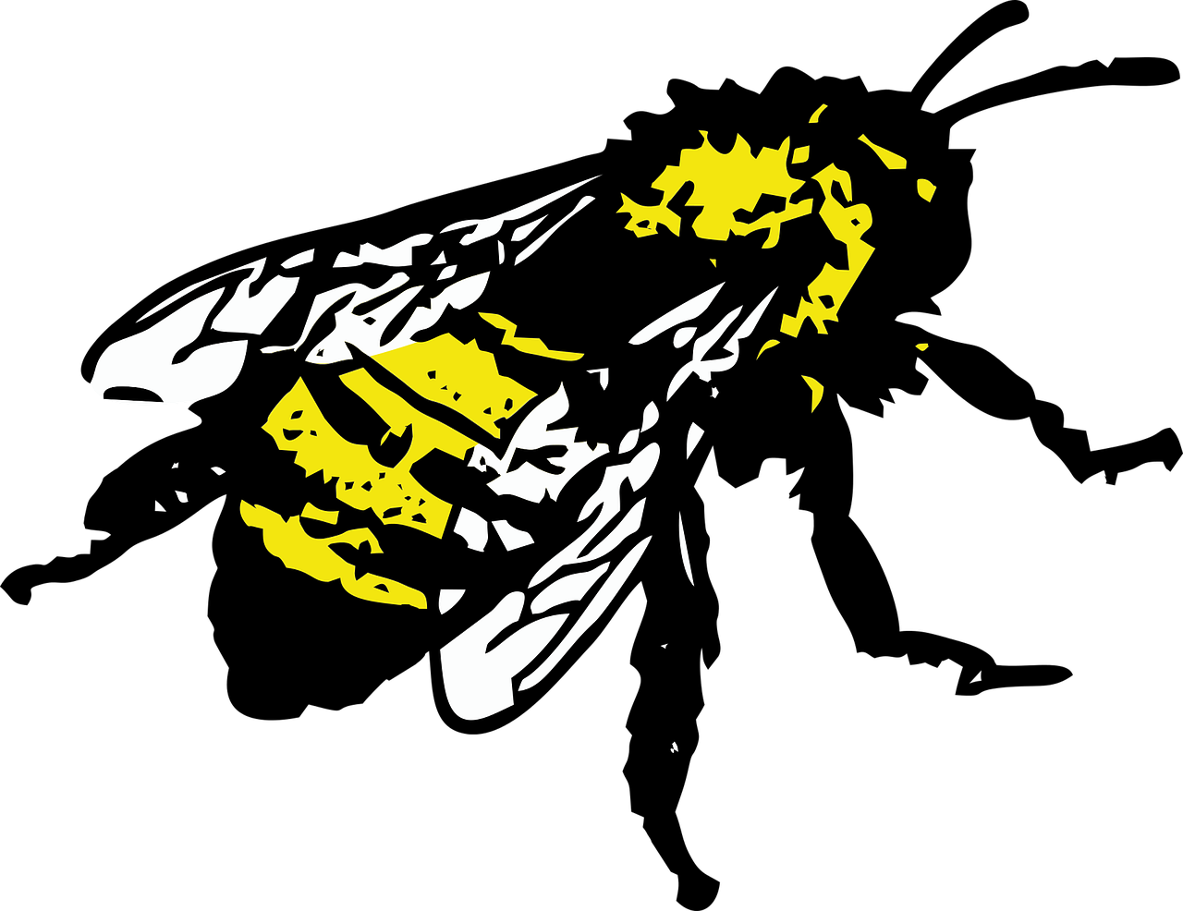
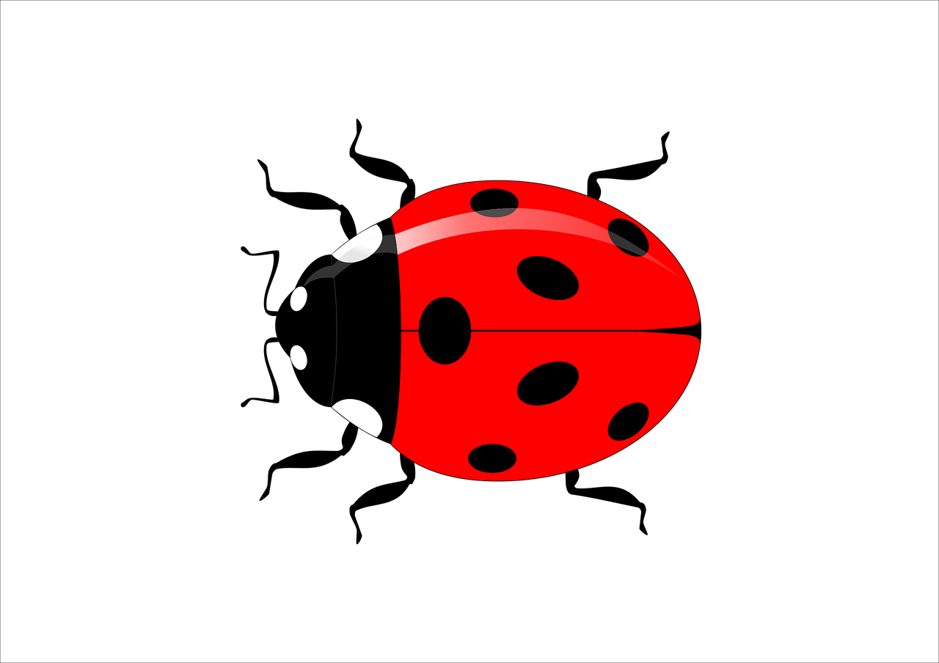
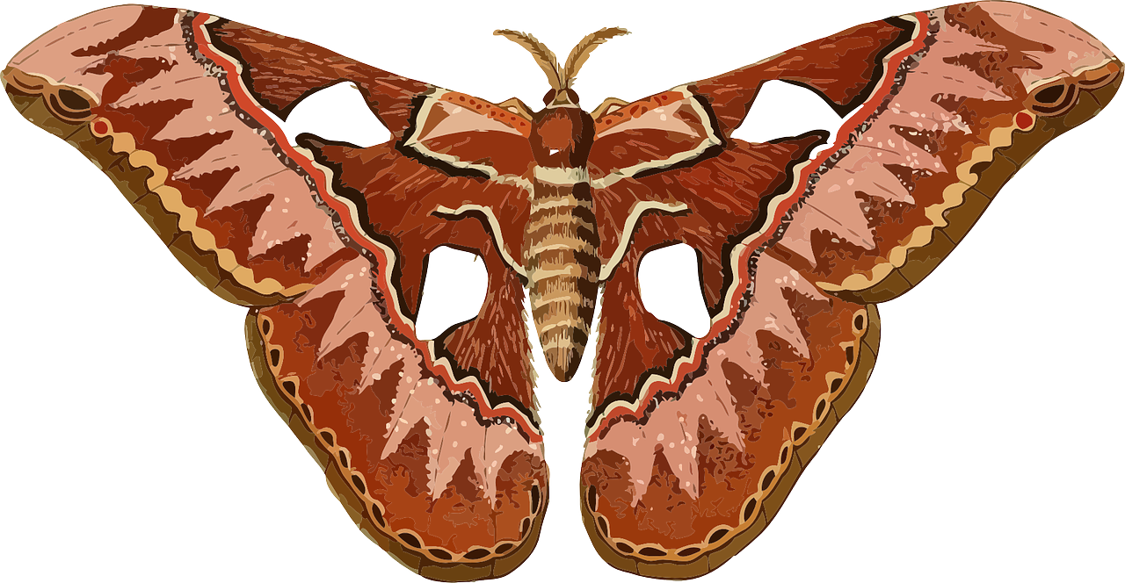
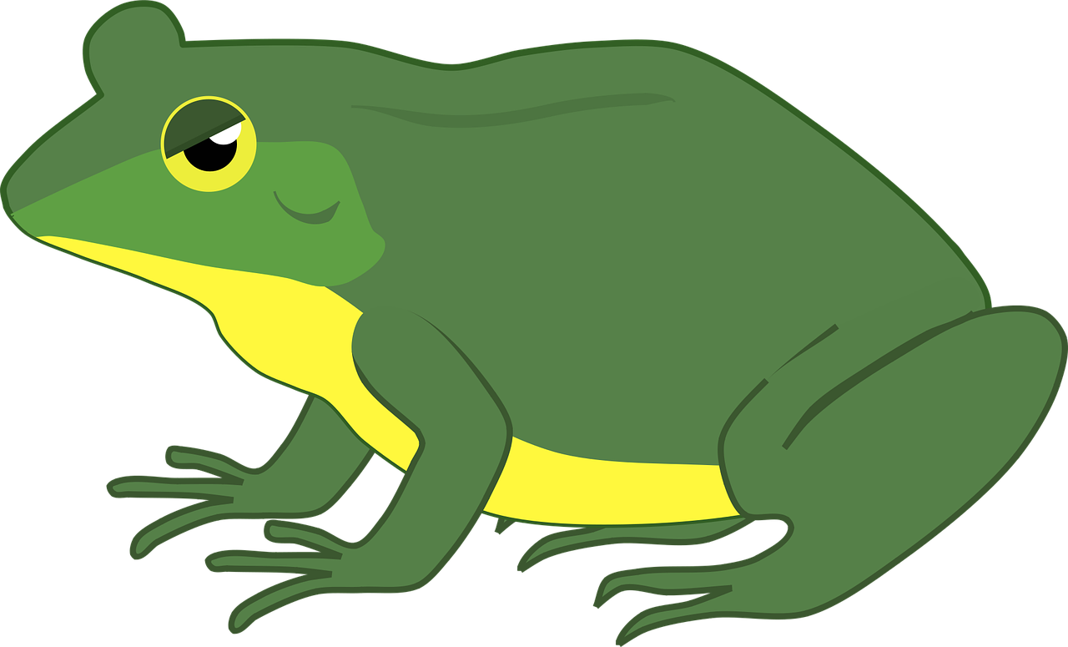
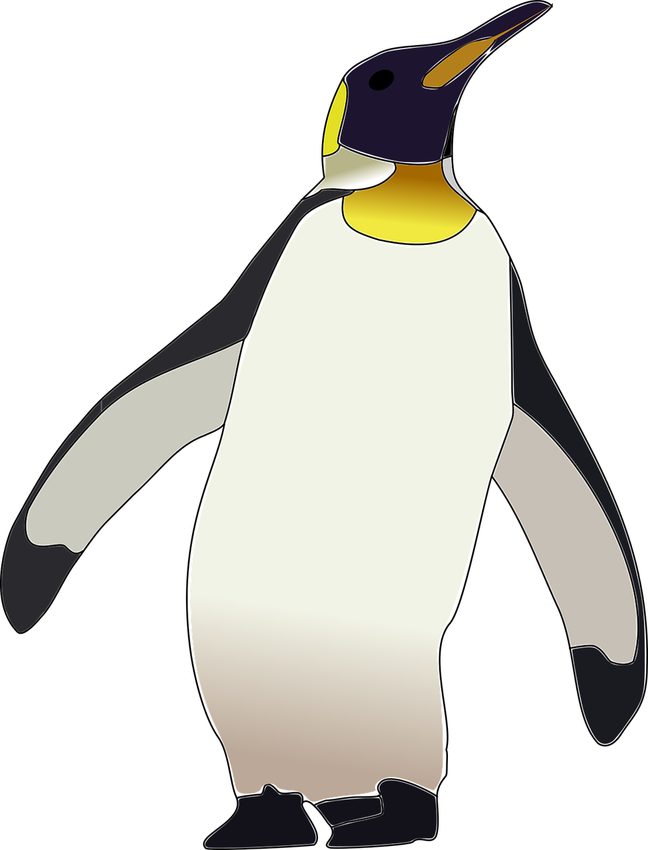
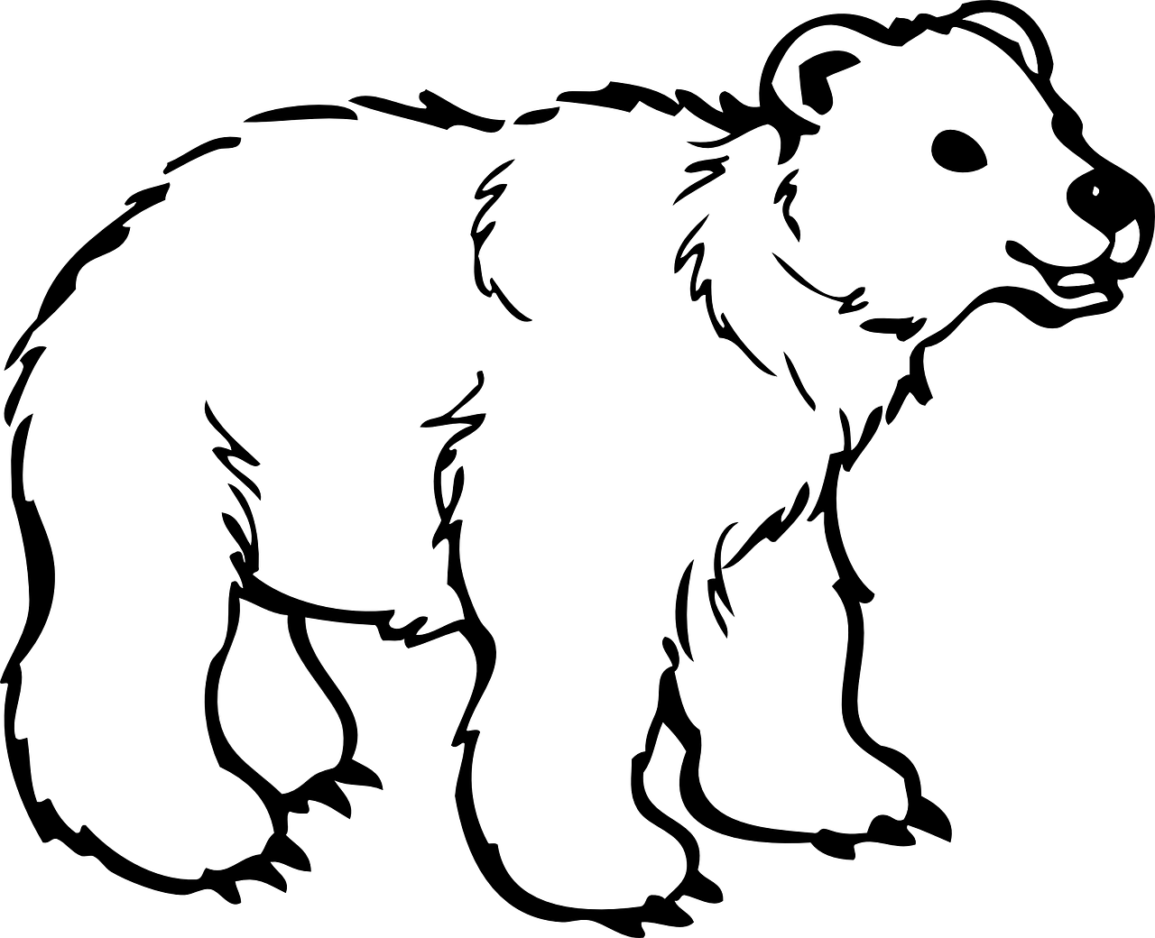
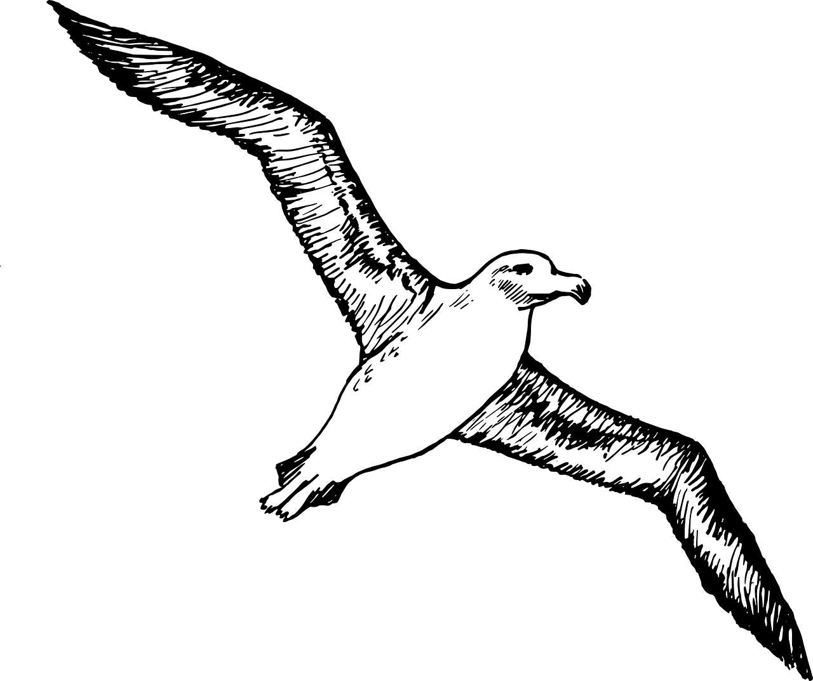
Hibernation - Cards
Bumblebees
Frog
Size | 0
Amount of food eaten | 1
Time hibernating | 4
eat pollen and nectar hibernate in hives hibernate from December to March
Size | 0
Amount of food eaten | 1
Time hibernating | 3
eat insects, such as aphids live on plants and vegetation hibernate from November to April
Moth
Size | 1
Amount of food eaten | 2
Time hibernating | 1
eat insects, slugs and worms live in the mud in ponds during winter hibernates from February to March
Ladybirds
Size | 0
Amount of food eaten | 1
Time hibernating | 3
eat nectar and flowers hibernate as a caterpillar in vegetation hibernate from December to March
Whale
Penguin
Polar Bear
Albatross
Size | 5
Amount of food eaten | 5
Time hibernating | 0
eat small plankton and krill live in the ocean do not hibernate
Size | 2
Amount of food eaten | 3
Time hibernating | 0
eat krill live on the ice in Antarctica do not hibernate
Size | 4
Amount of food eaten | 5
Time hibernating | 0
eat seals live on the ice in the Artic do not hibernate
Size | 3
Amount of food eaten | 3
Time hibernating | 0
eat fish live on the coast in Antarctica do not hibernate

Slide 7
Hibernation - Cards

