Slide 1
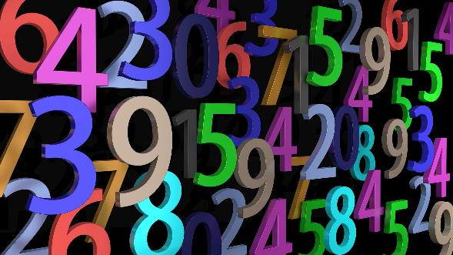
Triangular numbers
How to calculate triangular numbers
Notes:
For a video explanation, please see https://www.youtube.com/watch?v=oYXoyvUv4DA&list=PLS_EtymQc9PMPa2ALIwrAL-pInR5A27lr&index=10

Slide 2
Triangular numbers
Stay safe
Whether you are a scientist researching a new medicine or an engineer solving climate change, safety always comes first. An adult must always be around and supervising when doing this activity. You are responsible for:
ensuring that any equipment used for this activity is in good working condition
behaving sensibly and following any safety instructions so as not to hurt or injure yourself or others
Please note that in the absence of any negligence or other breach of duty by us, this activity is carried out at your own risk. It is important to take extra care at the stages marked with this symbol: ⚠
Notes:
For a video explanation, please see https://www.youtube.com/watch?v=oYXoyvUv4DA&list=PLS_EtymQc9PMPa2ALIwrAL-pInR5A27lr&index=10

Slide 3
Triangular numbers – what are they?
Numbers can be drawn so that they make triangles as dots
The number of dots in the bottom row of the triangle
= the number of rows

Slide 4
Triangular numbers – what are they?
To get the total, add up the dots in each row
For example 1 + 2 + 3 + 4 = 10
The next triangle will have 5 dots in the bottom row – so 1 + 2 + 3 + 4 + 5 = 15

Slide 5
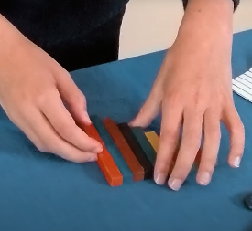
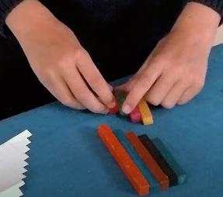
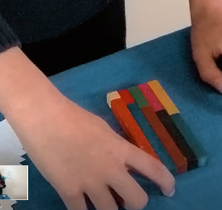
Triangular number staircase
We can add together numbers using a triangular staircase
Set out numbers 1 to 10 in columns
Cut the columns in half
Rotate one of the halves and place on top
Multiply the length by height to get the total
11 x 5 = 55

Slide 6
Triangular number staircase 1 to 15
1 of 2
Draw staircase grid 1 to 15
Fold in half
Carefully cut in half with scissors ⚠
?

Slide 7
Triangular number staircase 1 to 15
2 of 2
Place cut half on top
Multiply the number of columns by the number of rows
Triangular Number 1 to 15
71/2 x 16 = 120
?

Slide 8
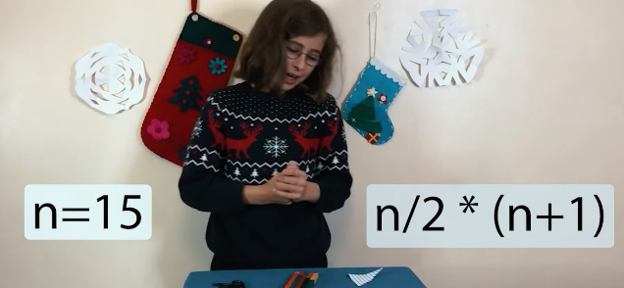
Triangular number formula using n
We can calculate the sum when adding triangular numbers using a formula
n is any number
Example n = 15

Slide 9
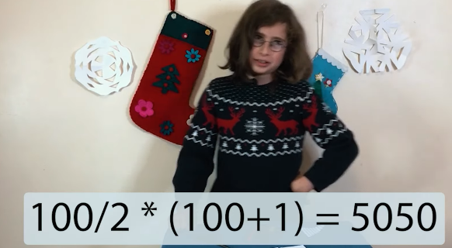
Triangular number formula using n
n is any number
Example n = 100
?

Slide 10
Triangular number formula using n
n is any number
Choose a number for n and calculate the triangular number
?
N = ?

