Slide 1
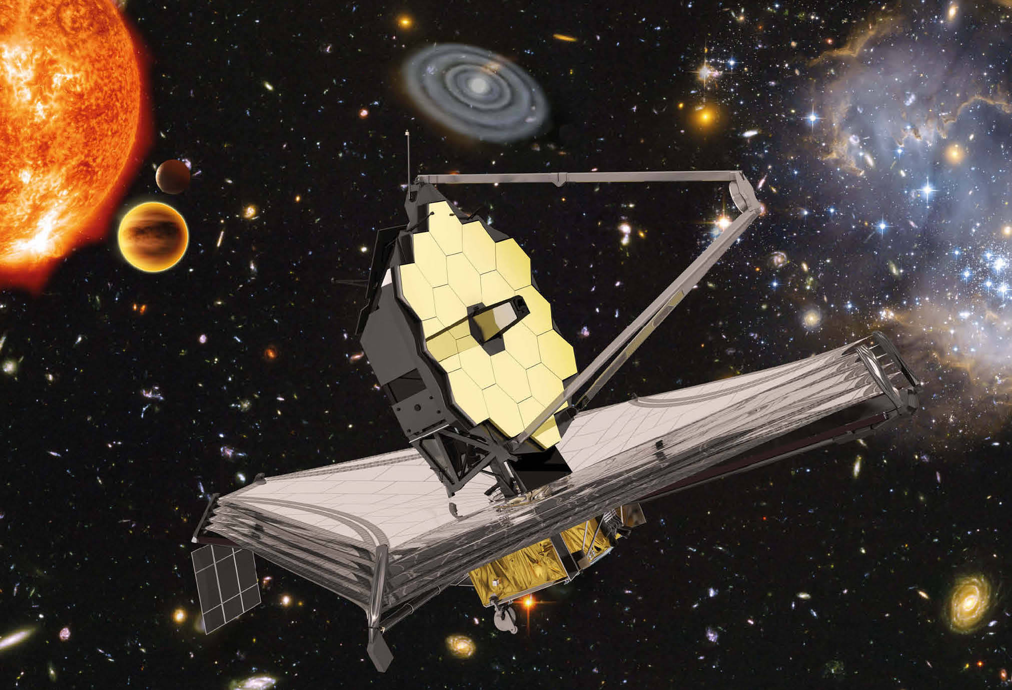
Sensors for space
Identifying sensors that could be used on the
James Webb Space Telescope

Slide 2
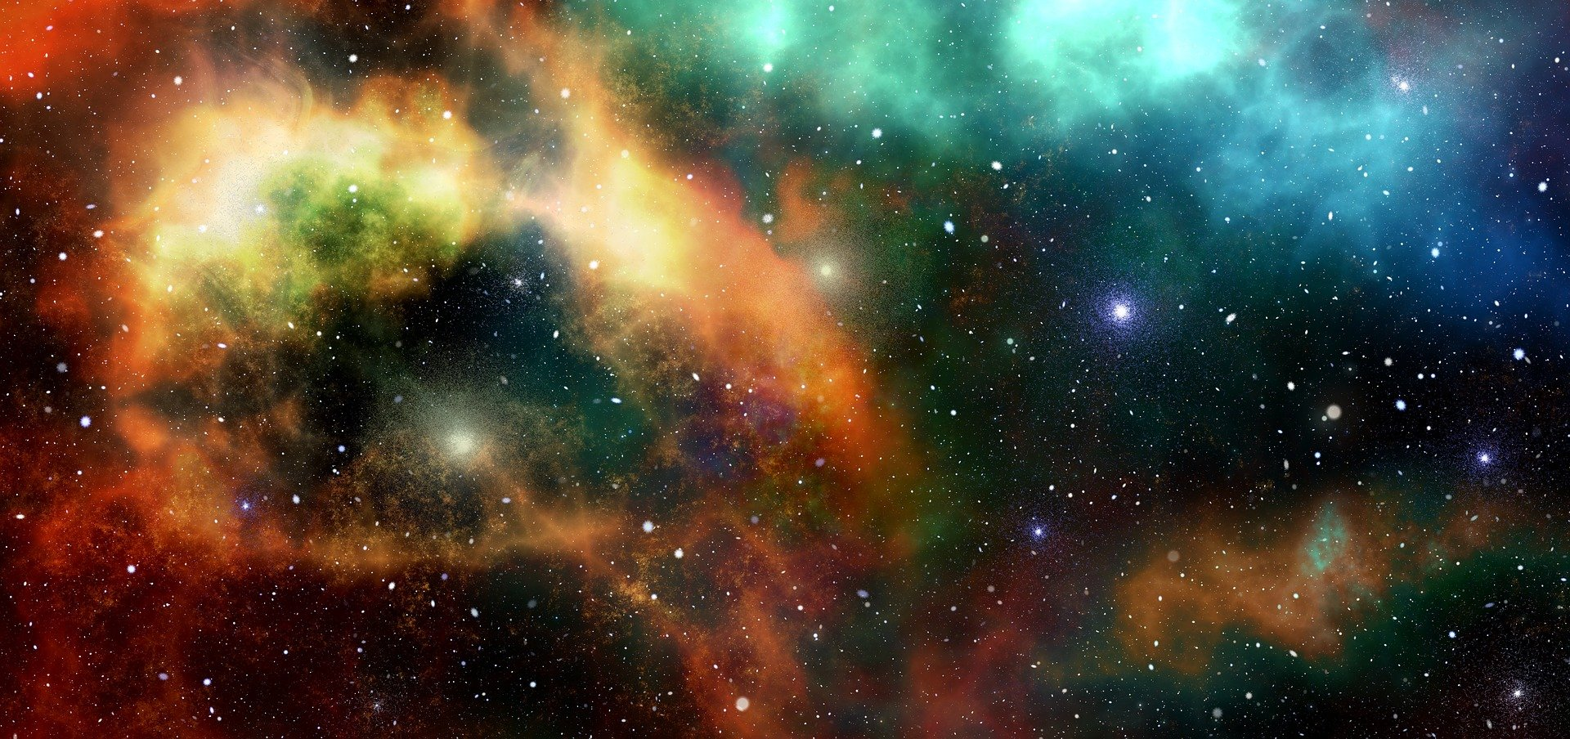
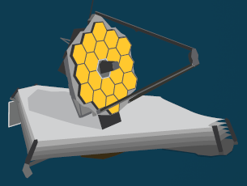
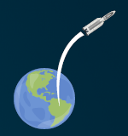
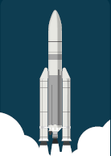
James Webb Space Telescope
The James Webb Space telescope will allow us to look at far away stars and galaxies
We can see some stars from earth – but this telescope will let us see them much better!
It will be positioned in space, 1.5 million km from earth!
It will be launched into space on a rocket
Notes:
The James Webb Space Telescope (Webb) will be the largest, most powerful telescope ever launched into space. It follows in the footsteps of the Hubble Space Telescope as the next great space science observatory, designed to
answer outstanding questions about the Universe and to make breakthrough discoveries in all fields of astronomy.
Webb will reveal the hidden Universe to our eyes: stars shrouded in clouds of dust, molecules in the atmospheres of other worlds, and light from the first stars and galaxies. With its suite of state-of-the-art instruments, Webb will push the frontiers of our knowledge of the Solar System, of how stars and planets form, and of galaxy formation and evolution, in new ways.
The telescope will launch on an Ariane 5 rocket from Europe’s Spaceport in French Guiana. From there it embarks on a month-long journey to its destination orbit around the second Lagrange point (L2), about one and a half million kilometres from Earth. In the first month after launch, Webb will unfold its sunshield, which is the size of a tennis court, and then deploy its 6.5-metre primary mirror that can detect the faint light of distant stars and galaxies with a sensitivity a hundred times greater than that of Hubble.
The bottom right images are an Ariane 5 rocket taking off and leaving earth. The middle image is the James Webb Space Telescope that will be deployed in space. The image at the top right shows distant stars in space.

Slide 3
Where are sensors needed?
Notes:
The image could be presented on an interactive whiteboard so that learners could annotate it with their ideas

