Slide 1
Generating Electricity
Investigating how electrical energy is created

Slide 2
Stay safe
Whether you are a scientist researching a new medicine or an engineer solving climate change, safety always comes first. An adult must always be around and supervising when doing this activity. You are responsible for:
ensuring that any equipment used for this activity is in good working condition
behaving sensibly and following any safety instructions so as not to hurt or injure yourself or others
Please note that in the absence of any negligence or other breach of duty by us, this activity is carried out at your own risk. It is important to take extra care at the stages marked with this symbol: ⚠

Slide 3
Sources of Electrical Energy
Electrical energy can be generated from renewable or non-renewable sources.
Renewable sources are naturally replaced relatively quickly.
Non-renewable sources are limited and will eventually run out.
In your book:
Write down two examples of renewable energy sources and two examples of non-renewable energy sources.
Notes:
Examples of renewable sources could include solar, wind and hydro.
Examples of non-renewable sources could include fossil fuels (coal, oil, gas) and nuclear.

Slide 4
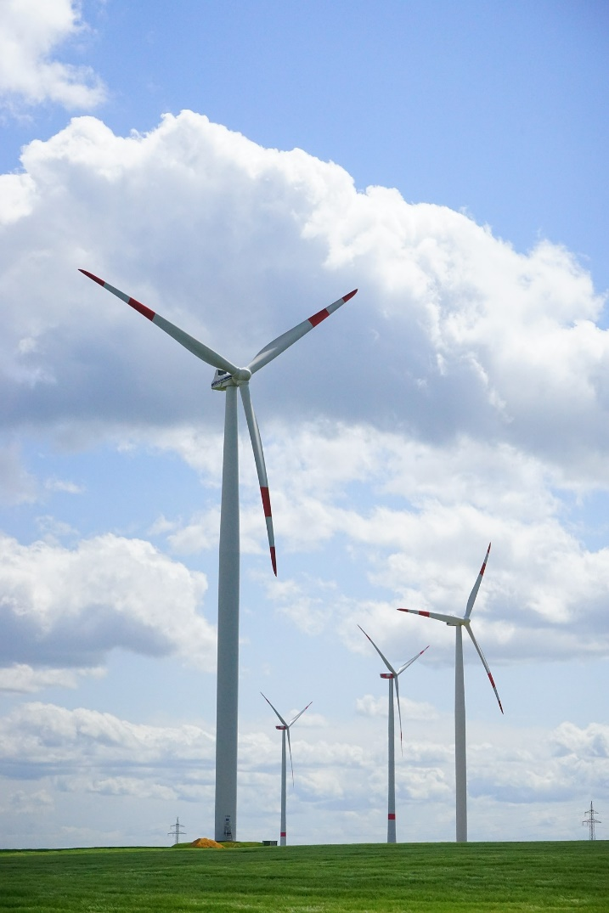
Examples of Renewable Energy Sources
Solar
Wind
Hydro
Tidal
Biomass
Notes:
Briefly outline what is meant by each term.

Slide 5
Examples of Non-renewable Energy Sources
Fossil fuels:
Coal
Oil
Gas
Nuclear
Notes:
Briefly outline what is meant by each term.

Slide 6
Investigating How Energy is Generated
Select one renewable energy source and one non-renewable energy source.
Using the internet or other resources available to you:
Research how electrical energy is generated from each source.
Use notes and sketches to describe each stage of the process.
Notes:
Ideally learners should have access to the internet for this activity. If this is not possible then they can use appropriate books, such as GCSE D&T and/or Engineering course books.

Slide 7
Renewable Energy Source: ____________________________
Step 1
Step 2
Step 3
Step 4
____________________________________________________________
____________________________________________________________
____________________________________________________________
____________________________________________________________
Notes:
This can be handed out to learners to complete the main activity.

Slide 8
Non-renewable Energy Source: ____________________________
Step 1
Step 2
Step 3
Step 4
____________________________________________________________
____________________________________________________________
____________________________________________________________
____________________________________________________________
Notes:
This can be handed out to learners to complete the main activity.

Slide 9
Peer Assessment
Swap your work with a partner.
Write down two things they have done well and one target for improvement.
Swap back and improve your work.

Slide 10
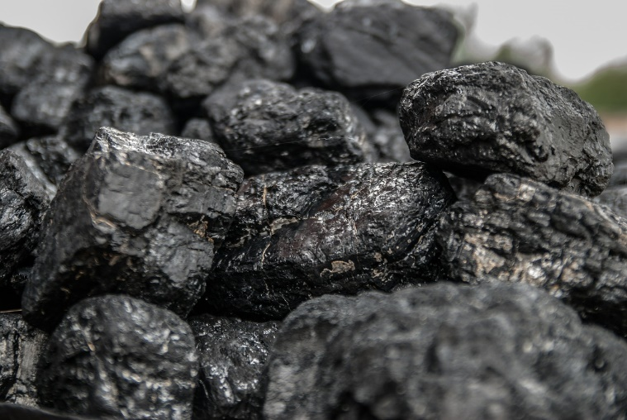
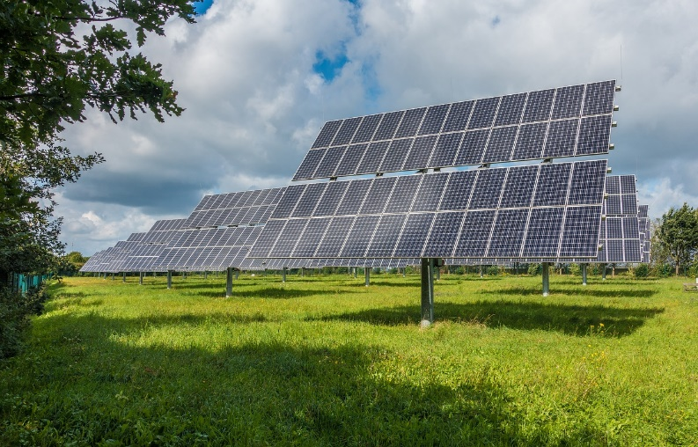
Extension
Explain the advantages and disadvantages of generating electrical energy using each method that you have described.

