Slide 1
Investigating How Hoverboards Work
Product analysis
HOVER
BOARD

Slide 2
Stay safe
Whether you are a scientist researching a new medicine or an engineer solving climate change, safety always comes first. An adult must always be around and supervising when doing this activity. You are responsible for:
ensuring that any equipment used for this activity is in good working condition
behaving sensibly and following any safety instructions so as not to hurt or injure yourself or others
Please note that in the absence of any negligence or other breach of duty by us, this activity is carried out at your own risk. It is important to take extra care at the stages marked with this symbol: ⚠

Slide 3
How the Lexus Hoverboard was designed
Story behind the design:
https://www.youtube.com/watch?v=oyGlNLpQ7CQ&t=2s
Science behind the design:
https://www.youtube.com/watch?v=qGiGMX0t3_U&t=5s
Notes:
These videos show how the Lexus Hoverboard was designed and science/technology behind it.

Slide 4
Investigating hoverboards
You are now going to analyse how two hoverboard designs work.
For each product, draw a picture of it and label its main features.
Explain how the product works.
Give at least one positive feature and one improvement that could be made.
Notes:
When describing how the product works, encourage learners to focus on the science and technology behind this e.g. the application of magnetism.

Slide 5
Product analysis – Hoverboard 1
What the product looks like and its main features:
How does the product work?
____________________________________________________________
____________________________________________________________
____________________________________________________________
____________________________________________________________
What has been done well?
____________________________________________________________
____________________________________________________________
What could be improved?
____________________________________________________________
____________________________________________________________
Notes:
Learners could use this template to present their analysis of the hoverboards that they have investigated. They could draw each product and label its main features. They could then use the prompts to explain how it works (e.g. how it achieves levitation), what it does well and what could be improved.

Slide 6
Product analysis – Hoverboard 2
What the product looks like and its main features:
How does the product work?
____________________________________________________________
____________________________________________________________
____________________________________________________________
____________________________________________________________
What has been done well?
____________________________________________________________
____________________________________________________________
What could be improved?
____________________________________________________________
____________________________________________________________
Notes:
Learners could use this template to present their analysis of the hoverboards that they have investigated. They could draw each product and label its main features. They could then use the prompts to explain how it works (e.g how it achieves levitation)., what it does well and what could be improved.

Slide 7
Design comparison
Compare the two hoverboards that you have analysed.
Which do you think is the best design and why?

Slide 8
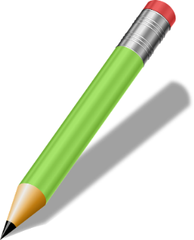
Extension
Make a list of the features that you have seen that you would carry forward into your own hoverboard design.
Explain in detail why you have chosen these features.

