Slide 1
Investigating Problems Faced by People in Remote Areas
Considering the social implications

Slide 2
Stay safe
Whether you are a scientist researching a new medicine or an engineer solving climate change, safety always comes first. An adult must always be around and supervising when doing this activity. You are responsible for:
ensuring that any equipment used for this activity is in good working condition
behaving sensibly and following any safety instructions so as not to hurt or injure yourself or others
Please note that in the absence of any negligence or other breach of duty by us, this activity is carried out at your own risk. It is important to take extra care at the stages marked with this symbol: ⚠

Slide 3
What is a remote area?
On a post-it note, write down what you understand by the term ‘remote area’.
Write down at least one example of a place that you consider to be ‘remote’.
Place your answers on the whiteboard.
Notes:
Discuss responses with the class.

Slide 4
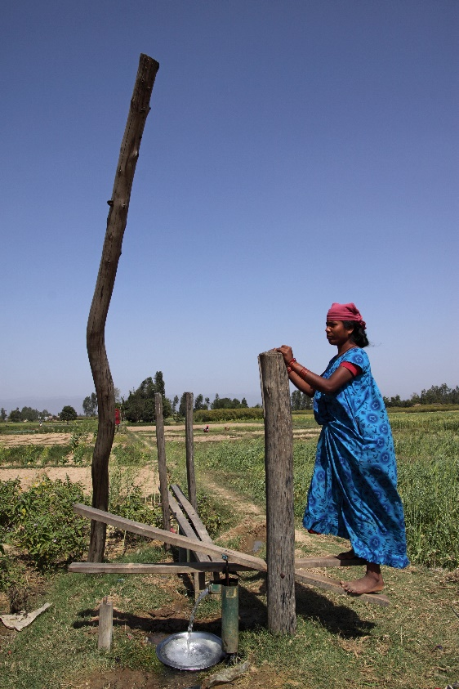
Living in remote areas
Ganesh is a 22 year old living in a remote Nepal village.
She belongs to the lowest caste in the Nepali system, the Dalits.
Her village has no access to mains electricity and water must be sourced from local wells.
In pairs, discuss and make a list of the challenges and problems that she might face in her daily life.
Notes:
Image credit: Anna de la Vega (photographer), Practical Action https://practicalaction.org/

Slide 5
Product ideas
Complete a spider chart of product ideas that could help to solve one or more of the problems that you have identified.

Slide 6
Spider chart

