Slide 1
Understanding Ergonomics and Anthropometrics
Measuring sizes of hands

Slide 2
Stay safe
Whether you are a scientist researching a new medicine or an engineer solving climate change, safety always comes first. An adult must always be around and supervising when doing this activity. You are responsible for:
ensuring that any equipment used for this activity is in good working condition
behaving sensibly and following any safety instructions so as not to hurt or injure yourself or others
Please note that in the absence of any negligence or other breach of duty by us, this activity is carried out at your own risk. It is important to take extra care at the stages marked with this symbol: ⚠

Slide 3
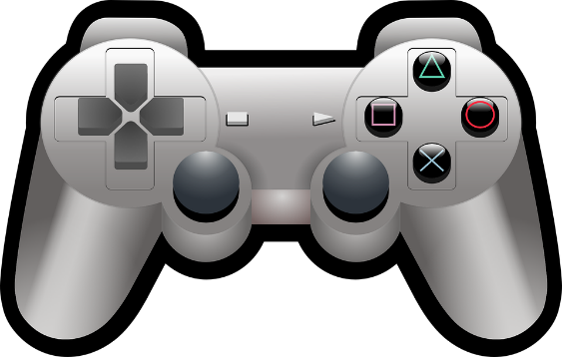
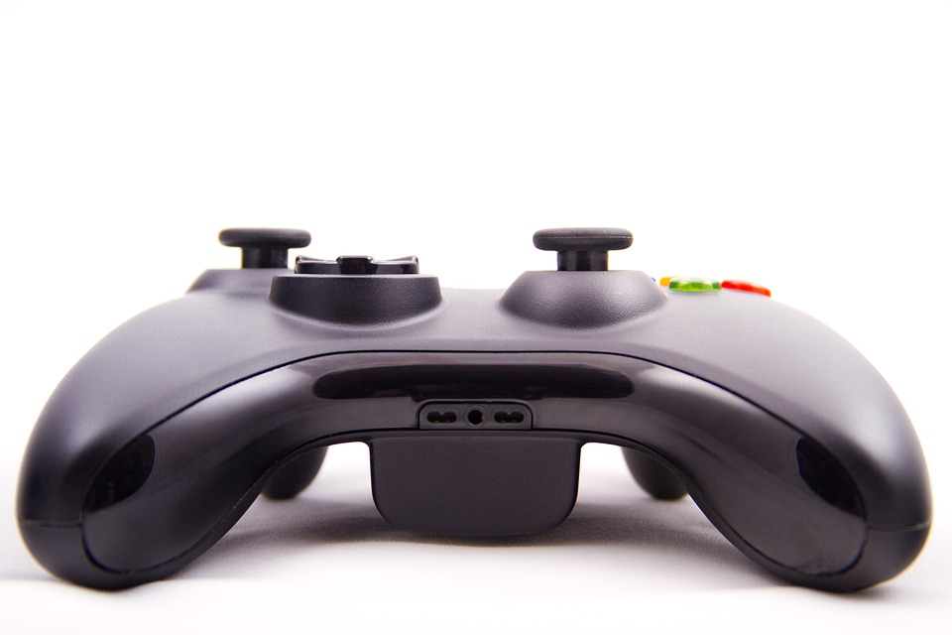
What is ergonomics?
Ergonomics is the study of how efficiently and comfortably people can interact with products and systems.
It is often referred to as ‘human factors’ or the relationship between people and products.
For example, a computer games controller is designed to fit comfortably in the hand.
Notes:
Teacher could show a games controller or other example of ergonomic design and pass round the class. A discussion could then be held about what features are included to make it ergonomic.

Slide 4
What is anthropometric data?
Anthropometrics is the consideration of the sizes of people, so that products can be effectively designed.
Anthropometric data is a collection of measurements of people that is presented in tables and available for designers to use.
For example, hand, feet and head sizes.
When designing a firefighters’ helmet, average adult head sizes would need to be considered.

Slide 5
Measuring hand sizes
You are now going to take your own anthropometric measurements.
Data that is taken directly by the designer is called primary data.
Measure the length and width of the dominant hands of 10 people aged 60+.
Calculate the total length and width and the mean average of each.
Width
Length
Notes:
If doing as a standalone activity the measurements can be of any 10 people, such as 10 members of the class. If this is to be used as an introductory activity for ‘Designing an Ergonomic Shopping Bag Holder’ then ideally these measurements should be from people aged 60+. This could be done by visiting a local residential home or set as a homework activity. Learners could be placed in groups with each measuring the hand sizes of grandparents or other relatives to produce the overall data. If it is not possible to gather data for this age group then separate data can be provided for the follow up activity, with the data gathered here used as an example/rough guide. To ensure all measurements taken are comparable, all people having their hand measured should form it in the shape shown above.

Slide 6
Recording data – dominant hand sizes
Person number | Length of hand (mm) | Width of hand (mm)
1)
2)
3)
4)
5)
6)
7)
8)
9)
10)
Total
Mean
Width
Length
Notes:
Measurements should be taken for the person’s dominant hand. So, if they are right handed this would be their right hand, or left handed it would be their left hand.

Slide 7
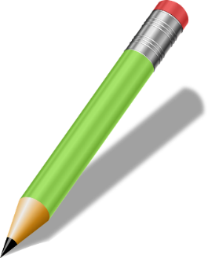
Extension
Present the data that you have gathered in the form of a bar chart.
Notes:
This could be done using spreadsheet software or produced by hand.

