Slide 1
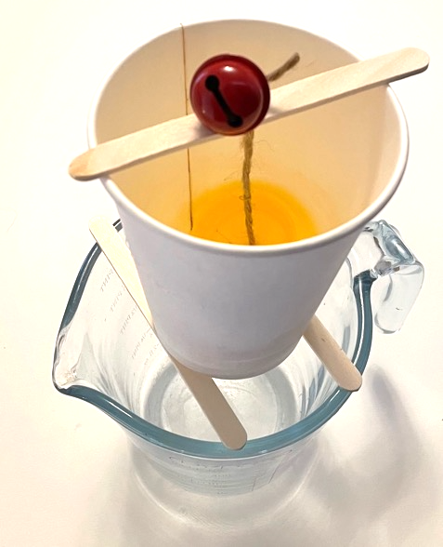
Measure time with a water clock
How to make a water clock that measures time
Notes:
This clock works on the principle that the cap floats on the water. As the water level drops the cap pulls the bell off the stick, making a sound.

Slide 2
Stay safe
Whether you are a scientist researching a new medicine or an engineer solving climate change, safety always comes first. An adult must always be around and supervising when doing this activity. You are responsible for:
ensuring that any equipment used for this activity is in good working condition
behaving sensibly and following any safety instructions so as not to hurt or injure yourself or others
Please note that in the absence of any negligence or other breach of duty by us, this activity is carried out at your own risk. It is important to take extra care at the stages marked with this symbol: ⚠

Slide 3
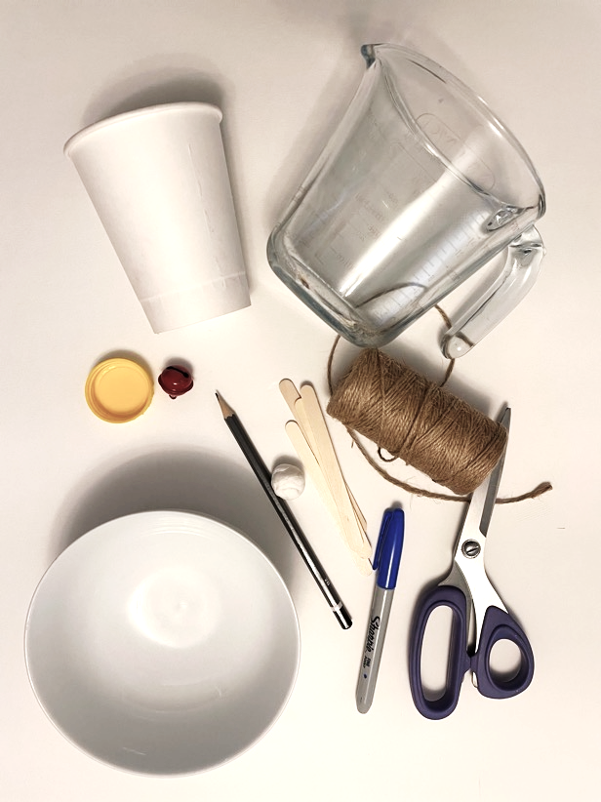
Equipment and Resources
Disposable card / paper cup
Pencil and pen
Scissors
String
Measuring jug
Modelling clay
Water
Three craft (lollipop) sticks
Plastic bottle top
Small bell

Slide 4
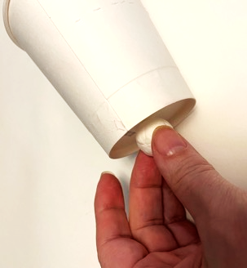
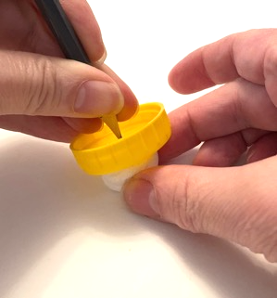
Making holes
Use a sharp pencil to make small holes in the bottom of the paper cup and the plastic cap
Put the modelling clay on the outside and press the pencil through the cup into the clay
Using the same method, make a small hole in the middle of the plastic cap

Slide 5
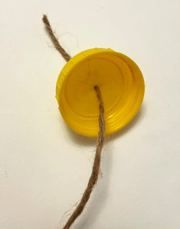
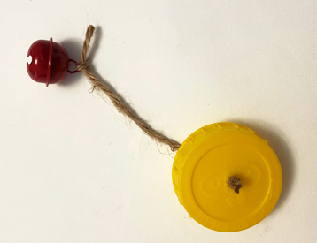
Make your water clock
Thread a length of string through the hole in the cap
Knot the string to hold the cap in place
Thread on the bell and knot in place

Slide 6
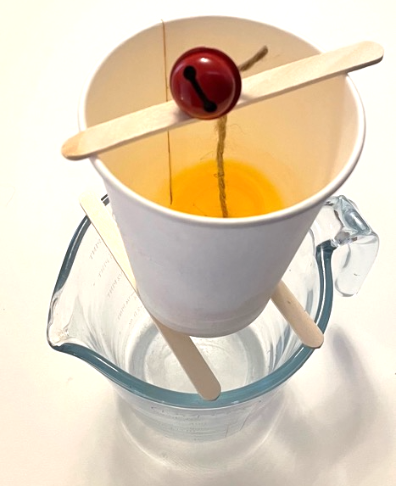
Getting ready to use your water clock
Measure out 100 mls of water
Balance your cup over a collection bowl
Carefully balance the bell on one of your lollipop sticks

Slide 7
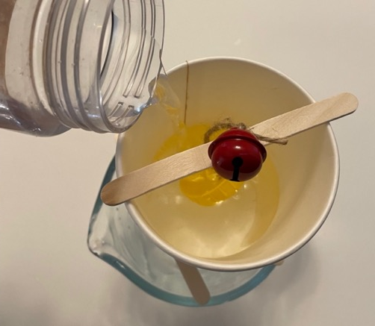
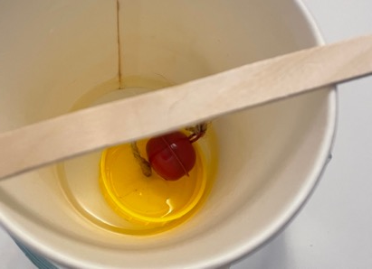
Getting ready to use your water clock
Pour in the water to the cup – be careful not to pour it into the plastic cap
Immediately start a stopwatch
Time how long it takes before the bell falls into the cup
Repeat the measurement at least three times!
Notes:
This clock works on the principle that the cap floats on the water. As the water level drops the cap pulls the bell off the stick, making a sound.

Slide 8
Additional experiments
This clock takes 3 minutes and 23 seconds using 100mls of water
How could you use this clock to measure different times?
What happens if you:
Increase the quantity of water?
Make the hole in the cup bigger?
Make the length of string shorter or longer?

