Slide 1
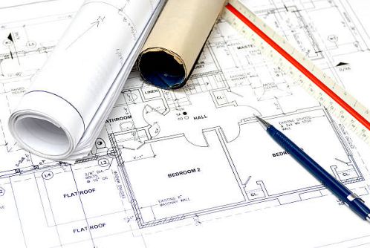
Ancient Greek mathematics
Working with scale to produce a drawing

Slide 2
Stay safe
Whether you are a scientist researching a new medicine or an engineer solving climate change, safety always comes first. An adult must always be around and supervising when doing this activity. You are responsible for:
ensuring that any equipment used for this activity is in good working condition
behaving sensibly and following any safety instructions so as not to hurt or injure yourself or others
Please note that in the absence of any negligence or other breach of duty by us, this activity is carried out at your own risk. It is important to take extra care at the stages marked with this symbol: ⚠

Slide 3
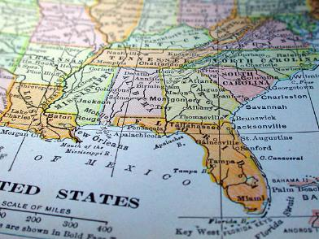
What is scale?
Most maps and drawings show things smaller than real life
To draw this map full size you would need a really big piece of paper!

Slide 4
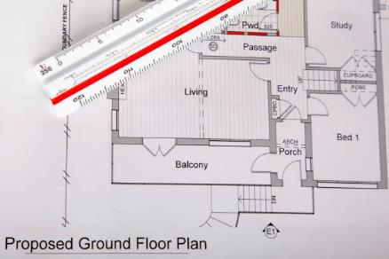
Where else is scale used?
Scale is used when drawing buildings and houses
This means the drawing can fit on a piece of paper easily

Slide 5
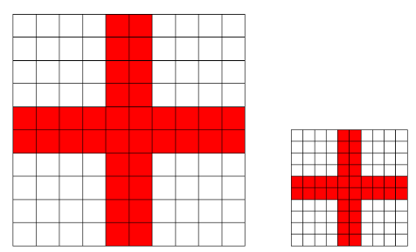
Show me an example!
10cm
The scale here is written 1:2
5cm
The drawing is made smaller
2cm in the big drawing is the same as 1cm in the smaller one

Slide 6
Equipment and Resources
You will need:
Ruler
Pencil
Worksheet
Calculator

Slide 7
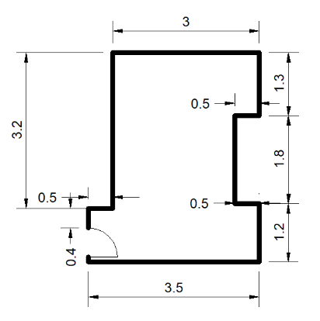
Try this…
This is a plan of Maisie’s bedroom drawn with sizes in metres
Can you draw this to a scale of 1:50
1cm in your drawing = 50cm in real life

Slide 8
If you need some help…

Slide 9
Now do this…
Measure each wall in your classroom
Create a sketch plan of the room
Add doors and windows as below
Can you add furniture too?
Task
Can you draw your classroom to scale of 1:50?
Door (open)
Window

