Slide 1
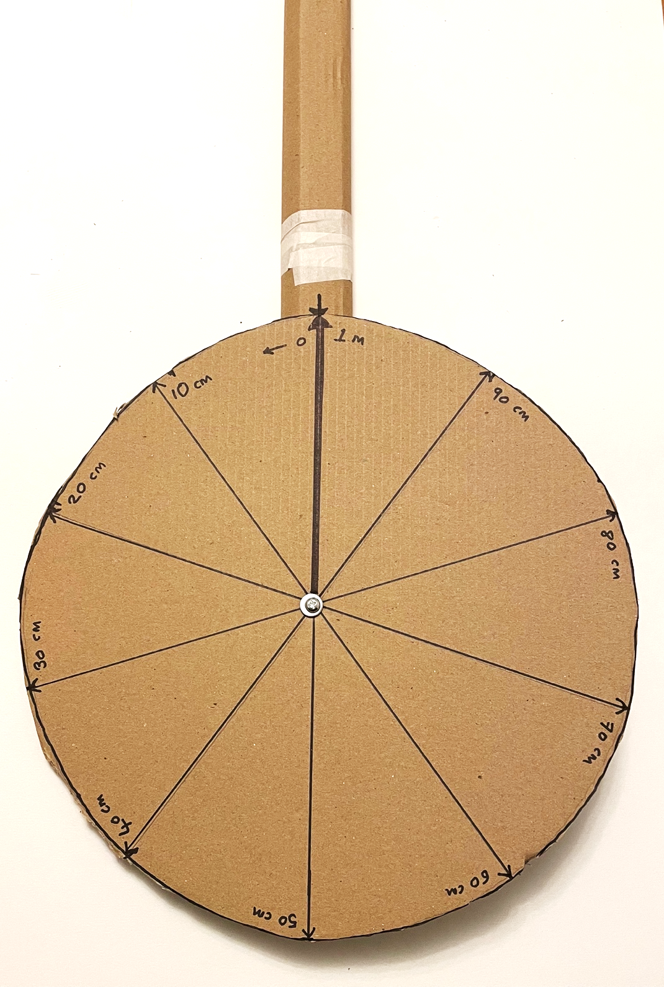
Measure distance
How to make a wheel that measures distances

Slide 2
Stay safe
Whether you are a scientist researching a new medicine or an engineer solving climate change, safety always comes first. An adult must always be around and supervising when doing this activity. You are responsible for:
ensuring that any equipment used for this activity is in good working condition
behaving sensibly and following any safety instructions so as not to hurt or injure yourself or others
Please note that in the absence of any negligence or other breach of duty by us, this activity is carried out at your own risk. It is important to take extra care at the stages marked with this symbol: ⚠

Slide 3
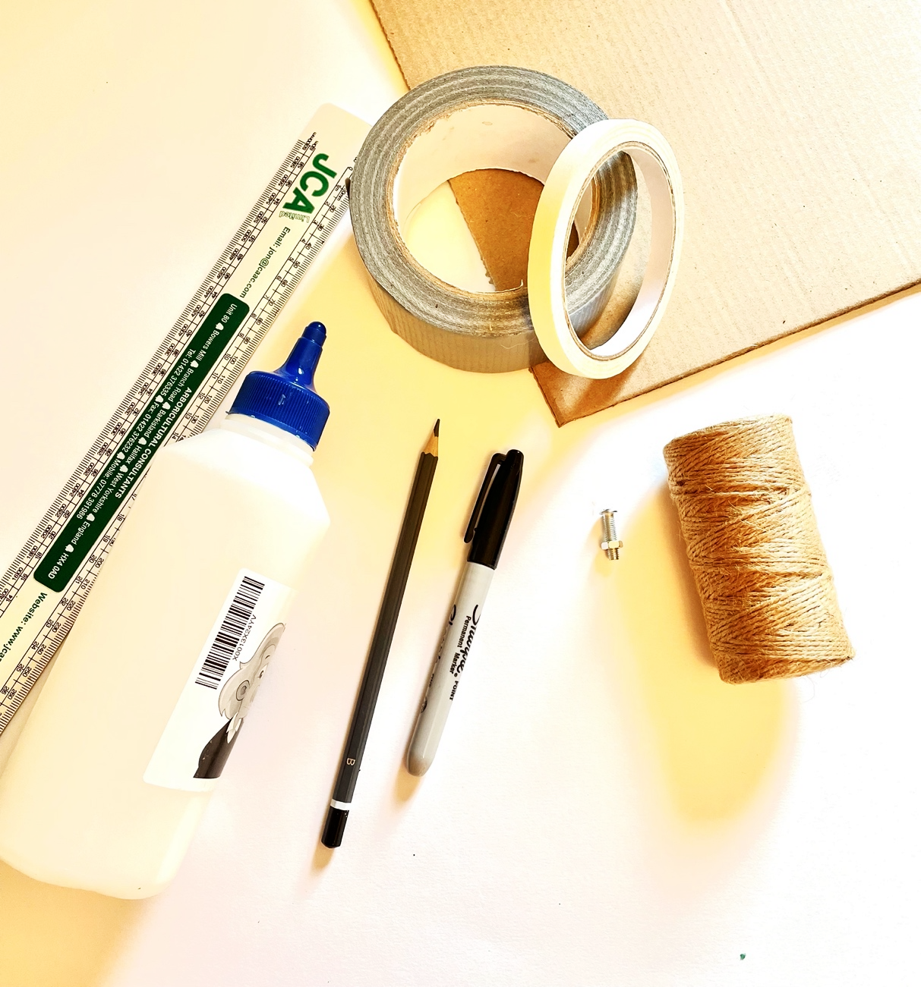
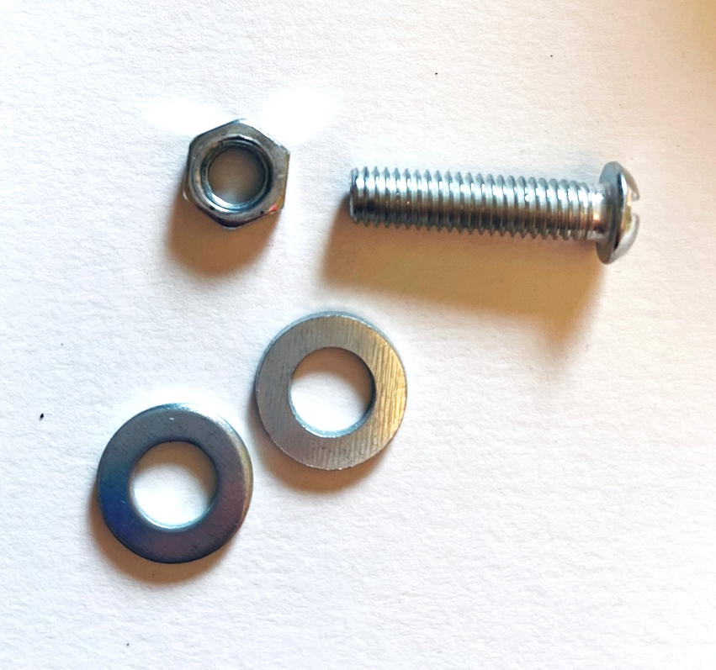
Equipment and Resources
Cardboard
Pencil and pens
Ruler
Scissors
Tape and PVA glue
Large bolt and washers
String
Modelling clay

Slide 4
Maths
Your wheel needs to be the exact size so that 1 complete revolution = 1m
The more accurate you are cutting out your wheel, the more accurate your measurements will be
To achieve this, you need to cut out a circle that has a radius of 15.9cm
The diameter needs to be 31.8cm
15.9 cm
31.8 cm

Slide 5
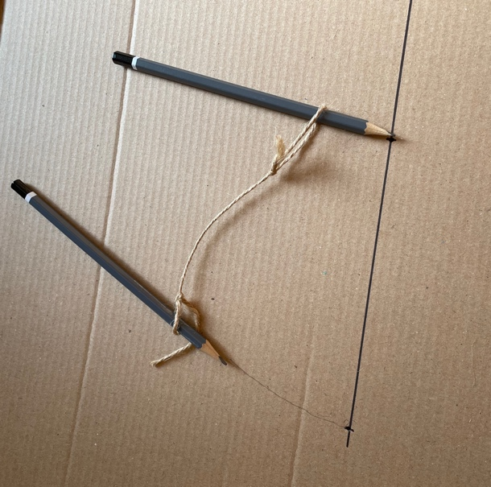
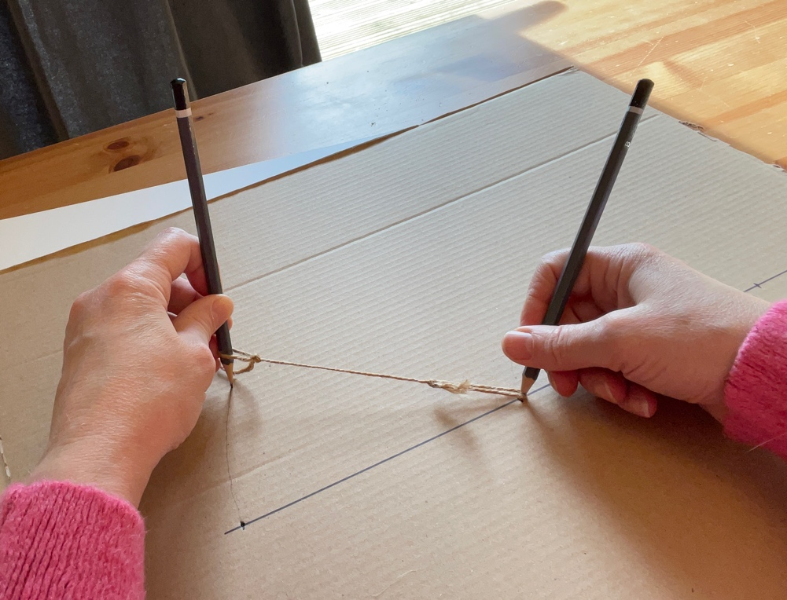
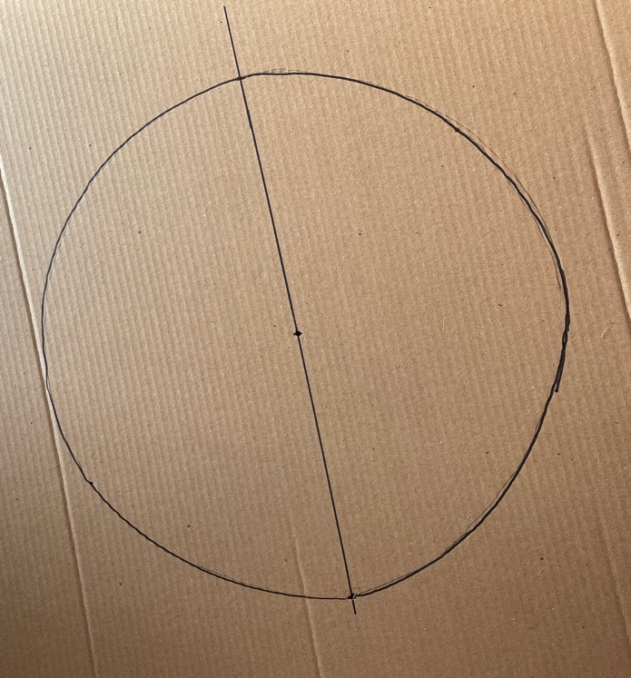
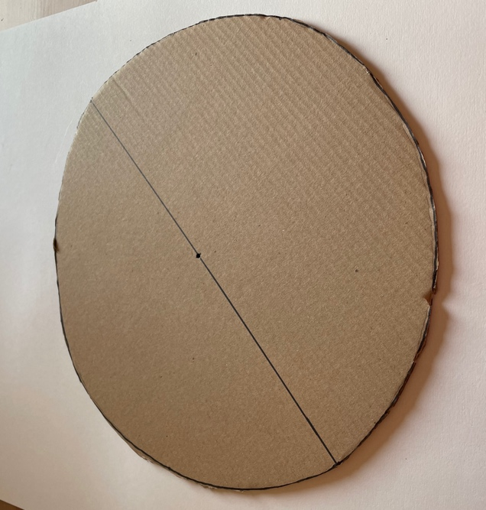
Cut out your wheel
Very carefully mark out your circle
Use the string to make a loop around one of your pencils and measure 15.9cm to form another loop
Place one pencil in the centre of the card, mark your centre point, pull the string tight and draw a circle
Cut your circle out

Slide 6
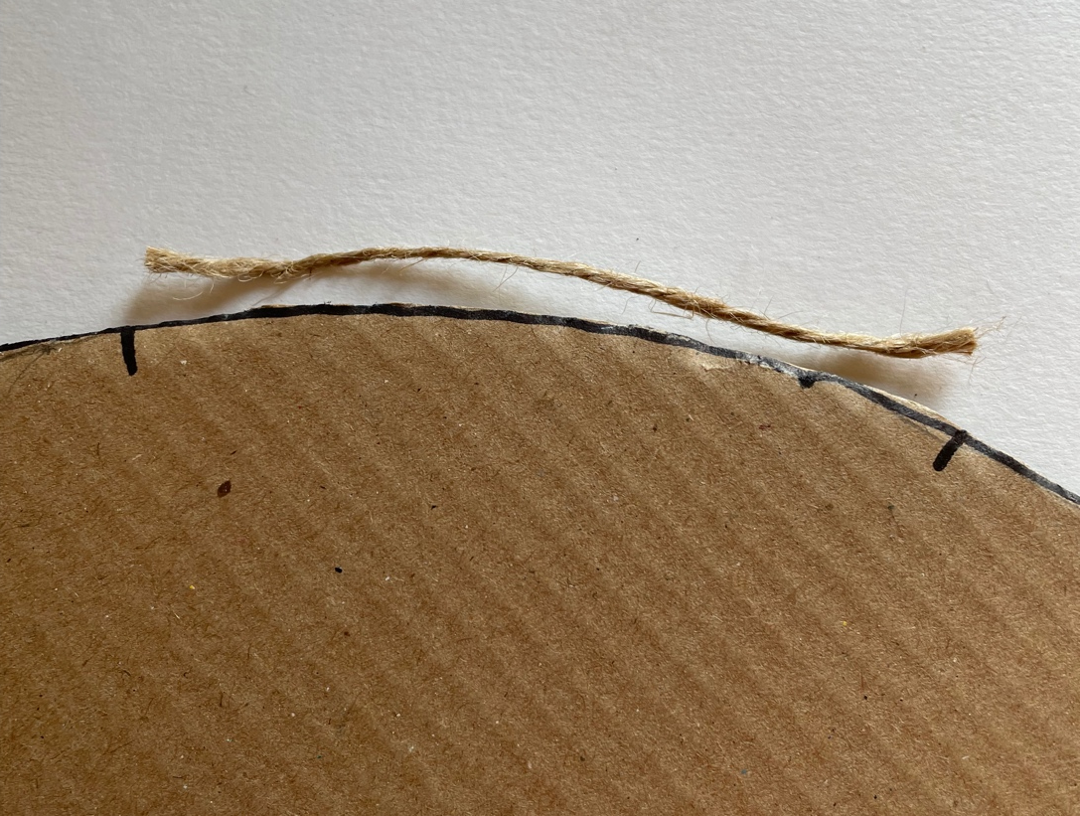
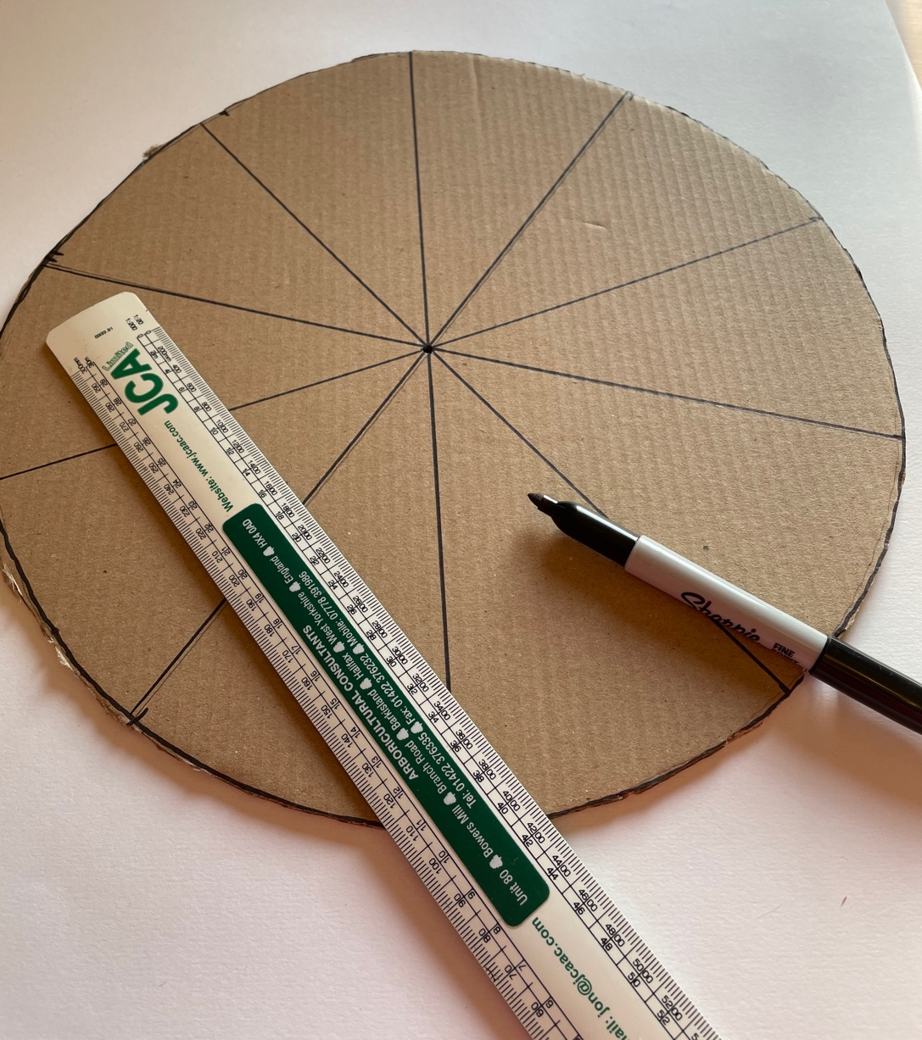
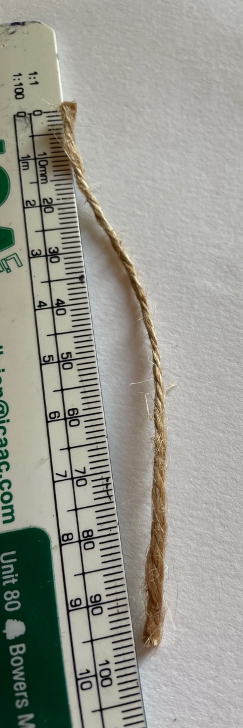
Mark out measurements on your wheel
Cut a piece of string to 10cm
Use the string to mark every 10cm around the edge of your wheel
Use your ruler to join up opposite 10cm marks around the wheel – the lines should go through the centre point

Slide 7
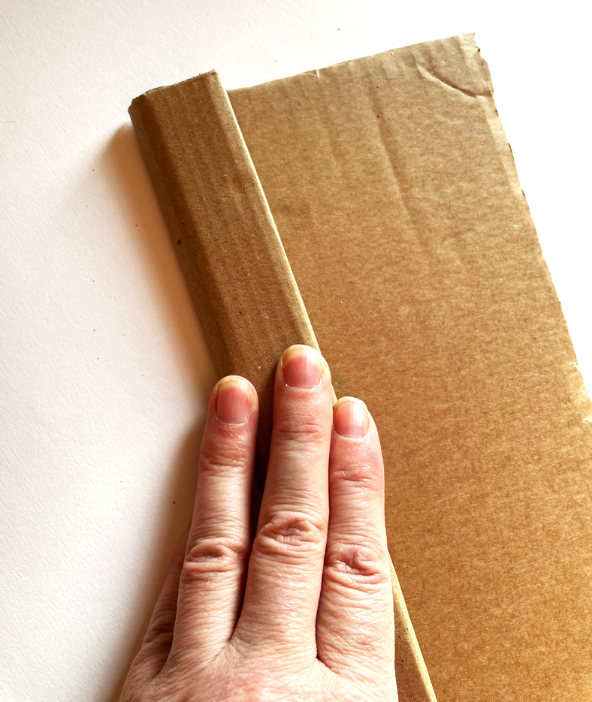
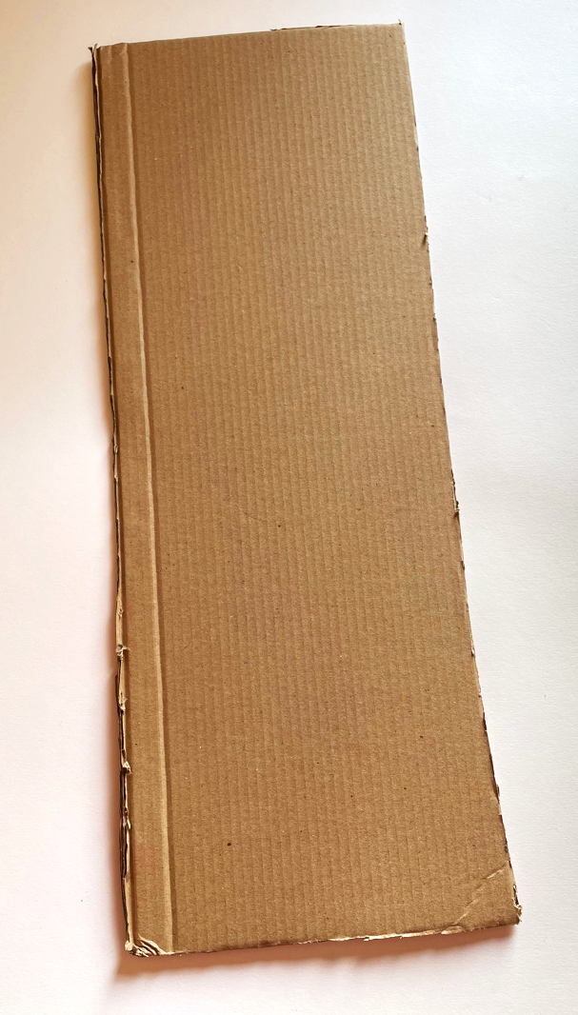
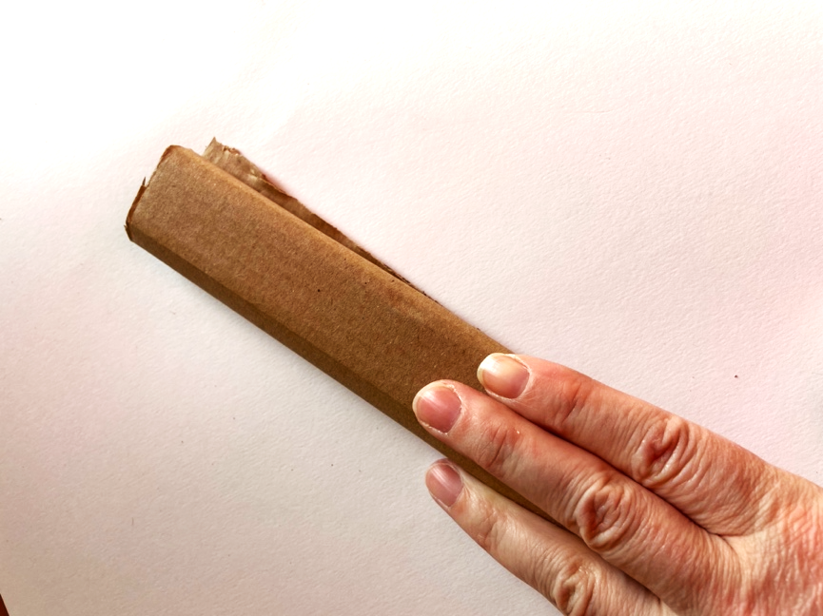
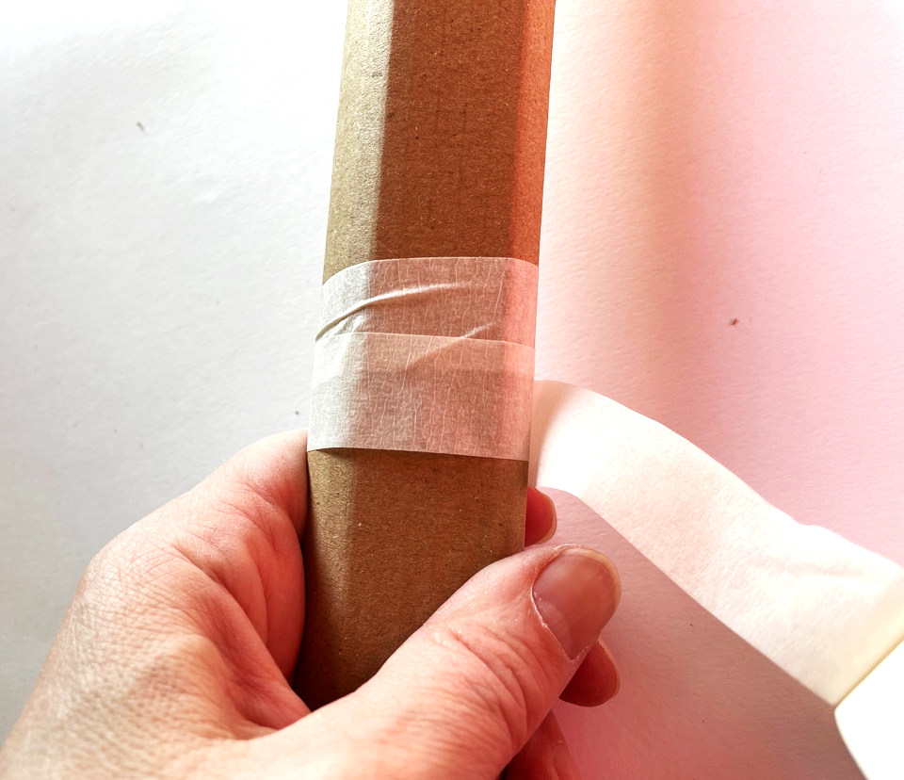
Make the handle
Cut a piece of card (approximately 60cm long x 10cm wide)
Make sure that the ridges in the cardboard follow the length of the card
Fold the cardboard over on itself, using the ridges to help
Once folded use tape to secure tightly

Slide 8
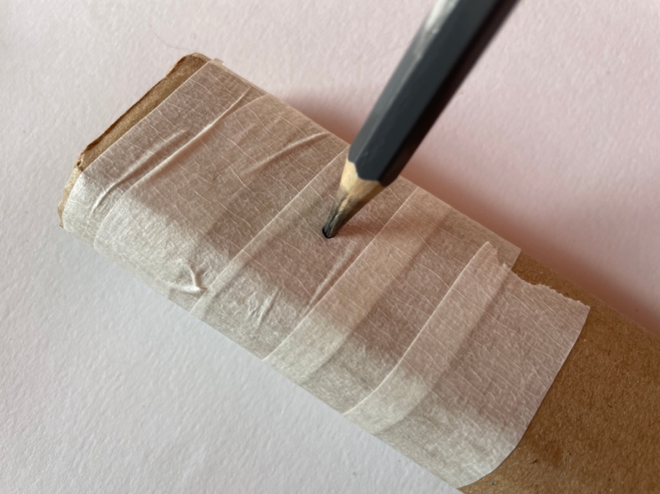
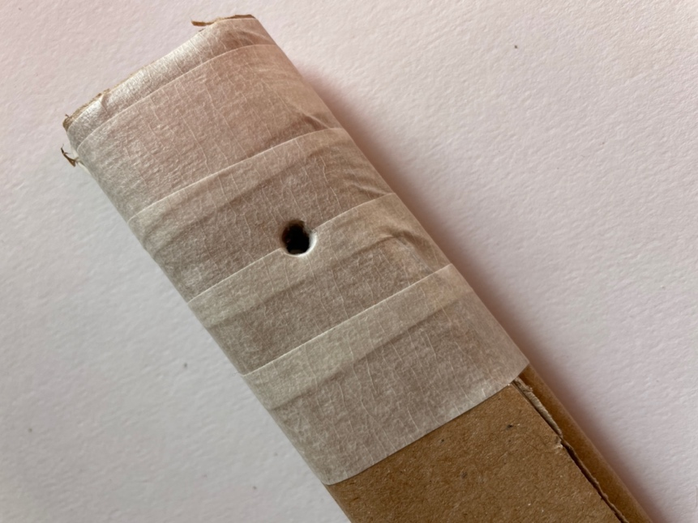
Making a hole in the handle
Put some modelling clay behind the handle
Using a sharp pencil, push into the handle on the opposite side to the clay, to make a hole
You may need to push the pencil from the reverse side to make the hole large enough to thread the bolt through

Slide 9
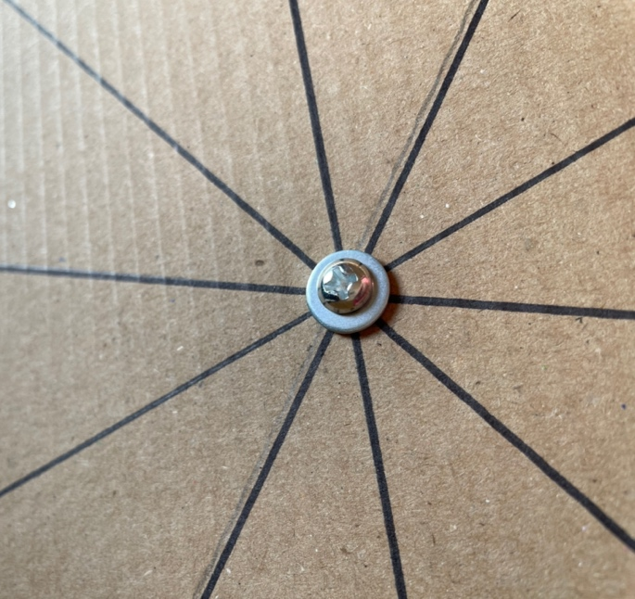
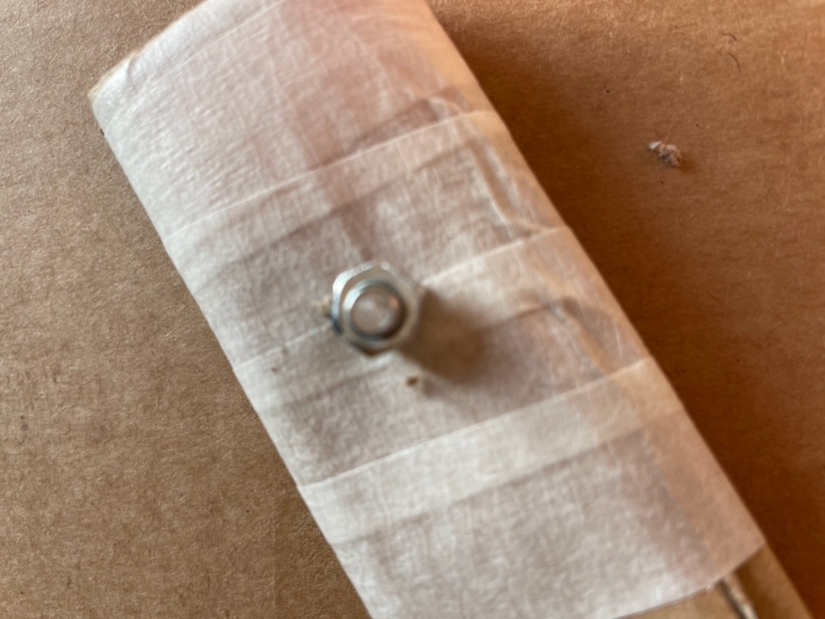
Attach the handle to the wheel
Put a washer onto the bolt then push it through the middle point of your wheel
Put on another washer, then thread through the handle and do up the bolt

Slide 10
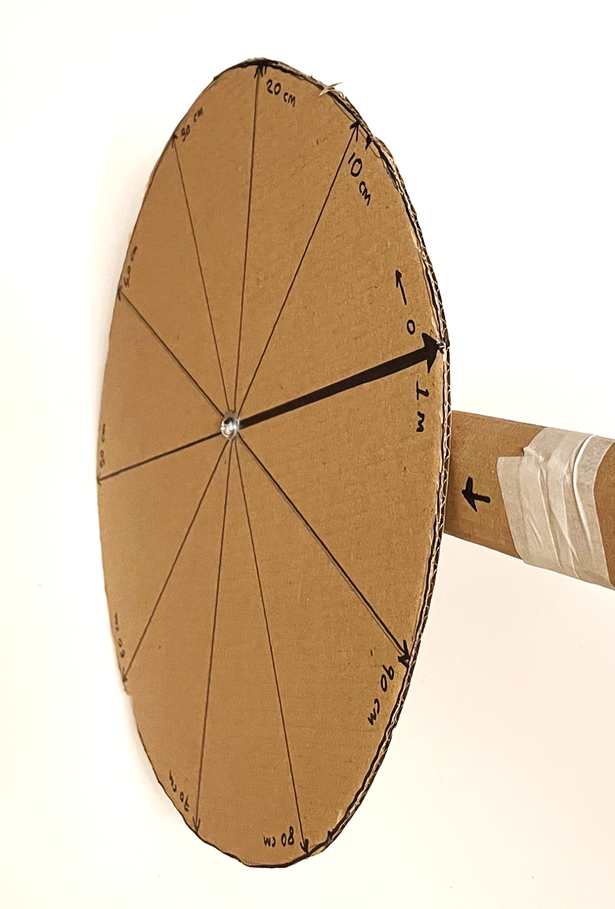
Mark up your wheel
Using your marks around the wheel, add measurements
Add a clear start mark on your handle
Use your wheel by rolling it along the ground. Carefully count the times it passes your top mark and add on the measurement achieved
For example: 3 complete turns and the wheel stopped at 60cm = 3.6m in length

