Slide 1
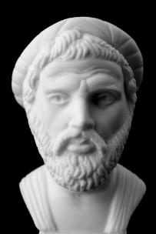
Using Pythagoras Theorem
Making a 3:4:5 string triangle to check if an object is upright

Slide 2
Stay safe
Whether you are a scientist researching a new medicine or an engineer solving climate change, safety always comes first. An adult must always be around and supervising when doing this activity. You are responsible for:
ensuring that any equipment used for this activity is in good working condition
behaving sensibly and following any safety instructions so as not to hurt or injure yourself or others
Please note that in the absence of any negligence or other breach of duty by us, this activity is carried out at your own risk. It is important to take extra care at the stages marked with this symbol: ⚠

Slide 3
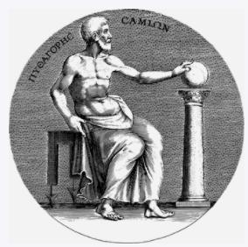
Who was Pythagoras?
Pythagoras lived in ancient Greece, about 2500 years ago
He is best known for using math's to work out the size of triangles
Very little is known about his life – but what he created is still widely used today

Slide 4
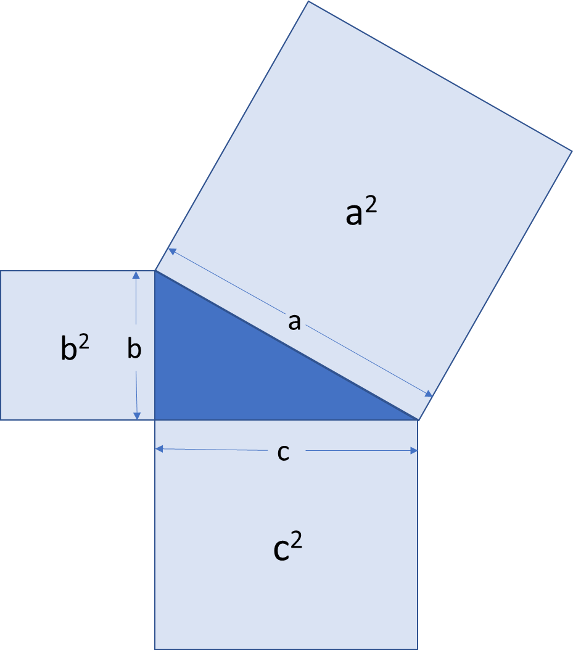
What is Pythagoras Theorem?
Pythagoras theorem is about the sizes of right-angled triangles
When you know the sizes of two sides, you can use it to work out the other

Slide 5
Pythagoras Theorem
Pythagoras' Theorem is:
The square of the hypotenuse is equal to the sum of the squares on the other two sides
a² = b² + c²
From this, we know if the length of the two shorter sides are 3 and 4, then the longest side will be 5
This is often called a 3:4:5 triangle

Slide 6
Equipment and Resources
You will need:
2 nails
Ruler and pencil
A hammer
Piece of wood
Length of string (70cm)
Masking tape

Slide 7
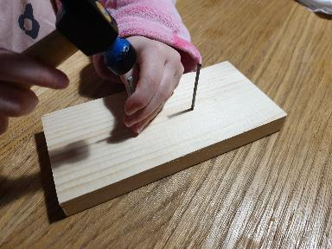
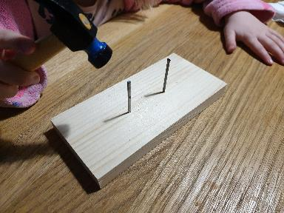
Step 1
Mark two points on the wood, 5 cm apart
Hammer the two nails into the piece of wood until they stick out by about 5cm
Take care not to hit fingers!

Slide 8
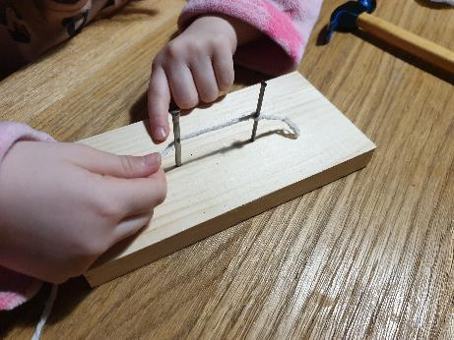
Step 2
Tie one end of the string to the first nail, then tie a knot to the second nail
Ensure the string is kept tight at all times

Slide 9
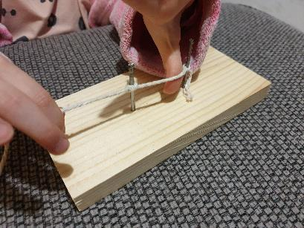
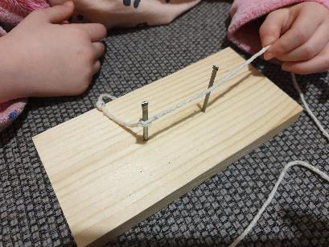
Step 3
Slip the string off the first nail, take the long end of string then tie another knot on the free nail as shown.
First knot
Take off and rotate
First knot

Slide 10
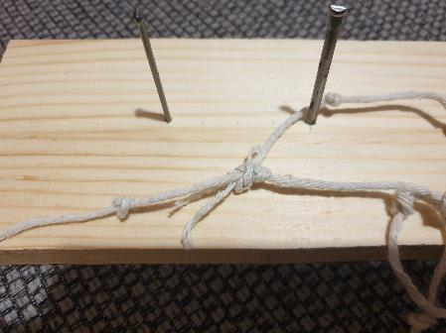
Step 4
Repeat step 3 until you have 12 knots
Tie the ends together keeping the last gap at 5cm as before
Cut off the excess string

Slide 11
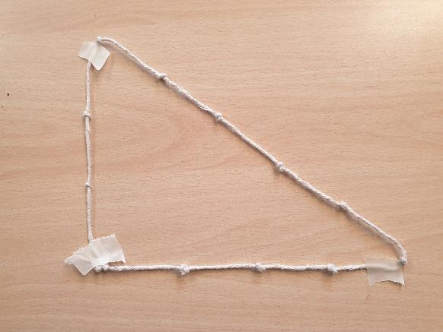
Finished example
5
3
4

Slide 12
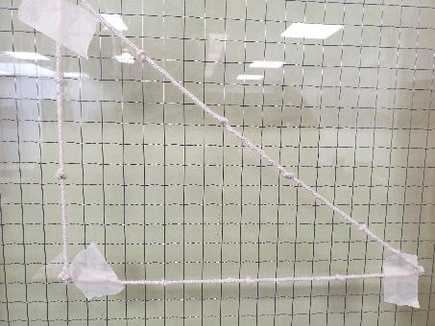
Put it into Practice
Tape your string onto a window – 4 knots at the bottom
Put this edge against the object you want to check

Slide 13
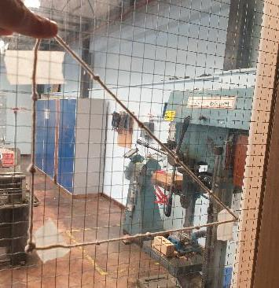
Is the Cupboard Perpendicular to its Base?
String is tight
String against object
String is parallel to the base of the cupboard
Cupboard is Perpendicular ✓

Slide 14
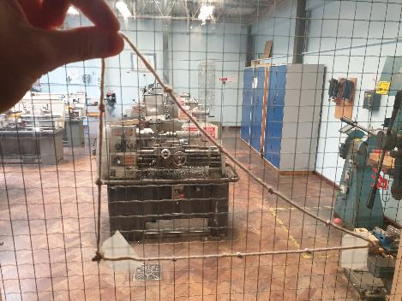
Is the Machine Perpendicular to its Base?
String sagging
String against object
String is parallel to the base of the machine
The edge of the machine is NOT Perpendicular ✗

Slide 15
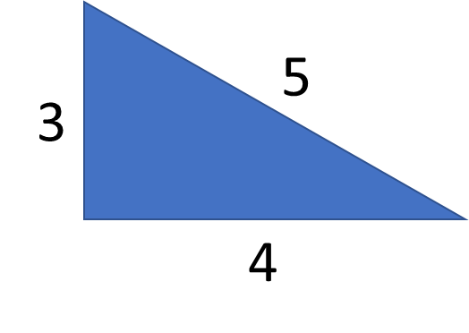
Now do this…
Use your string triangle to check if things you can see are upright
What can you see out of the window that you could check?
Record your results on the work sheet
Task
Stick the string onto a window with the 4 length at the bottom
Object | Perpendicular (✓ or ✗)
Building
Tree
Fence

