Slide 1
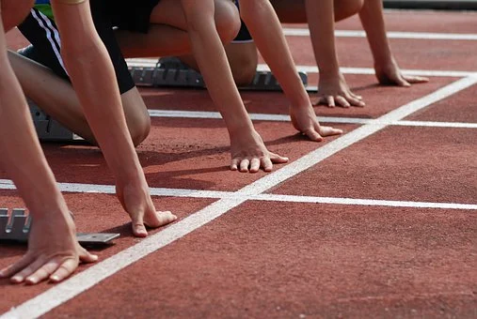
Using time to record
Using timing to record the time taken to complete a set distance

Slide 2
Stay safe
Whether you are a scientist researching a new medicine or an engineer solving climate change, safety always comes first. An adult must always be around and supervising when doing this activity. You are responsible for:
ensuring that any equipment used for this activity is in good working condition
behaving sensibly and following any safety instructions so as not to hurt or injure yourself or others
Please note that in the absence of any negligence or other breach of duty by us, this activity is carried out at your own risk. It is important to take extra care at the stages marked with this symbol: ⚠

Slide 3
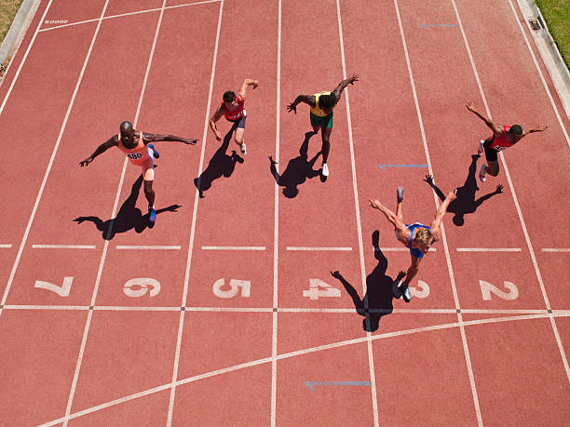
What is timing?
We use timing to see who or what is the fastest …
… or how long something takes
Often used in a running race at the Olympics
The World Record for running 100m is 9.58 seconds

Slide 4
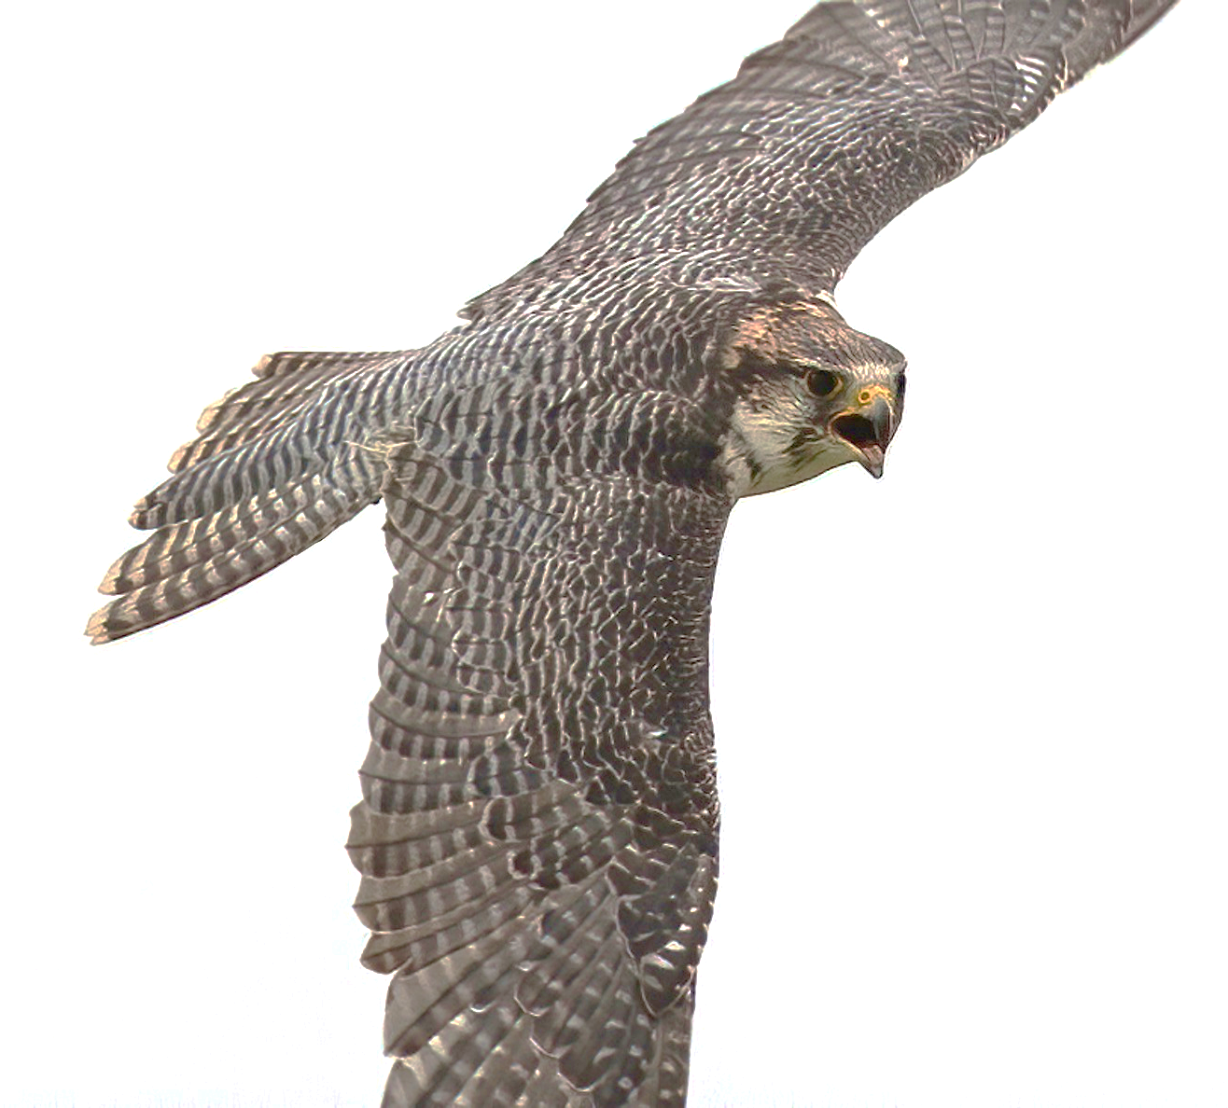
Who is the fastest?
Usain Bolt is the fastest human ever (28 mph)
The Cheetah is the fastest land animal (75mph)
The Peregrine Falcon is the fastest bird (242mph)
MPH means miles per hour and is one way of measuring speed

Slide 5
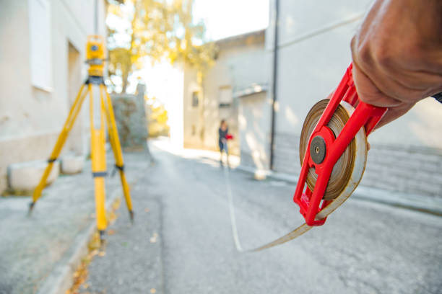
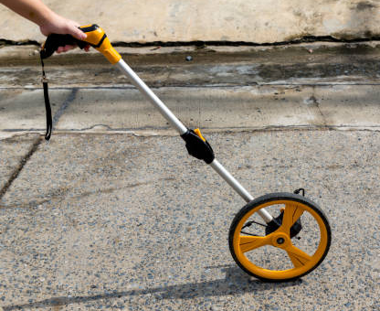
How do we measure distance?
There are lots of ways to measure distance
You could use a tape measure for shorter distances (up to 10m)
An odometer wheel is used for longer distances
Tape measure
Odometer

Slide 6
Equipment and Resources
You will need:
Paper
Pencil
Stop watch or phone timer
Timing worksheet
Measuring device

Slide 7
Race time!!!
You need a space to race
Make a start and a finish line – 10m apart

Slide 8
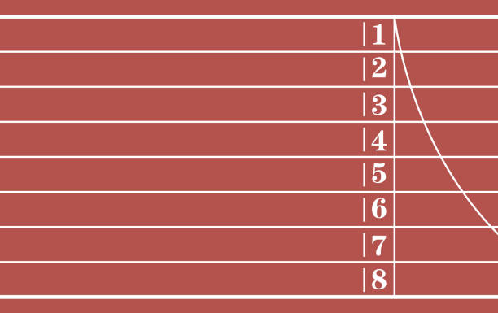
What to do…
10 metres
Run 1 – run 10 m and back (20 m)
Run 2 – run 40 m (there and back twice)
Run 3 – run 60 m
Run 4 – run 80 m
Run 5 – run 100 m

Slide 9
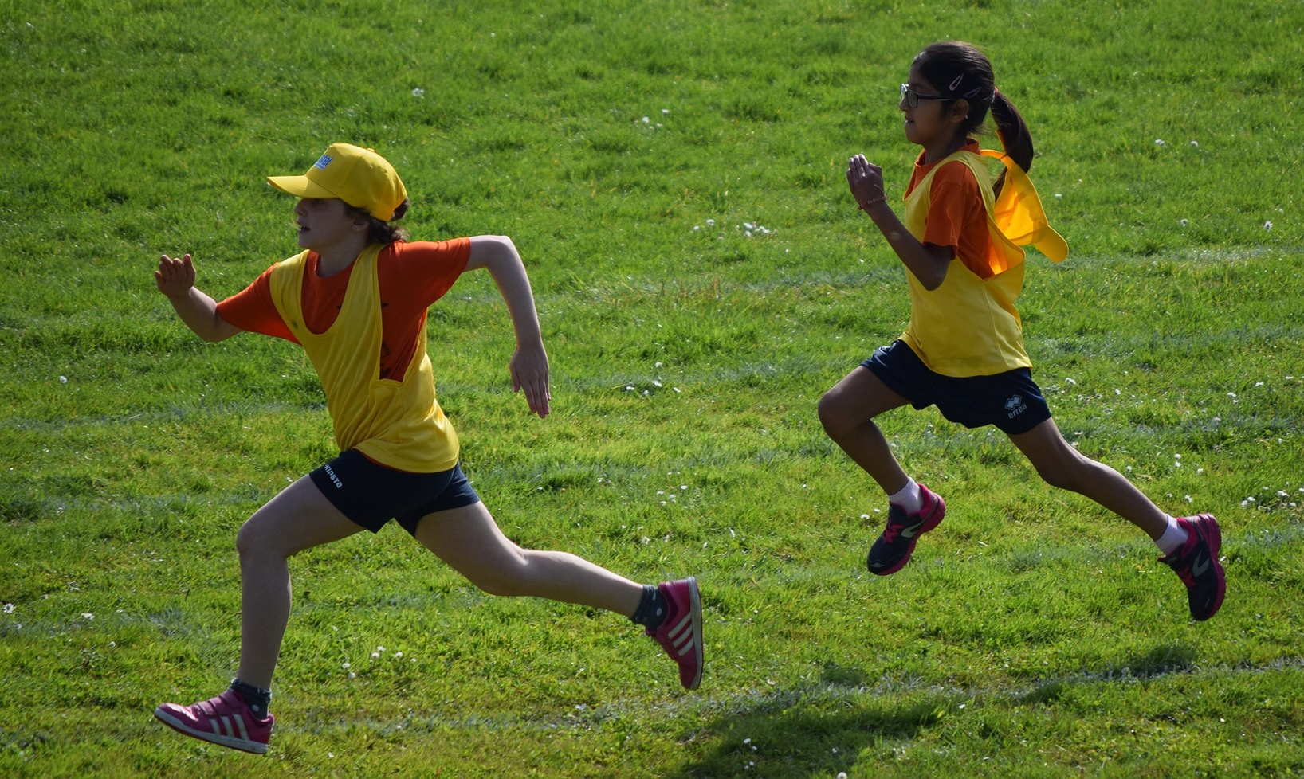
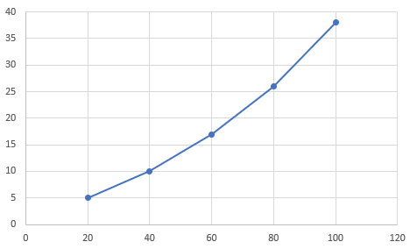
Now do this…
Record each run in seconds
Plot onto a line graph
Are your times a straight line?
Are you getting faster or slower for each extra 20 m?
Why?
Time, seconds
Distance, metres

