Slide 1
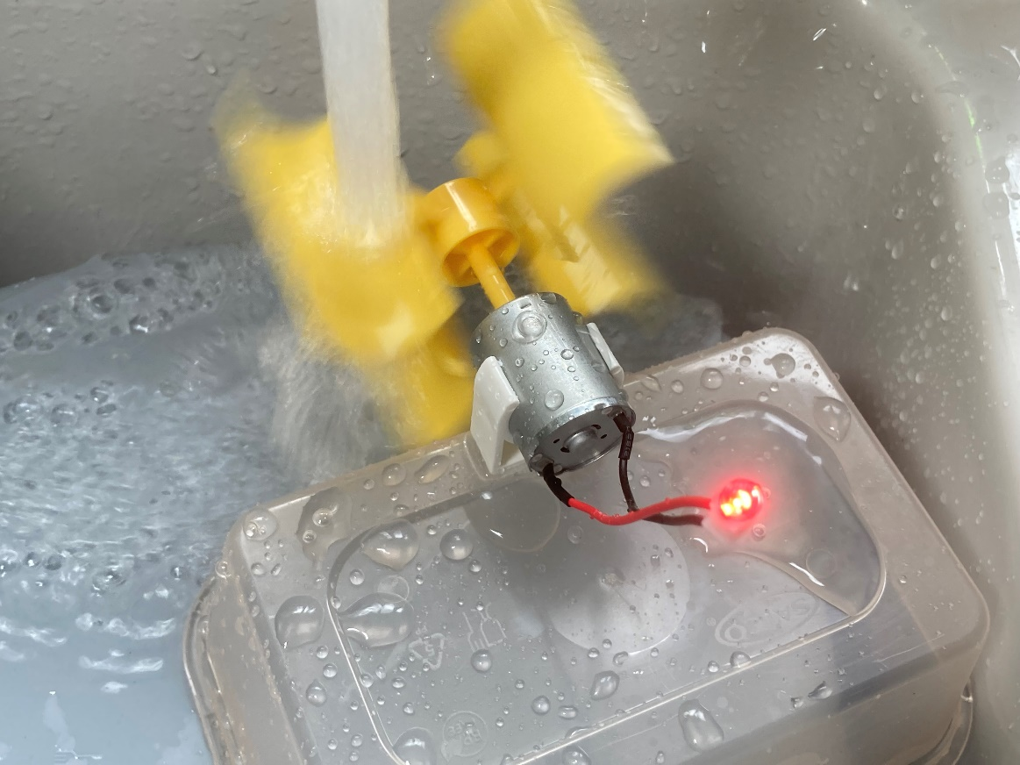
Make a water mill that generates electricity
Making a water mill to produce electricity and power an LED

Slide 2
Stay safe
Whether you are a scientist researching a new medicine or an engineer solving climate change, safety always comes first. An adult must always be around and supervising when doing this activity. You are responsible for:
ensuring that any equipment used for this activity is in good working condition
behaving sensibly and following any safety instructions so as not to hurt or injure yourself or others
Please note that in the absence of any negligence or other breach of duty by us, this activity is carried out at your own risk. It is important to take extra care at the stages marked with this symbol: ⚠

Slide 3
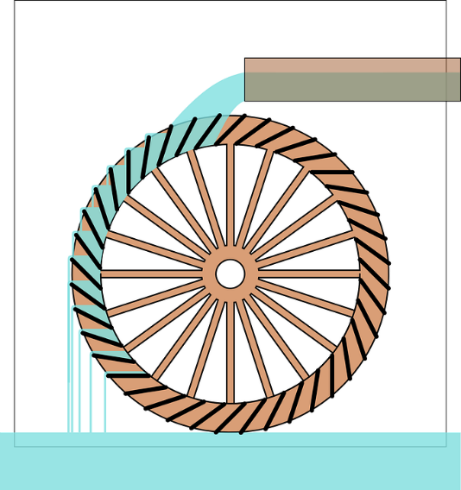
Brief
The ancient Greeks used water mills to grind grain
These days we can use the power of the water to make clean, green electricity!
We are going to make a water wheel that creates enough electricity to make an LED light up when it turns

Slide 4
Equipment and resources
Hi-bright light emitting diodes (LEDs)
Block connectors with two pin connections at either end, or solder and soldering equipment
Insulation tape
Red and black wires or crocodile clips
Small DC generator/motor
Pre-made or purchased turbine blades to attach to the generator
Motor clip/holder
Plastic container
Source of moving water e.g. tap

Slide 5
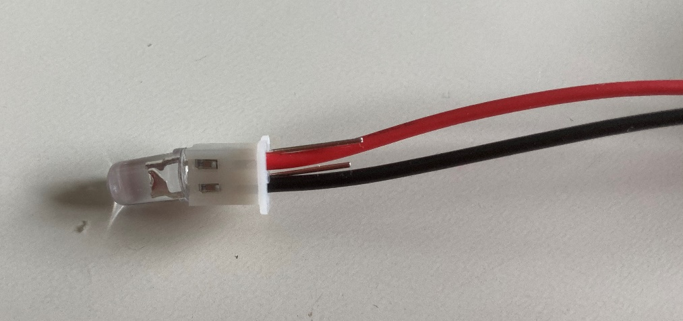
Step 1 ⚠
Block connector
Red wire
Push both legs of the LED into one end of the block connector
Connect a red wire to the long leg of the LED and a black wire to the short leg of the LED through the other end of the block connector
LED
Black wire
Notes:
Instead of a block connector the wires could be soldered to the LED legs if soldering equipment is available. Wires should be cut to an appropriate size either by the learners, or by teachers in advance. Many modern hi-bright LEDs do not require a protective resistor, but some do. This must be checked before assembling the prototype.

Slide 6
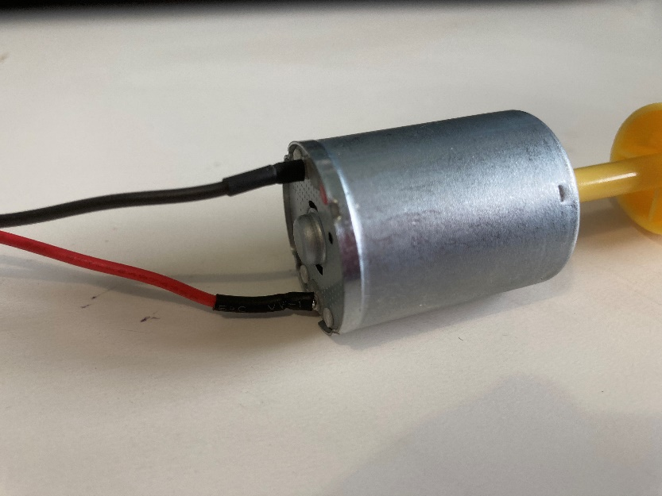
Black wire
Step 2 ⚠
Connect the black wire to the negative leg of the generator
Connect the red wire to the positive leg of the generator
Red wire
Generator
Notes:
Wires can be soldered to the legs of the generator or wrapped around the legs, with insulation tape used to secure them.
Always be careful working with electrical wires.

Slide 7
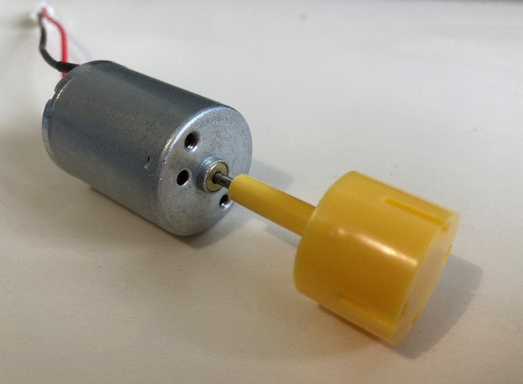
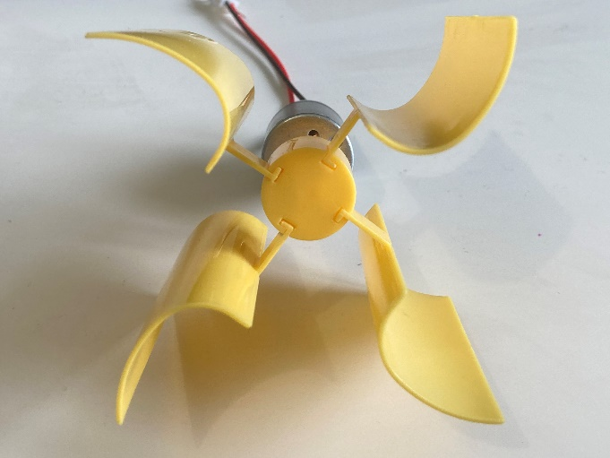
Step 3
Attach the water wheel blades to the generator
Make sure these are secured firmly in place
Notes:
Blades could be pre-produced in advance by the teacher (for example, using a 3D printer, or by cutting quarters from a polymer pipe and attaching to a solid cylinder with an interference-fit hole to push onto the generator), or kits can be purchased from Amazon or Rapid Electronics. The LED should light up when the blades rotate.

Slide 8
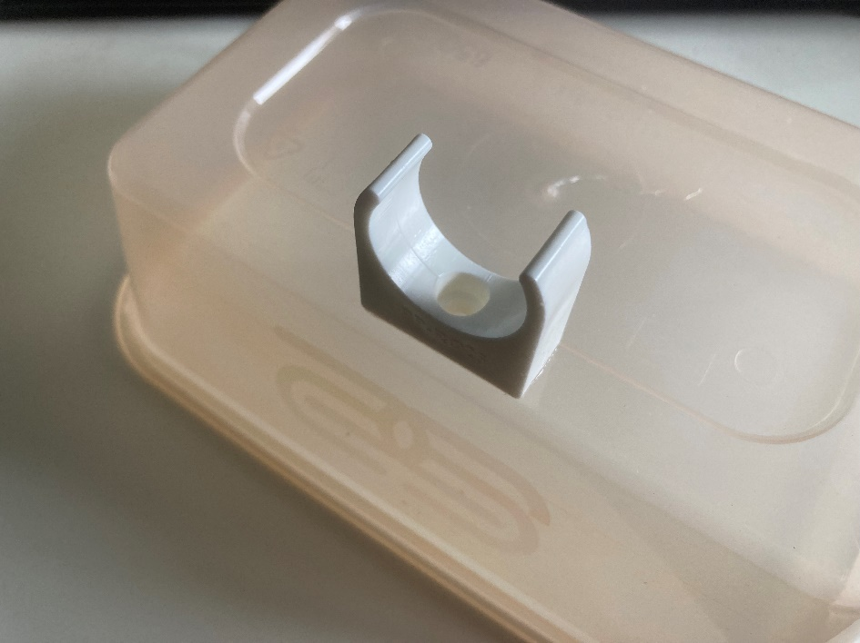
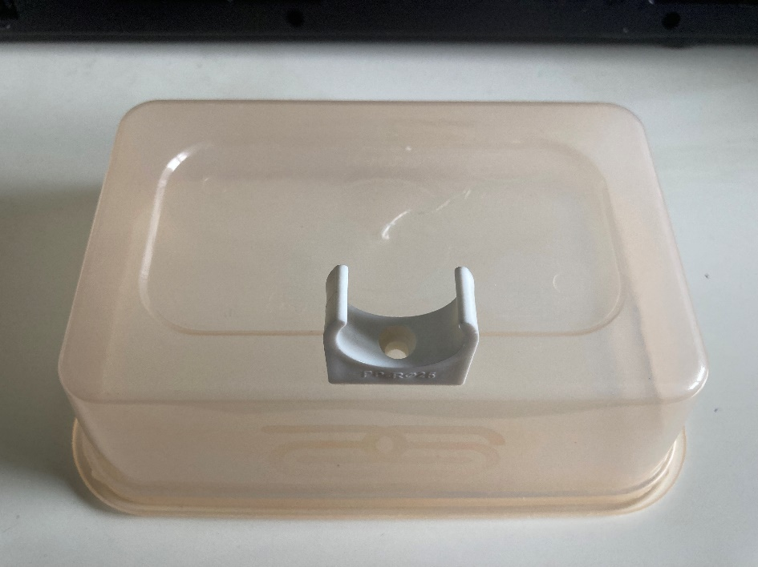
Step 4
Turn the plastic container upside down to create the base
Using the adhesive pad, attach the motor clip as shown
Notes:
Instead of the adhesive pad, any water resistant adhesive suitable for joining plastics will work for this. E.g. super glue or a glue gun.
Take care when using adhesives not to inhale or spill.

Slide 9
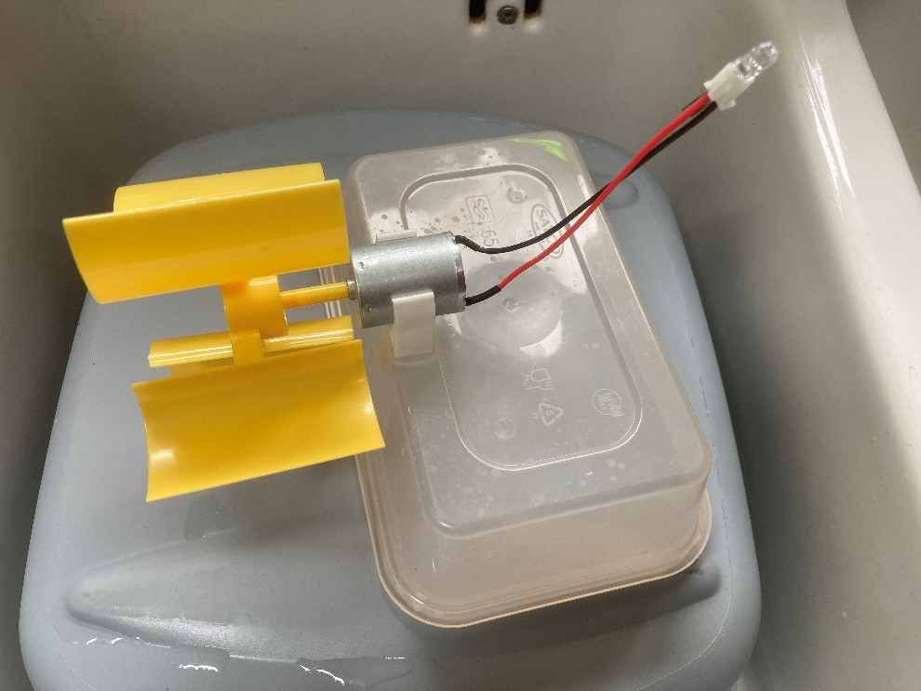
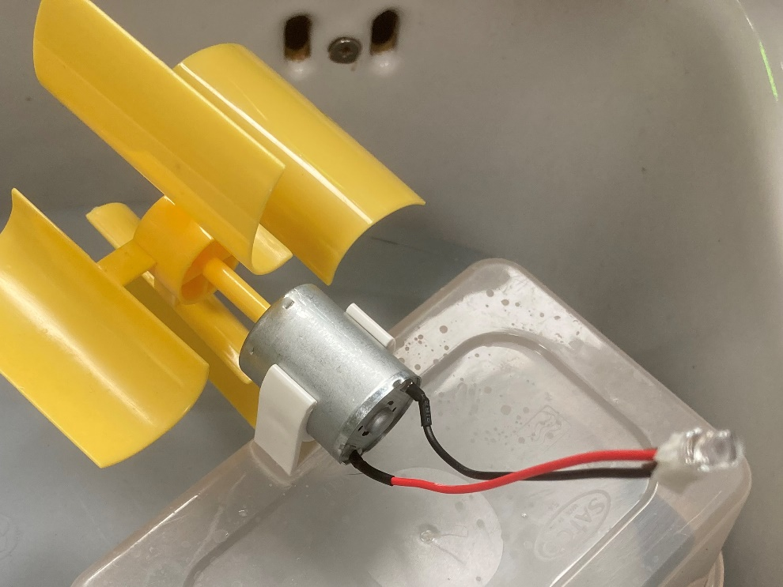
Step 5
Fit the motor to the clip with the water wheel facing outwards from the base

Slide 10
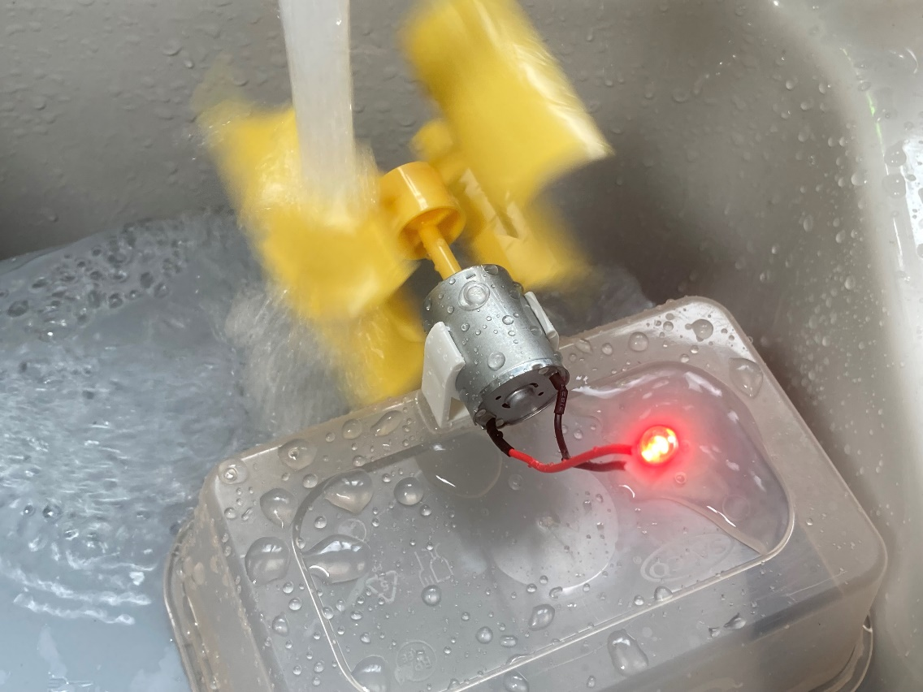
Testing
⚠
Use a tap or other source of running water to test the water mill
The LED should light up as the wheel turns
Notes:
Take care when using water around electricity and electrical circuits! The current produced is less than a small battery and not sufficient to cause a significant shock.

Slide 11
Working water wheel video
Notes:
Take care when using water around electricity and electrical circuits!

Slide 12
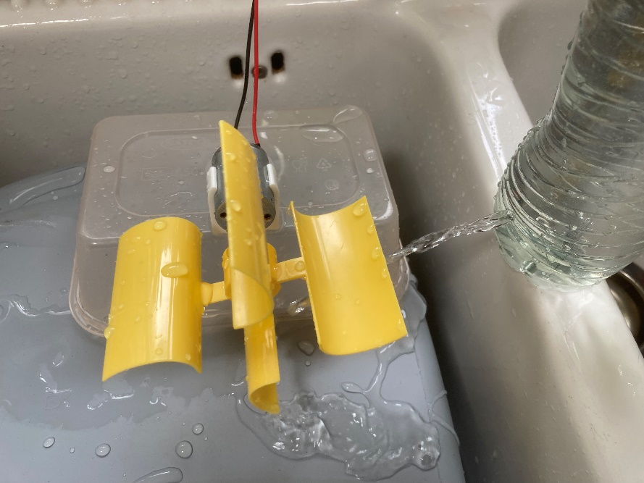
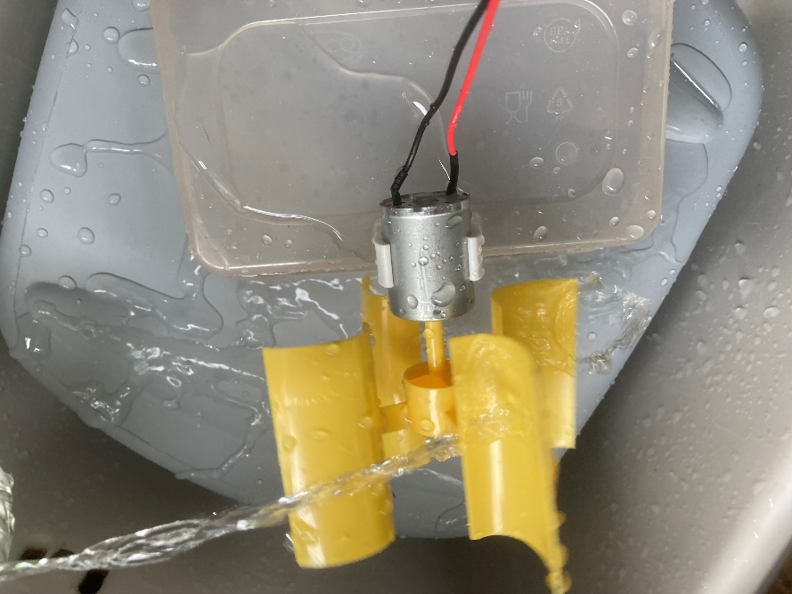
Extension – water supply
Make a hole towards the bottom of a water bottle
Fill it up with water and use it to drive the wheel
You could also make a stand for this
Notes:
The bottle could be topped up periodically to maintain a constant flow at the outlet

