Slide 1
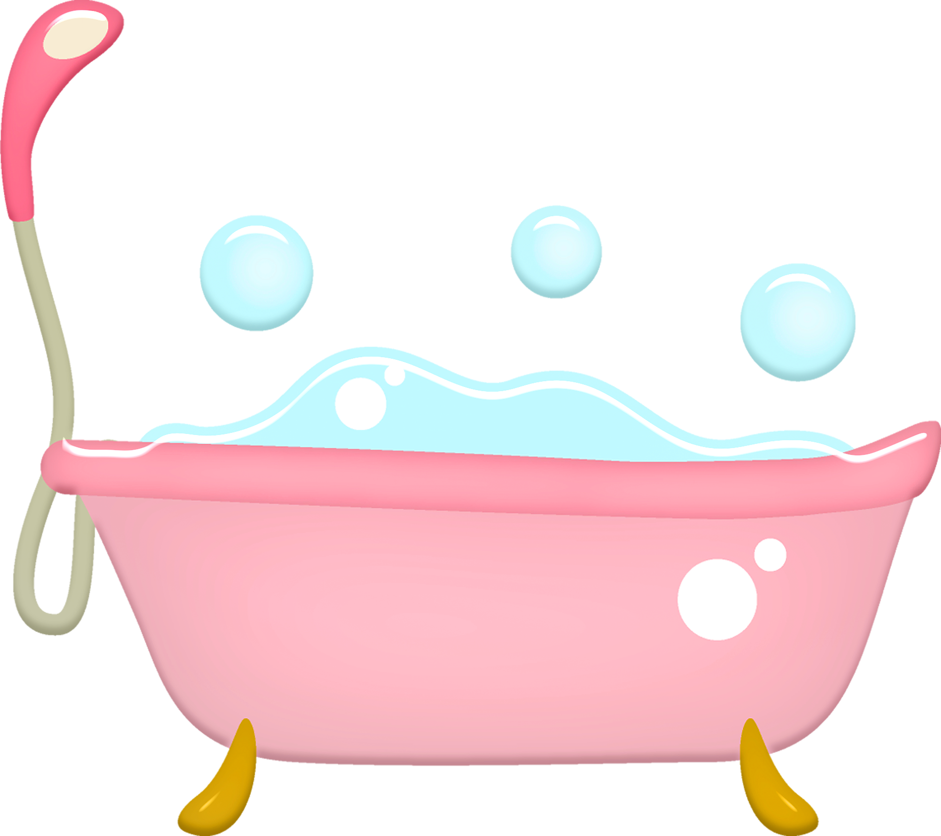
Density using Archimedes principle!
Working out the density of materials

Slide 2
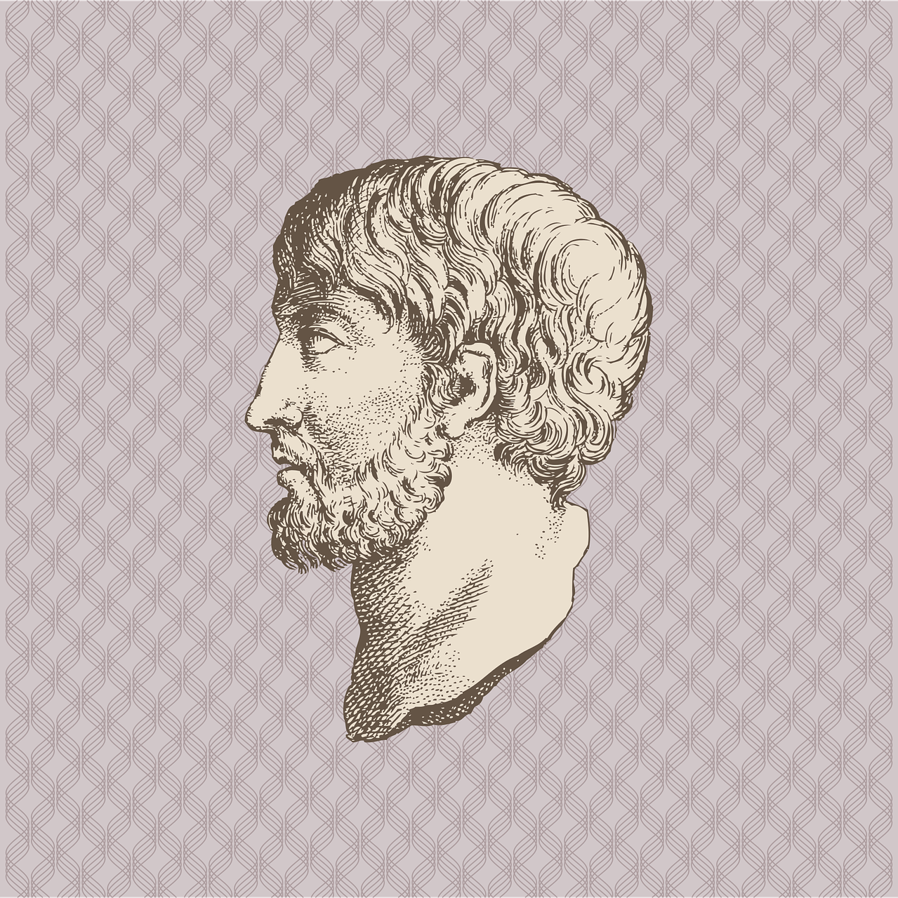
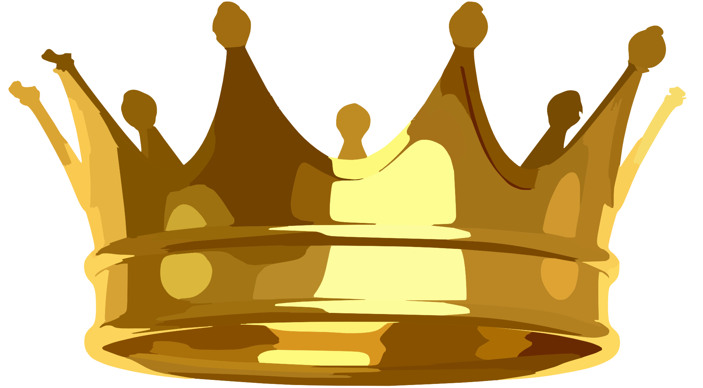
Archimedes and the crown
Archimedes was a very clever man who lived in the city of Syracuse in ancient Greece, about 2200-2300 years ago
The king of Syracuse had a new crown
The craftsman who made it said it was gold – but the king wasn’t sure
The king asked Archimedes to examine the crown to find out – but the shape of the crown made this very difficult
Notes:
Image in top left is Archimedes. The tale of Archimedes and the crown is based on popular rendition and may not necessarily have happened exactly as described!

Slide 3
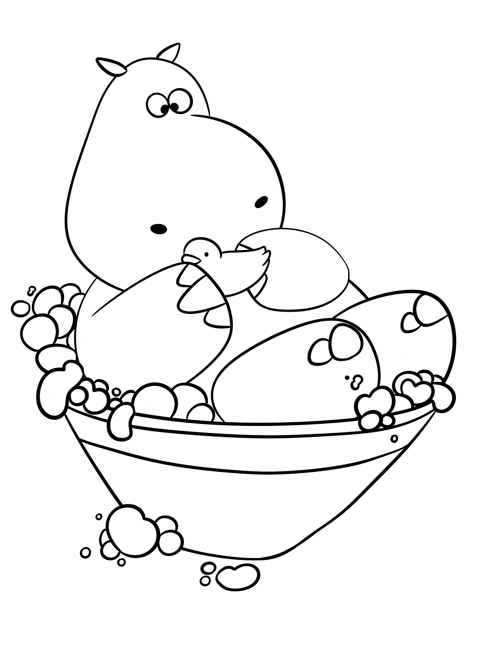
Archimedes and the crown
Archimedes decided to have a bath to think about this
The bath was full to the brim - when he got in, water spilled over the edge!
This gave him an idea for how to work out if the crown was gold! He was so excited that he jumped out of the bath ….
… and ran naked through the streets to see the king, shouting Eureka!
Eureka means ‘I have it’ in ancient Greek

Slide 4
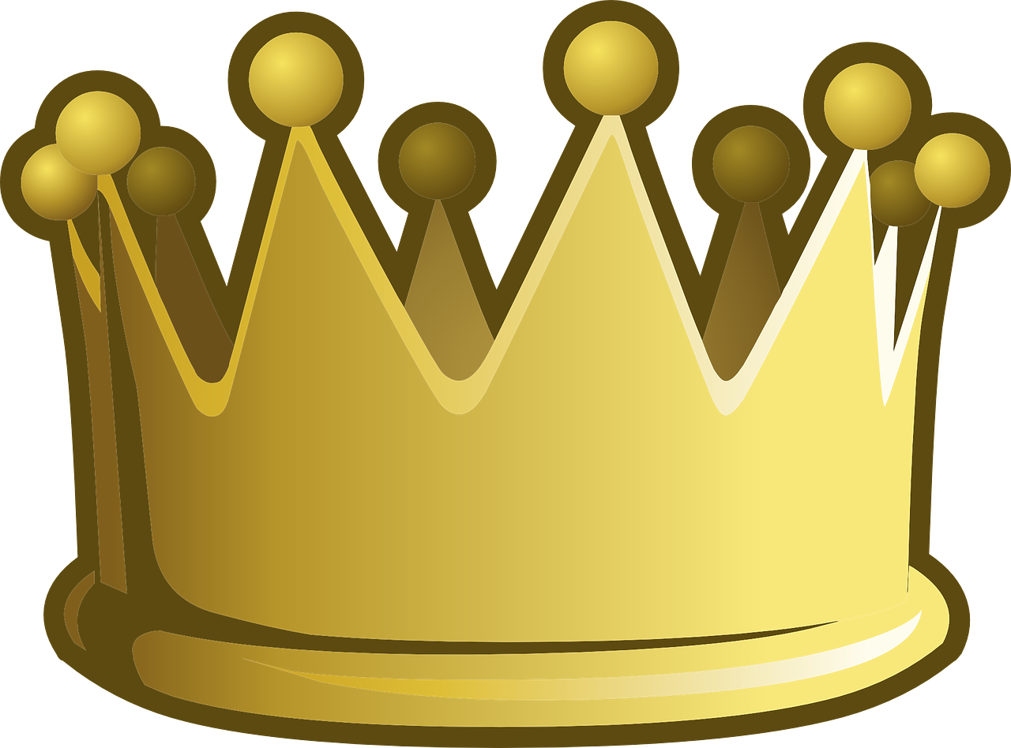
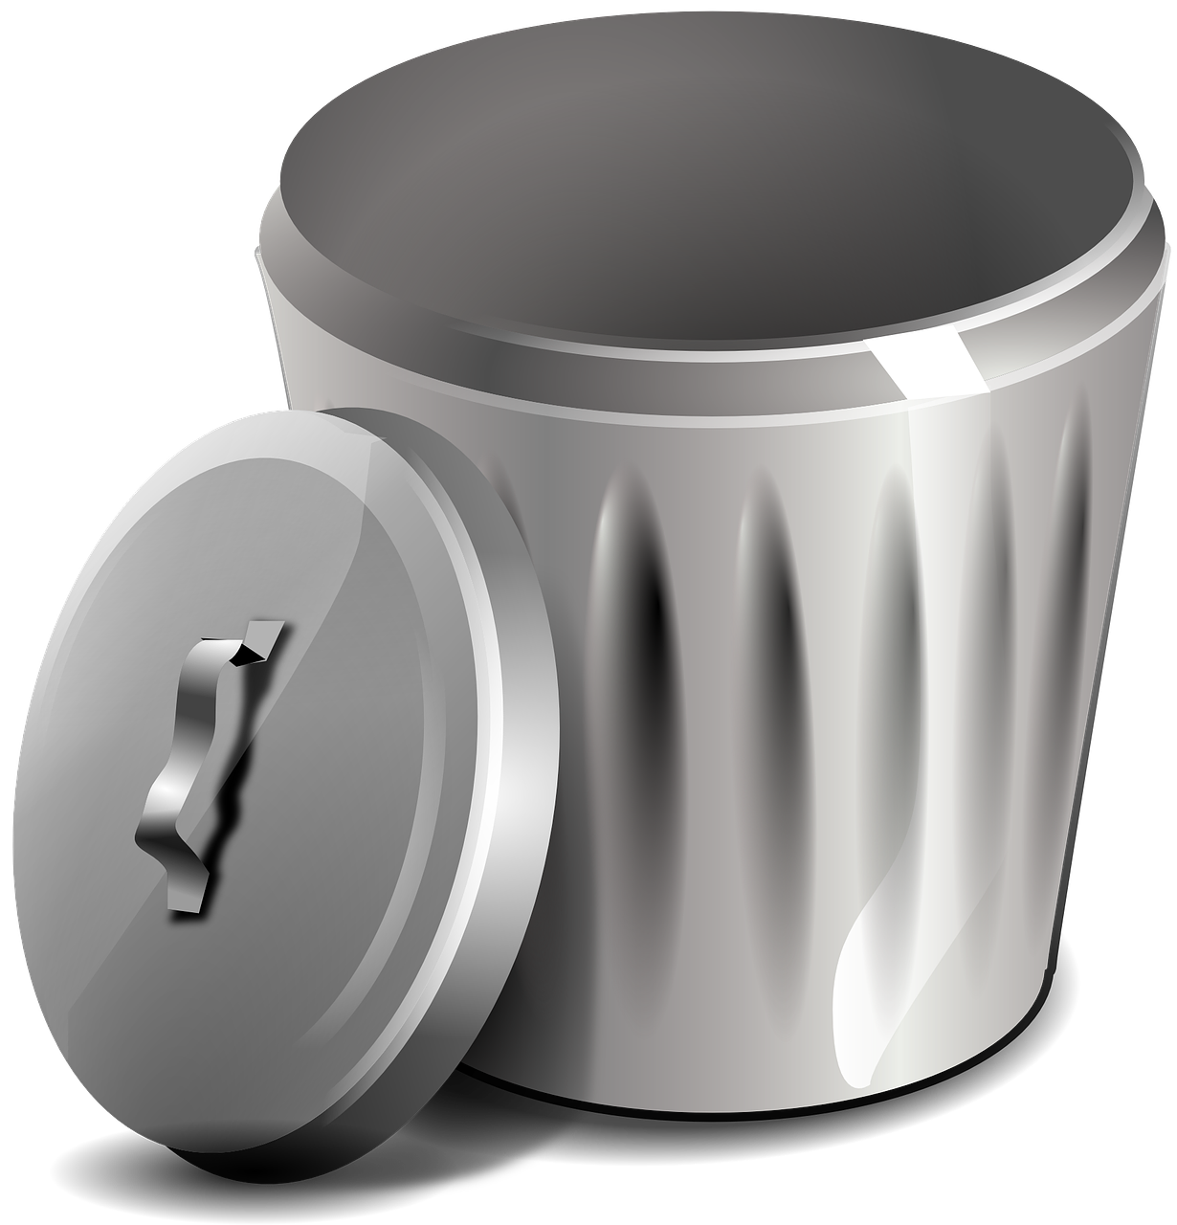
Archimedes idea
When an object is put in water, it ‘displaces’ its volume of water
If you weigh an object and divide it by its volume, this gives you it’s density
Materials all have different densities
When they tested the crown they found it wasn’t pure gold…
You can guess what the king did to the craftsman!

Slide 5

Material density
If two things are the same size,
the one that is more dense is heavier
The cubes are the same size
Low density
High density

Slide 6
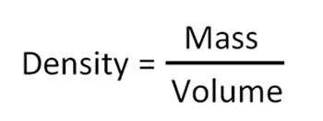
Density
The density of an object is its mass divided by its volume:
The units of density are g/cm³

Slide 7
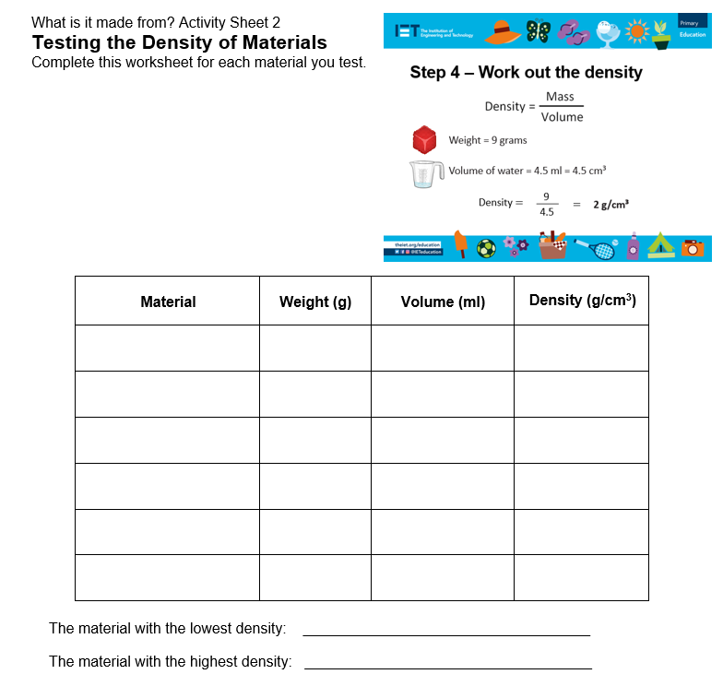
Measuring density
Use the activity sheet
Follow the instructions on the next slides to measure the density of the provided materials

Slide 8
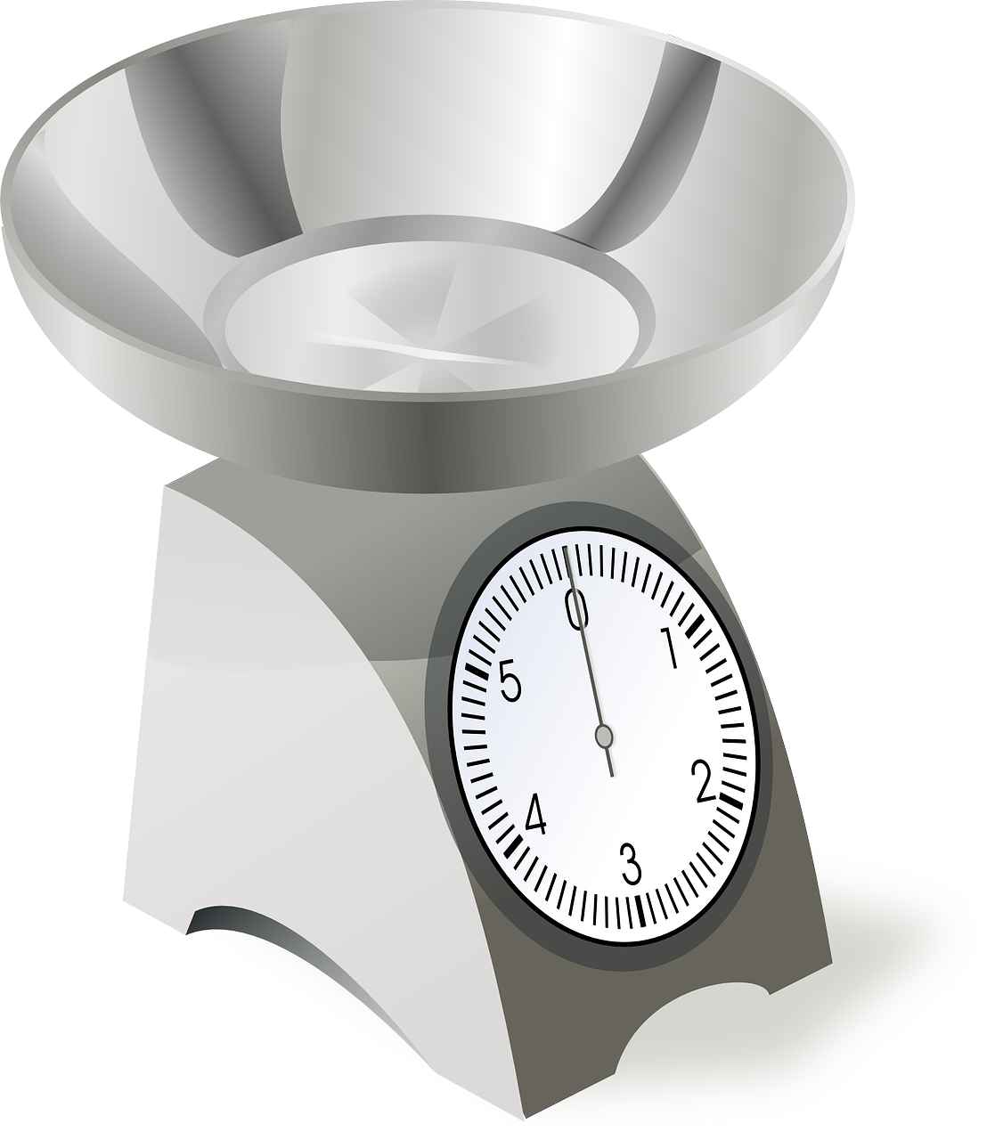
Step 1 – Weigh the material
Use material of the same size
Weigh the material
Write down the weight in grams

Slide 9
Step 2 – Find the volume
Place a bowl on a tray
Fill the bowl to the brim with water
Put the object in the water
The tray will catch all the water that overflows

Slide 10
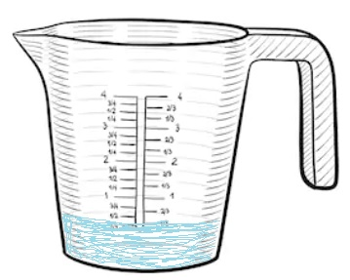
Step 3 – Measure the water
Carefully take the bowl from the tray
Pour the water on the tray into a jug
Write down how much water has been collected in ml
Remember 1 ml = 1 cm³

Slide 11

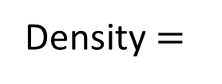
Step 4 – Work out the density
Weight = 9 grams
Volume of water = 4.5 ml = 4.5 cm³
9
____
Density $=$
$$=$$
2 g/cm³
4.5

Slide 12
Review – Results of testing
How similar are your results?
Which material was the most dense?
Which material was the least dense?

