Slide 1
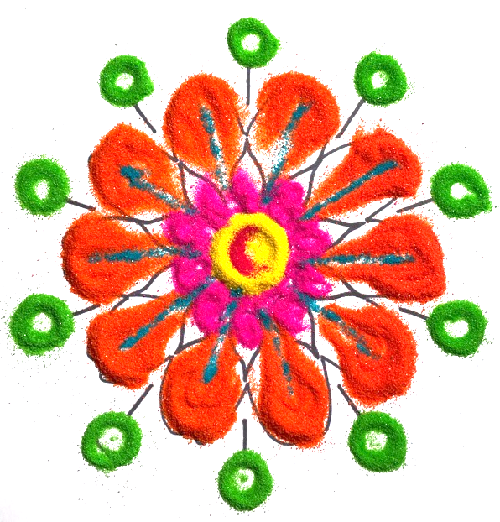
Design a rangoli/kolam
Exploring designs, patterns and materials

Slide 2
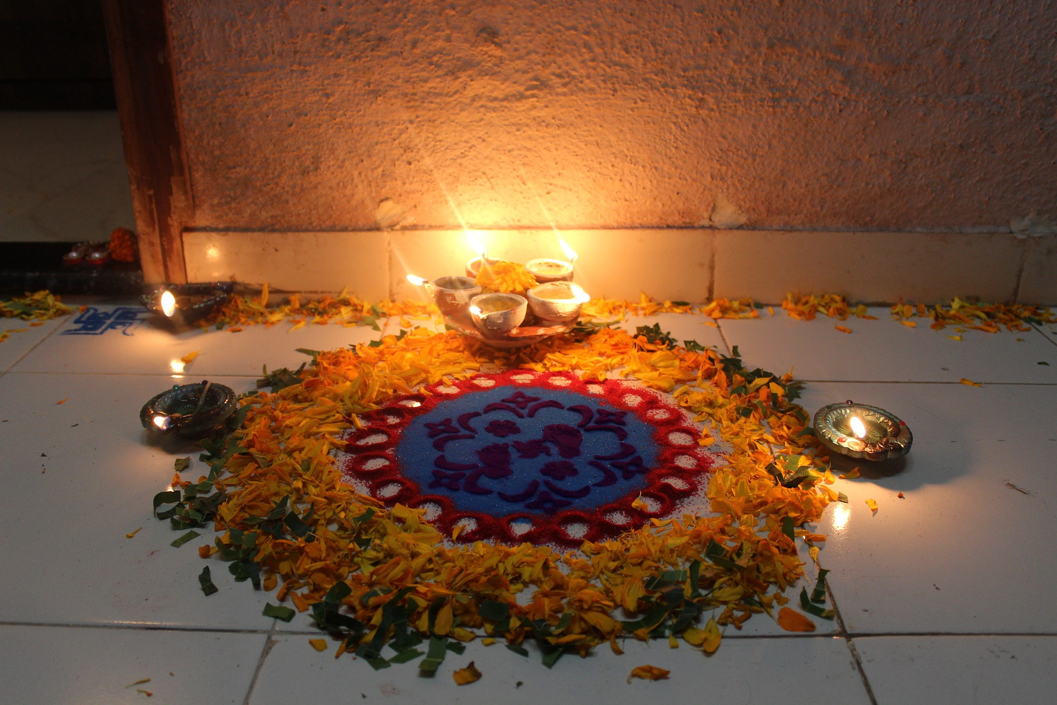
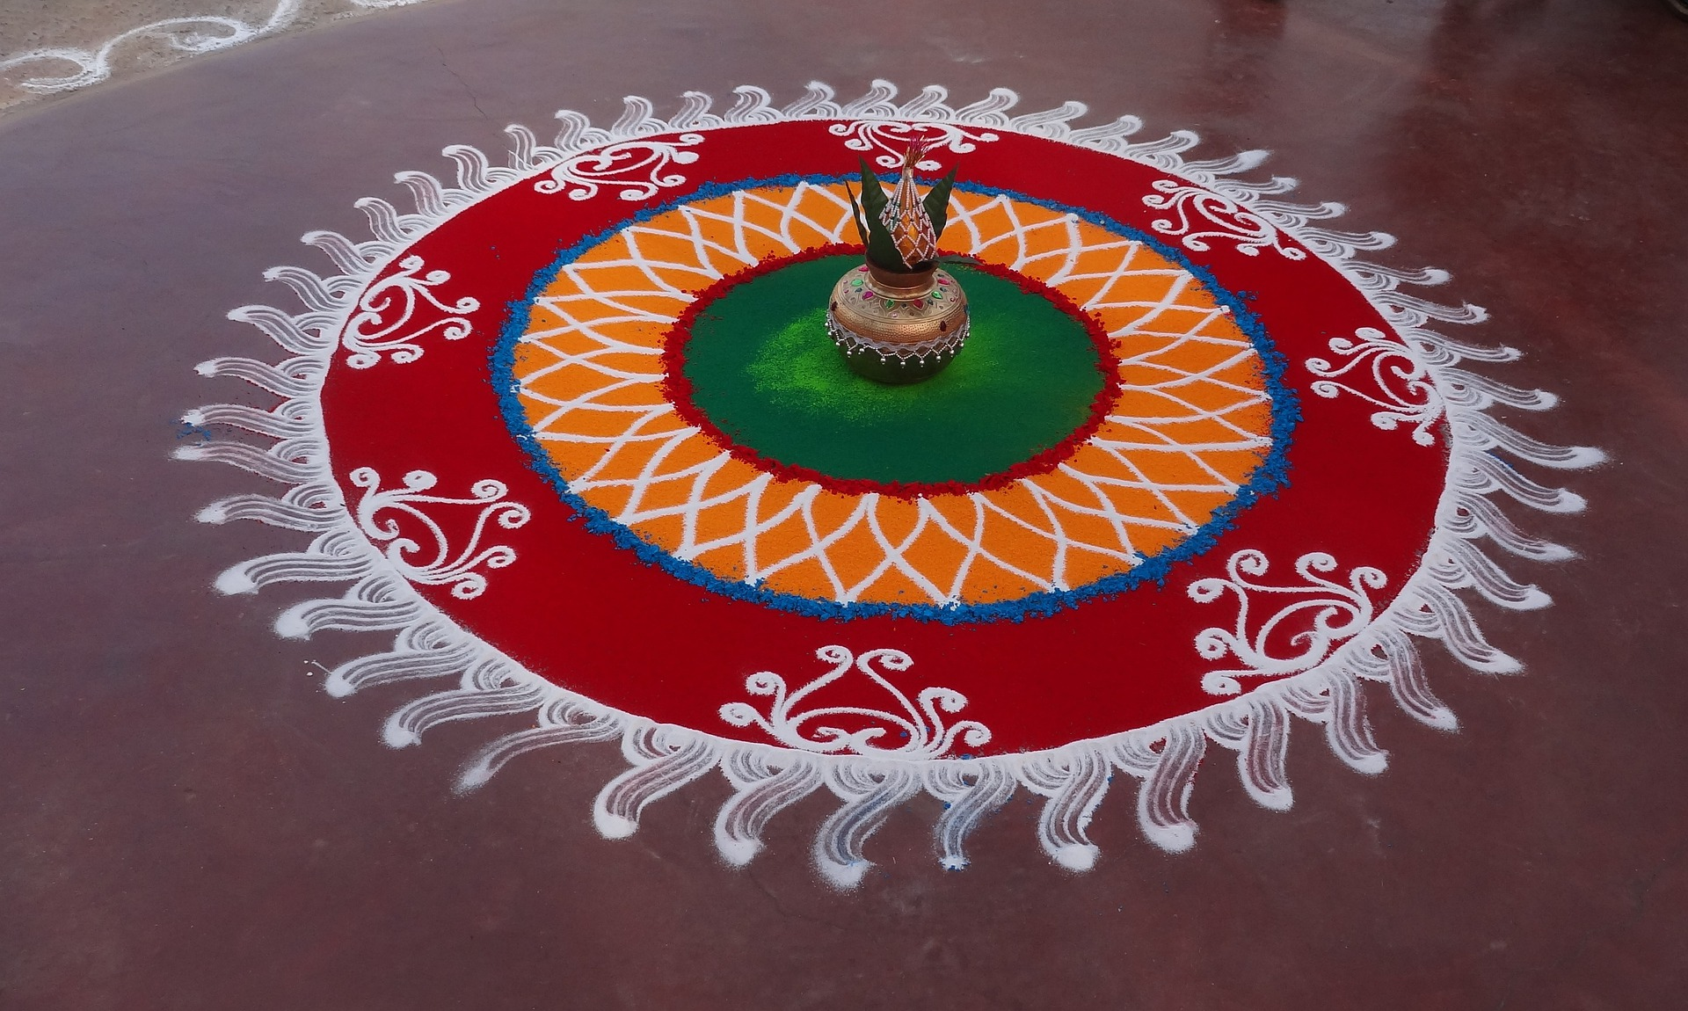
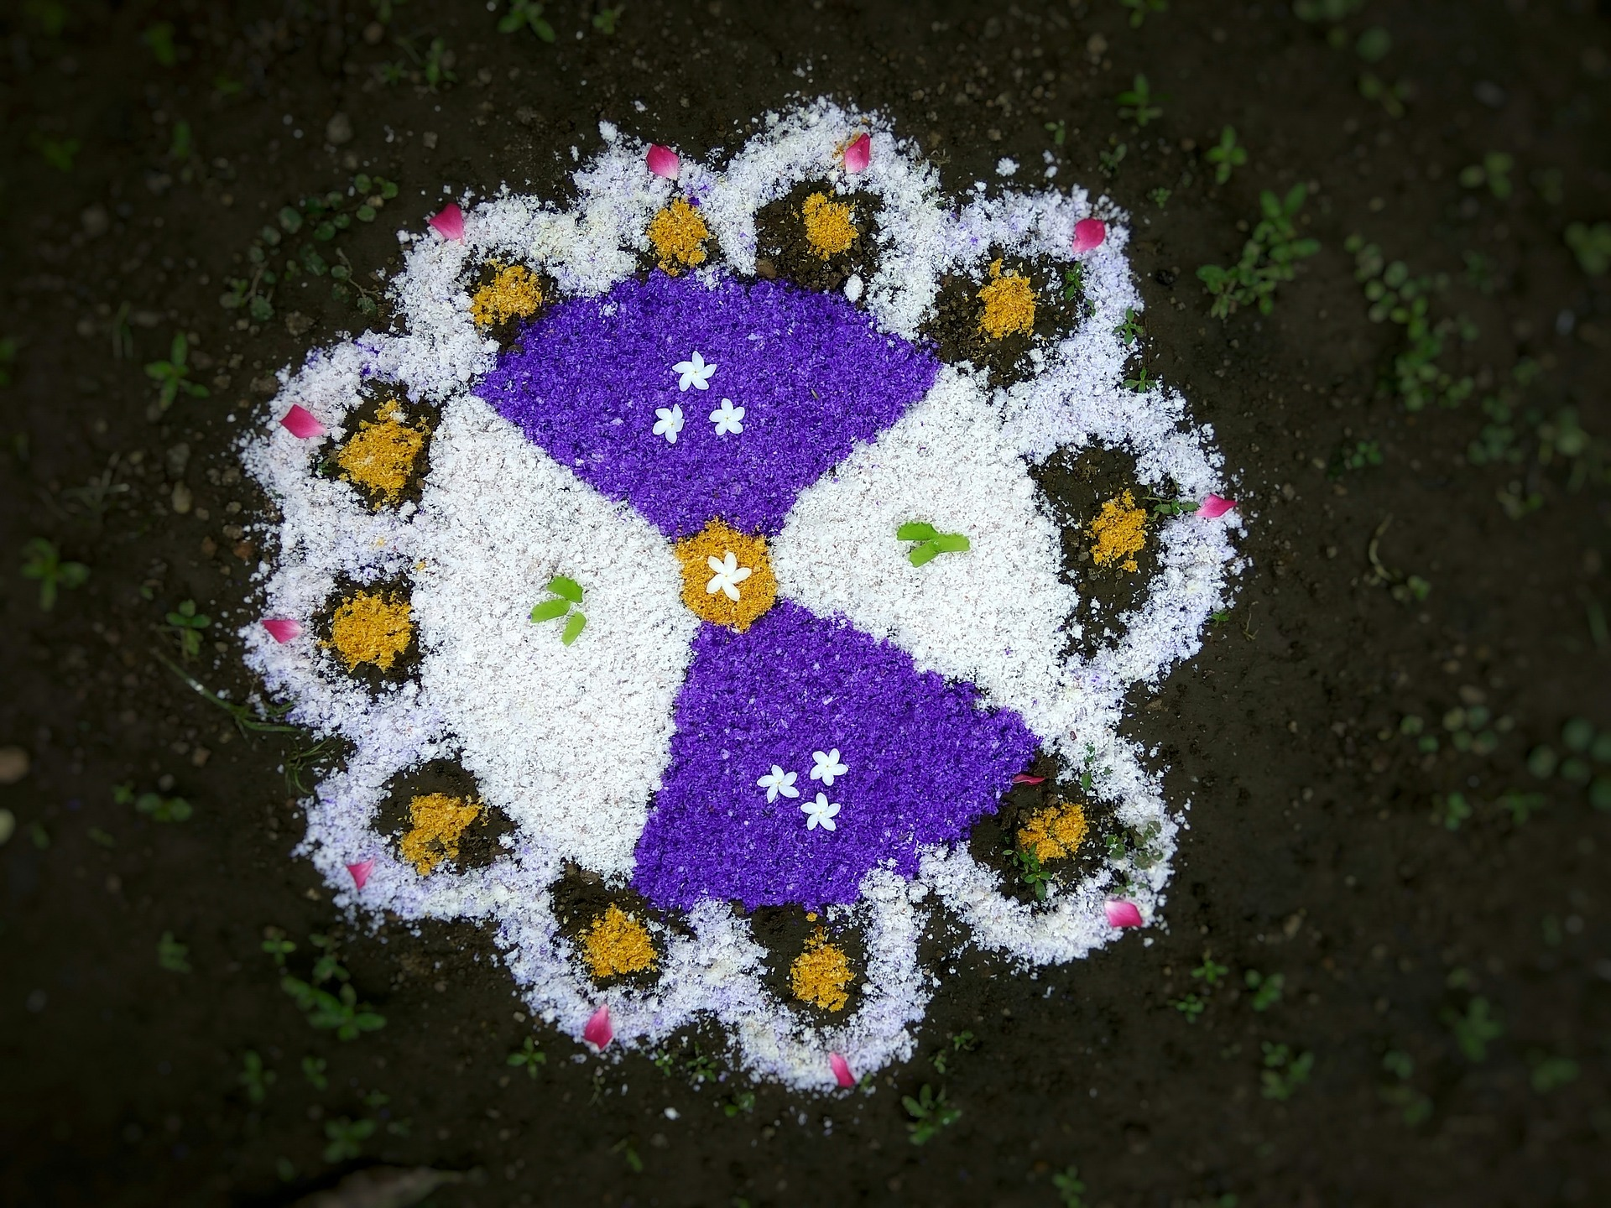
What is a rangoli/kolam?
Rangoli/kolam patterns are bright and colourful designs used by Hindus throughout Diwali (the festival of lights)
Kolam is the name given to the art of Rangoli in southern parts of India
They are placed to welcome the Hindu Goddess Lakshmi - the Goddess of wealth - into a house and are thought to bring good luck
They are usually made on the floor, or on a board which can be moved to where they are displayed

Slide 3
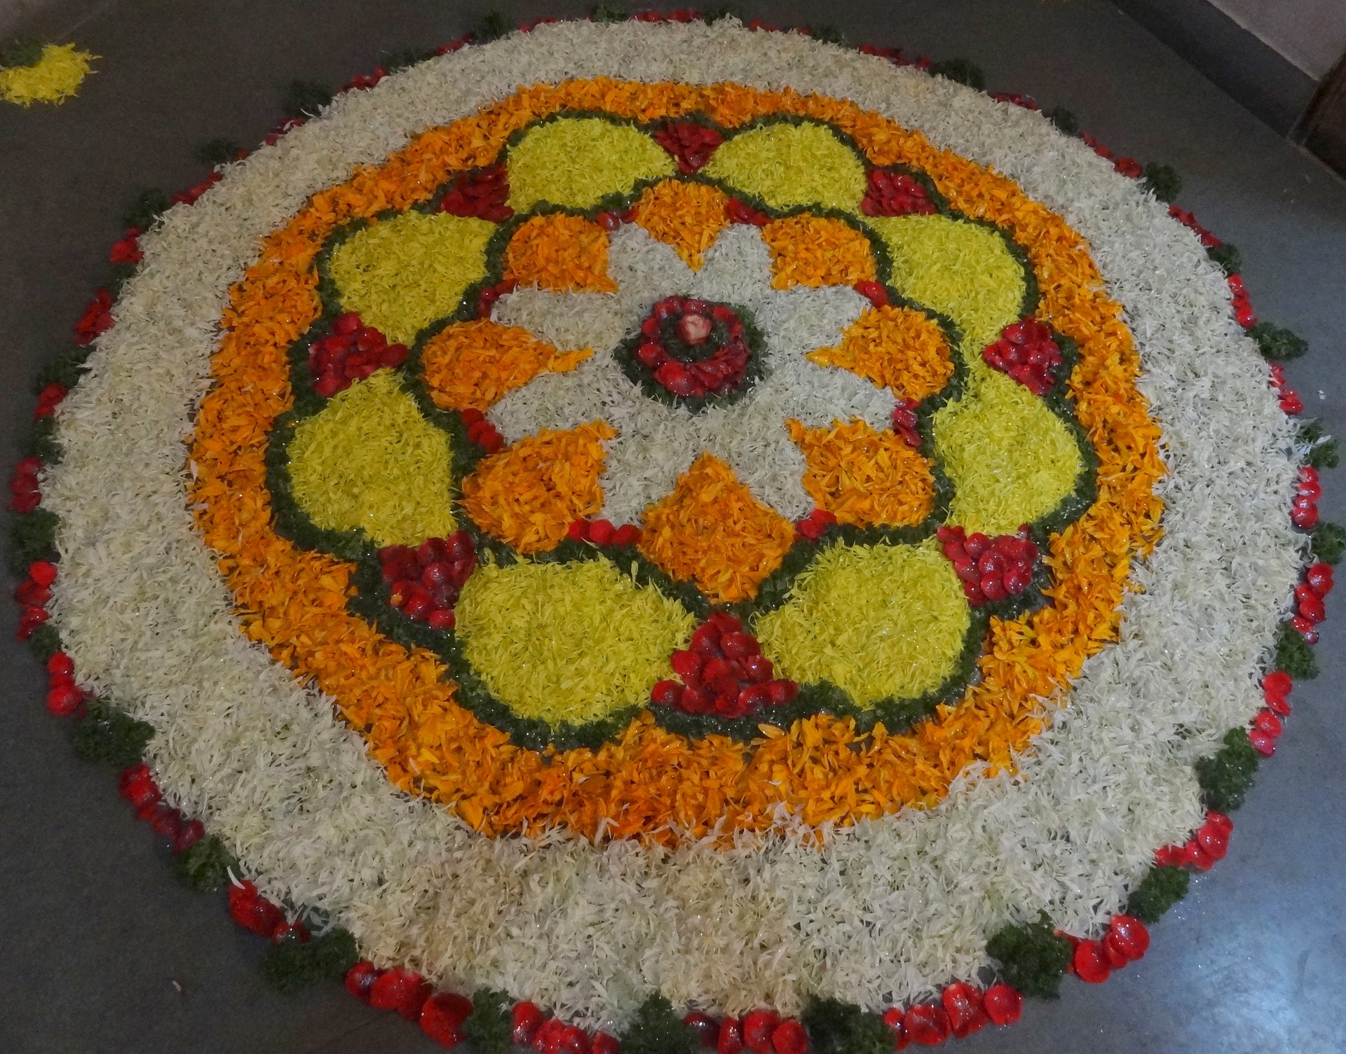
Characteristics of rangoli/kolam patterns
Rangoli/kolam patterns combine straight lines, curved lines and images like flowers and other things from nature
The symmetry of the designs is a symbol of prosperity, growth and luck
Rangoli/kolam patterns can be small or large - in parts of India, there are Rangoli/kolam competitions where teams of people work together to produce large designs for the public to enjoy
They might be made using powdered rocks, sand, coloured rice powder or flower petals

Slide 4
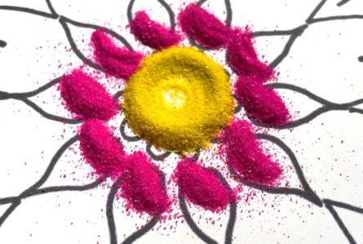
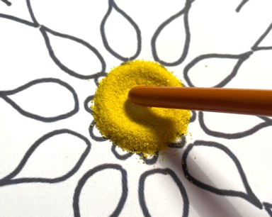
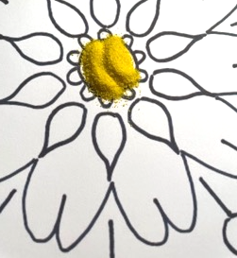
How to create a rangoli/kolam pattern using sand
Print out your chosen design – this example is using the design to the right
Using coloured sand, create a small pile on the central feature (circle)
Use the end of a paint brush to move the sand into a circle
Using a small spoon, add small piles of sand to the surrounding petal shapes

Slide 5
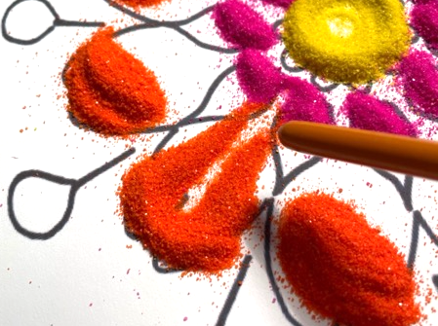
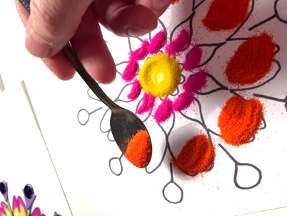
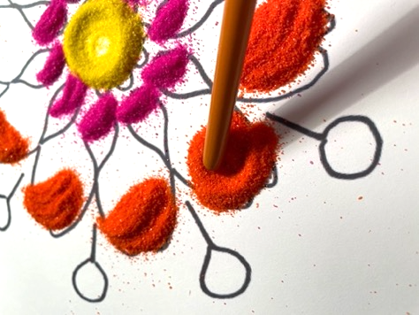
Build up the detail
Add further sand in contrasting colours
Shape the piles of sand to form interesting shapes by dragging it using the end of a paint brush
Work from the centre outwards on your pattern

Slide 6
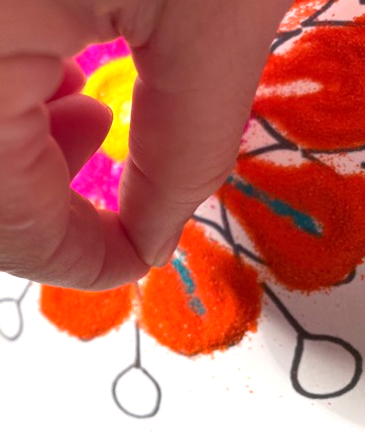
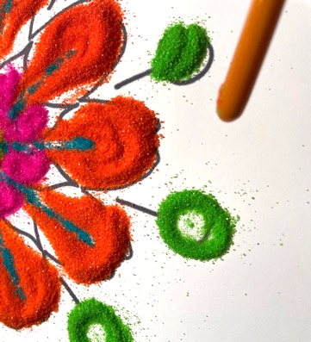
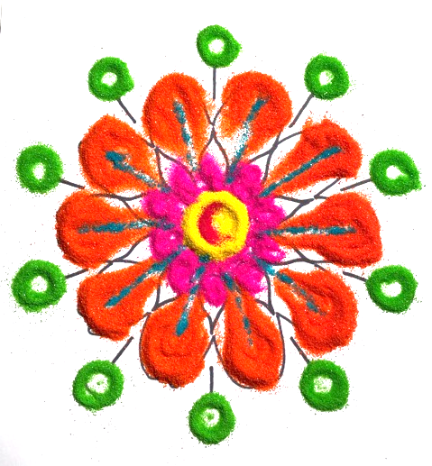
Add more detail
Add sand in contrasting colours in lines, by very carefully pinching then dropping a few grains at a time
Add sand and use the end of a paint brush to make circles
As a finishing touch, add a contrasting colour to the centre circle

Slide 7
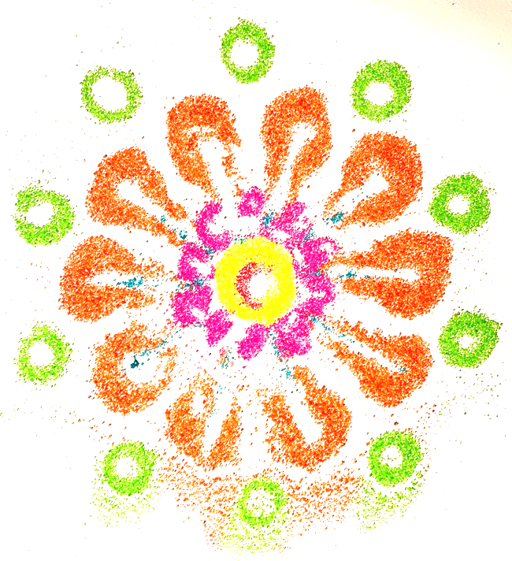
Extension: take a print
Carefully cover a piece of card with a very light coating of PVA glue
Place the glued card over your sand picture and gently press down
Very carefully remove the glued card to reveal a copy of your sand picture

Slide 8
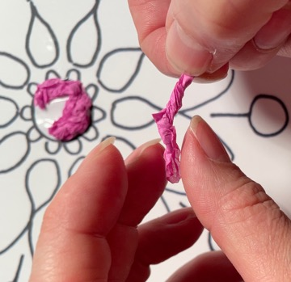
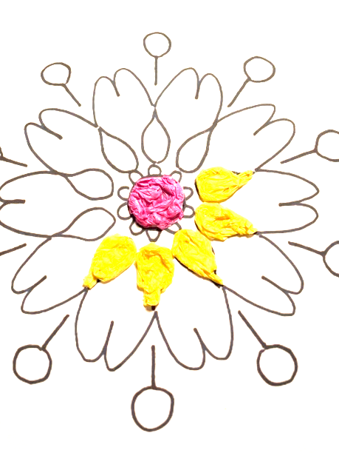
Extension: explore rangoli/kolam designs using alternative materials
Use colourful tissue paper
Rip the tissue into stripes and twist the paper into lengths
Glue individual shapes and stick the twisted paper into the shape
Use contrasting colours

Slide 9
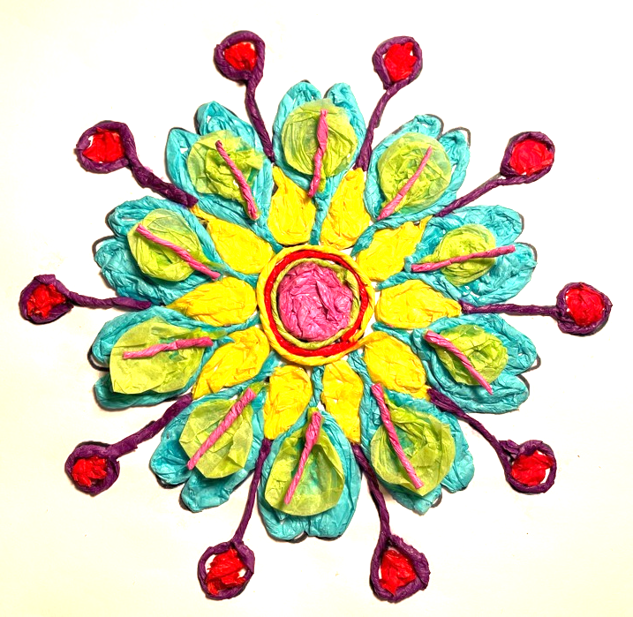
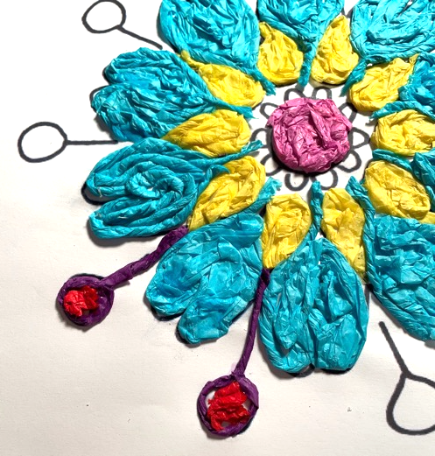
Continue to build up your design
Continue building up the colours
Add details to embellish your design

Slide 10
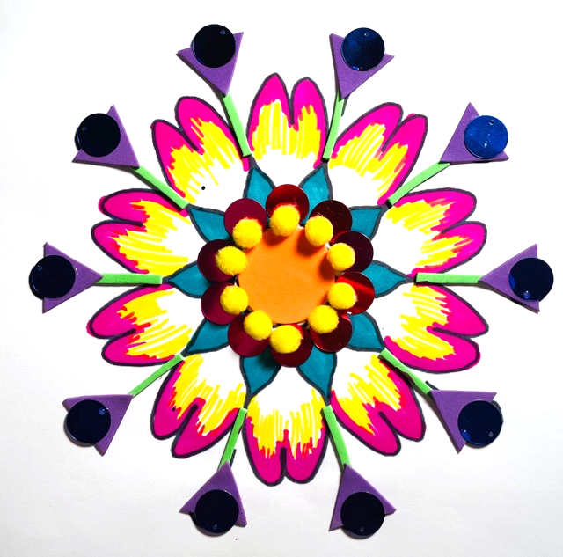
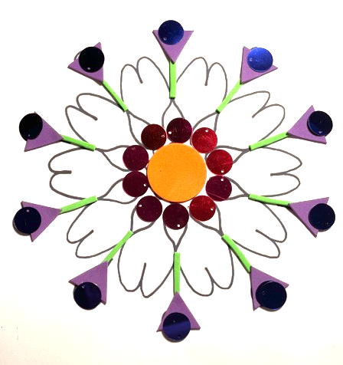
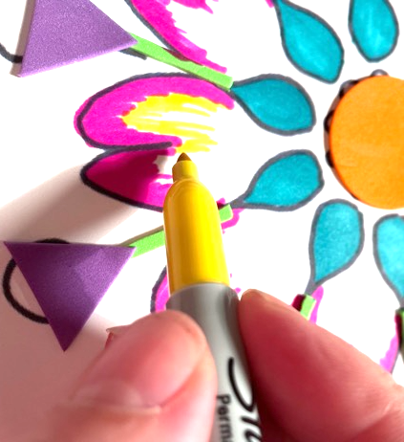
Extension: use coloured pens & stickers
Use different textures, stickers and shading to add to your design

Slide 11
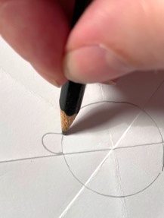
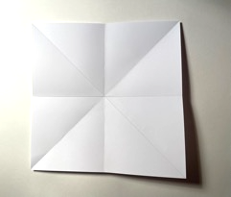
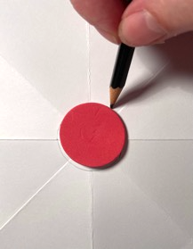
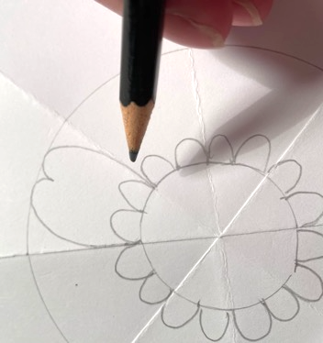
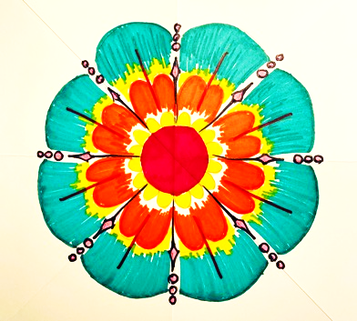
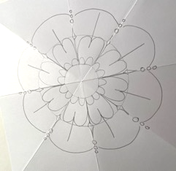
Extension: design your own fractal pattern
Fold a square piece of paper in half and then diagonally
Use the fold marks to place the shapes to draw around
Add free style elements, remember to copy symmetry of your pattern
Add color to make your design amazing

Slide 12
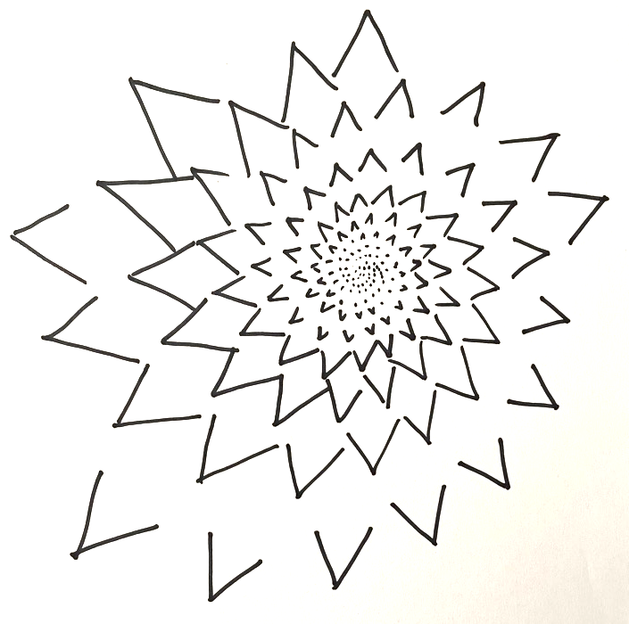
Extension: complex fractal designs
Research more complex fractal designs
Look for patterns that use shapes of increasing sizes - this example uses triangles to achieve a repetitive pattern

