Slide 1
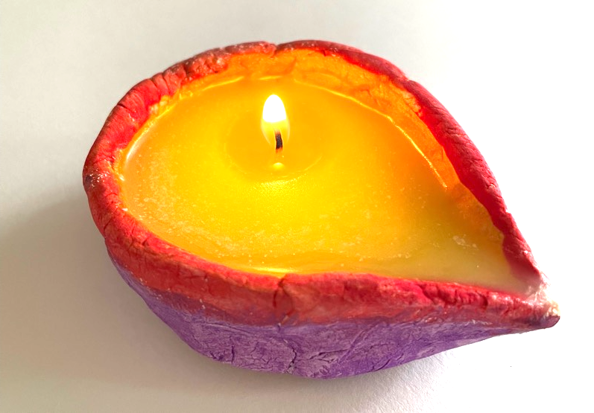
Making your own diya
Making a ghee lamp for Diwali

Slide 2
Stay safe
Whether you are a scientist researching a new medicine or an engineer solving climate change, safety always comes first. An adult must always be around and supervising when doing this activity. You are responsible for:
ensuring that any equipment used for this activity is in good working condition
behaving sensibly and following any safety instructions so as not to hurt or injure yourself or others
Please note that in the absence of any negligence or other breach of duty by us, this activity is carried out at your own risk. It is important to take extra care at the stages marked with this symbol: ⚠

Slide 3
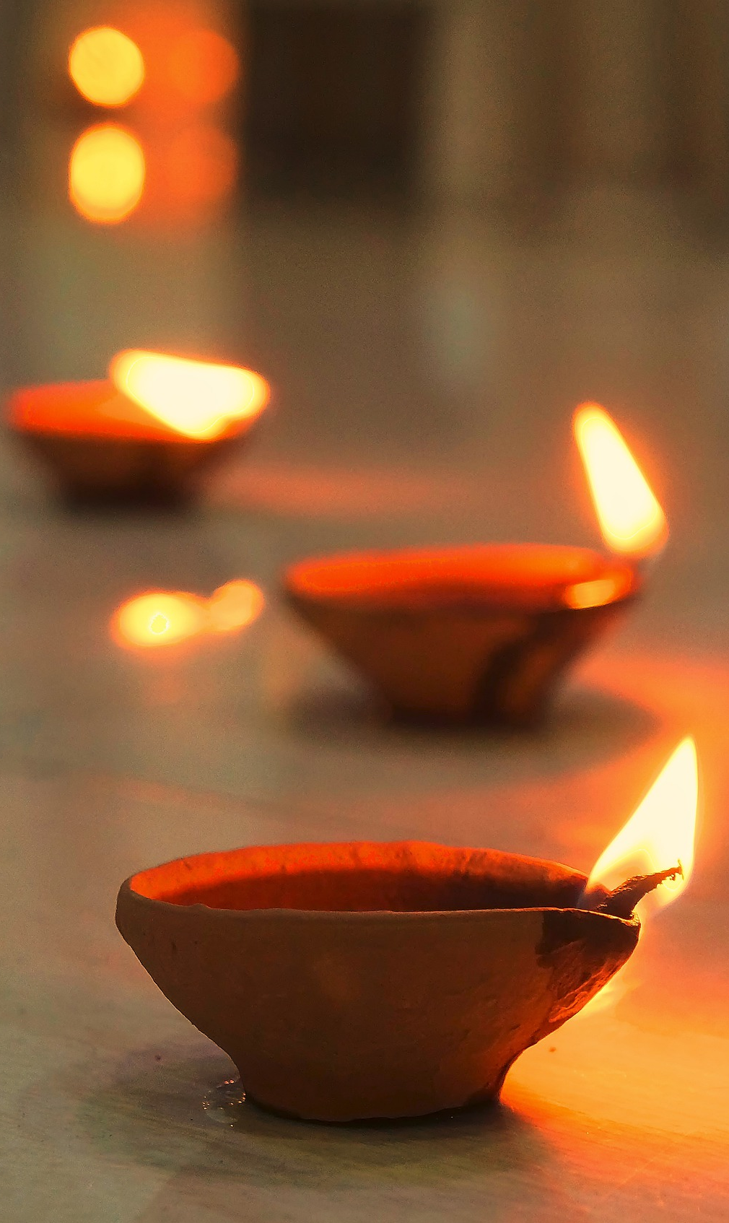
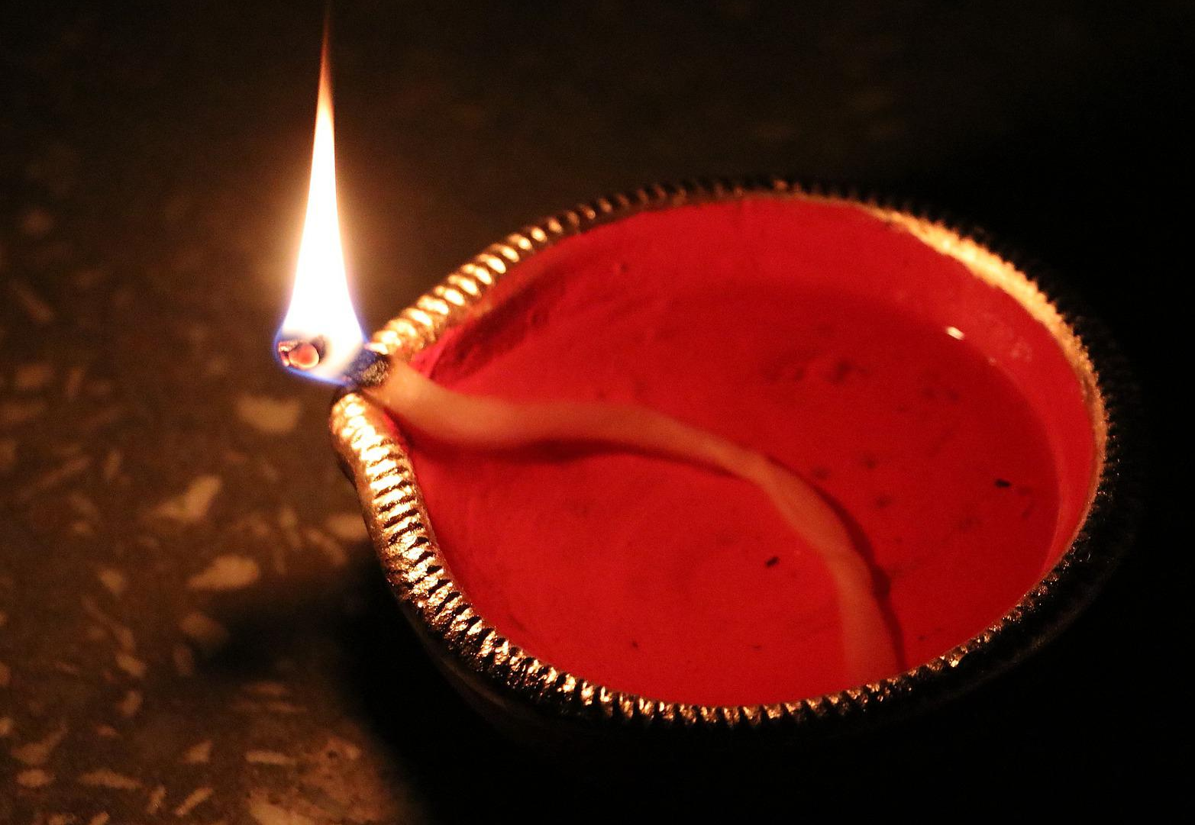
What is a diya?
A diya is an oil lamp
Diyas represent the triumph of light over dark, and good over evil
The warm, bright glow from a diya is considered to bring good fortune
They are traditionally made from clay or mud, with a cotton wick dipped in ghee

Slide 4
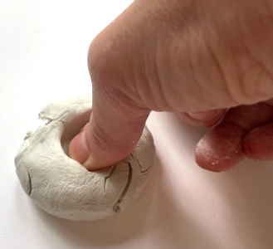
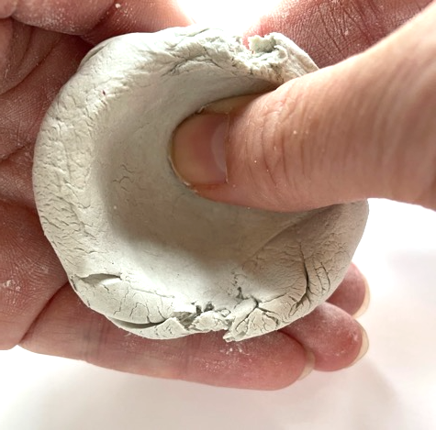
Make a pinch pot
Break off a lump of air-drying clay
Roll into a large ball
Use your thumb to create a well in the clay

Slide 5
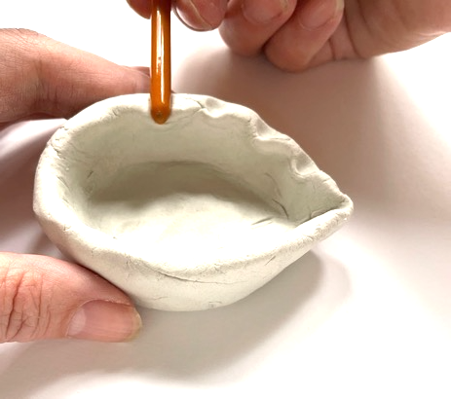
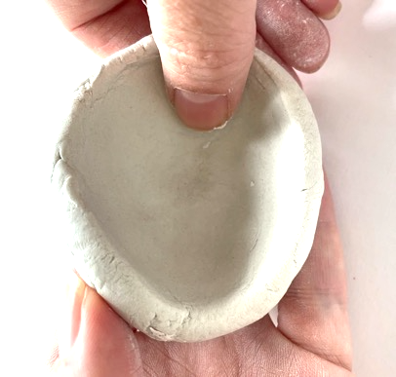
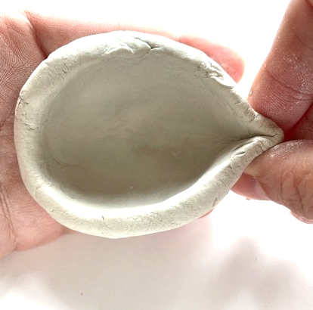
Shape your pinch pot into a diya
Using your fingers, carefully shape the sides of your pot
Create a spout, forming your pot into a tear shape
Create a design around the top of your pot by using the tip of a paint brush or pen

Slide 6
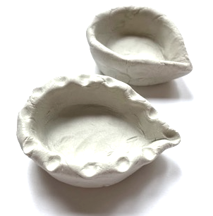
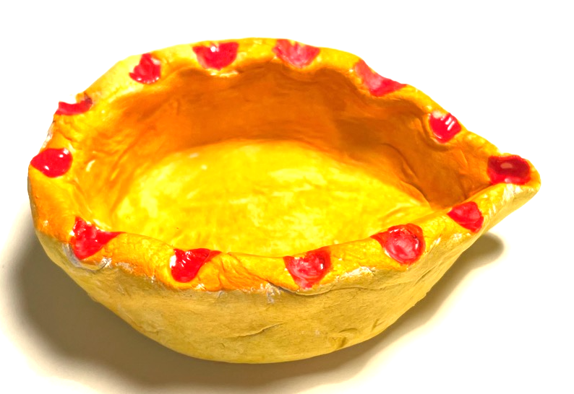
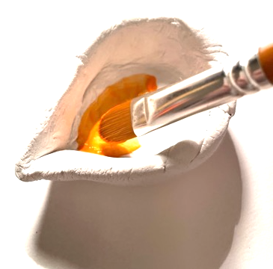
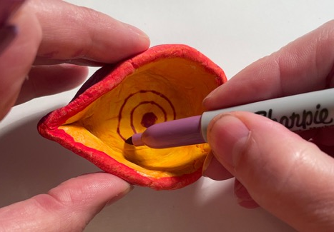
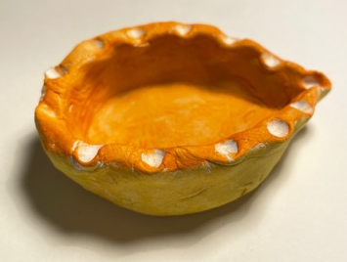
Finish your diya
Allow your pot to dry
Add colour - use bright colors that contrast dramatically
Add a design to the centre of the pot with a pen

Slide 7
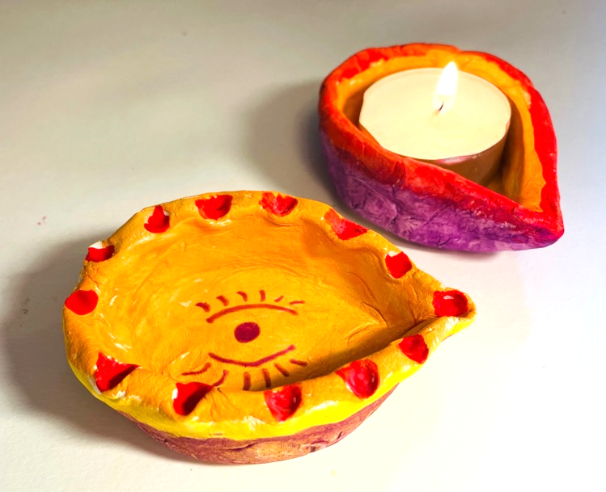
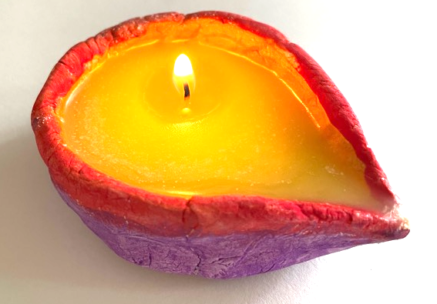
Using your Diya ⚠
With adult supervision - use a tea light to create your lamp ⚠
… or fill the diya with melted ghee and use a wick from a tea light to create your lamp ⚠

Slide 8
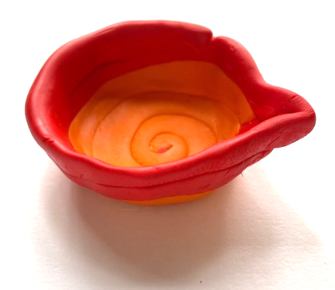
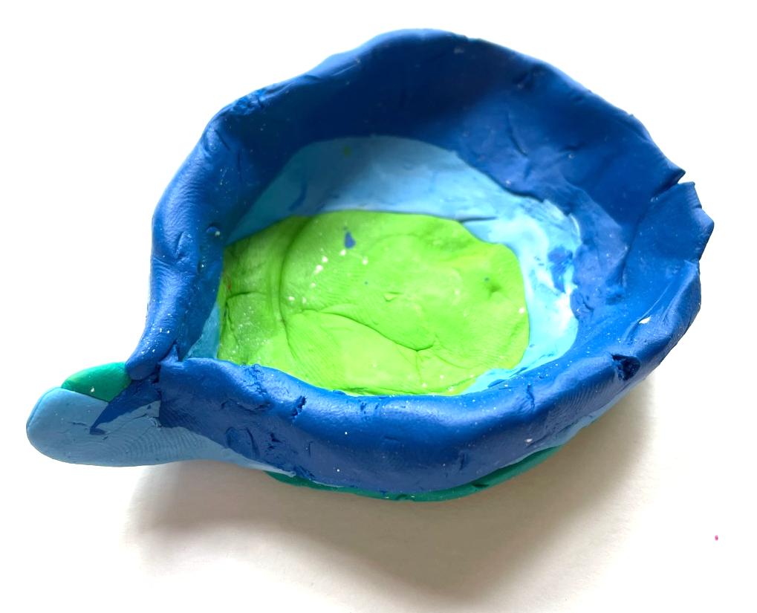
Extension
Create different designs using coloured clay

