Slide 1
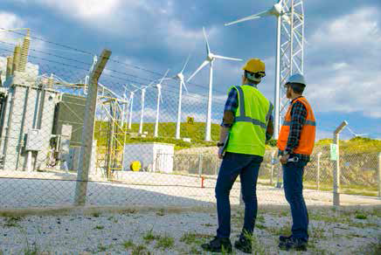


Session 1
White Energy
Journey

Slide 2

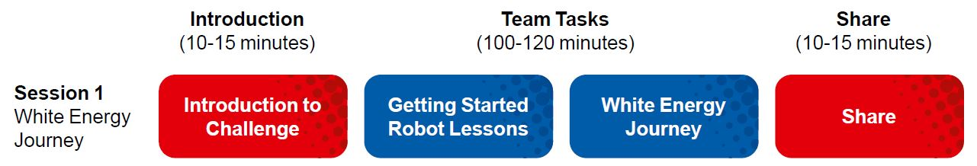
Session Overview
Outcomes
The team will learn how to connect and use the sensors and motors.
The team will make connections from the mission models to the White Energy Journey Project Spark ideas.
Notes:
Facilitator Tips
Each session in this guide is two hours. If needed, split each session into two separate 60-minute meetings by having the team complete each page in a 60-minute meeting.
Every session starts with an introduction and ends with a Share activity. Details for these activities are given in the session pages.

Slide 3
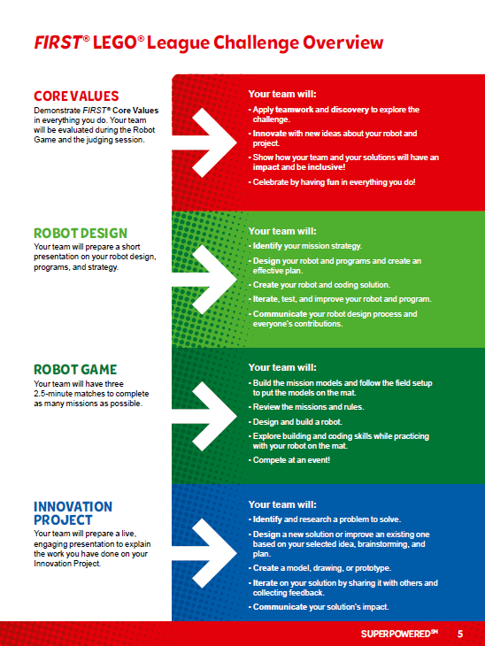
Introduction
Read pages 3-9 explaining how FIRST® LEGO® League Challenge works.
Now that you have read about SUPERPOWEREDSM, you are ready to get started.

Slide 4



Visit the
FIRST® LEGO ® League
YouTube Channel
to watch the
SUPERPOWERED season launch video
Notes:
Facilitator Tips
Share the season videos on the FIRST® LEGO® League YouTube Channel with the team.
If you have already watched the season launch video in the introductory slides, you may choose to skip it here.

Slide 5
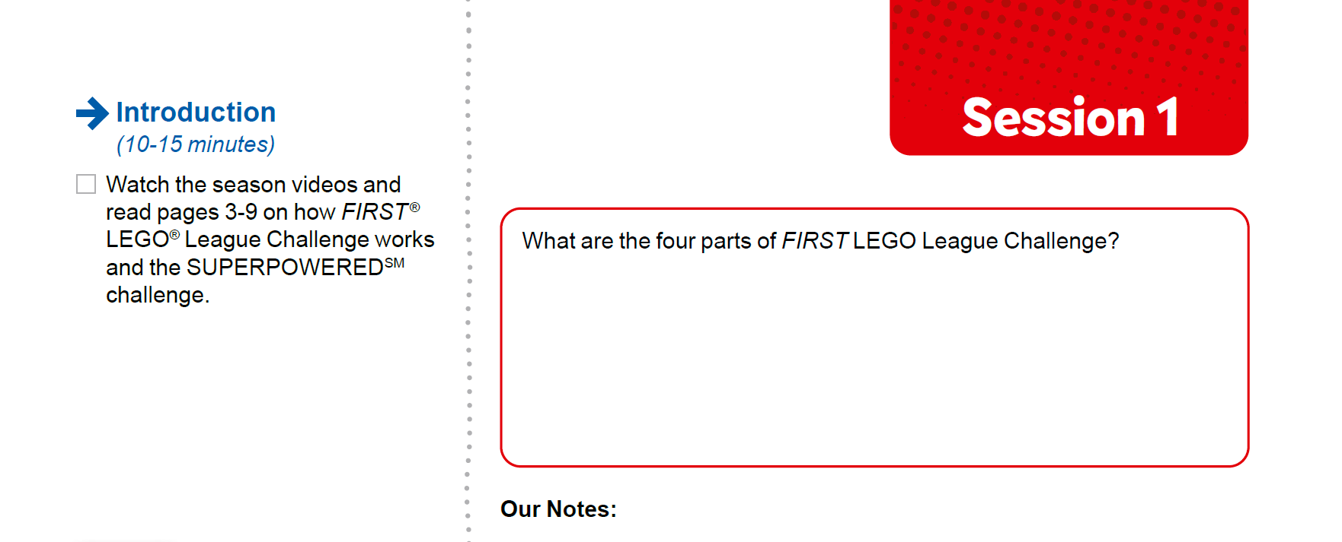
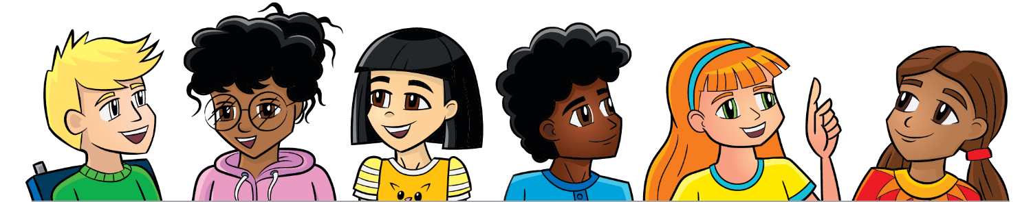
Introduction
Watch the season videos and read pages 3-9 on how FIRST® LEGO® League Challenge works and the SUPERPOWEREDSM challenge.
Notes:
Facilitator Tips
Every session has an Introduction prompt and space to document the team’s responses.
Visit the FIRST® LEGO ® League YouTube Channel to watch the SUPERPOWERED season launch video

Slide 6
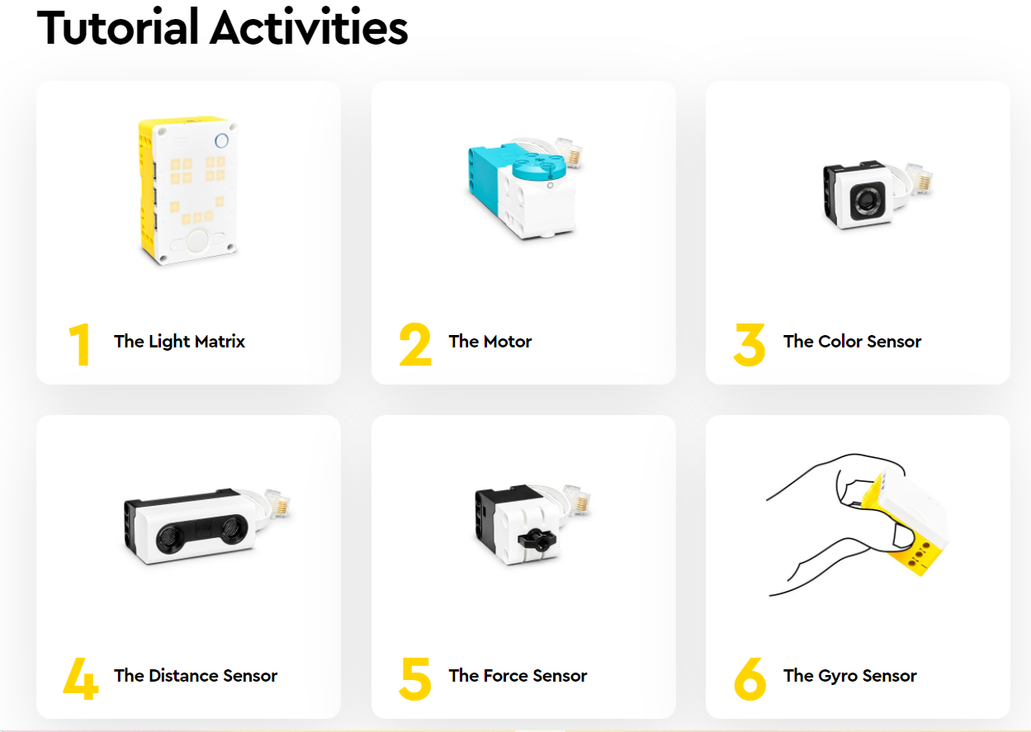

Robot Lesson 1
Open the SPIKE™ Prime app. Find your lesson.
Identify the missions that could be solved with the coding skills learned in this lesson.
Notes:
URL for SPIKE on-line: https://spike.legoeducation.com (remember to use a Chrome browser)
Facilitator Tips
Two devices are suggested, one for the robot and one for project work. Additional devices for the mission model building are useful.
Activities in the sessions are for LEGO Education SPIKE™ PRIME app.
Make sure the controller and device are plugged in and charging at the end of the session.
Robot Game Connection: Have the team plan for how to get the robot to a model or target area.

Slide 7
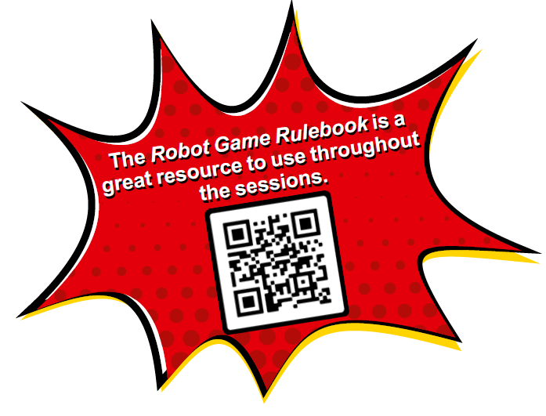

Reflection Questions
How could stopping a motor help you solve a mission with your robot?
What do you know about energy? What are resources that can help you learn more?
Read over the Robot Game Rulebook for all the details on the missions.

Slide 8
White Energy Project Spark
Renewable energy comes from natural sources that will never run out. Amazing new technologies are being developed to capture and store energy from these types of renewable sources.
Think about and research:
• Are renewable energy sources reliable?
How can we store energy when the wind is not blowing or the sun is not shining?
How do we make the use of renewable energy technologies more widespread?
What is the impact of using these renewable technologies?
Notes:
Facilitator Tips
Project Sparks provide the team with ideas for their Innovation Project and how the mission models connect to the theme.

Slide 9

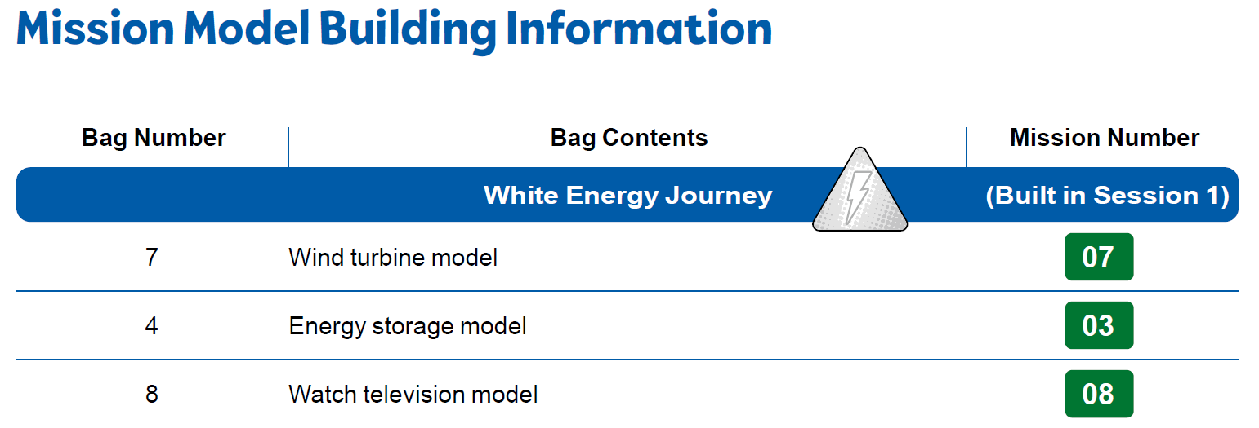
White Energy Project Spark
Build the white energy journey models in Bags 4, 7, & 8 using Building Instruction Books 4, 7, & 8.
Notes:
Facilitator Tips
Provide the digital building instructions Books 4, 7, & 8 to the team. Find them at firstlegoleague.org/ season#resources
The team will need Bags 4, 7, & 8 from the Challenge set. Larger pieces may be in an unnumbered LEGO® bag.
Have the team record their brainstorming ideas as a bulleted list in the Engineering Notebook or in another location.

Slide 10
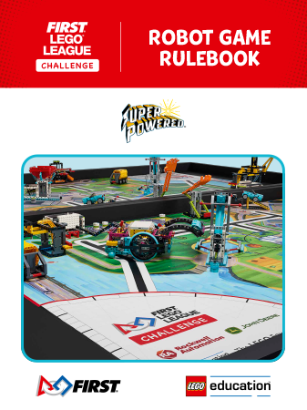
White Energy Project Spark
Check out the Robot Game Rulebook. This will be a great resource throughout the sessions.
Review the missions that relate to the models you built.
Notes:
Facilitator Tips
Provide the digital building instructions Books 4, 7, & 8 to the team. Find them at firstlegoleague.org/ season#resources
The team will need Bags 4, 7, & 8 from the Challenge set. Larger pieces may be in an unnumbered LEGO® bag.
Have the team record their brainstorming ideas as a bulleted list in the Engineering Notebook or in another location.

Slide 11
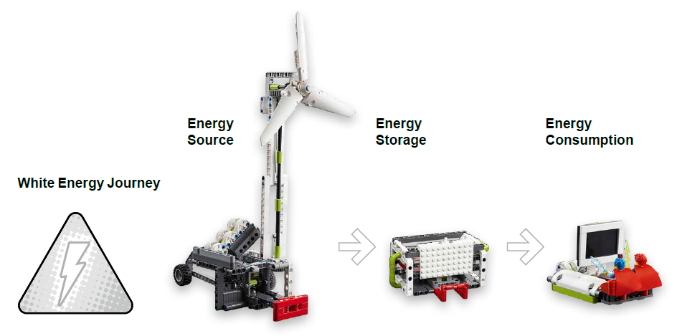
White Energy Project Spark
Discuss how the mission models are linked to the Project Spark.
Brainstorm and record your ideas that relate to this Project Spark.
Notes:
Facilitator Tips
Provide the digital building instructions Books 4, 7, & 8 to the team. Find them at firstlegoleague.org/ season#resources.
The team will need Bags 4, 7, & 8 from the Challenge set. Larger pieces may be in an unnumbered LEGO® bag.
Have the team record their brainstorming ideas as a bulleted list in the Engineering Notebook or in another location.

Slide 12

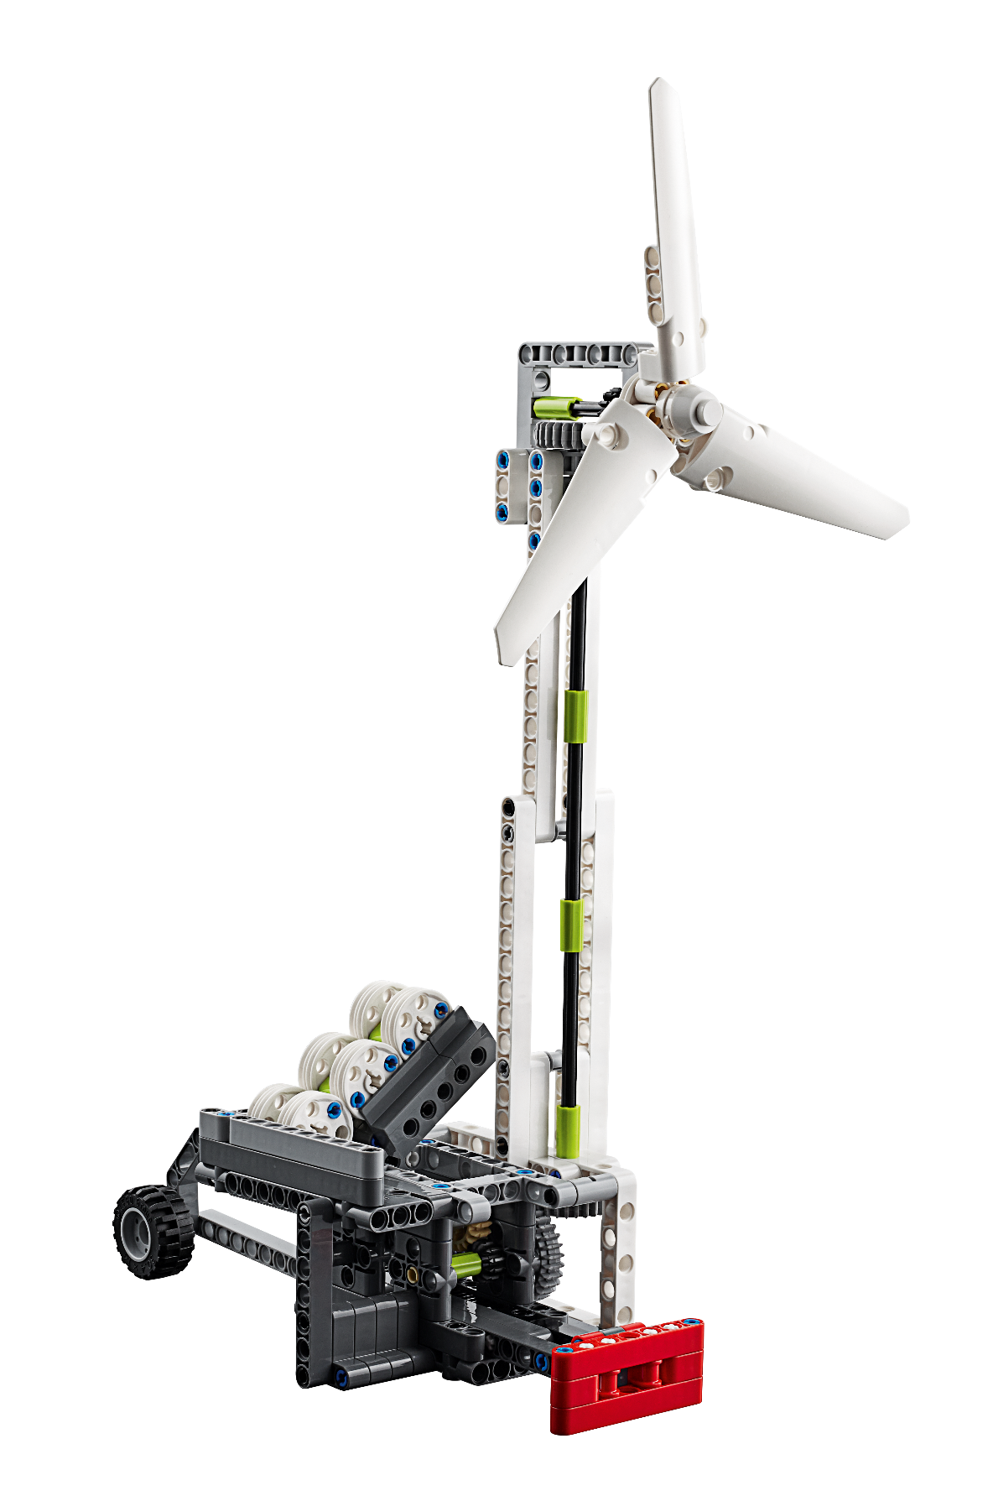
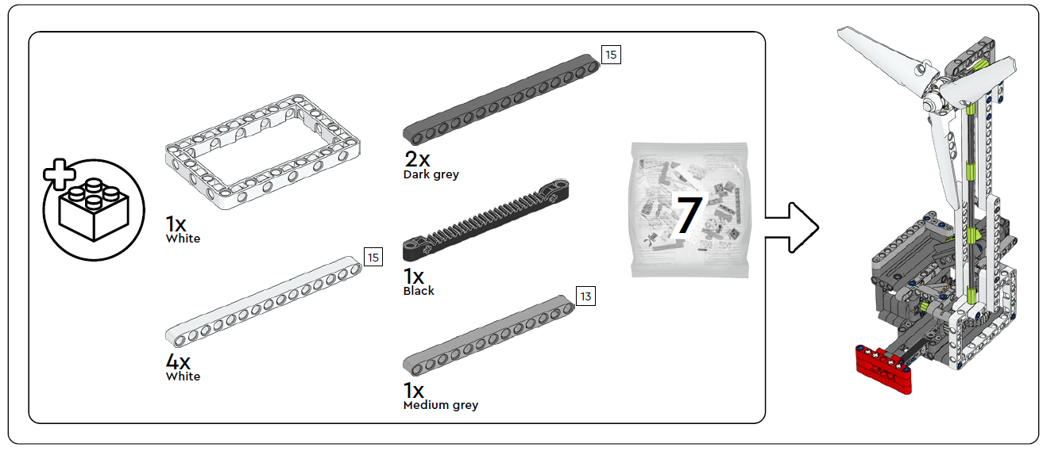
Wind Turbine
3 bags
Notes:
Facilitator Tips
Find videos for each mission in the interactive Robot Game Rulebook.

Slide 13
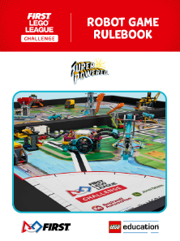
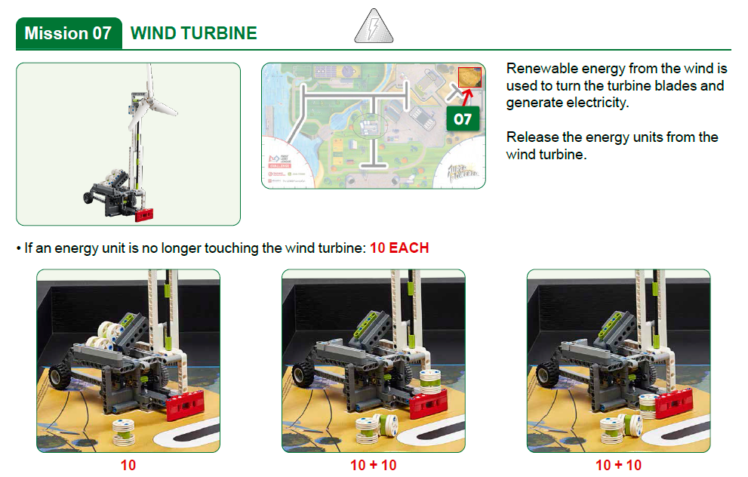
Robot
Game
Rulebook
page 9

Slide 14

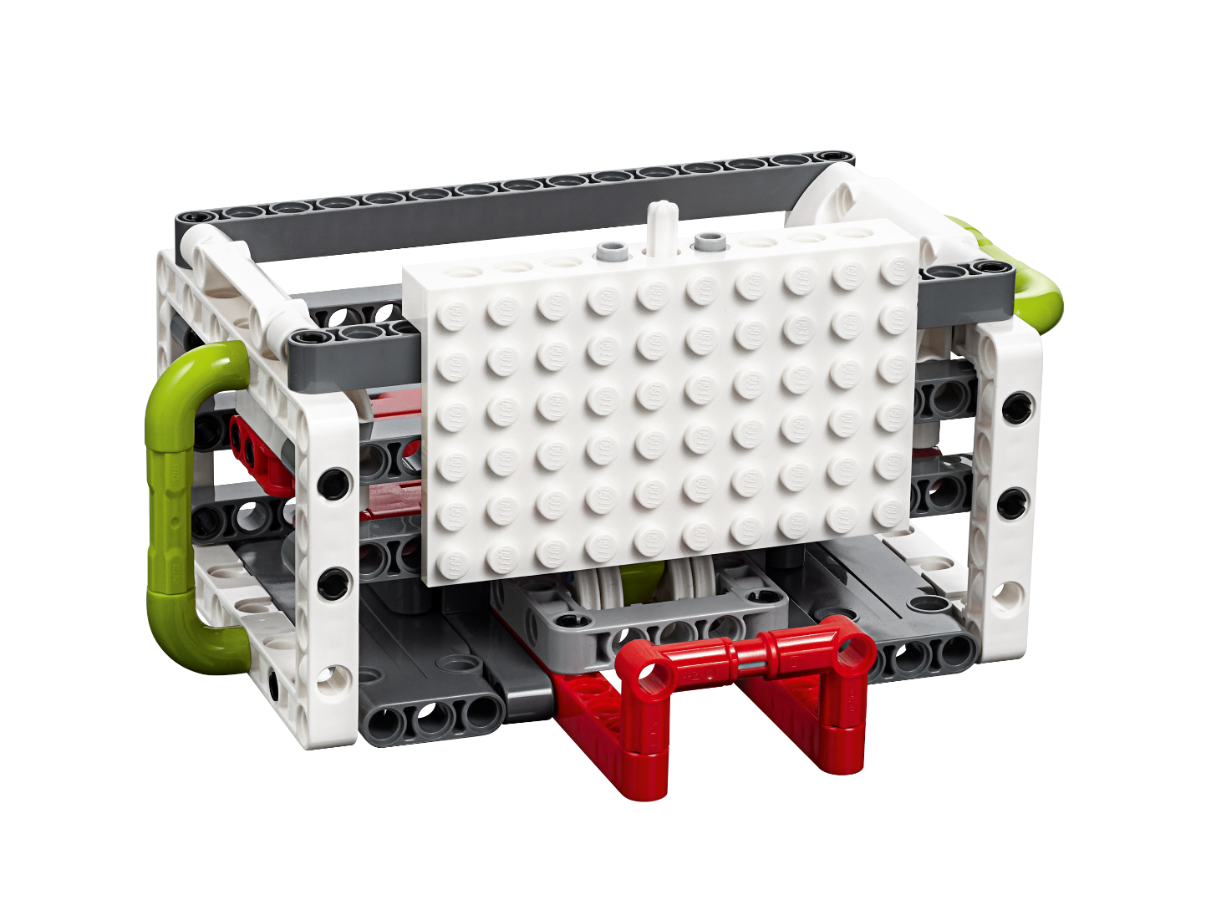
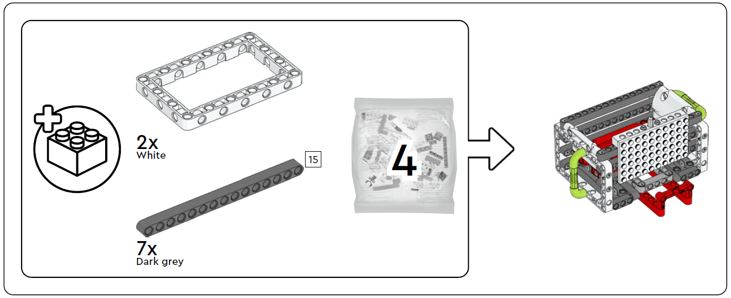
Energy Storage
2 bags
Notes:
Facilitator Tips
Find videos for each mission in the interactive Robot Game Rulebook.

Slide 15
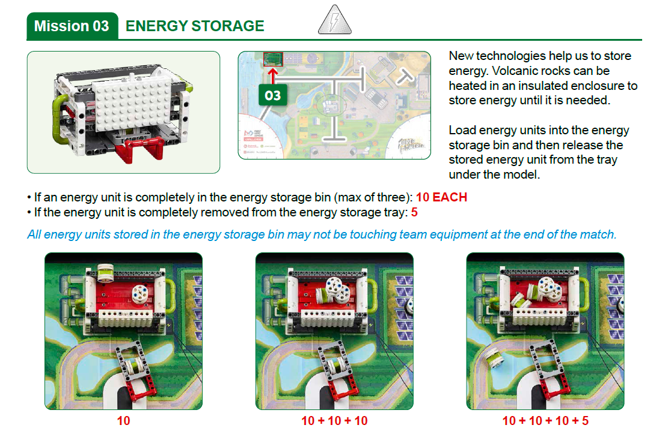
Robot
Game
Rulebook
page 9

Slide 16

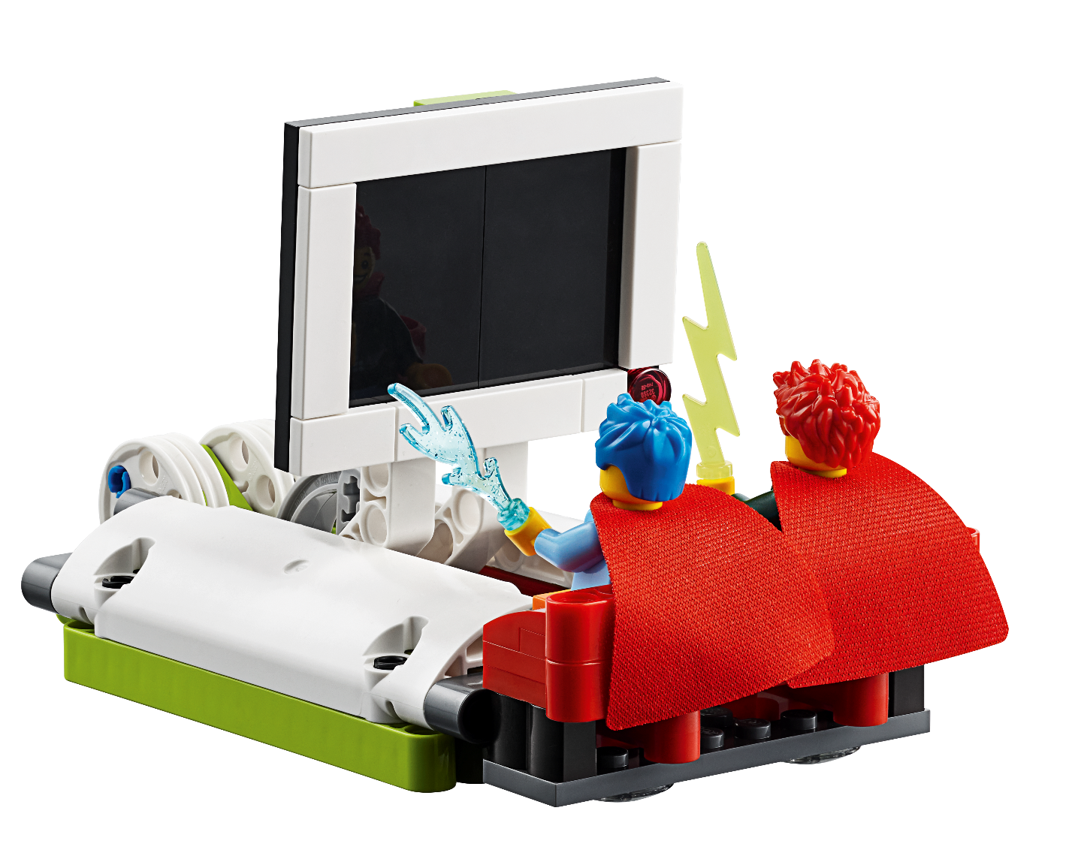
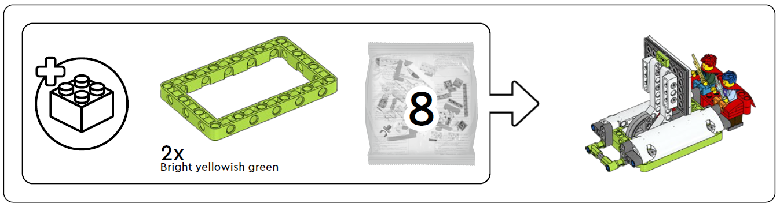
Watch Television
2 bags
Notes:
Facilitator Tips
Find videos for each mission in the interactive Robot Game Rulebook.

Slide 17
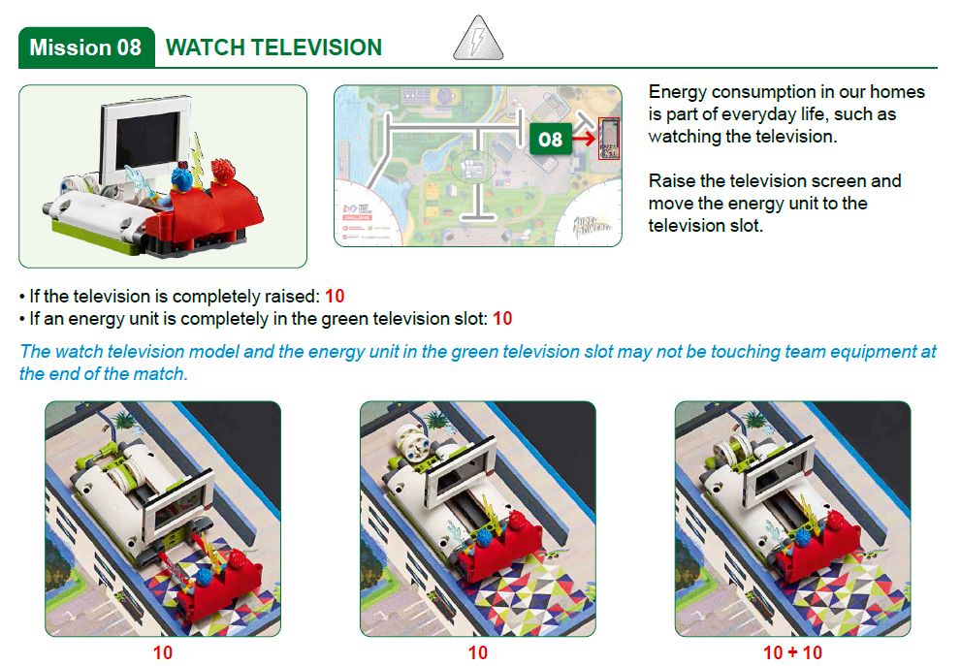
Robot
Game
Rulebook
page 9

Slide 18
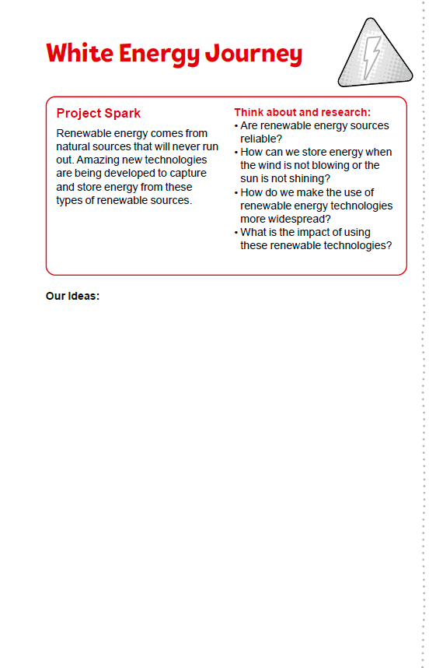
White Energy Project Spark
Look over the orange energy journey on page 9.
Identify the missions that relate to the models you built.
Discuss how the mission models are linked to the Project Spark.
Capture your ideas.
Notes:
Facilitator Tips
Make sure the team label their diagram with lots of details that explains how their solution works.

Slide 19

Share
Get together at the mat.
Place each model where it belongs. Refer to the Field Setup section in the Robot Game Rulebook.
Share the robot skills you learned.
Show how the models work and explain their connections to the Project Spark.
Chat about the reflection questions.
Clean up your space.

Slide 20
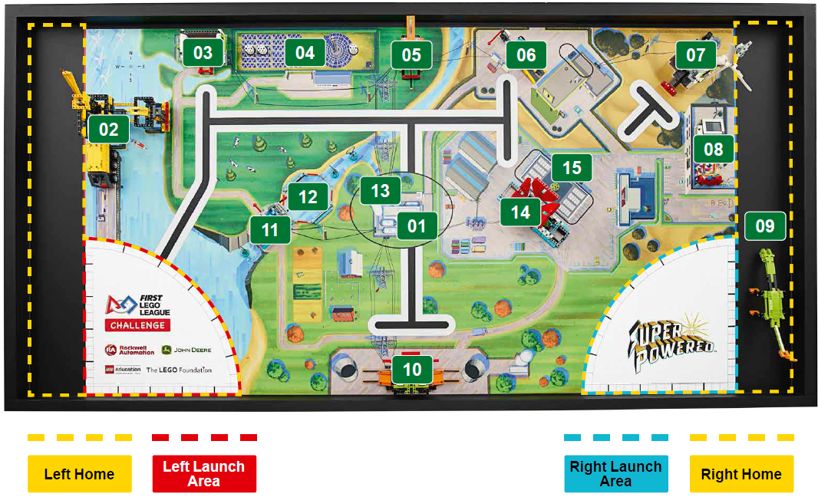
Models built this session are for the circled missions.
Notes:
Place the completed models on the mat with Dual Lock™ according to the field setup in the Robot Game Rulebook.

Slide 21
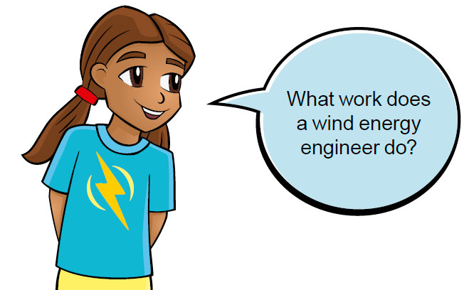
Reflection Questions
What Innovation Project ideas do the mission models spark?
What are the pros and cons of the different parts of the white energy journey?
Notes:
The team can use these Reflection Questions during the Share time. Sharing at the end is an important way for the team to summarize and reflect.

Slide 22
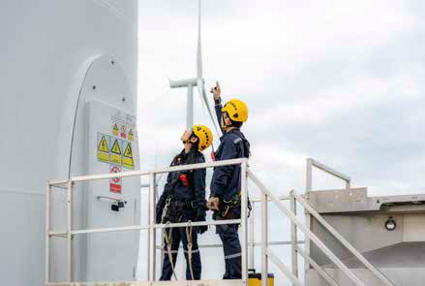

Career Connections
Wind Energy Engineer
Role:
A wind energy engineer designs wind turbines and wind farms and then creates and tests them in the field.
Notes:
https://firstinspiresst01.blob.core.windows.net/first-energize/fll-challenge/fll-challenge-career-connections.pdf

Slide 23

Multimedia Resources
You may wish to embed a relevant, age-appropriate video for your students here. See the Notes for an example.
Notes:
Choose a relevant, age-appropriate video for your students.
Example:
How is wind energy produced? - Sustainability for kids Part 1 | Vestas – https://www.youtube.com/watch?v=-8-9j3mXlYE – length 2:06
How does a wind turbine work? - Sustainability for kids Part 2 | Vestas – https://www.youtube.com/watch?v=gHUJqTT3THU – length 2:46

Slide 24

Clean Up
Notes:
Allow time for cleanup and place any unfinished models and their pieces in a sealed plastic bag.

Slide 25


FIRST® and the FIRST® logo are registered trademarks of For Inspiration and Recognition of Science and Technology (FIRST). LEGO® and MINDSTORMS® are registered trademarks of the LEGO Group. FIRST® LEGO® League and SUPERPOWEREDSM are jointly held trademarks of FIRST and the LEGO Group. SPIKE™ Prime is a trademark of LEGO® Education. All other trademarks are the property of their respective owners. ©2022 FIRST and the LEGO Group. All rights reserved.

