Slide 1



Session 6
Identify
Solutions

Slide 2
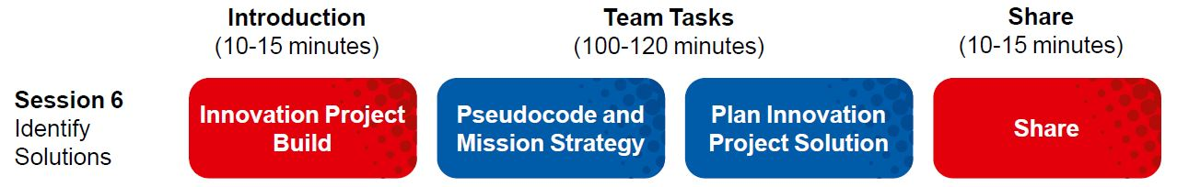
Session Overview
Outcomes
The team will create a mission strategy plan and write pseudocode for a mission.
The team will conduct research on their identified problem and start the Innovation Project Planning page.
Notes:
Facilitator Tips

Slide 3
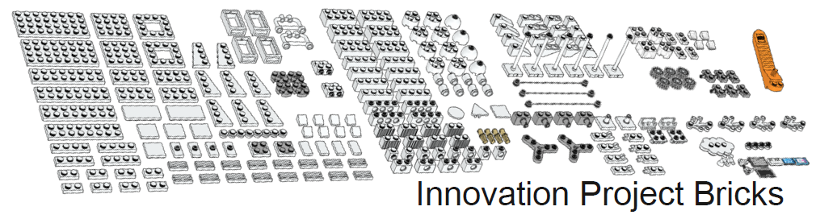

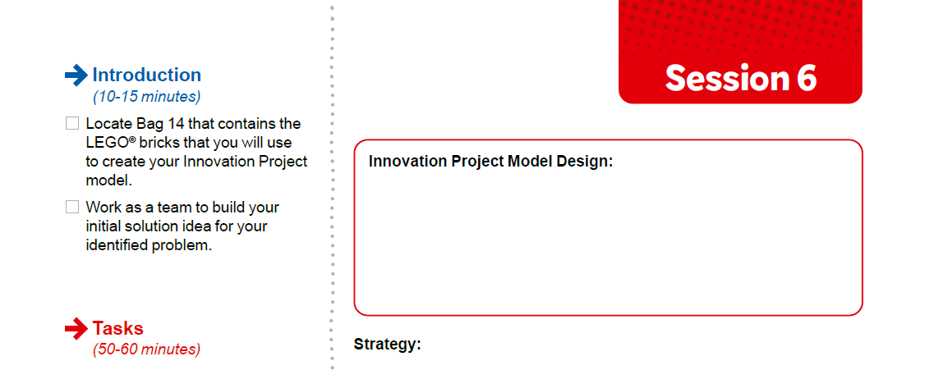

Introduction
Locate Bag 14 that contains the LEGO® bricks that you will use to create your Innovation Project model.
Work as a team to build your initial solution idea for your identified problem.
Notes:
Facilitator Tips
Using the Bag 14 bricks is a great way for the team to conceptualize their idea for an Innovation Project solution.

Slide 4

Pseudocode & Strategy
Watch the “Robot Game Missions” video.
Visit the
FIRST® LEGO ® League
YouTube Channel
to watch the
SUPERPOWERED season video
Notes:
Facilitator Tips
Mission videos can be found in the Robot Game Rulebook too!

Slide 5

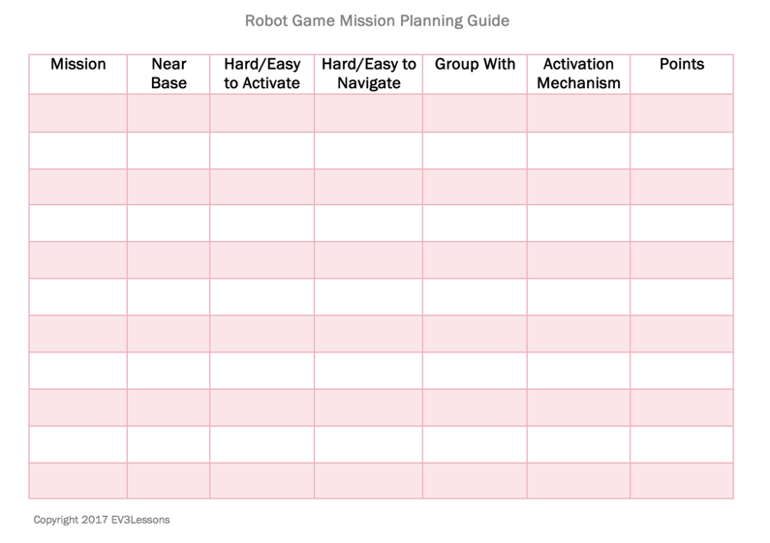
Pseudocode & Strategy
Start to think about your mission strategy.
Design an effective work plan.
Discuss which missions your team will attempt first.
Example from Droid Robotics (flltutorials.com)
Notes:
Facilitator Tips
Provide sticky notes and planning cards for team to place on the mat to map out their mission strategy.
Encourage the team to find the missions where points can be scored most easily and do these first.

Slide 6
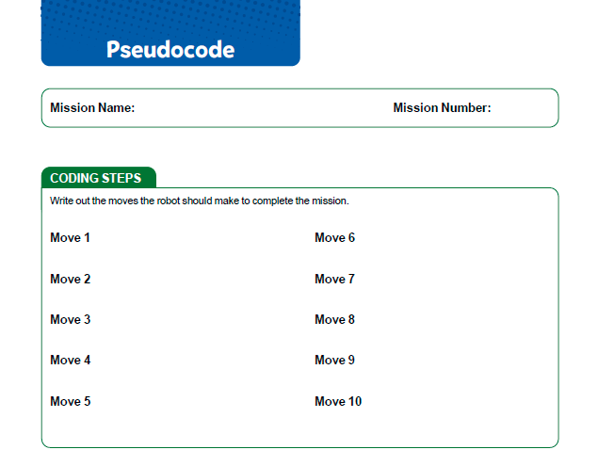
Pseudocode & Strategy
Complete the Pseudocode page.
Notes:
Facilitator Tips
The Pseudocode page can be photocopied. It can be used for each mission the team attempts.

Slide 7
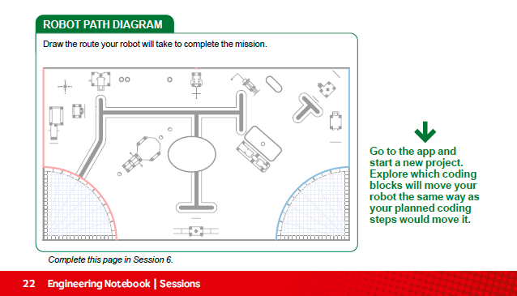
Pseudocode & Strategy
Notes:
Complete Pseudocode on page 22.
The Pseudocode page can be photocopied. It can be used for each mission the team attempts.

Slide 8
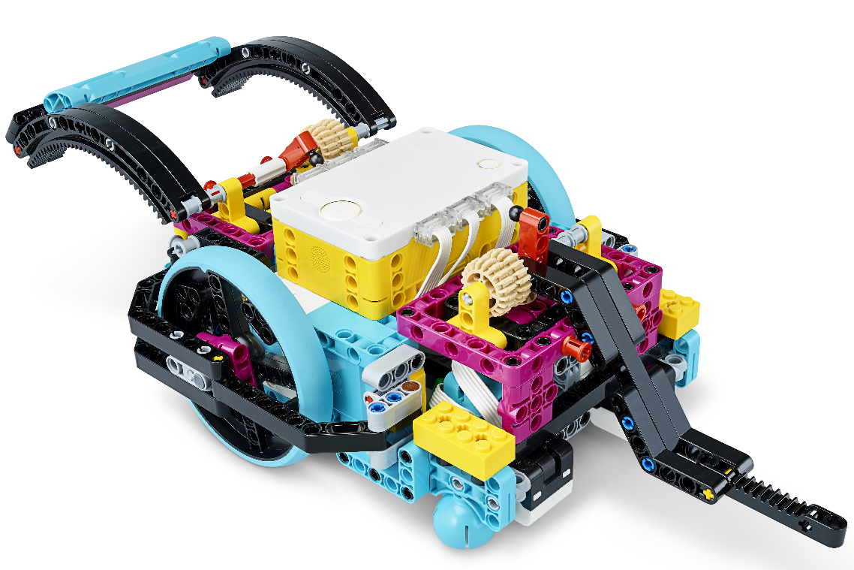

Pseudocode & Strategy
Think about how the program will make your robot act.
Revisit the earlier lessons or do the optional lesson listed here.
Revisit the earlier lessons or do the optional lesson listed here.
Notes:
URL for SPIKE on-line: https://spike.legoeducation.com (remember to use a Chrome browser)
Assembling an Advanced Driving Base – https://education.lego.com/en-us/lessons/prime-competition-ready/assembling-an-advanced-driving-base#lesson-plan

Slide 9


Reflection Questions
Pseudocode is a written description
of the steps for your planned robot program.
How could you use line following on the horizontal line at the top of the mat to help you navigate to the solar farm?
How did you use the engineering design process to create your mission strategy?

Slide 10
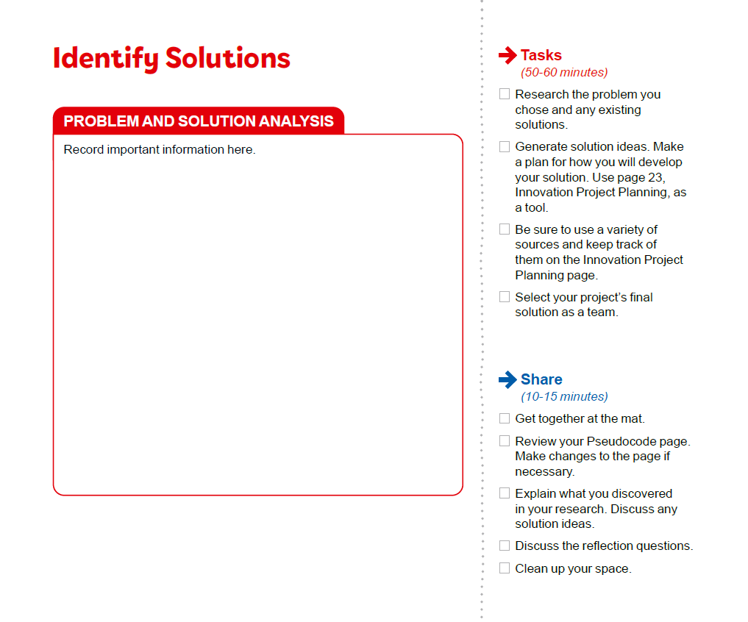
Teamwork
Research the problem you chose and any existing solutions.
Generate solution ideas. Make a plan for how you will develop your solution. Use page 23, Innovation Project Planning, as a tool.
Be sure to use a variety of sources and keep track of them on the Innovation Project Planning page.
Select your project’s final solution as a team.
Notes:
Facilitator Tips
Be sure the team collects their sources in a shared location, either online or on paper.
Take some extra time with the team if needed to explore all the solution ideas and narrow it down to one.
Make sure their solution has the potential to be developed and they can explain their solution clearly.
The Innovation Project Planning page can be completed over multiple sessions and helps the team document their process.

Slide 11
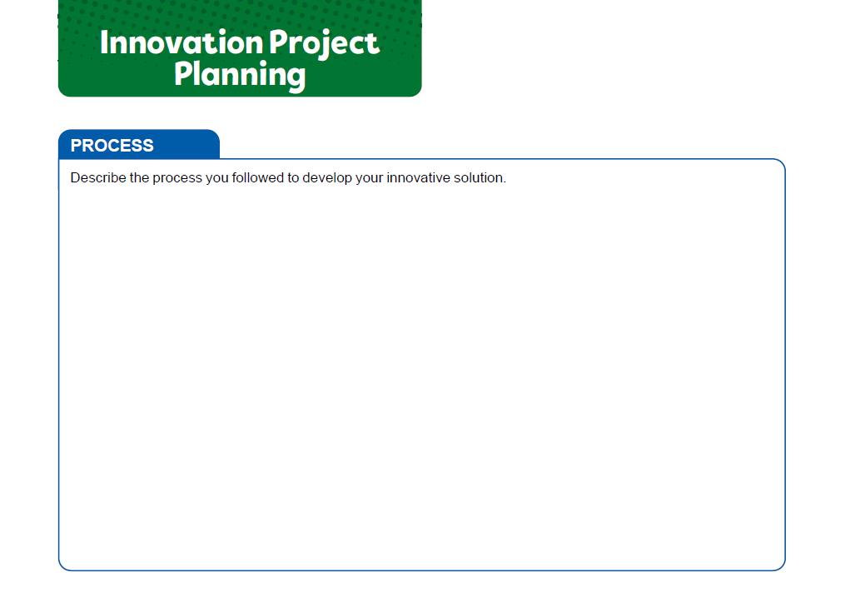

Notes:
Facilitator Tips

Slide 12
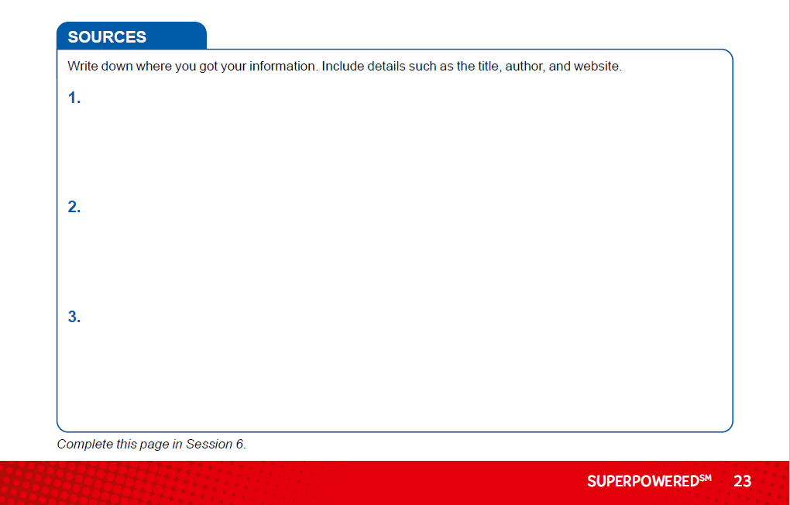
Notes:
Facilitator Tips

Slide 13
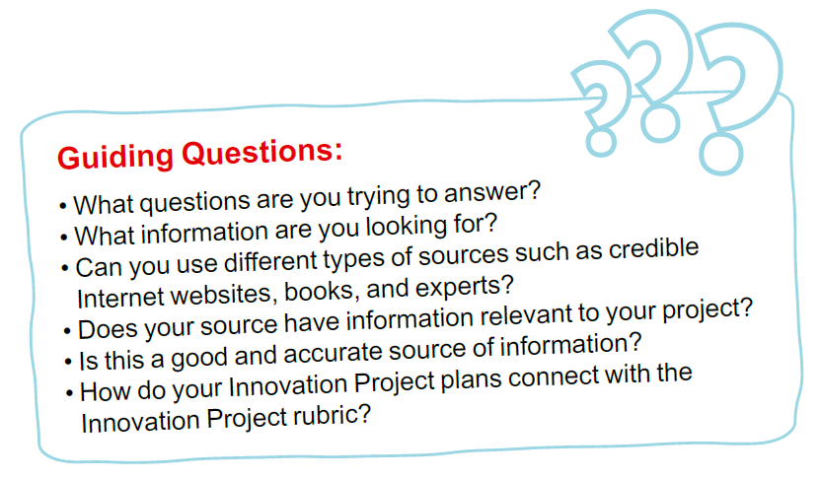
Guiding Questions
Notes:
Facilitator Tips

Slide 14

Share
Get together at the mat.
Review your Pseudocode page. Make changes to the page if necessary.
Explain what you discovered in your research. Discuss any solution ideas.
Discuss the reflection questions.
Clean up your space.

Slide 15

Reflection Questions
• What types of improvements do existing solutions need?
• What are your brand-new ideas to solve the problem?

Slide 16


Career Connections
Oil and Gas or Petroleum Industry
Warehouse Worker
Notes:
Know the Oil and Gas or Petroleum Industry — Career, and Job Options – https://www.youtube.com/watch?v=2dCvfwJNlNc – length 3:13
What Do Reservoir Engineers Do in the Oil and Gas Industry? – https://www.youtube.com/watch?v=D2ttA9nsMfc – length 3:30
Day in the Life: Process Engineer – https://www.youtube.com/watch?v=We6crowUIkM&t=1s – length 3:36

Slide 17

Multimedia Resources
You may wish to embed a relevant, age-appropriate video for your students here. See the Notes for an example.
Notes:
Choose a relevant, age-appropriate video for your students.
Example:
5 Minutes to Code: Programming Basics "Pseudocode" – https://www.youtube.com/watch?v=HhBrkpTqzqg – length 5:00
How Robots Can Assist - Not Replace - Humans in Factories from CNBC Length 8:43 https://youtu.be/hhBSaVsMvgE

Slide 18

Clean Up

Slide 19


FIRST® and the FIRST® logo are registered trademarks of For Inspiration and Recognition of Science and Technology (FIRST). LEGO® and MINDSTORMS® are registered trademarks of the LEGO Group. FIRST® LEGO® League and SUPERPOWEREDSM are jointly held trademarks of FIRST and the LEGO Group. SPIKE™ Prime is a trademark of LEGO® Education. All other trademarks are the property of their respective owners. ©2022 FIRST and the LEGO Group. All rights reserved.

