Slide 1



Session 7
Create Solutions

Slide 2
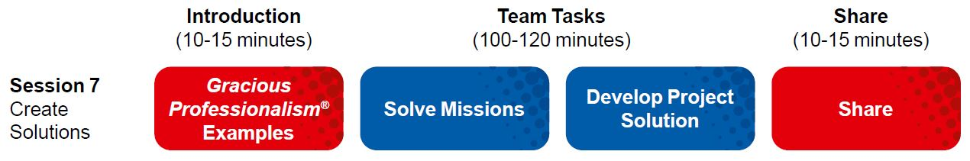
Session Overview
Outcomes
The team will create their project solution and complete the Innovation Project Planning page.
The team will design and create a robot to complete Robot Game missions.

Slide 3
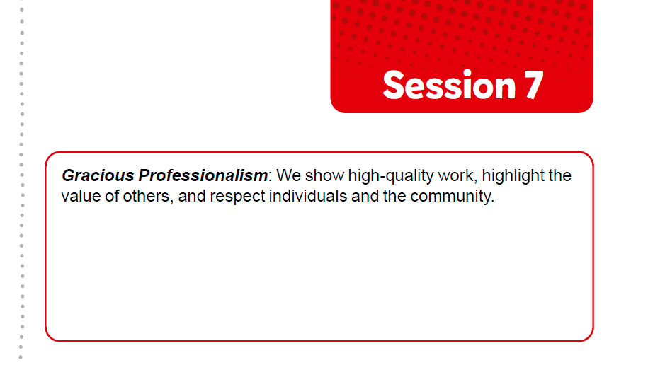

Introduction
Think about Gracious Professionalism®.
Write ways your team will demonstrate this in everything you do.
Notes:
Facilitator Tips
Check the team knows the Core Values and understands what Gracious Professionalism® is.

Slide 4
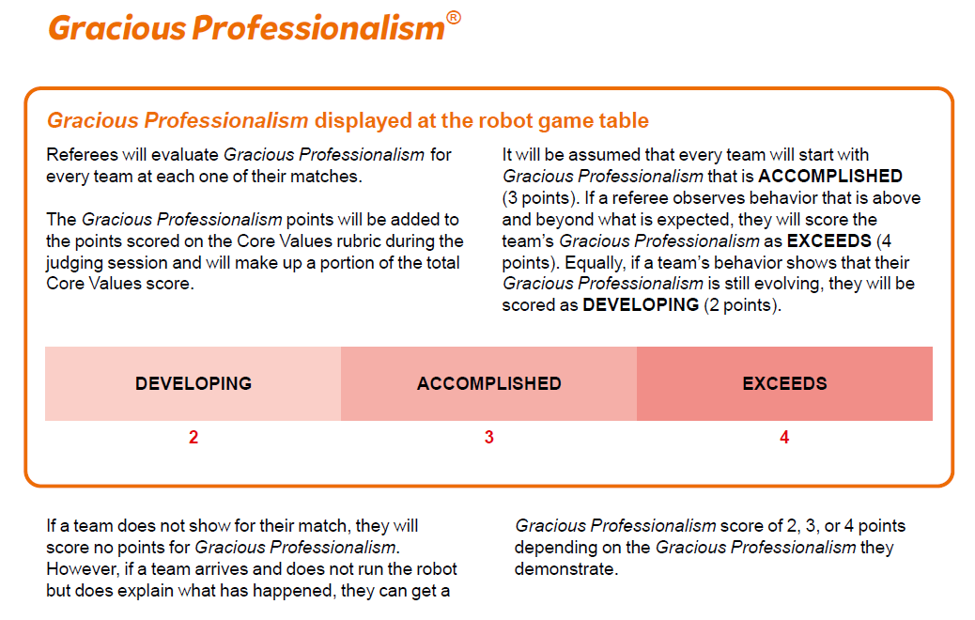
Introduction
Look over page 6 in the Robot Game Rulebook to see how Gracious Professionalism® is evaluated during the tournament.
Notes:
Facilitator Tips
Check the team knows the Core Values and understands what Gracious Professionalism® is.

Slide 5
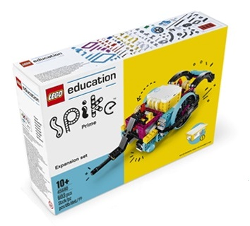
Solve Missions
Continue to develop your robot and its attachments to complete missions in the Robot Game.
You can improve the existing robot used in the previous sessions or create a new design.
Create a program for each new mission you attempt. You could combine mission solutions into one program.
Test and improve your robot and its programs.
Revisit previous lessons to develop your coding skills or work on solving the missions.
Notes:
URL for SPIKE on-line: https://spike.legoeducation.com (remember to use a Chrome browser)
Facilitator Tips
Different members of the team can be responsible for specific missions and develop and own the robot run for those missions.
When the team has a base robot, do a straight drive test. If it doesn’t go straight, look at the robot’s center of gravity and balance.
Have the team determine which launch area will be the starting position and make sure there is enough room for the whole robot to fit inside the launch area.
Encourage the students to explain the program as the robot moves.

Slide 6
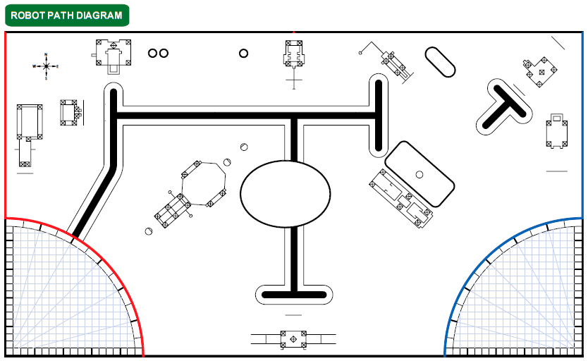
Solve Missions

Slide 7


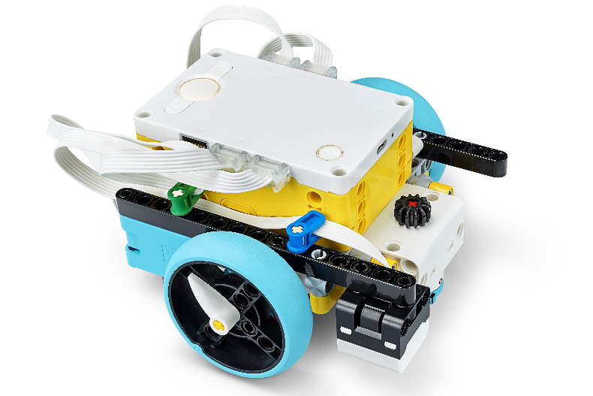
Reflection Questions
Can you follow how the program on your device is making your robot move?
How can you iterate and improve on the existing robot design used in previous sessions?

Slide 8
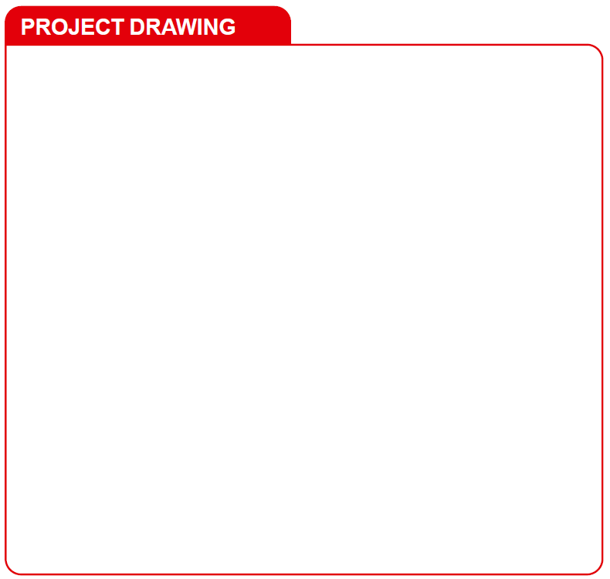
Develop Project Solution
Develop and create your Innovation Project solution.
Sketch your solution. Label the parts and how it will work.
Notes:
Facilitator Tips
Provide a variety of materials for the team to use to make a prototype of their project solution.
A drawing can include a detailed annotated sketch or a computer-aided design (CAD) drawing.

Slide 9

Develop Project Solution
Describe your solution and explain how it solves the problem.
Create a prototype, model, or drawing of your solution.
Document the process you use to develop your solution on page 23, Innovation Project Planning.
Notes:
Facilitator Tips
Have the team think of people (users or experts) they would like to get feedback from on their solution.
Arrange a visit to look at energy examples in your community that can be a focus of the project.
Consider inviting an expert or user to this session to share content about their identified problem.

Slide 10

Share
Get together at the mat.
Show any missions you are working on or have completed.
Discuss your research and your Innovation Project solution.
Discuss the reflection questions.
Clean up your space.

Slide 11

Reflection Questions
Can you describe your innovative solution in under five minutes?
How does your solution address your identified problem?

Slide 12



Career Connections
Hybrid Vehicle Technicians
Warehouse Worker

Slide 13

Multimedia Resources
You may wish to embed a relevant, age-appropriate video for your students here. See the Notes for an example.
Notes:
Choose a relevant, age-appropriate video for your students.
Example:
How Rechargeable Batteries Work – https://www.youtube.com/watch?v=vBovLDv7qvE – length 8:14
EnerSys Careers | Join a Winning Team – https://www.youtube.com/watch?v=TwnmIxrhnTk&t=3s – length 4:00

Slide 14

Clean Up

Slide 15


FIRST® and the FIRST® logo are registered trademarks of For Inspiration and Recognition of Science and Technology (FIRST). LEGO® and MINDSTORMS® are registered trademarks of the LEGO Group. FIRST® LEGO® League and SUPERPOWEREDSM are jointly held trademarks of FIRST and the LEGO Group. SPIKE™ Prime is a trademark of LEGO® Education. All other trademarks are the property of their respective owners. ©2022 FIRST and the LEGO Group. All rights reserved.

