Slide 1
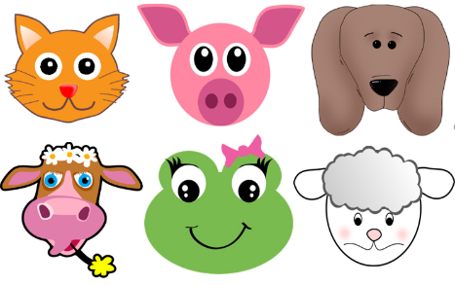
Animal graphic project
A project to make amazing animals that can walk!

Slide 2
Stay safe
Whether you are a scientist researching a new medicine or an engineer solving climate change, safety always comes first. An adult must always be around and supervising when doing this activity. You are responsible for:
ensuring that any equipment used for this activity is in good working condition
behaving sensibly and following any safety instructions so as not to hurt or injure yourself or others
Please note that in the absence of any negligence or other breach of duty by us, this activity is carried out at your own risk. It is important to take extra care at the stages marked with this symbol: ⚠

Slide 3
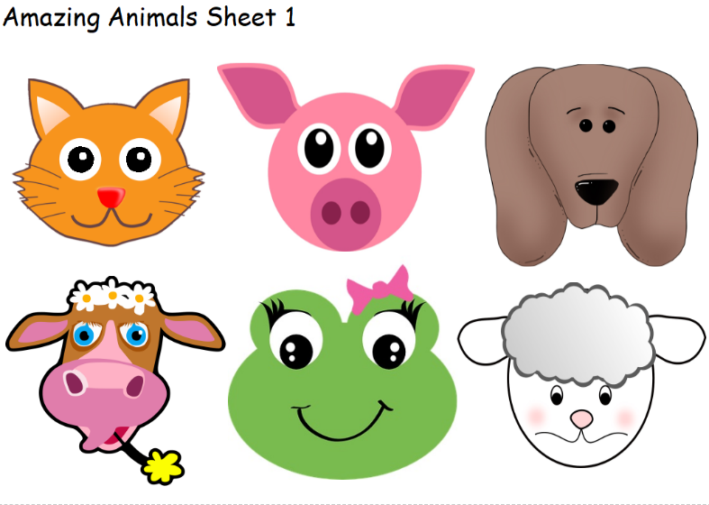
Step 1 – Choose your animal
Choose a face
⚠ Cut it out carefully with scissors
Or you could design your own animal face!

Slide 4
Step 2 – Attach the face
Gently squeeze the card tube
⚠ Make one cut near the end, carefully with scissors
Insert your animal face into the cut

Slide 5
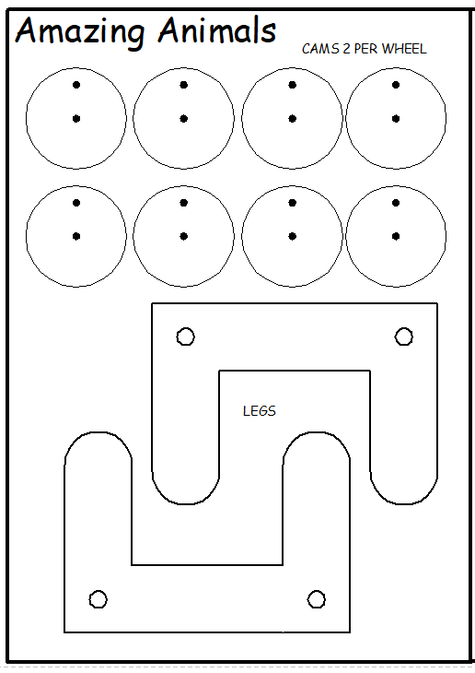
Step 3 – Animal legs template
⚠ Carefully cut the cams and legs with scissors

Slide 6
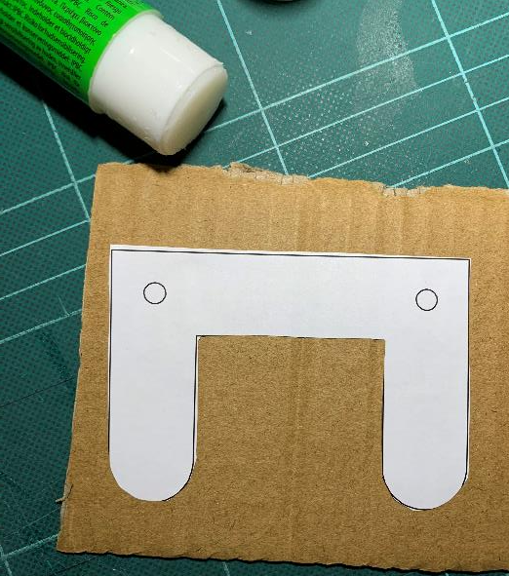
Step 4 – Animal legs
Glue template to cardboard
⚠ Carefully cut out with scissors
Put an eraser or sticky tack behind the hole, then push a sharp pencil in to make a small hole

Slide 7
Step 5 – Leg holes
Mark 2 points on each side of the card tube
Use the holes from the legs as a template - push a pencil through each hole in the legs to mark the points
Try to get the holes on each side in line with each other
Put an eraser or sticky tack behind the hole, then push a sharp pencil in to make a small hole. Repeat this for all 4 holes.

Slide 8
Step 6 – Leg holes
⚠ Carefully push a skewer or stick through the holes to make sure they line up
Keep your fingers out of the way of the skewer!
Get an adult to help you

Slide 9
Step 7 – Leg Cams
Glue cam templates to cardboard
⚠ Carefully cut out with scissors
Glue 2 cams together

Slide 10
Step 8 – Leg Cams
Split pin goes here
Put an eraser or sticky tack behind the hole, then push a sharp pencil in to make a small hole
Repeat this to make two holes in each cam
Connect the cams to the legs using split pins (through the hole nearest the edge)
Skewer goes here
Linkage

Slide 11
Step 9 – Leg 1
⚠ Cut the skewers to 7cm
Get an adult to help
Use glue to attach the skewers to the cams
LET THE GLUE DRY!
Push through the holes in the card tube

Slide 12
Step 10 – Leg 2
Use glue to attach the legs on the other side of the body to the skewers
LET THE GLUE DRY!
To see the legs work, roll the front skewer between 2 fingers

