Slide 1
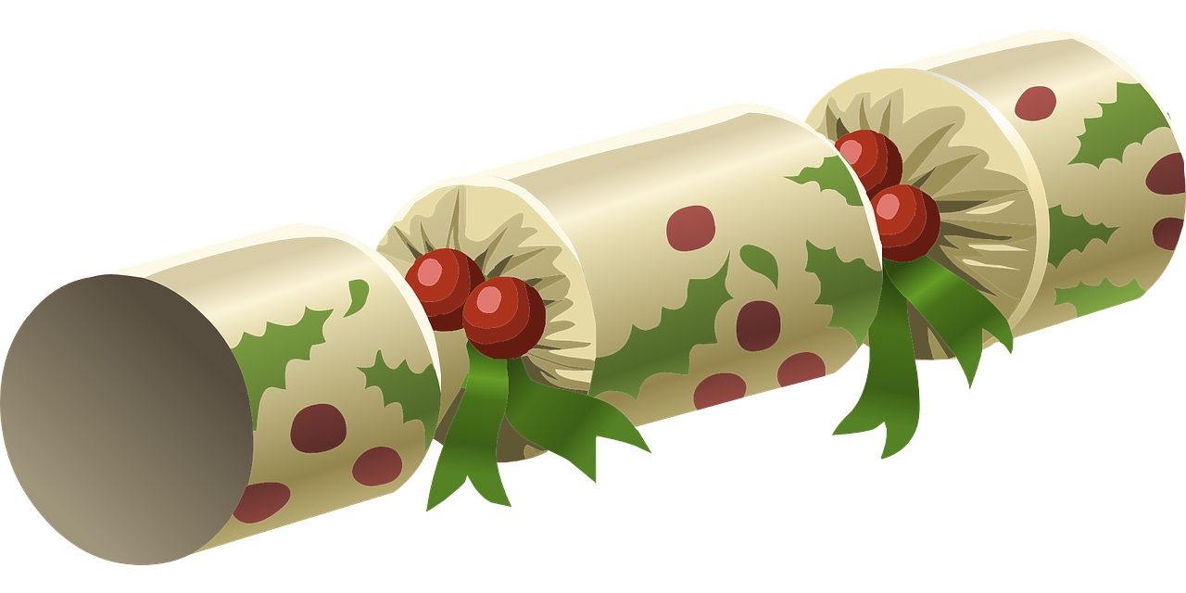
Christmas cracker jokes
Making a booklet to contain very funny Christmas cracker jokes

Slide 2
Stay safe
Whether you are a scientist researching a new medicine or an engineer solving climate change, safety always comes first. An adult must always be around and supervising when doing this activity. You are responsible for:
ensuring that any equipment used for this activity is in good working condition
behaving sensibly and following any safety instructions so as not to hurt or injure yourself or others
Please note that in the absence of any negligence or other breach of duty by us, this activity is carried out at your own risk. It is important to take extra care at the stages marked with this symbol: ⚠

Slide 3
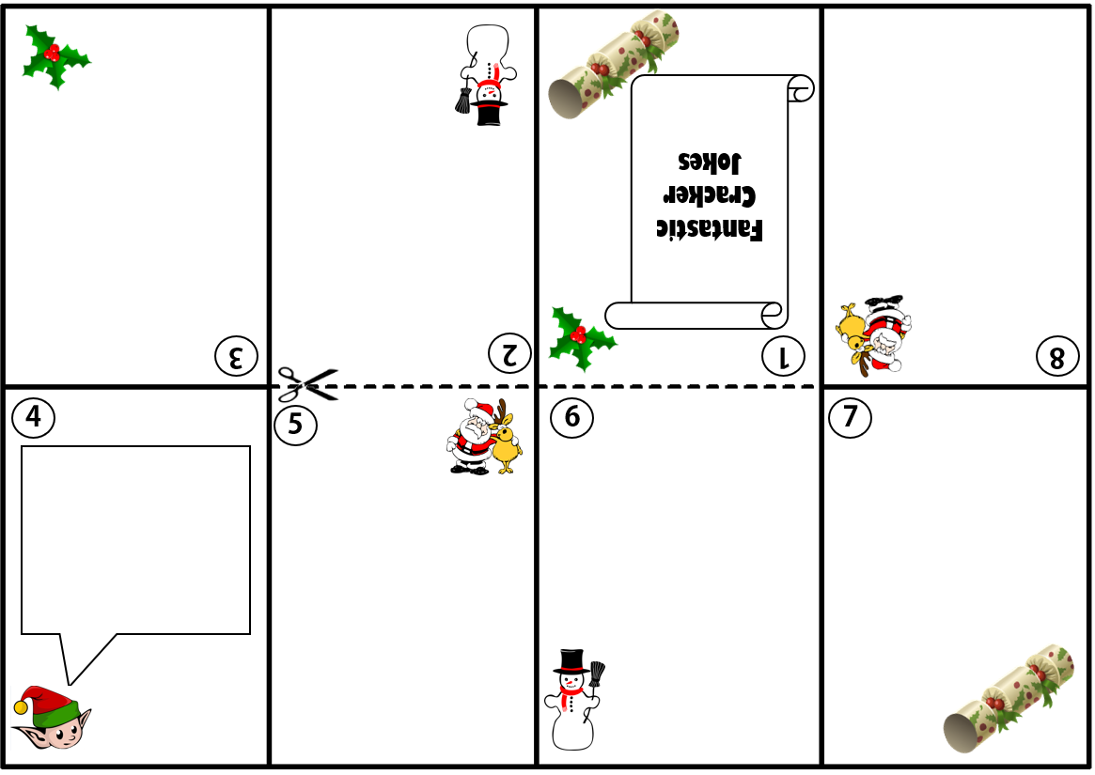
Step 1 – Activity handout

Slide 4
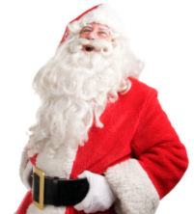
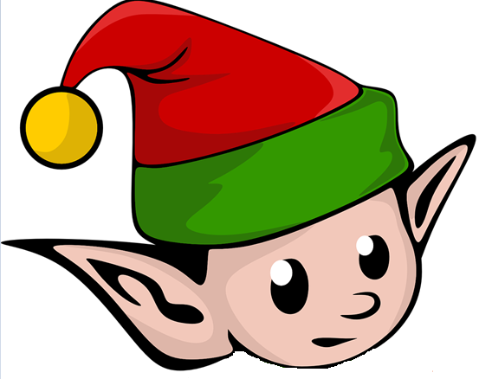
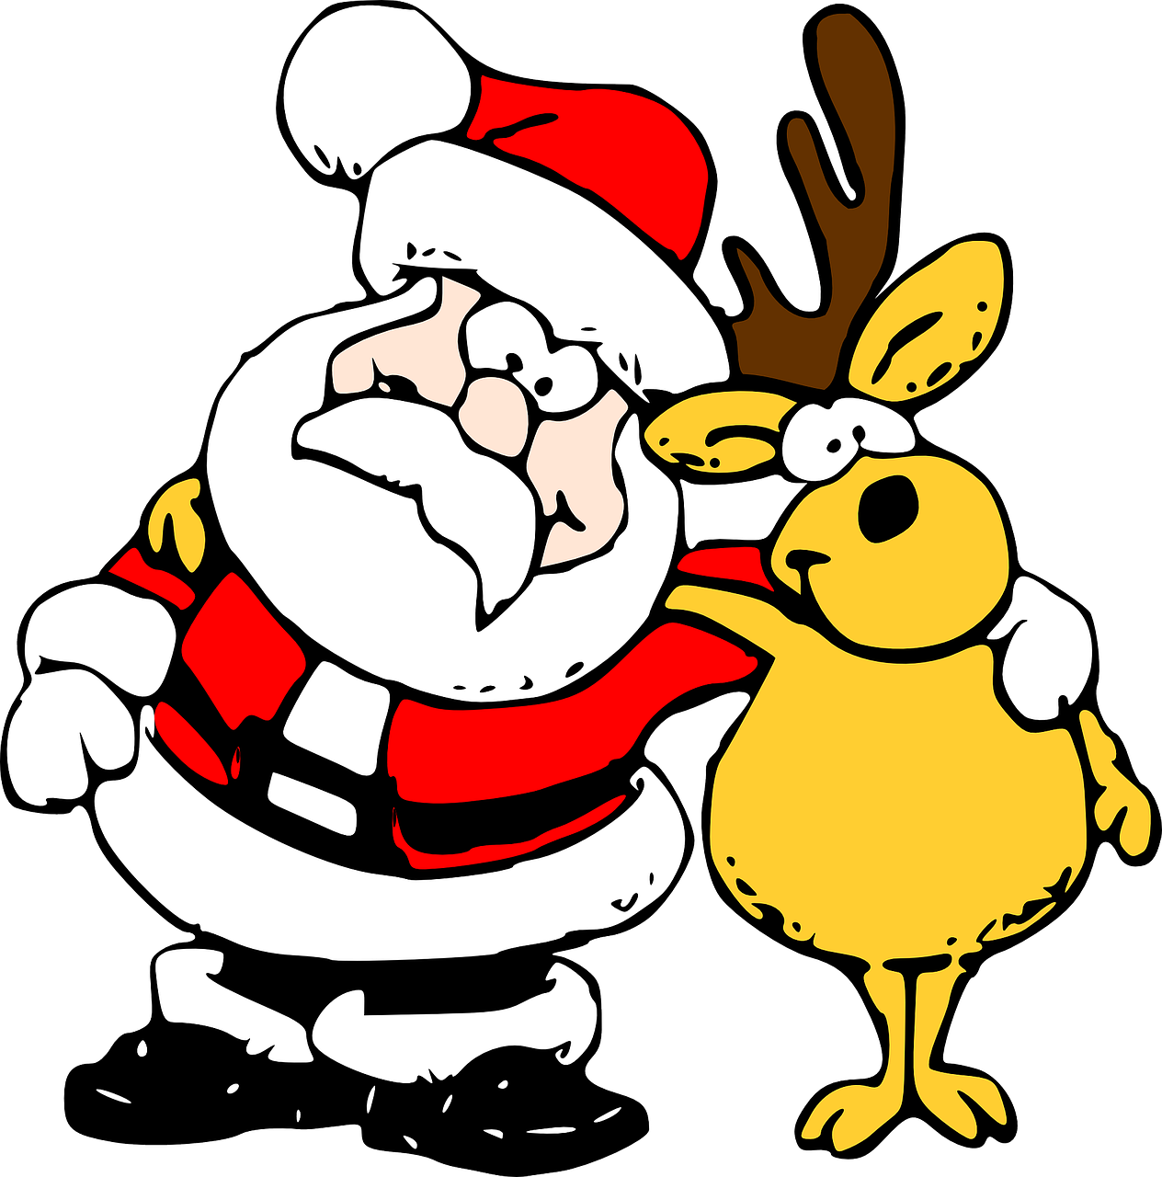
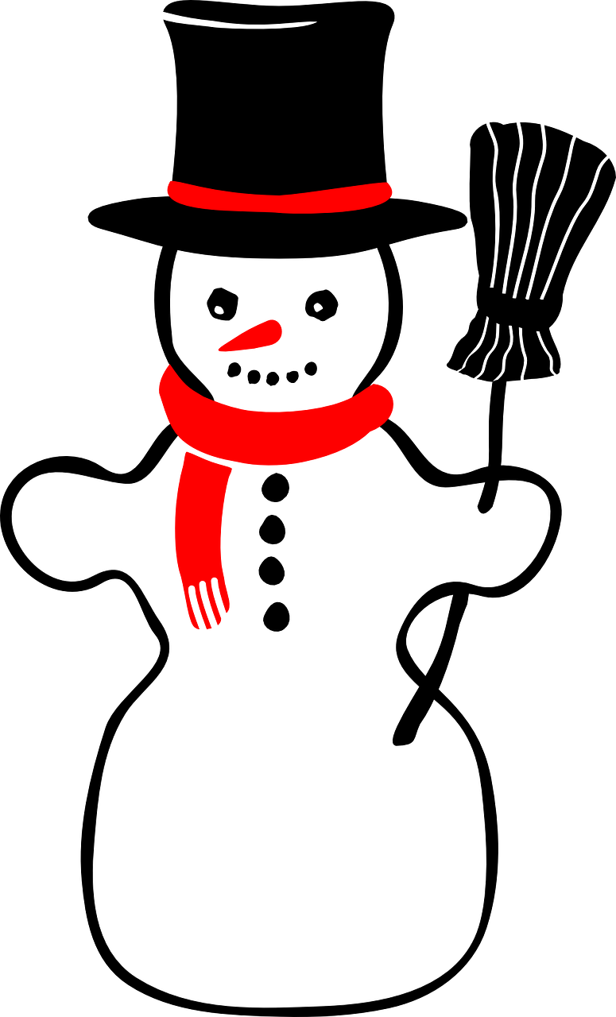
Step 2 – Add your jokes
What do you call
Santa Claus when
he doesn’t move?
Santa Pause
Why is it always
cold at Christmas?
Because it’s
Decemberrrrrrrr!
What did the cow
get for Christmas?
A COWculator!
What do you call a
snowman in the
Summer?
A puddle!
What did the big candle say to the little candle??
I’m going out tonight.
What do elves learn
in school?
The elf-abet!
More jokes next slide

Slide 5
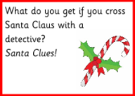
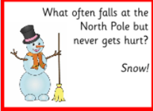
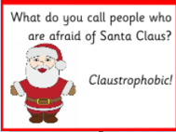
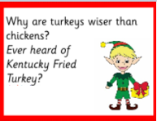
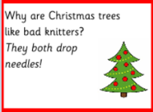
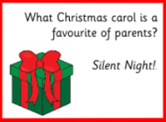
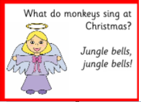
Step 2 – Add your jokes

Slide 6
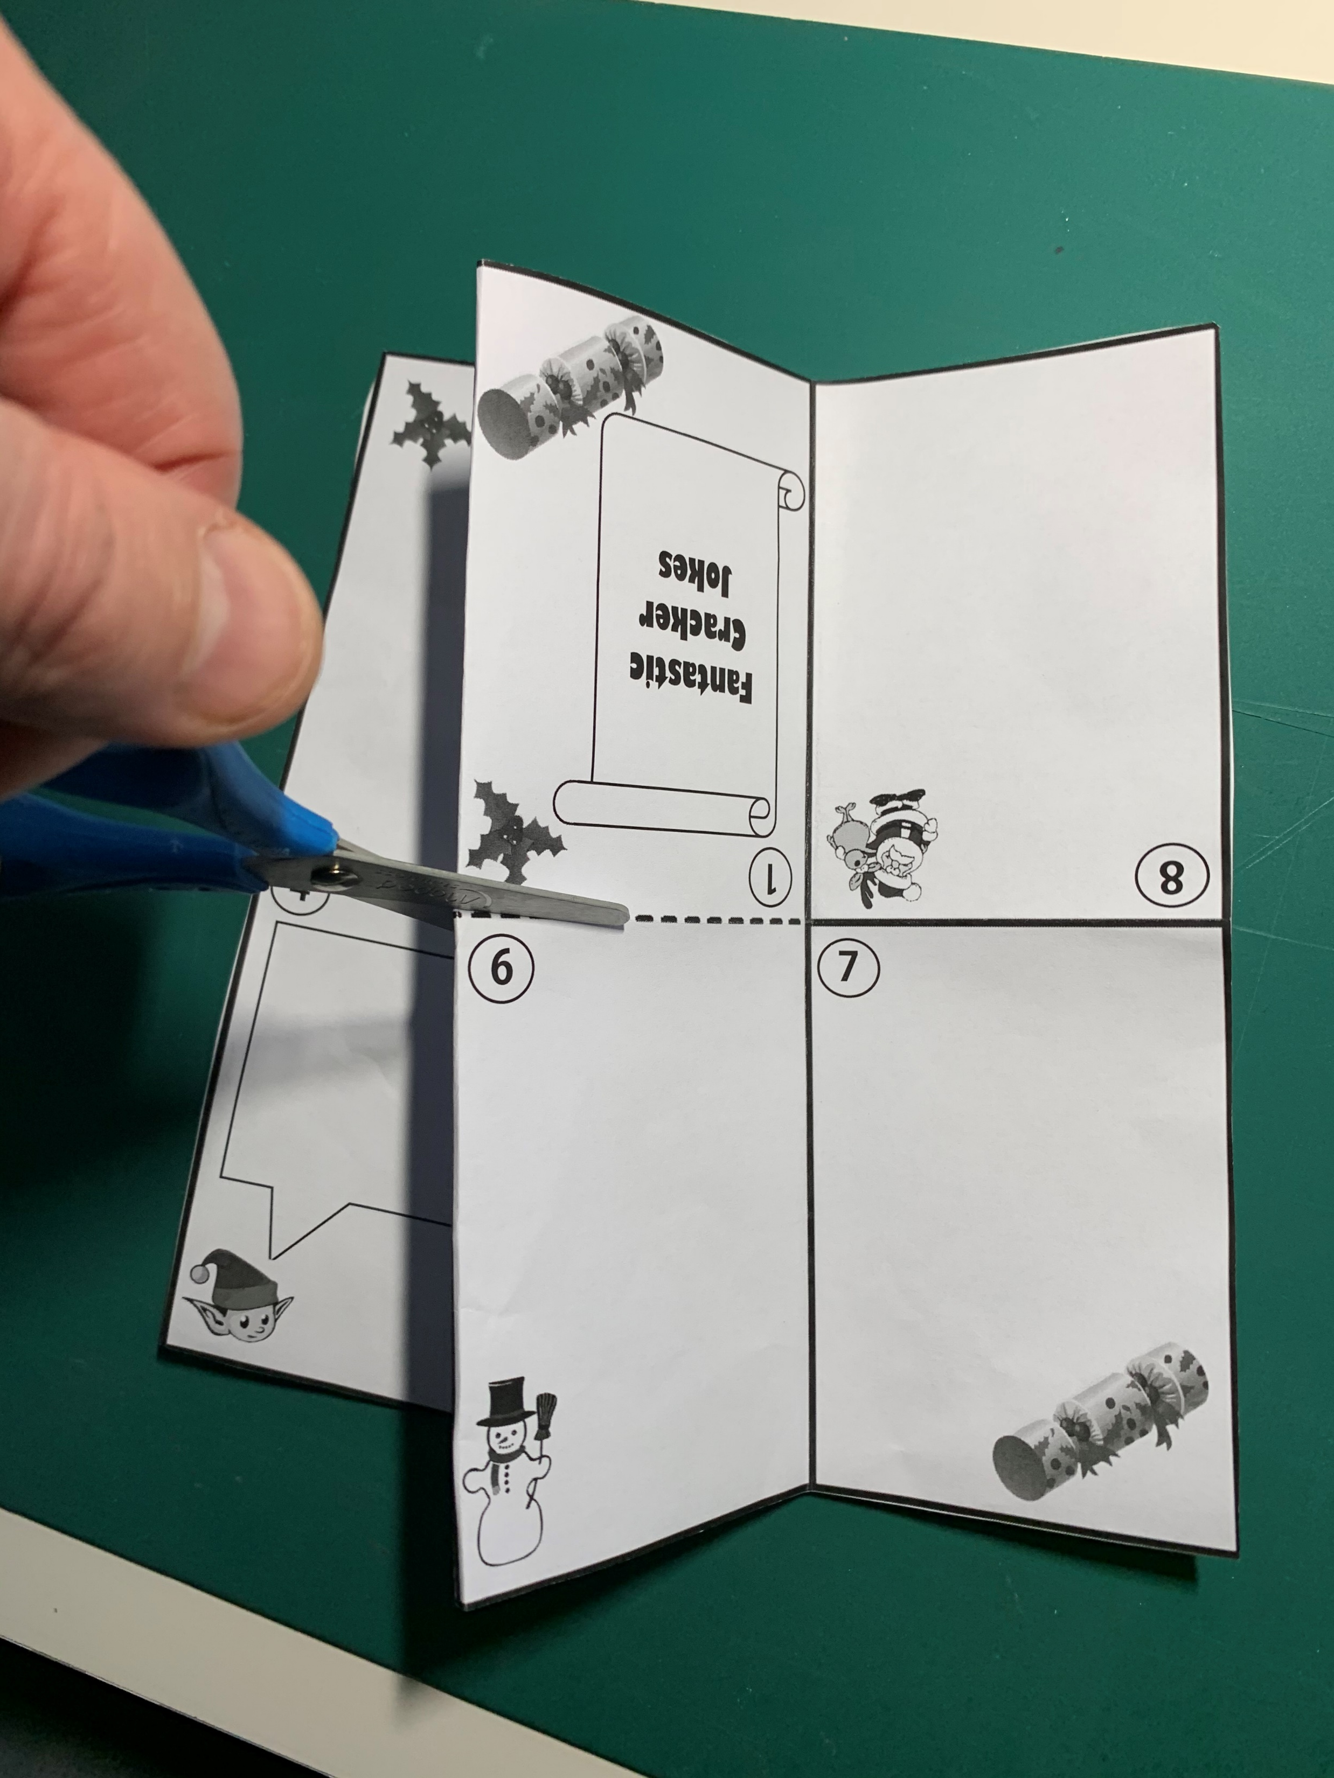
Step 3 – Cut out and fold the template
Carefully cut along the solid lines
Fold along the solid lines
Cut along the centre

Slide 7
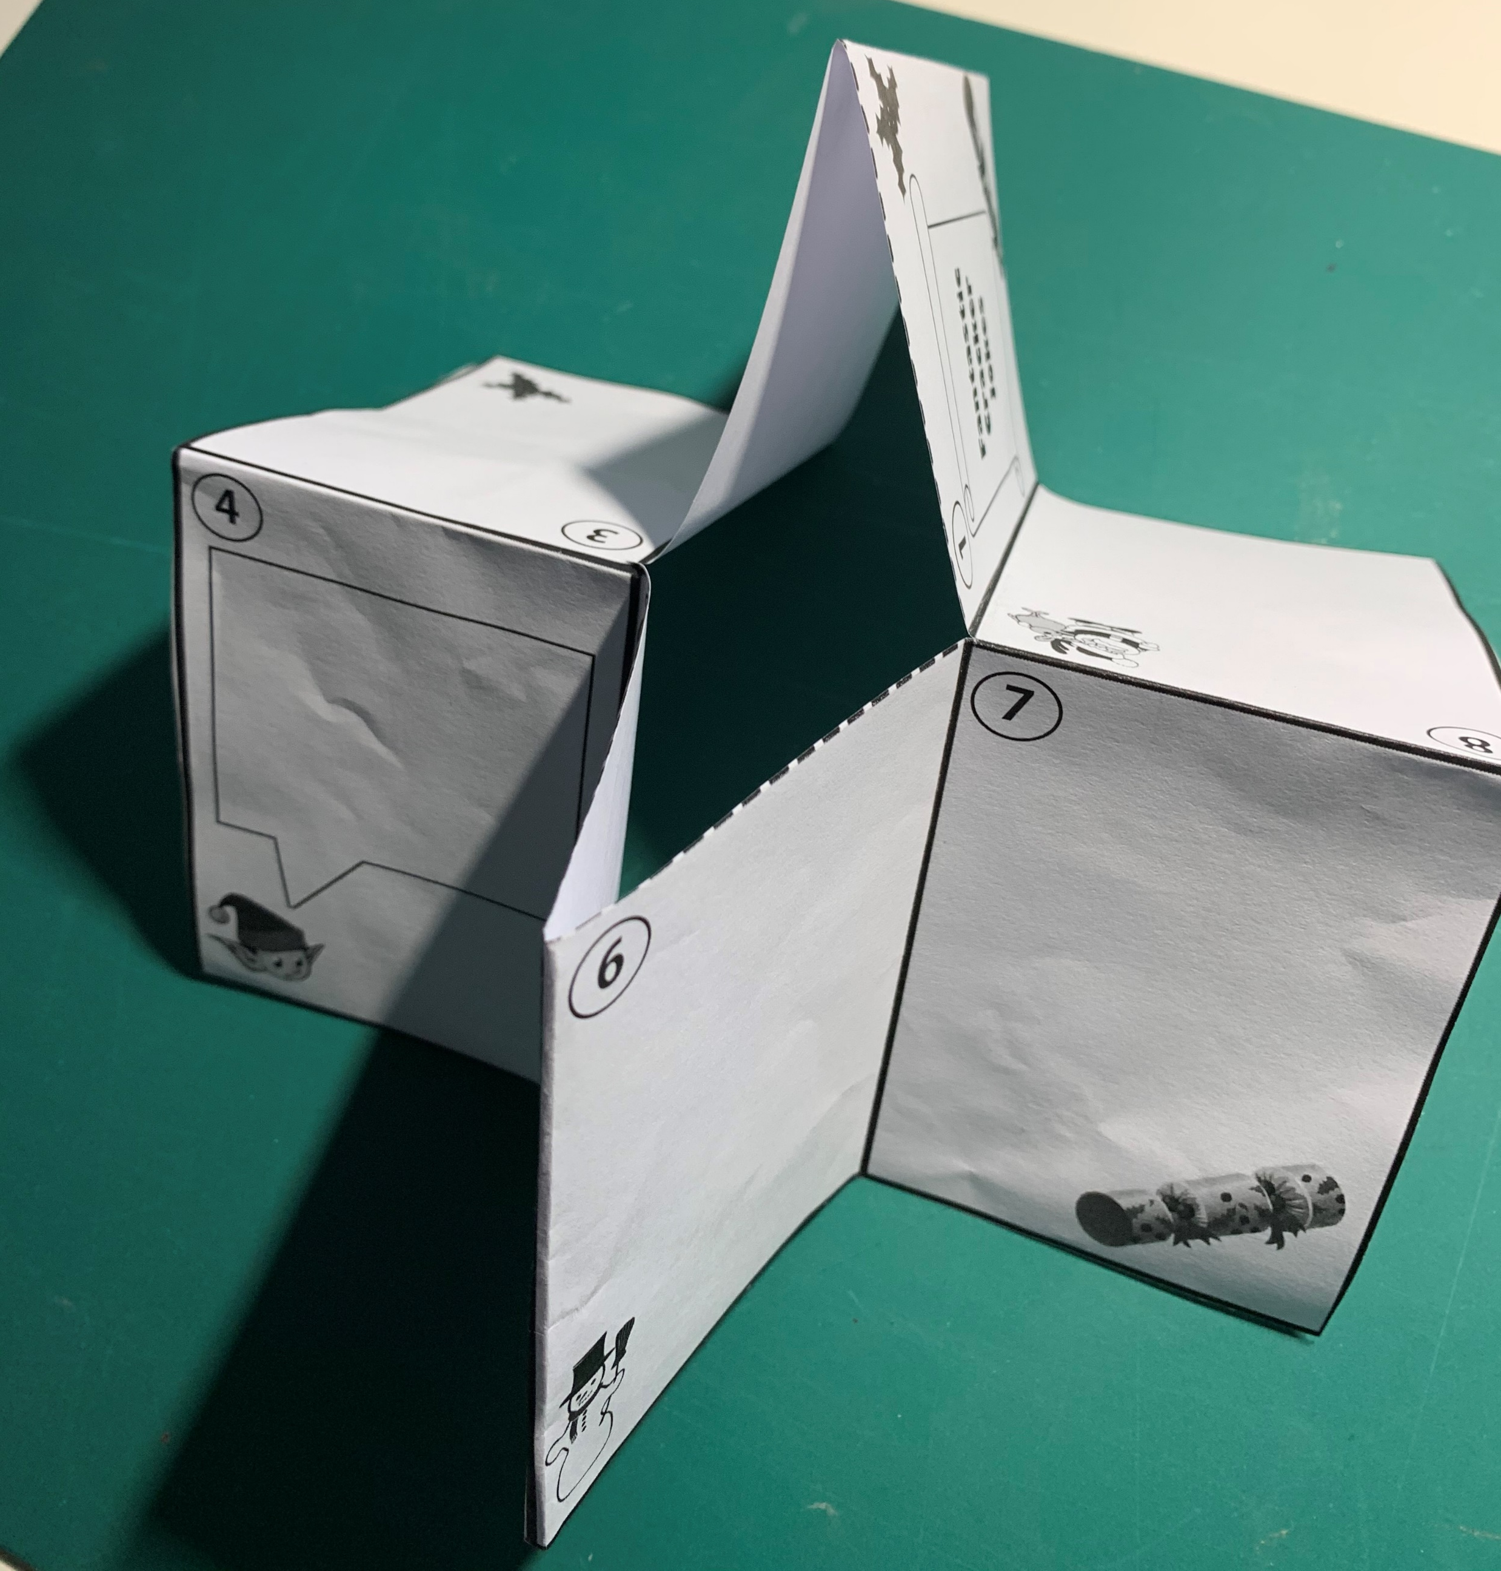
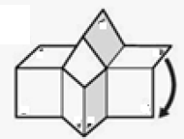
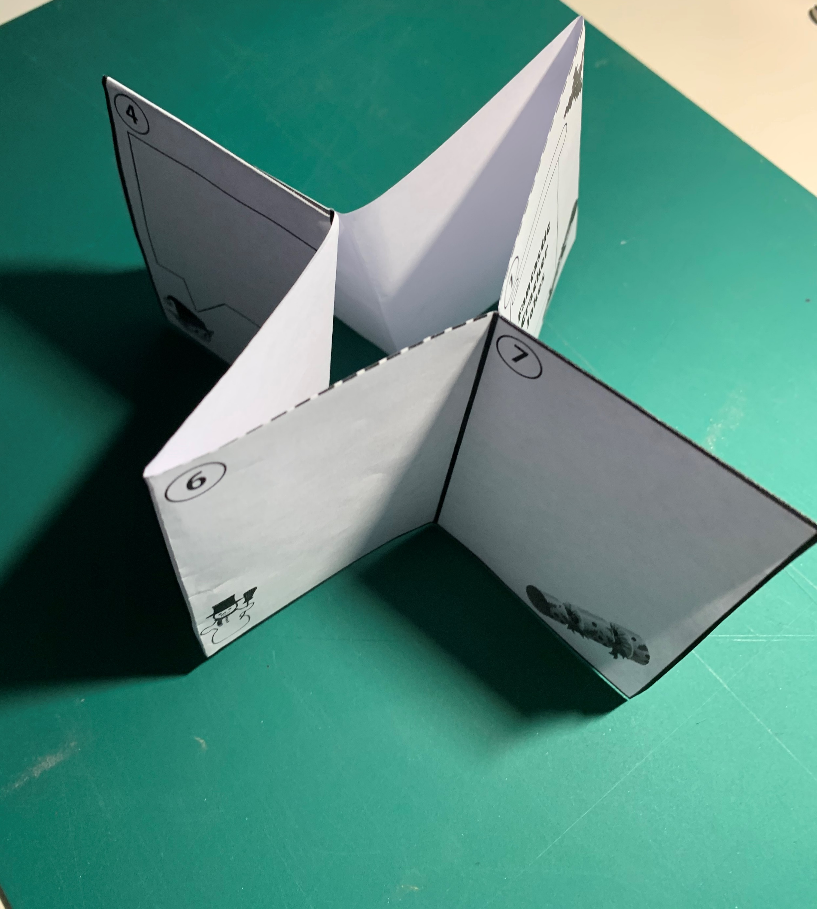
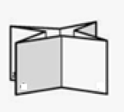
Step 4a – Fold the booklet over

Slide 8
Step 4b – Make your booklet
Fold to make a booklet
Now try out your joke book!

