Slide 1
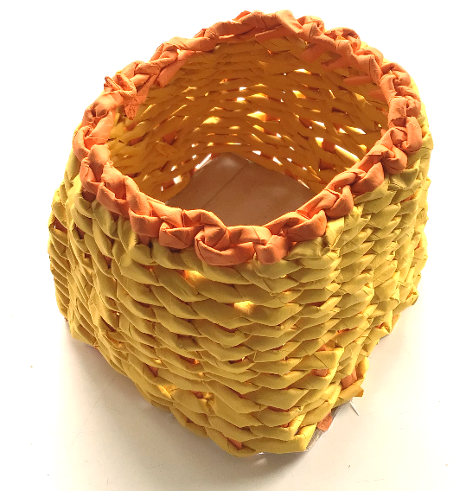
Recycled Basket
Making woven baskets out of recycled paper

Slide 2
Recycled Basket
Stay safe
Whether you are a scientist researching a new medicine or an engineer solving climate change, safety always comes first. An adult must always be around and supervising when doing this activity. You are responsible for:
ensuring that any equipment used for this activity is in good working condition
behaving sensibly and following any safety instructions so as not to hurt or injure yourself or others
Please note that in the absence of any negligence or other breach of duty by us, this activity is carried out at your own risk. It is important to take extra care at the stages marked with this symbol: ⚠

Slide 3
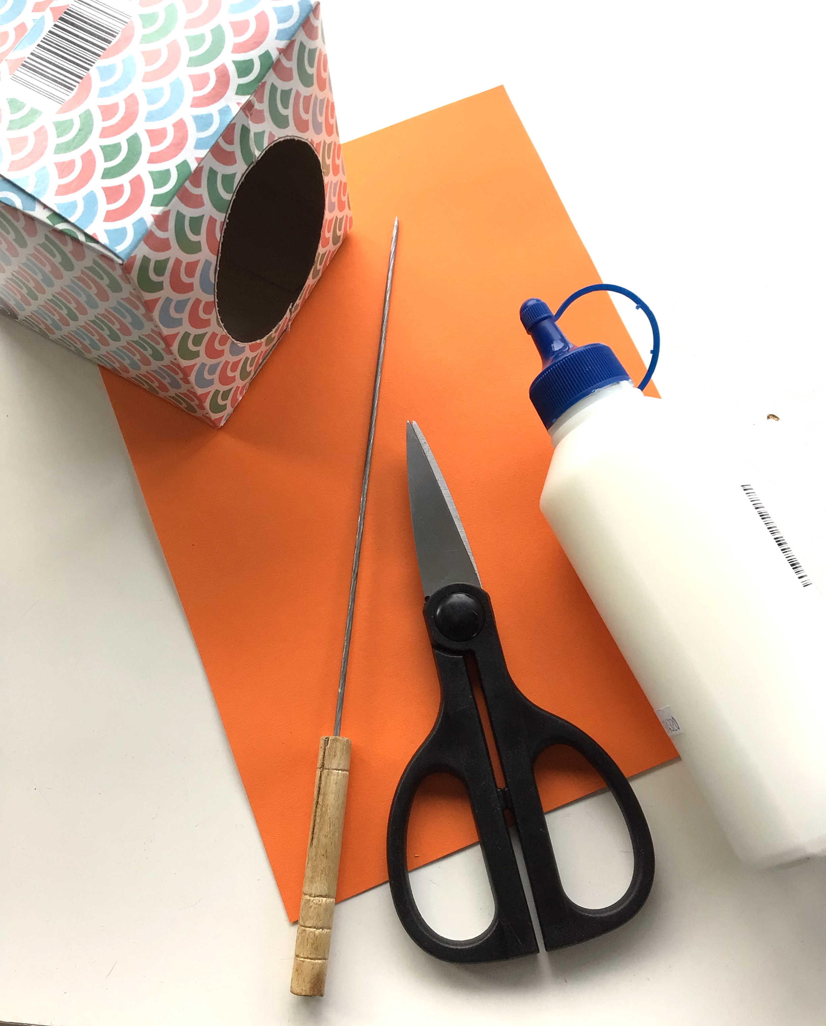
Resources ⚠
Recycled paper
Scissors
PVA glue
Skewer
Empty cardboard box
Notes:
Recycled newspaper or other types of recycled paper can be used. Artstraws can be used instead of paper – if using art straws go directly to step 4.

Slide 4
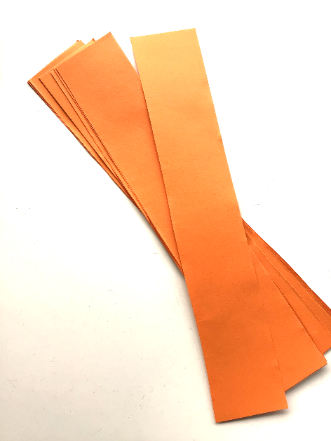
Step 1
Cut each piece of paper into four long strips ⚠
Notes:
Four lengths from a sheet of A4 is about the right width.

Slide 5
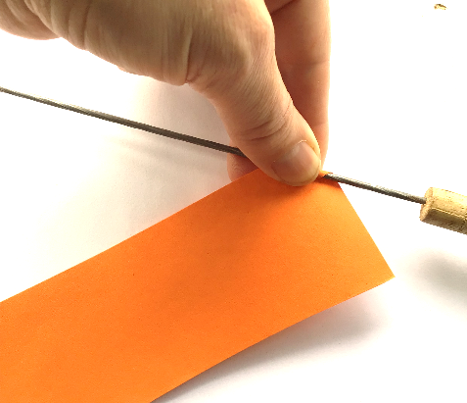
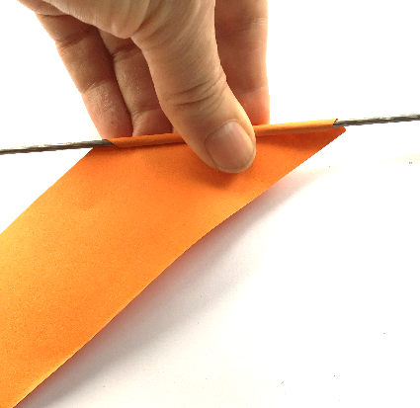
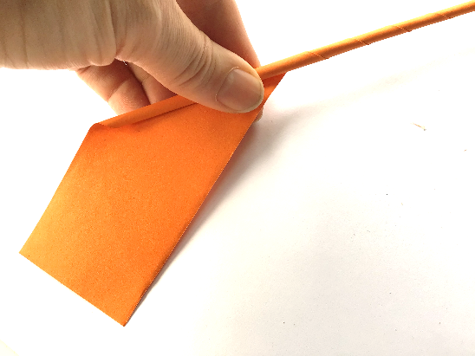
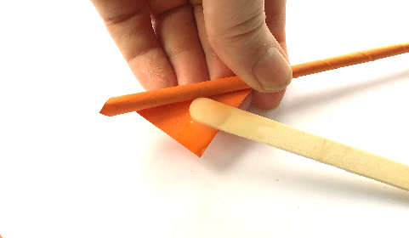
Step 2
Wrap a strip of paper around the skewer at an angle
Roll tightly to form a straw
Glue the end of the straw ⚠
Notes:
Use a blob of glue to the end of the straw to secure in place. The skewers should be removed form the inside of each newly made straw, taking care not to touch any sharp edges.

Slide 6
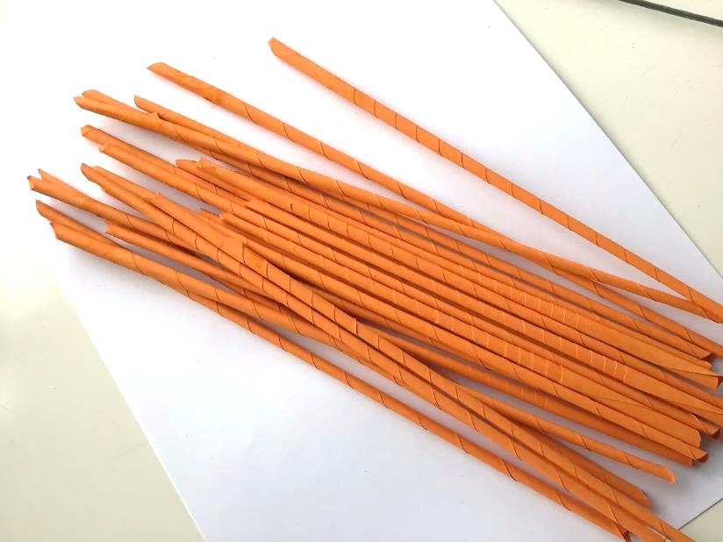
Step 3
Make 24 straws for the frame of the basket
Make 20 straws of a different colour
Notes:
A minimum of 24 straws must be made for the frame, with an additional 20 of a different colour.

Slide 7
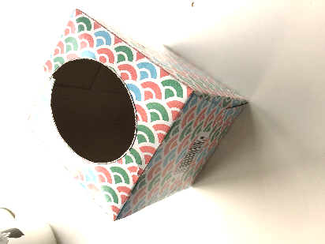
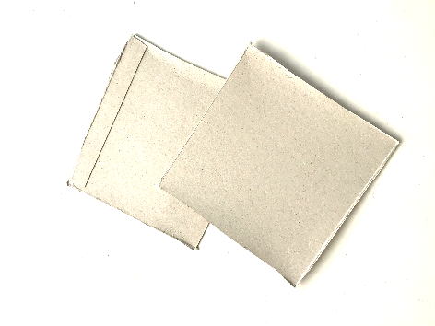
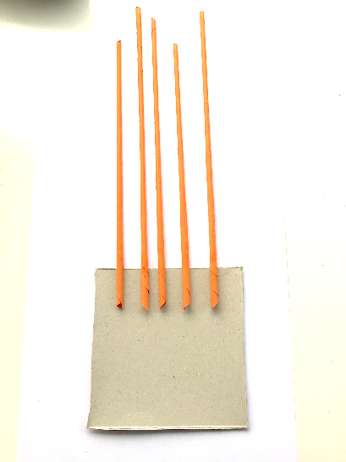
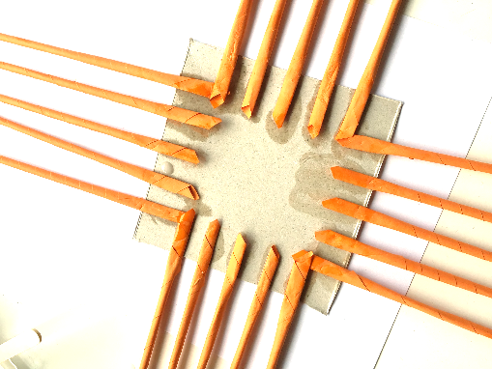
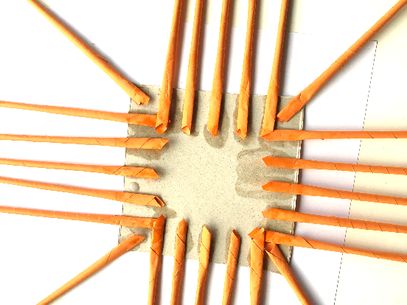
Step 4a
Cut out 2 squares from the cardboard box ⚠
Glue 5 straws to the base – do again for each side
Glue another straw at an angle in each corner (4 total)

Slide 8
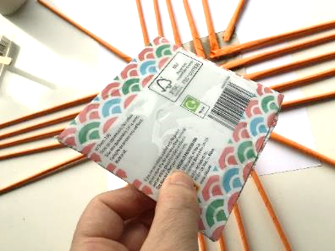
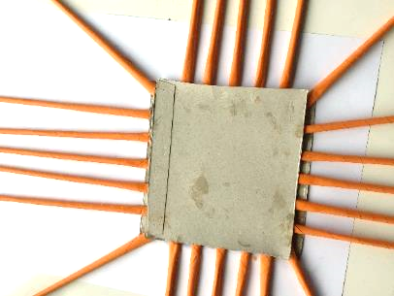
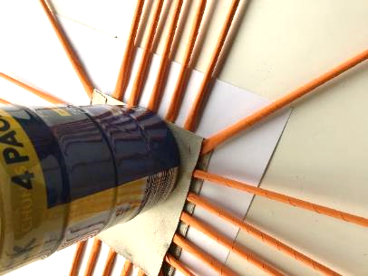
Step 4b
Cover the second card square with glue ⚠
Stick this square on top of the base - use a weight to hold it down ⚠
Wait for the glue to dry
Notes:
Make sure the second cover is well covered with glue. For the weight, a tin can be used, but anything heavy will work. Ensure the glue has dried completely before moving to the next step.

Slide 9
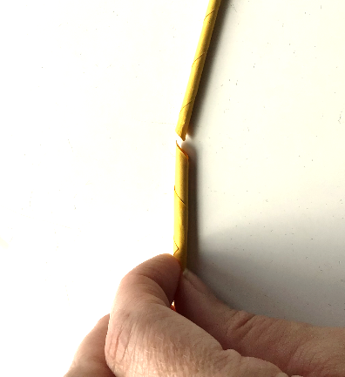
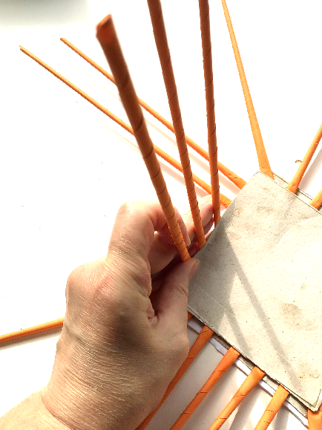
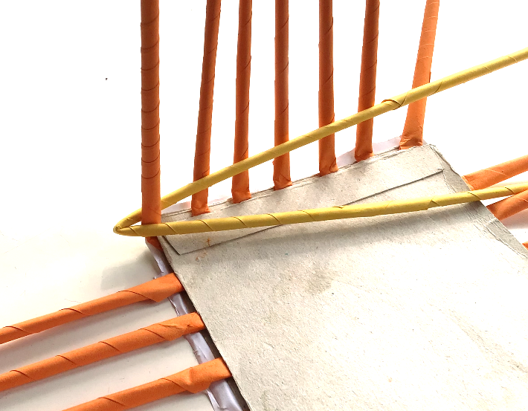
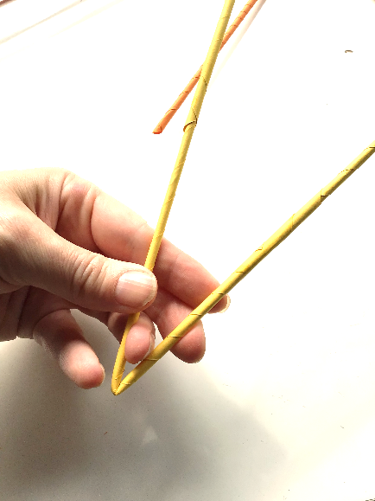
Step 5a
Fold the frame straws upwards
Create a weaving straw – fit the narrow end of a straw into the fatter end of another
Fold around the frame corner

Slide 10
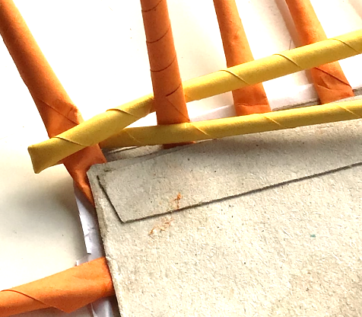
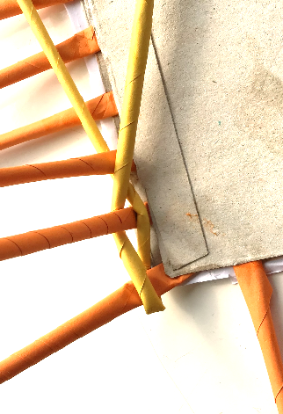
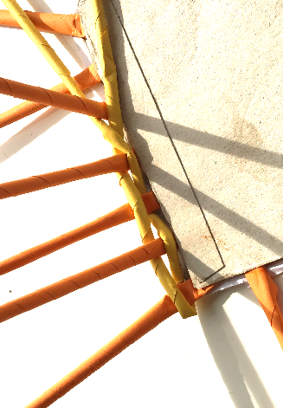
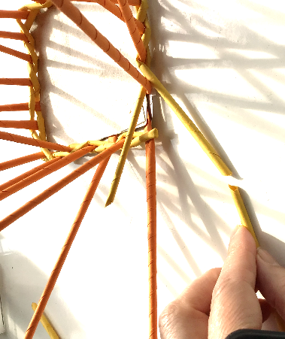
Step 5b
Fold the weaving straws either side of the frame straws as shown
Keep adding straws to the weaving straws to make bigger as needed
Notes:
The yellow straw in the pictures is the weaving straw. Overlap the upright straws and work along the base of the basket. Keep folding the front first to the rear and then bring the rear straw over the top to the front.

Slide 11
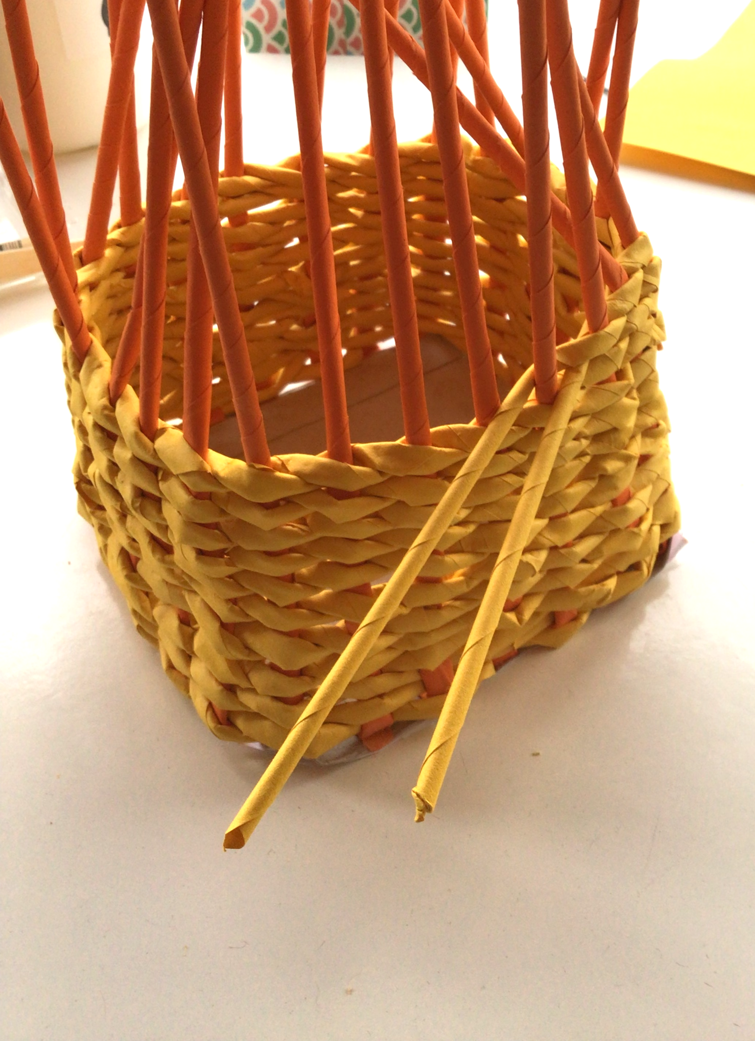
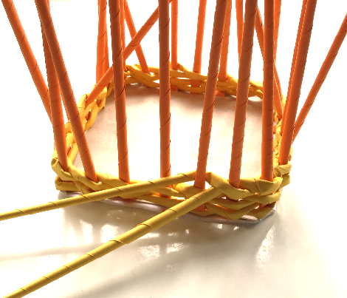
Step 5c
Continue to weave straws around the basket until it is high enough

Slide 12
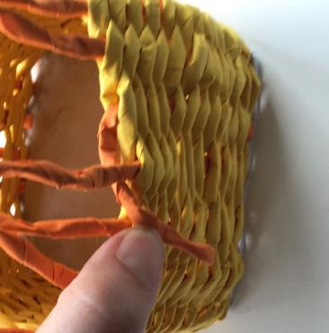
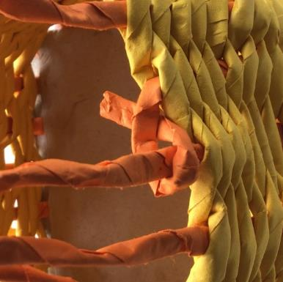
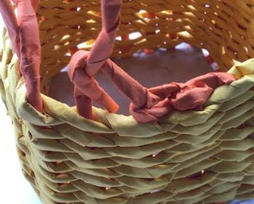
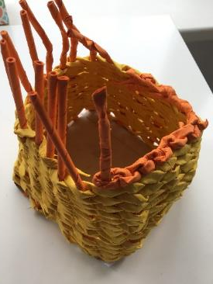
Step 6
Secure the ends as shown
Use glue to hold in place ⚠
Repeat around the top of the basket
Notes:
Fold each of the upright straws over to the right and fold down, flatten the end and cut at an angle.
Use a small blob of glue and tuck the end into the weave to the front of the next upright.
Repeat the process around the top of the basket.

Slide 13
Extension
Use a variety of coloured paper to create different designs
Create a basket using a different sized or shaped base
Add handles to make a basket that can be carried

