Slide 1
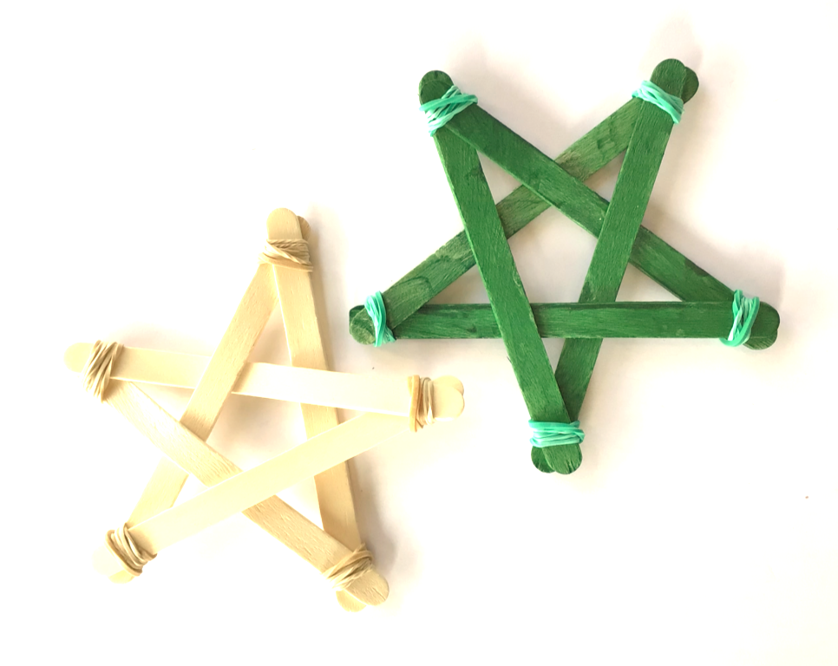
Handmade Christmas decoration
Making interesting Christmas tree decorations with simple materials

Slide 2
Stay safe
Whether you are a scientist researching a new medicine or an engineer solving climate change, safety always comes first. An adult must always be around and supervising when doing this activity. You are responsible for:
ensuring that any equipment used for this activity is in good working condition
behaving sensibly and following any safety instructions so as not to hurt or injure yourself or others
Please note that in the absence of any negligence or other breach of duty by us, this activity is carried out at your own risk. It is important to take extra care at the stages marked with this symbol: ⚠

Slide 3
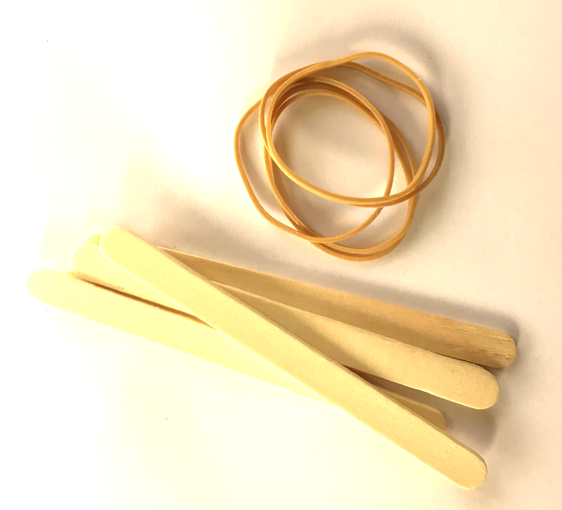
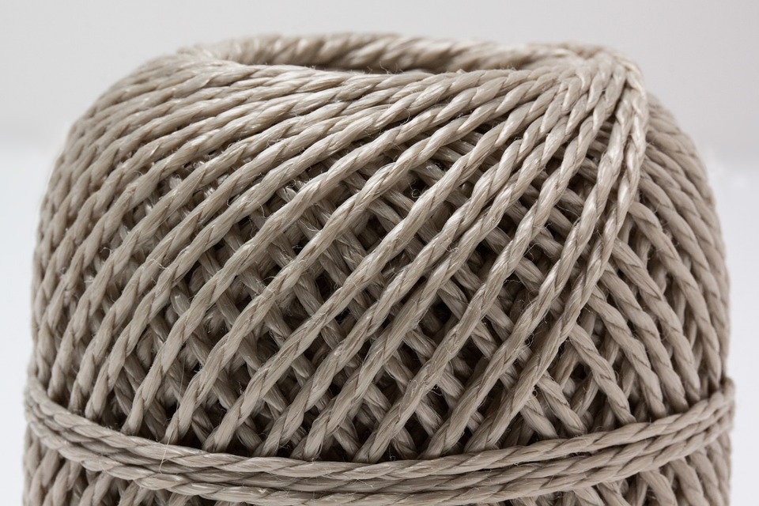
Resources ⚠
You will need:
5 sticks of the same length
5 rubber bands
String or twine for the hanging loops

Slide 4
Step 1
Using an elastic band, join the first two sticks together in a V shape
Can you undo the rubber band by moving the ‘legs’ around?
Notes:
Learners could investigate the strength of this structure e.g. can you undo the rubber band by moving the ‘legs’ around? Then put it back together for the next step.

Slide 5
Step 2
Lay over the 3rd stick and join at an angle
How strong is it now? Why do you think this is so?
Notes:
If the strength test results in the structure being broken, it will need to be put back together again for the next step.

Slide 6
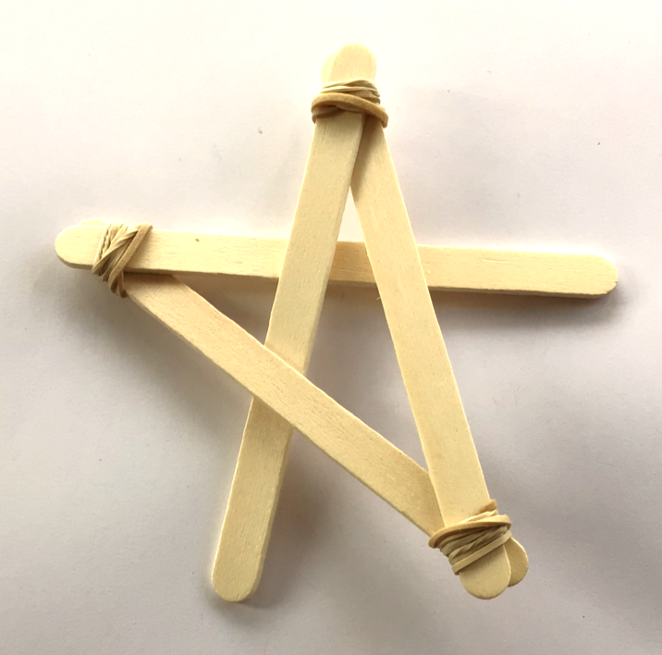
Step 3
Place the 4th stick at an angle and weave between the sticks
Try your strength test again. Is it getting stronger or weaker?
Notes:
If the strength test results in the structure being broken, it will need to be put back together again for the next step.

Slide 7
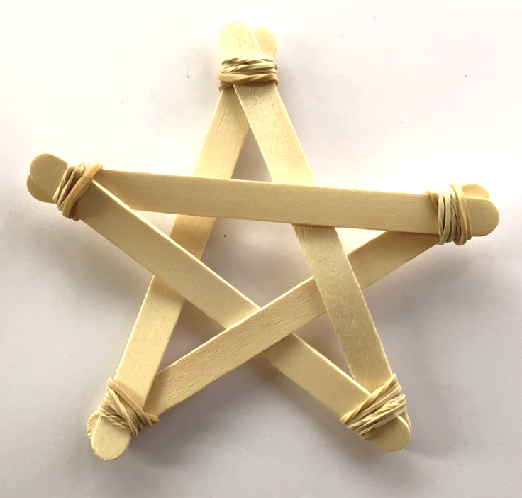
Step 4
Place the last stick to complete the star shape and secure in place
Add a loop to a hang from a tree ⚠
Notes:
The last stick does not have to be ‘woven’. It lies across the rest of the star. Try to weave the last one in and see why it might not be recommended.

Slide 8
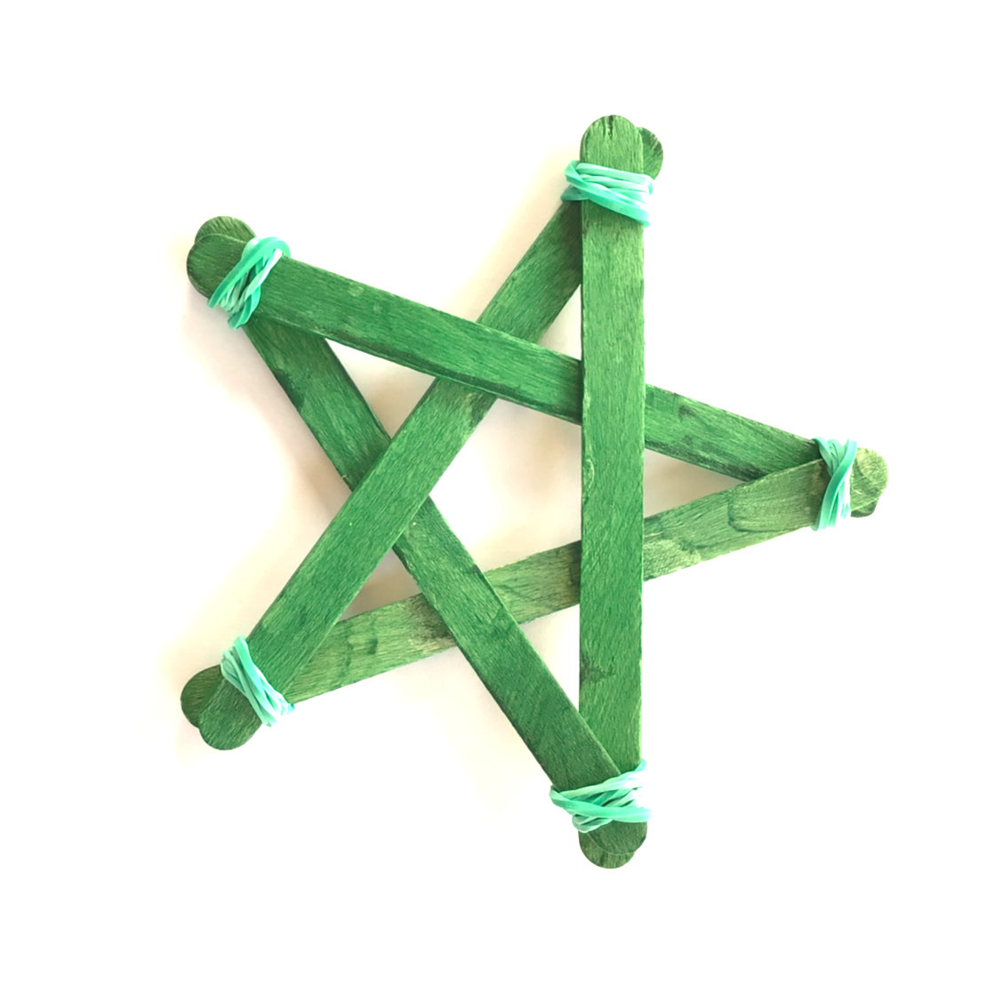
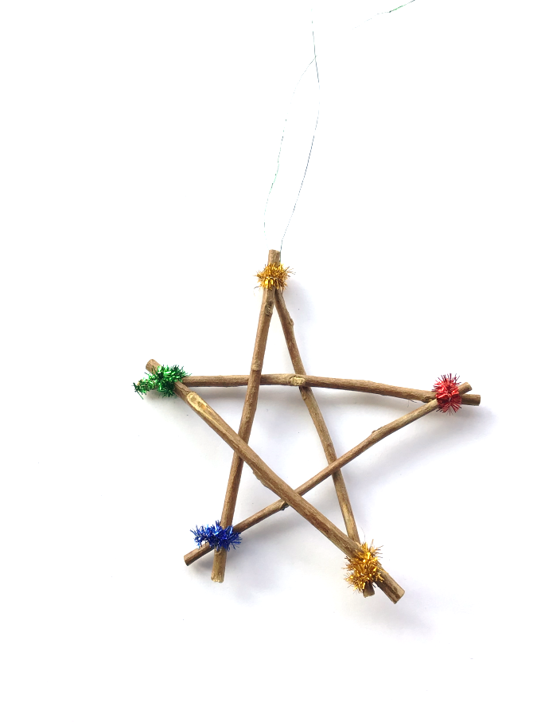
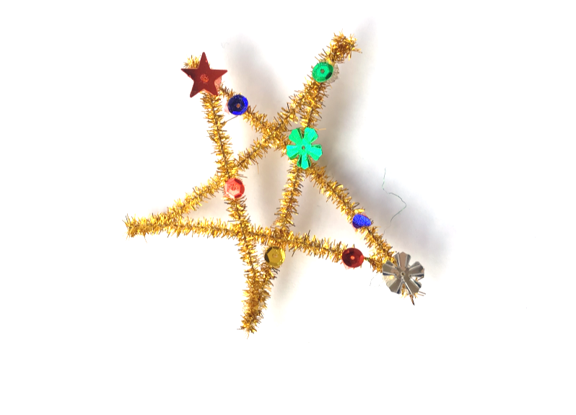
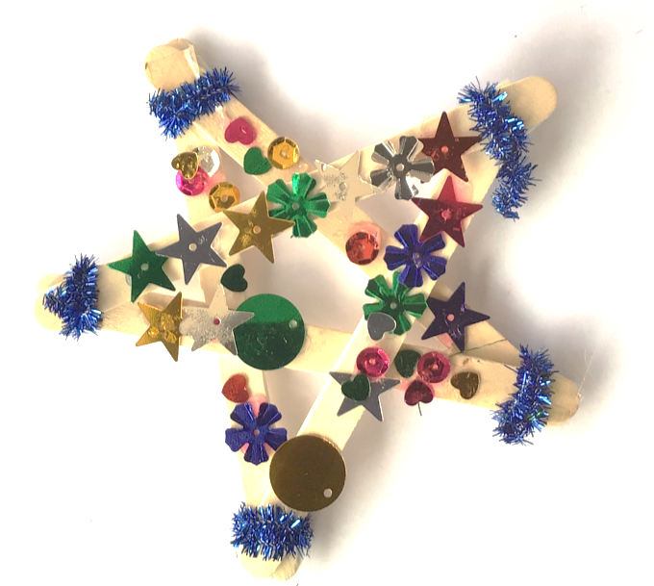
Step 5 - Variations
Use different styles of sticks and different fastening methods to make a variety of styles
Paint your sticks before you make your stars and use coloured bands

Slide 9
Extension
Can you make any other shapes with these sticks? Try triangle, square and six pointed star shapes
Can you make them stronger, so they will not fall apart when hanging on a tree?

