Slide 1
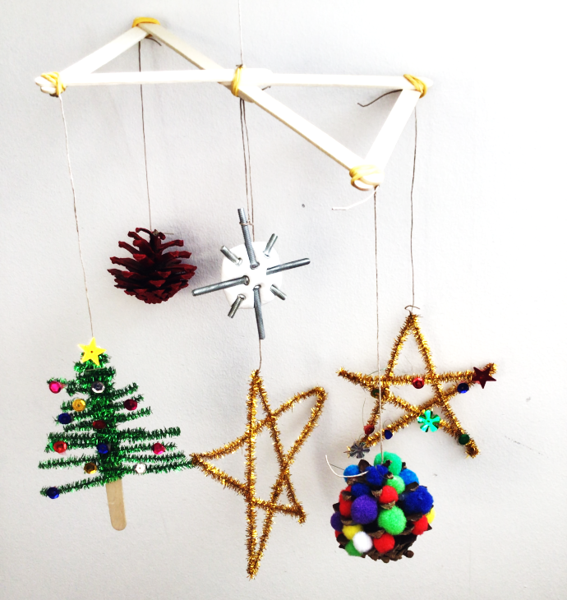
Create your own Christmas Mobile
Making Christmas mobiles and balancing them

Slide 2
Stay safe
Whether you are a scientist researching a new medicine or an engineer solving climate change, safety always comes first. An adult must always be around and supervising when doing this activity. You are responsible for:
ensuring that any equipment used for this activity is in good working condition
behaving sensibly and following any safety instructions so as not to hurt or injure yourself or others
Please note that in the absence of any negligence or other breach of duty by us, this activity is carried out at your own risk. It is important to take extra care at the stages marked with this symbol: ⚠

Slide 3
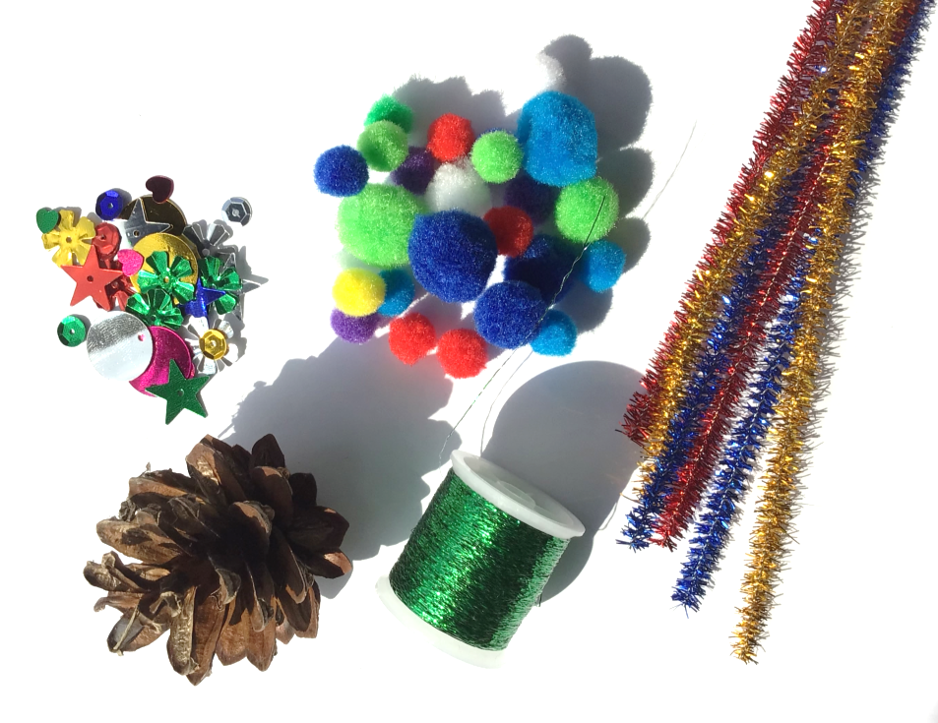
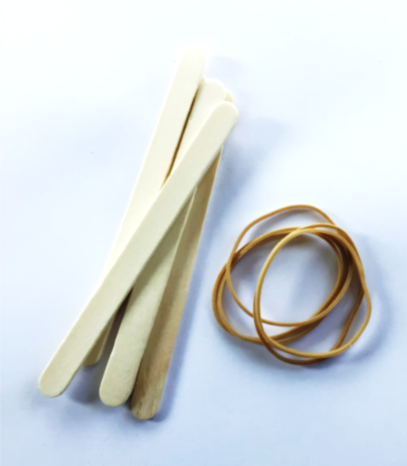
Resources ⚠
Sticks
Rubber bands
Pipe cleaners
Fir cones
Paint
Air drying clay
Bolts
Sequins
Pompoms
Hanging thread

Slide 4
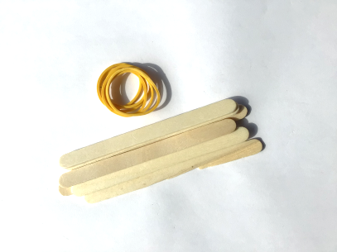
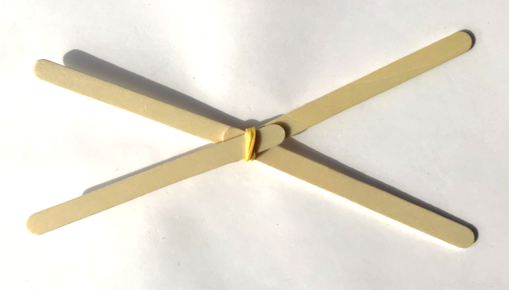
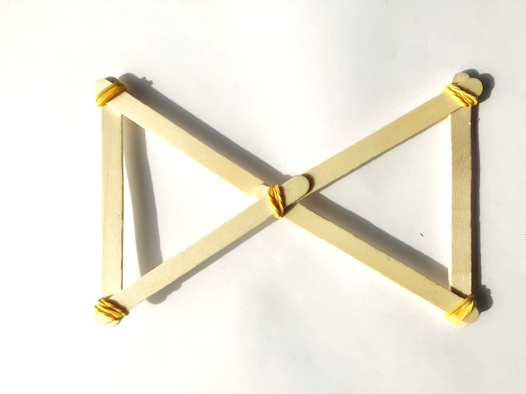
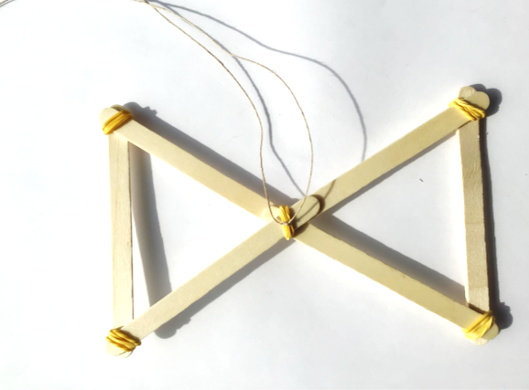
Making the hanger
You will need 6 sticks of the same length and 6 rubber bands
Use the bands to make a cross shape - add strength by fitting 2 extra sticks
Add a hanging loop and check your structure balances ⚠
Notes:
Discuss with learners: At the stages of putting this together notice how it gradually gets stronger. Why do you think this is?
Explain that attaching 2 additional sticks is adding strength - this is called ‘triangulation’.
Adjust the balancing if necessary.

Slide 5
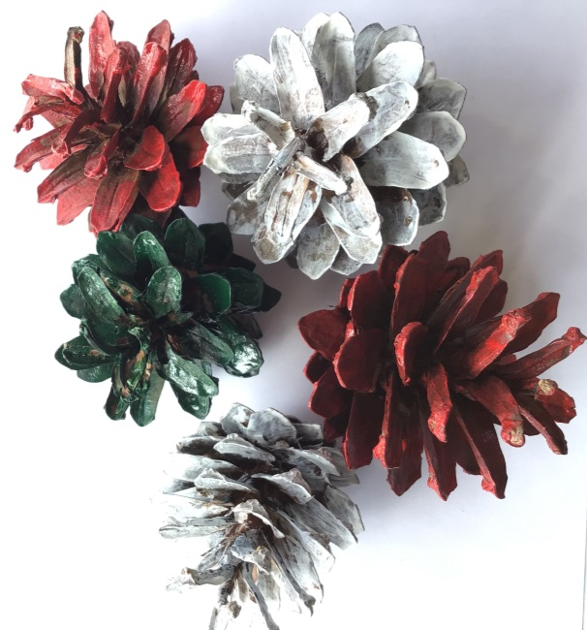
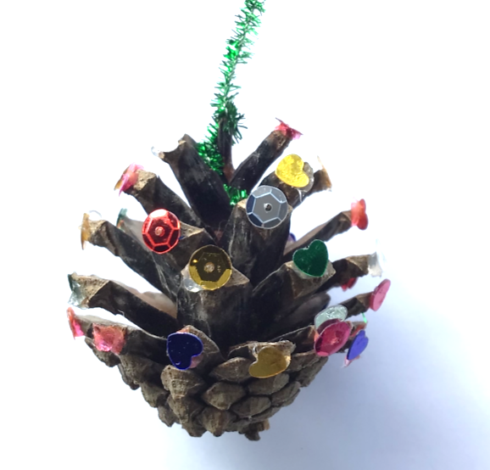
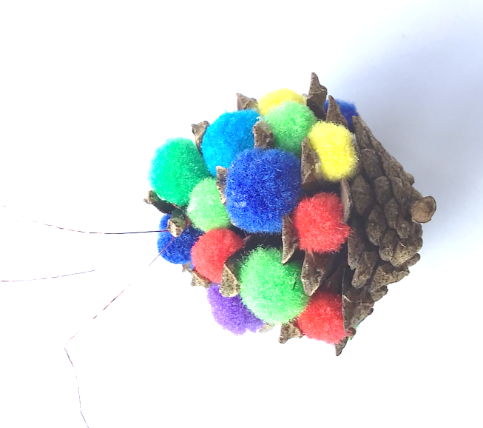
Fir cones
Paint your fir cones different colours
Decorate by gluing sequins or pompoms into the cone
Add a hanging thread

Slide 6
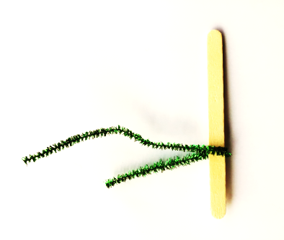
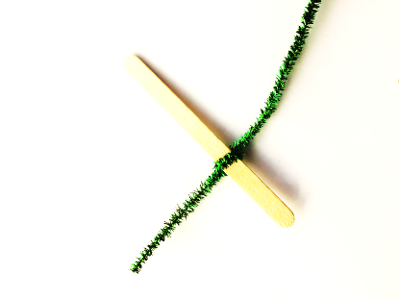
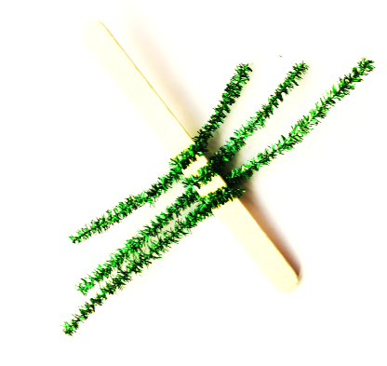
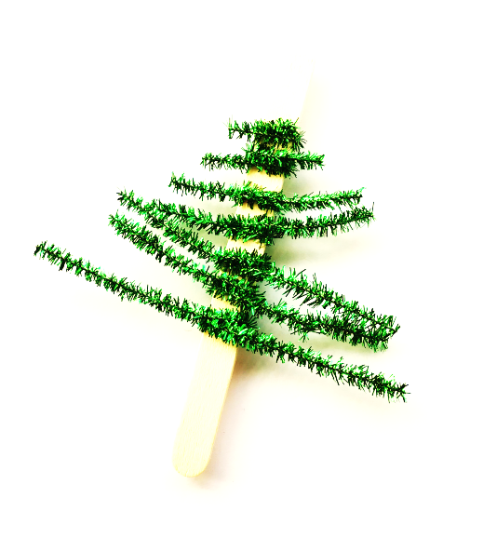
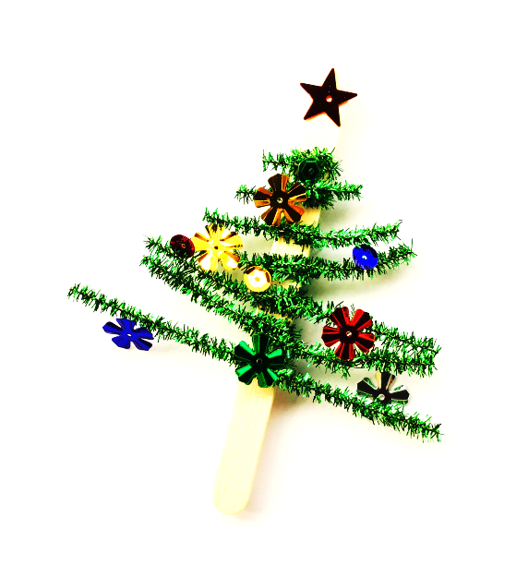
Little fir trees
Use a stick as the trunk of a tree
Wrap lengths around the stick with pipe cleaners
Stick on decoration, a star on top, babbles and a hanging loop
Notes:
Cut the pipe cleaner in short lengths.
Decrease the size of the pipe cleaner as the top of the tree is reached, to make it look like a mini Christmas tree.

Slide 7
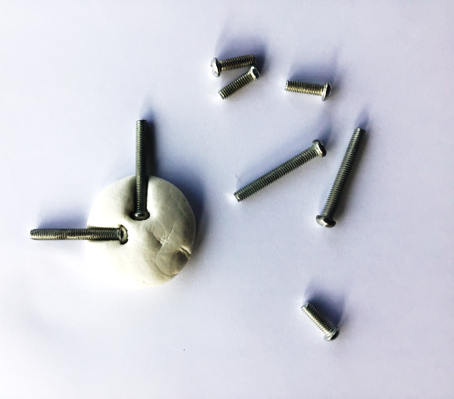
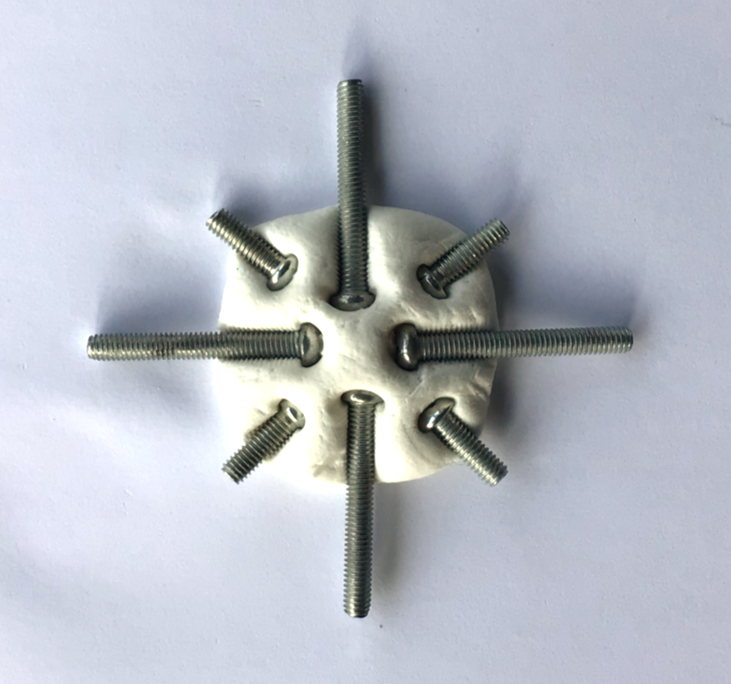
Clay star
Roll out a small lump of air drying clay
Press bolts into the clay to make a star shape
Allow the clay to dry and fit on a hanging loop
⚠

Slide 8
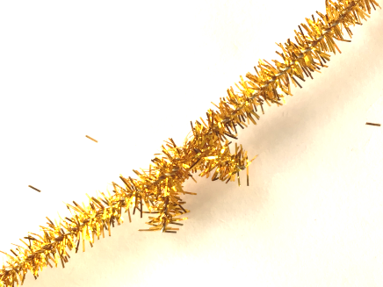
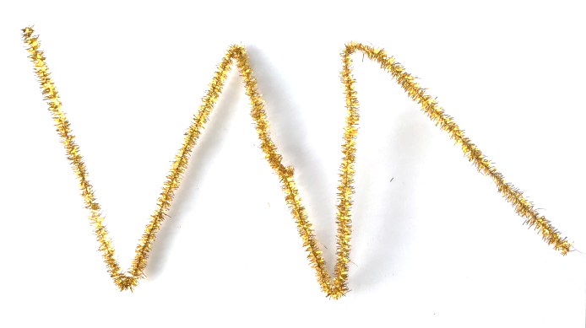
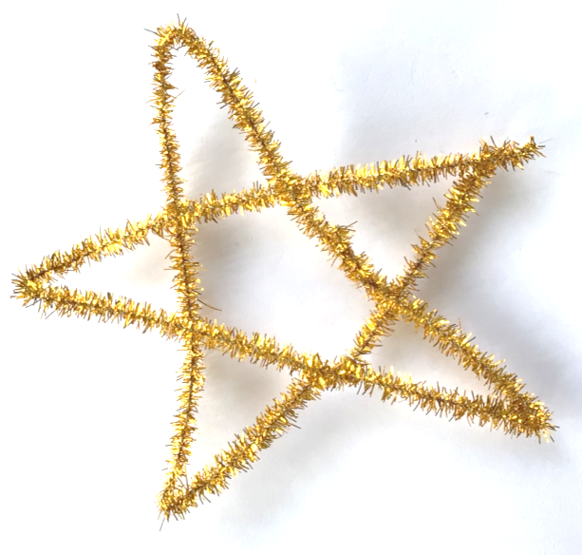
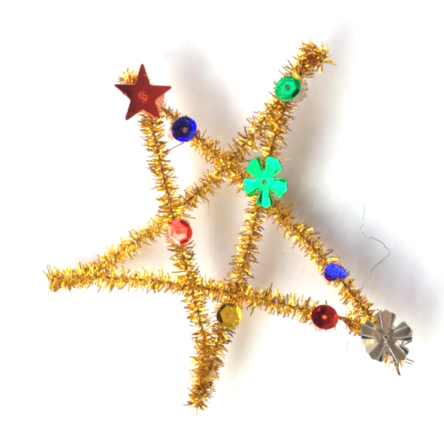
Pipe-cleaner star
Use 2 long pipe cleaners to make a star shape
Fold over each other to make a star
Stick on decorations
Add a hanging loop
⚠
Notes:
To make the star shape - join the cleaners together, by twisting them around each other. Then fold into 5 equal lengths. Learners might need to use a ruler and divide the length by 5 for this.

Slide 9
Getting the balance right - 1
You will need at least 5 of your decorations to fill the mobile
Which is the heaviest? Which is the lightest?
Try the heaviest on one end and the lightest on the other – what happens?
Notes:
Hang the mobile from the middle. Does it balance or does it hang at an angle?

Slide 10
Getting the balance right - 2
Two identical decorations at the ends of the arms will balance well

Slide 11
Getting the balance right - 3
Would this work?

Slide 12
Getting the balance right - 4
How about this?

Slide 13
Getting the balance right - 5
How about this?

Slide 14
Getting the balance right - 6
How about this?

Slide 15
Getting the balance right - 7
Would this work? Try it and find out

Slide 16
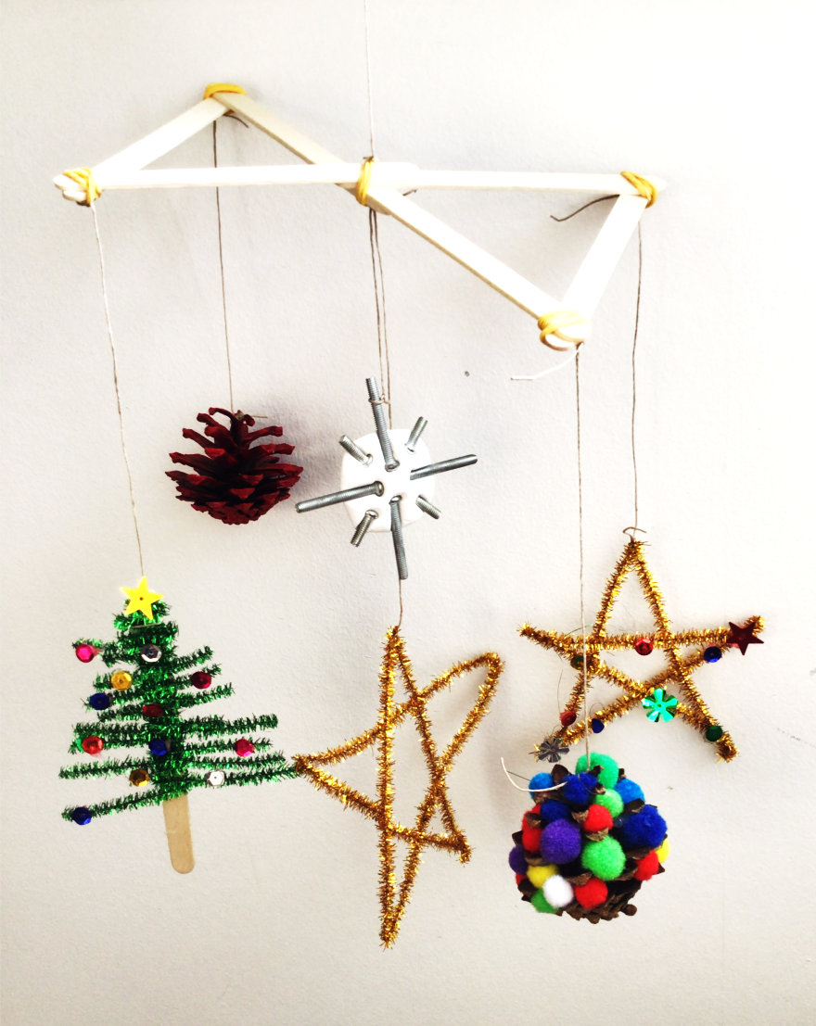
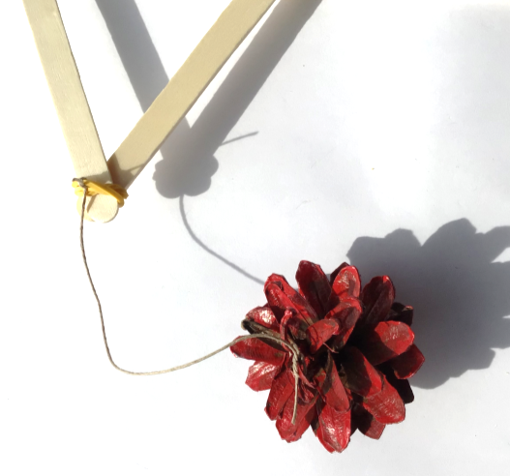
Hanging the decorations
Using what you have learnt, tie your decorations onto the corners of your hanger
Add a decoration to the middle of the hanger
Hang up your mobile!

Slide 17
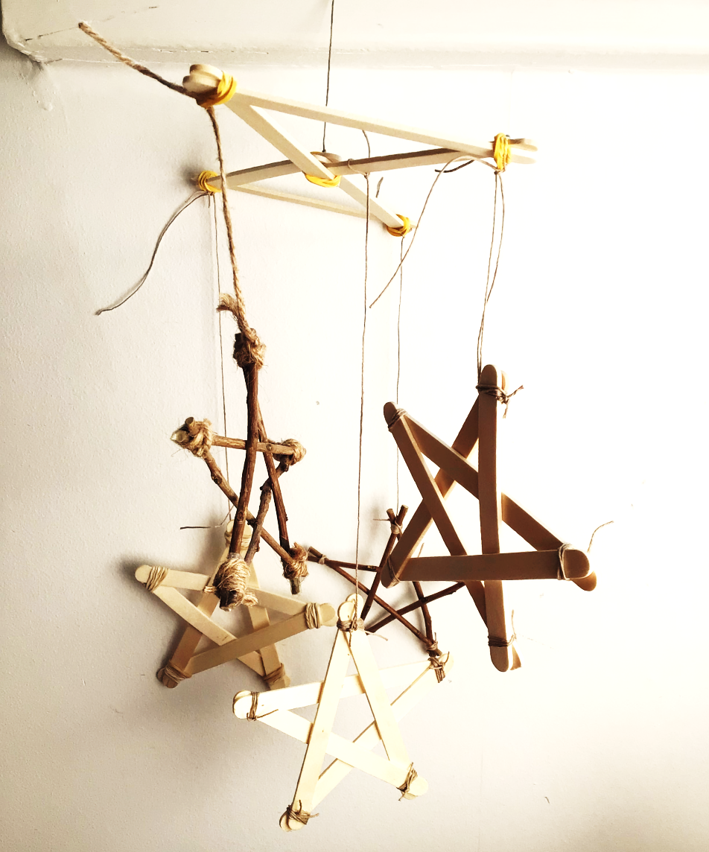
Variations
Use all natural materials to create a designer look
Create different combinations of shapes or ornaments of your own design

