Slide 1
How polar animals keep warm?
Understanding how polar animals keep warm in icy conditions

Slide 2
Stay safe
Whether you are a scientist researching a new medicine or an engineer solving climate change, safety always comes first. An adult must always be around and supervising when doing this activity. You are responsible for:
ensuring that any equipment used for this activity is in good working condition
behaving sensibly and following any safety instructions so as not to hurt or injure yourself or others
Please note that in the absence of any negligence or other breach of duty by us, this activity is carried out at your own risk. It is important to take extra care at the stages marked with this symbol: ⚠

Slide 3
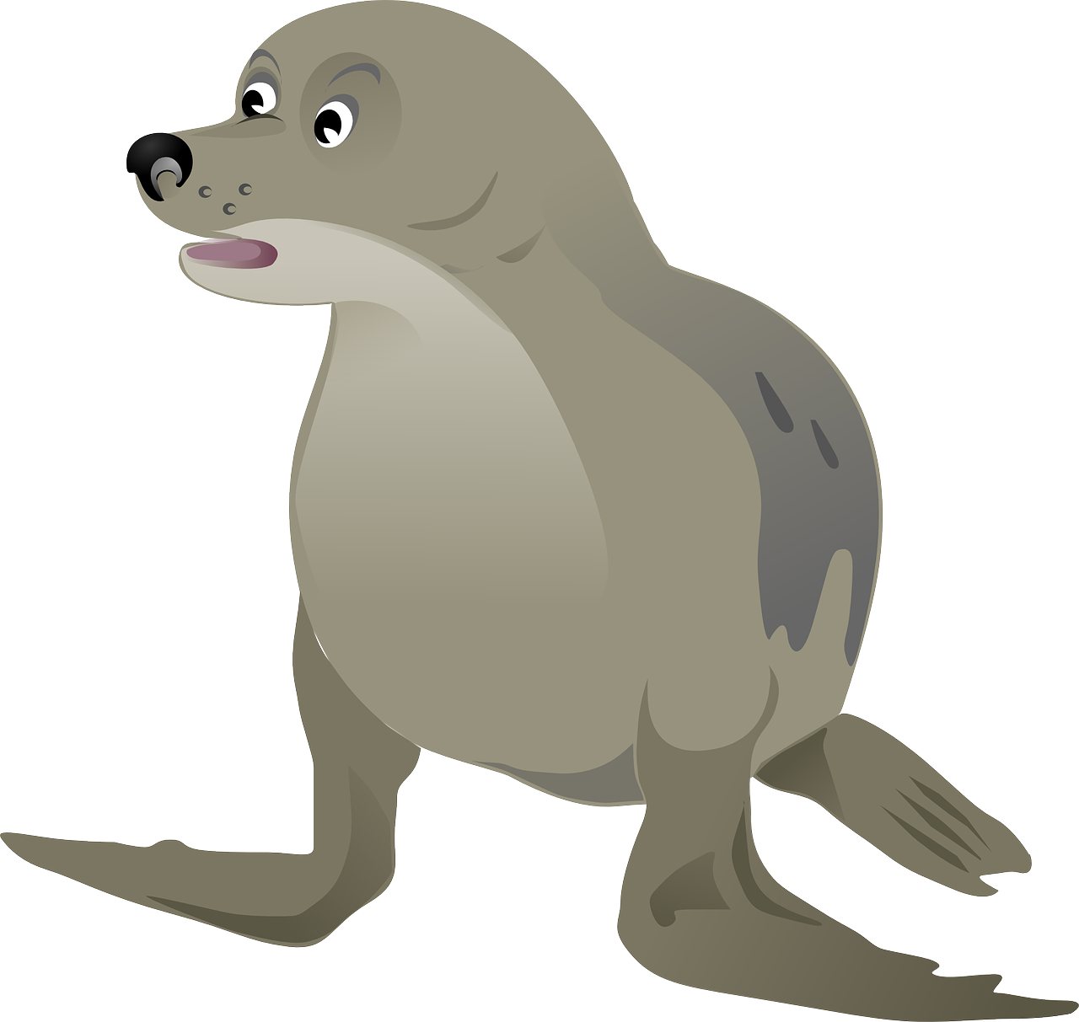
Introduction
In this activity we will:
look at how animals who live at the Earth’s poles keep out the cold
make a model seal to test how it keeps warm in a freezing sea
think about why this might mean they don’t want the climate to warm up
Notes:
Discuss with learners - When we design we should always understand how what we do impacts on the environment. Careless design can mean we waste the Earth’s resources or damage the environment. Global Climate change can effect all creatures on this planet.

Slide 4
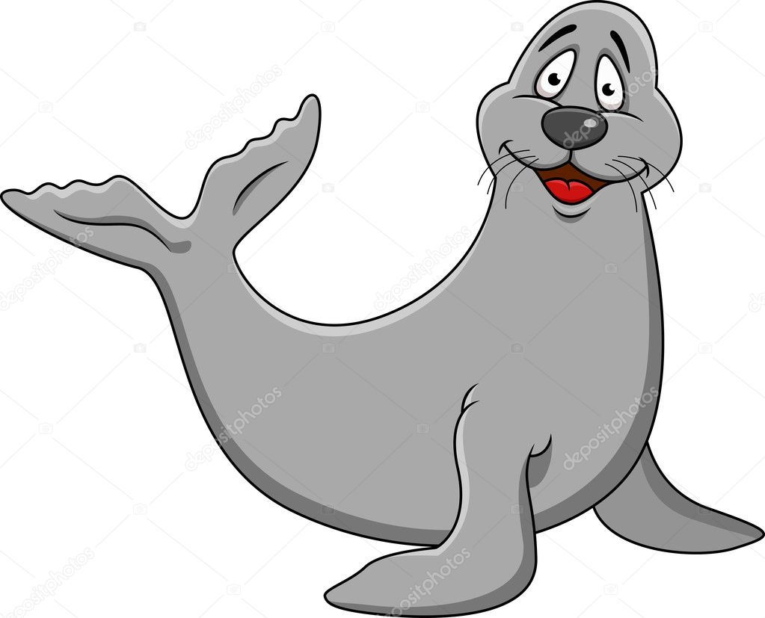
Resources
You will need:
An empty margarine tub
A full margarine tub
A large flat dish
Some warm water
Some cold water with ice
A thermometer and a stopwatch, or smart watch timer
Graph paper, a pencil and two differently coloured crayons
⚠

Slide 5
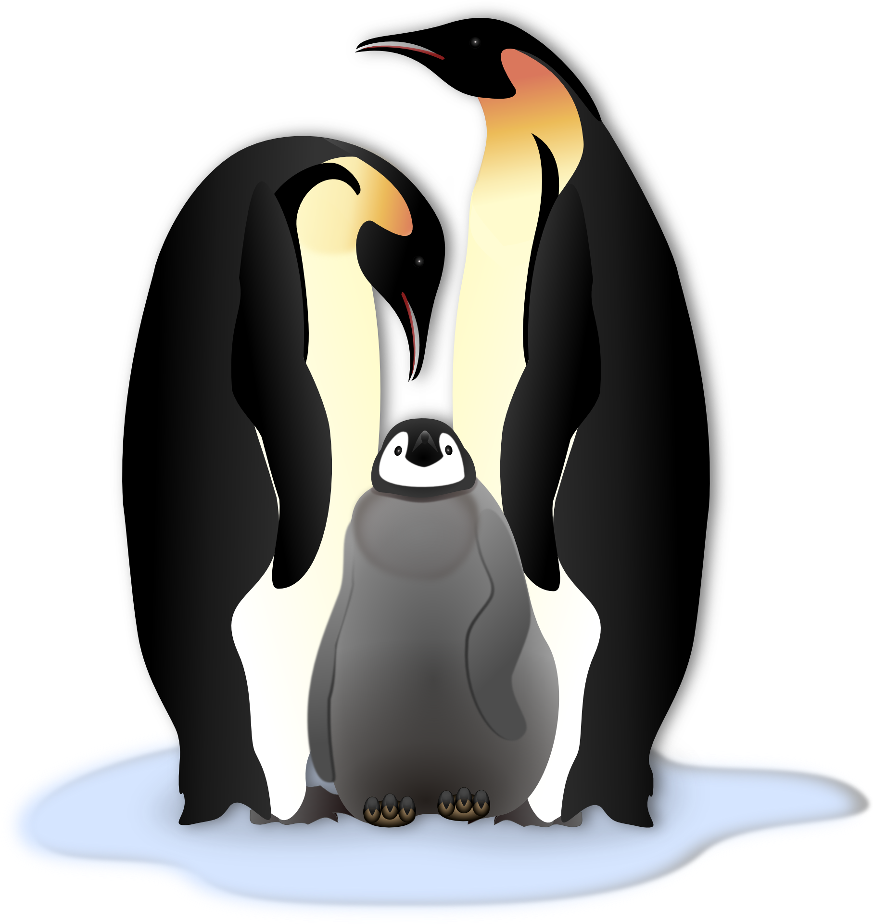
The Science
Seals, polar bears and penguins all have a body temperature close to our own - around 37ºC
The sea at the North and South poles can be as cold as 2ºC
Animals that have warm blood have to keep it warm to stay alive
They do this by growing a thick layer of fatty blubber under their skin
This is called insulation

Slide 6
Making a table for your results
Make a table as shown
Time | Temp of Skinny Seal | Temp of Blubbery Seal
Start
2m
4m
6m
8m
10m

Slide 7
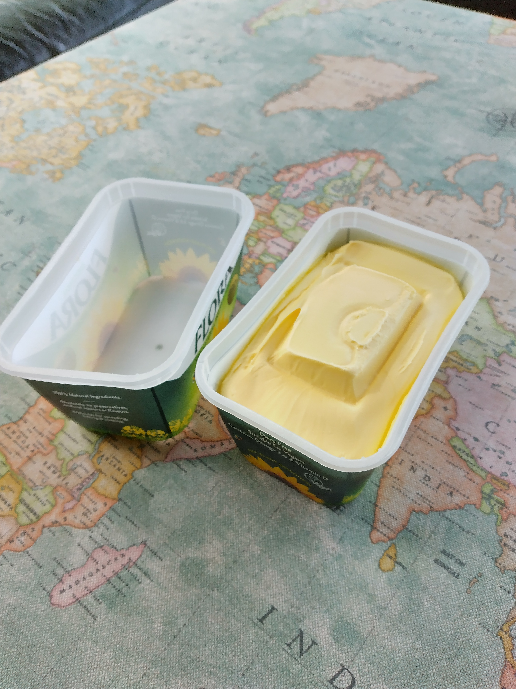
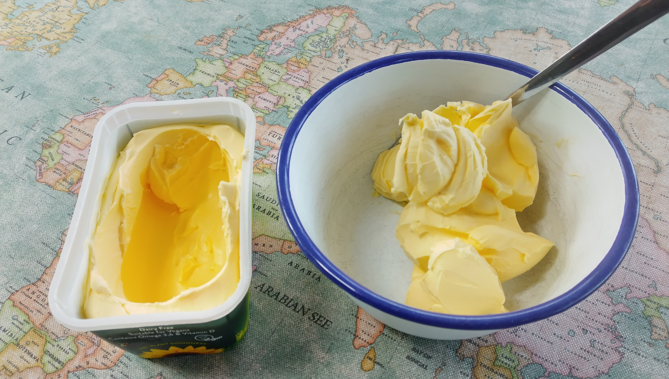
Step 1 - Preparing the ‘seals’
Use one empty margarine tub as a skinny seal with no blubber
For the full tub - scoop out some of the margarine to leave a hollow section in the middle
Ensure there is around 1 cm of margarine left all the way round the sides and across the bottom
⚠
Notes:
If you want to keep the spare margarine for your toast or to cook with wash your hands and use a clean spoon and bowl.

Slide 8
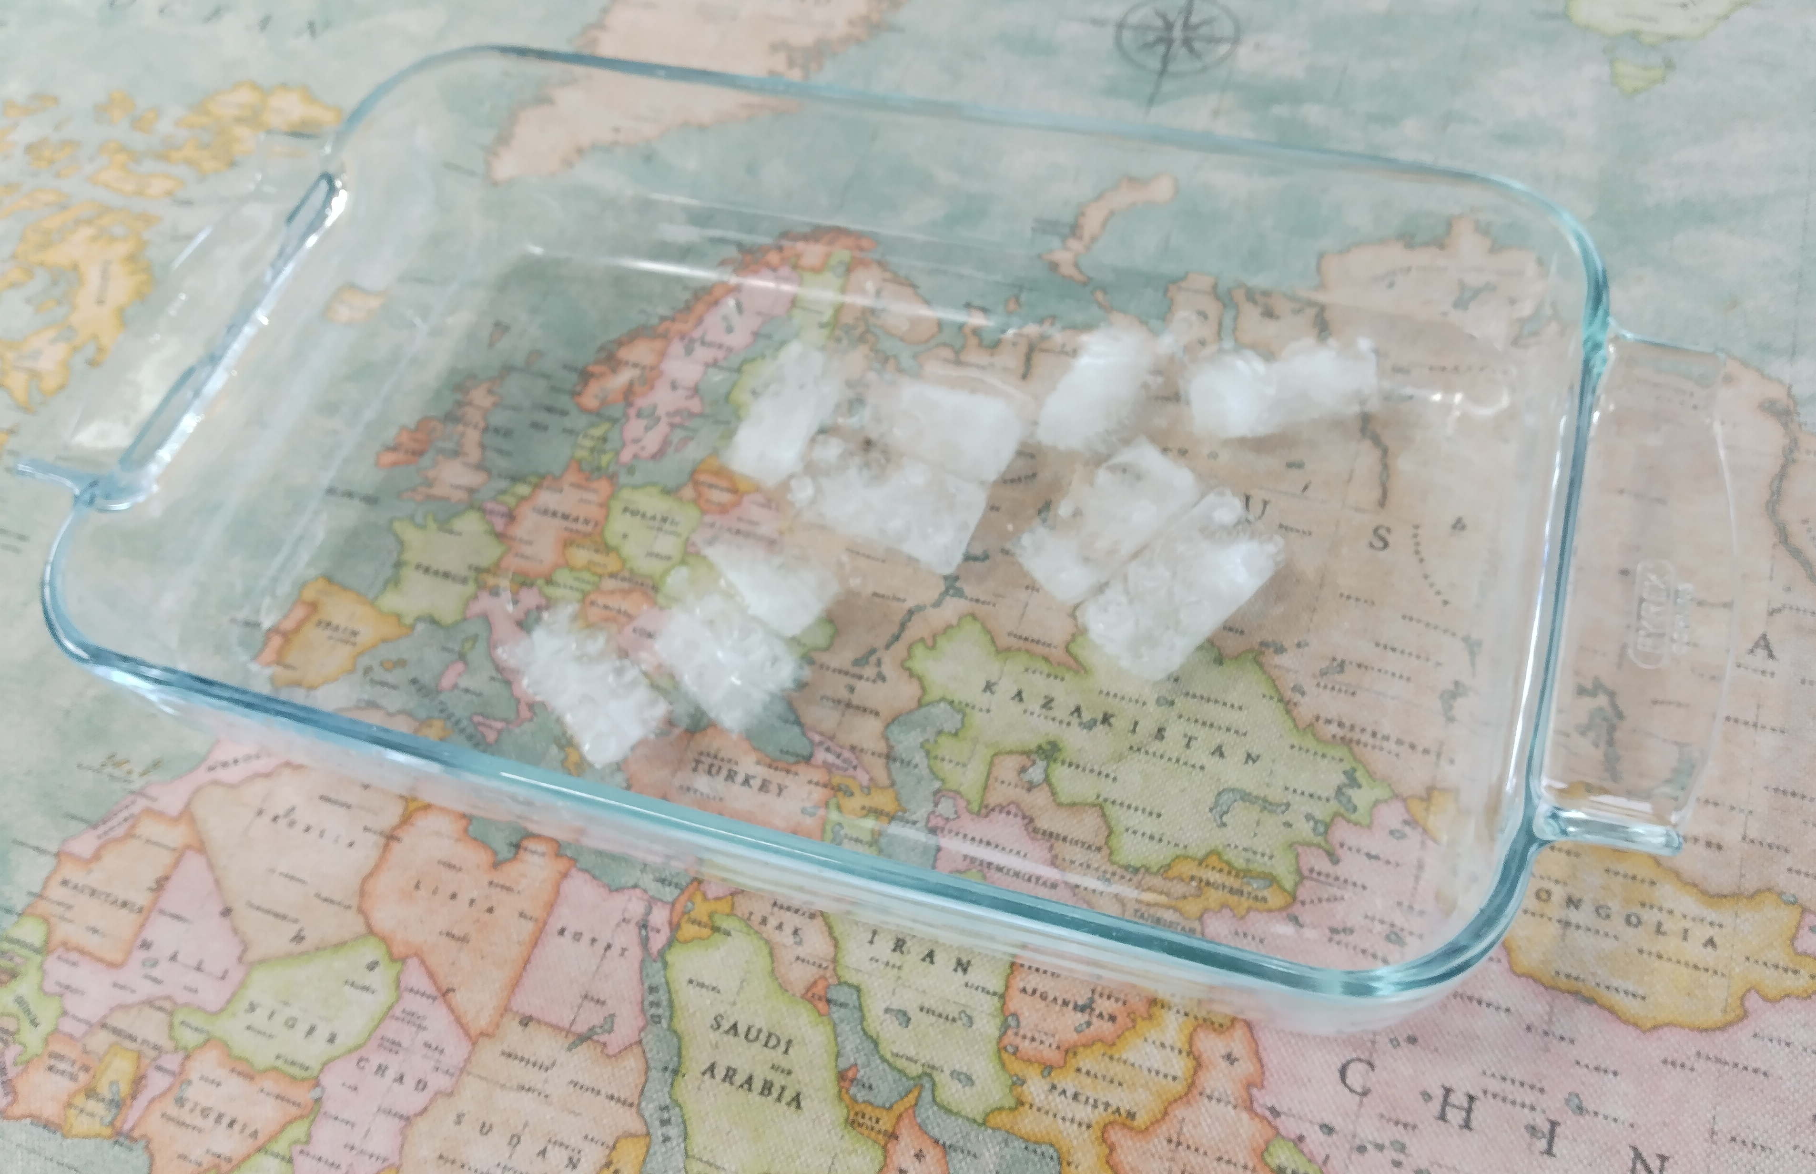
Step 2 – Preparing the ‘Arctic Ocean’ ⚠
Take a large dish and fill it with cold water
Add ice cubes to make it even colder

Slide 9
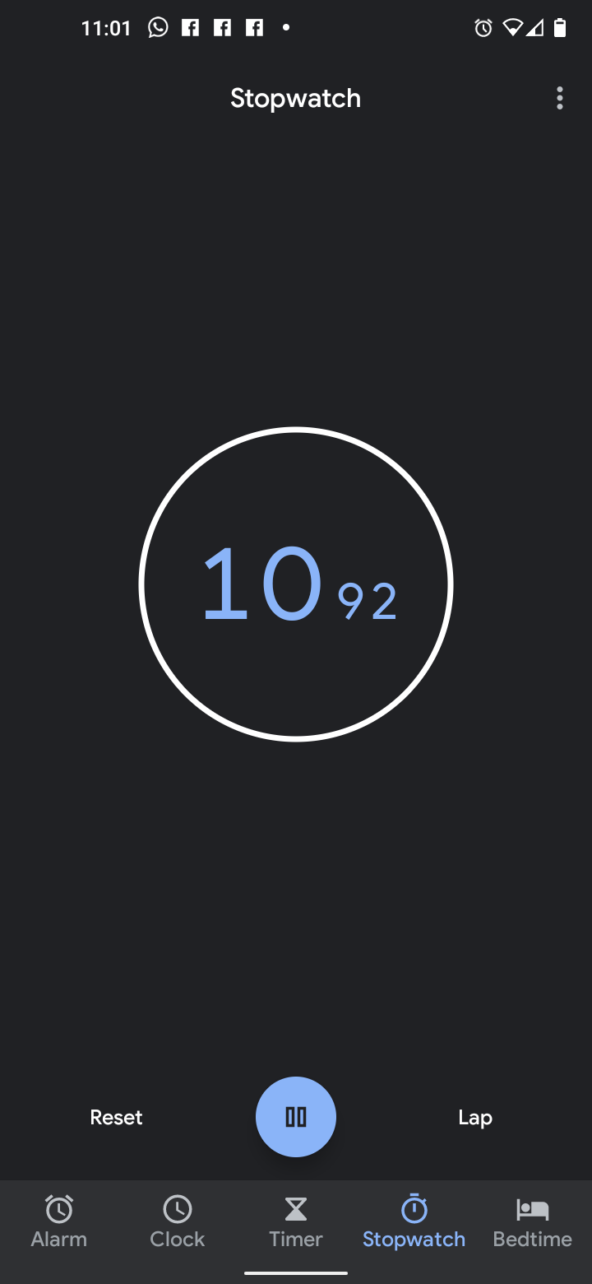
Step 3 – Making the warm blood ⚠
Mix some warm water with cold until it is about 37ºC
Get ready to start - you will need the stopwatch and the thermometer
Notes:
Explain that this will take a little time to get right - If it’s too warm it will melt the margarine, if it’s too cold the experiment may not work properly.

Slide 10
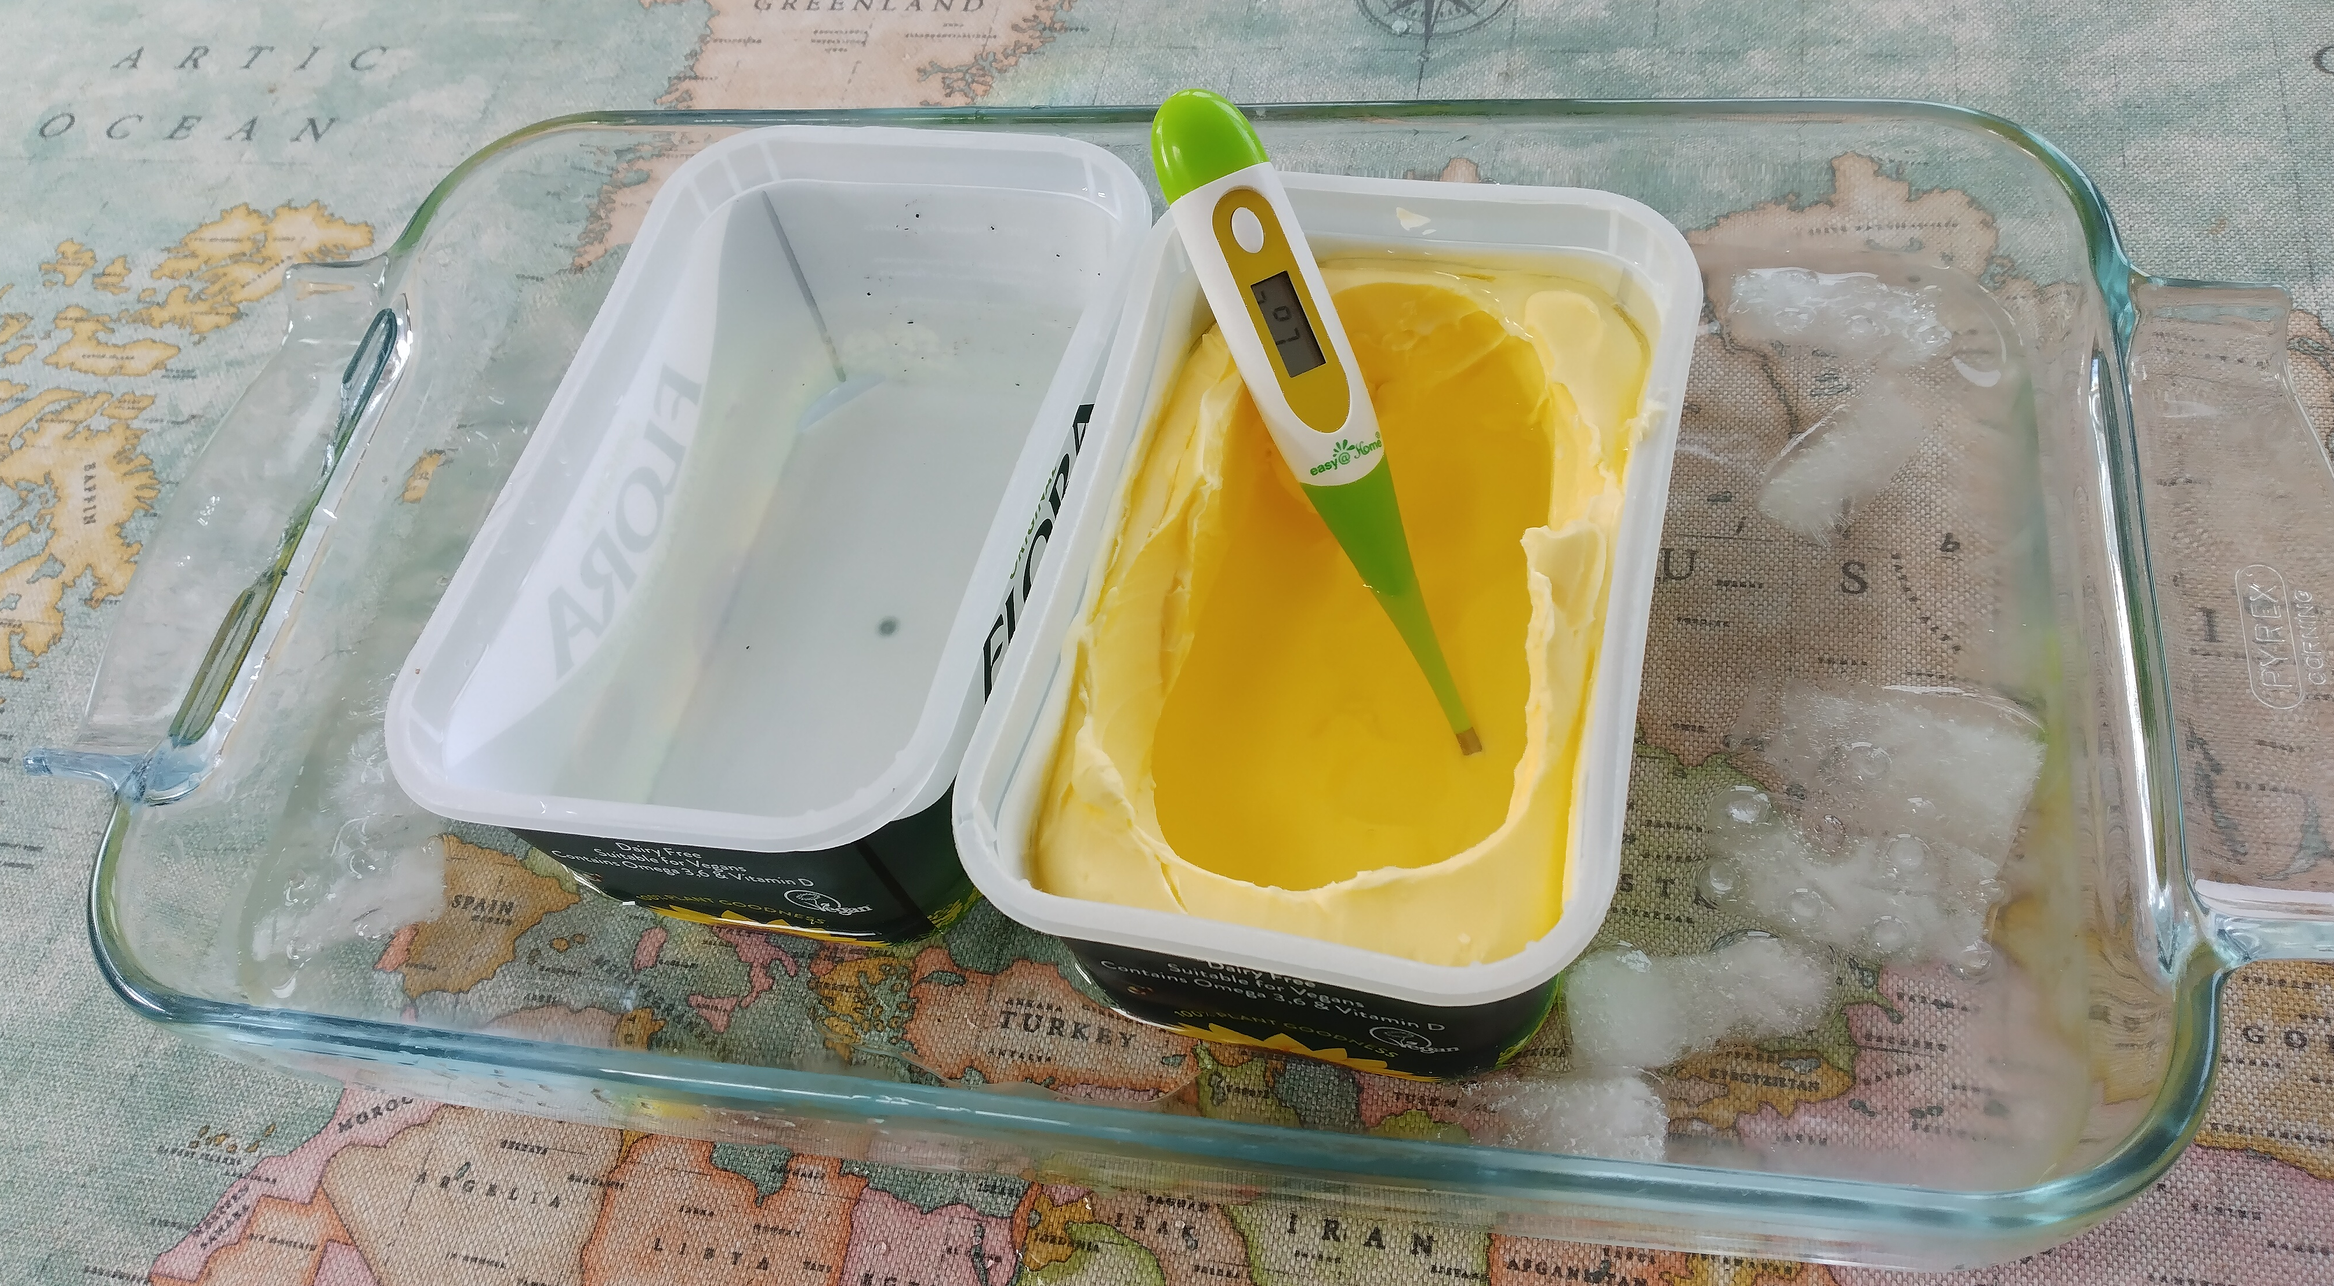
Step 4 – The experiment ⚠
Put the margarine tubs into the icy water bath
Add some ‘blood’ (warm water – step 3) to the two margarine tubs and measure the temperature straight away
Write down your results
Wait for two minutes and take the temperatures again
Write them down
Keep doing this until you have at least 5 measurements

Slide 11
Step 5 – The results
Look at your results
Do the temperatures change?
Do they change at the same rate or does one cool down faster than the other?
Time | Temp of Skinny Seal | Temp of Blubbery Seal
Start | 37 | 37
2m | 35.2 | 36.3
4m | 34.1 | 35.9
6m | 32.2 | 35.4
8m | 31 | 35
10m | 29.9 | 34.8

Slide 12
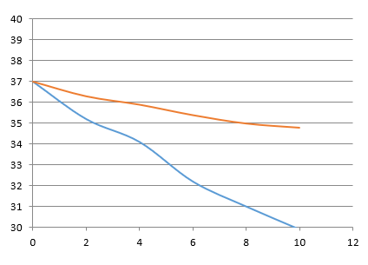
Step 6 – Plotting a graph
Plot your results on a graph like this one
Draw each line in a different colour.
How does this help explain why Arctic and Antarctic animals have so much blubber?
The skinny seal without any blubber is drawn in blue and the blubbery seal is in red

Slide 13
Step 6 – Extension questions
Why do you think the seals cooled down at different rates?
How could the experiment be improved?
How can the blood get cooler and the animal still be alive?
Does the blubber float on water? How does this help the animal in the sea?

Slide 14
Links Page
An article about how seals keep themselves warm in cold water compared to scuba divers https://www.abyss.com.au/en/blog/viewpost/185/seal-temperature-regulation
A website exploring the various ways seals have adapted to life in the freezing water https://animals.mom.com/seals-survive-antarctica-7385.html

