Slide 1
Magic of Christmas
A project that makes a magic trick.
Make a pack of cards disappear!

Slide 2
Stay safe
Whether you are a scientist researching a new medicine or an engineer solving climate change, safety always comes first. An adult must always be around and supervising when doing this activity. You are responsible for:
• ensuring that any equipment used for this activity is in good working condition
• behaving sensibly and following any safety instructions so as not to hurt or injure yourself or others
Please note that in the absence of any negligence or other breach of duty by us, this activity is carried out at your own risk. It is important to take extra care at the stages marked with this symbol: ⚠

Slide 3
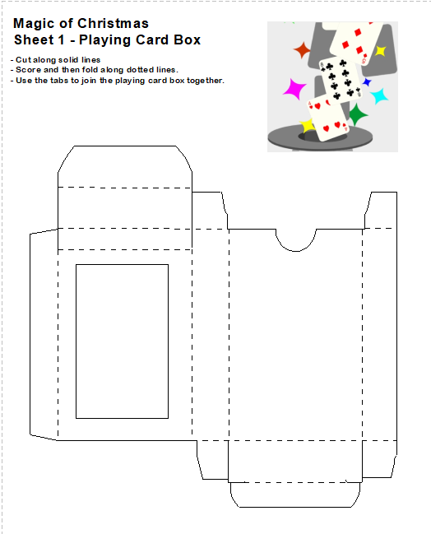
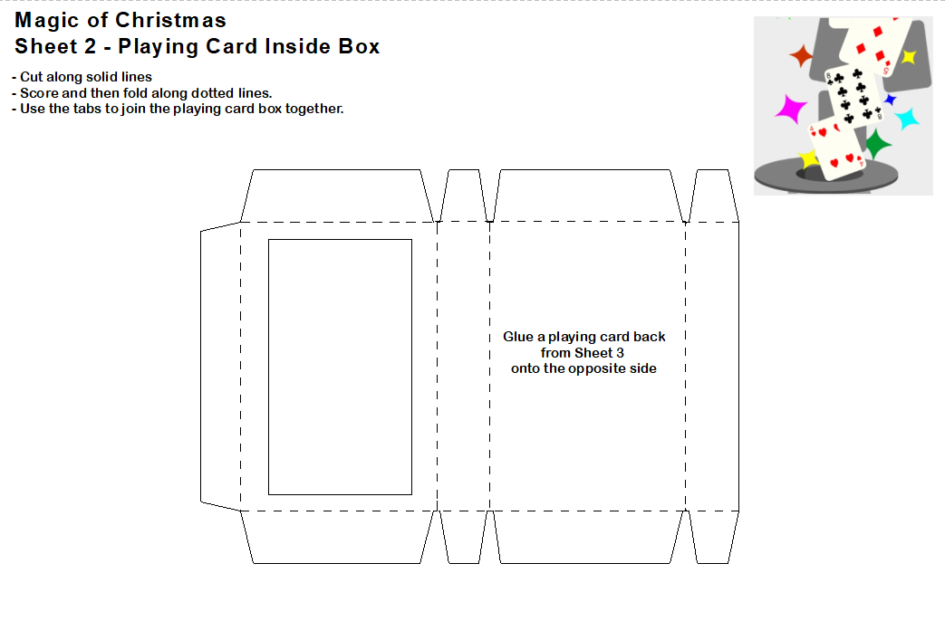
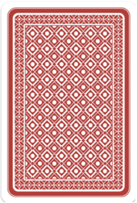
Templates

Slide 4
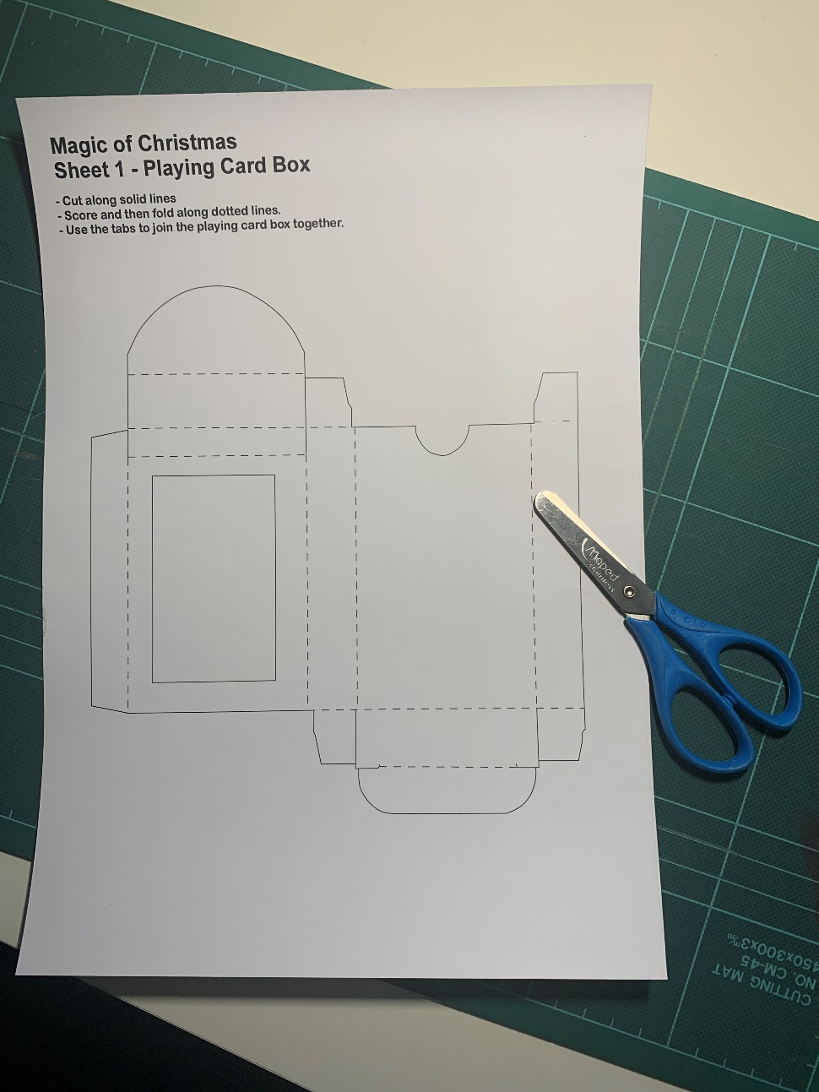
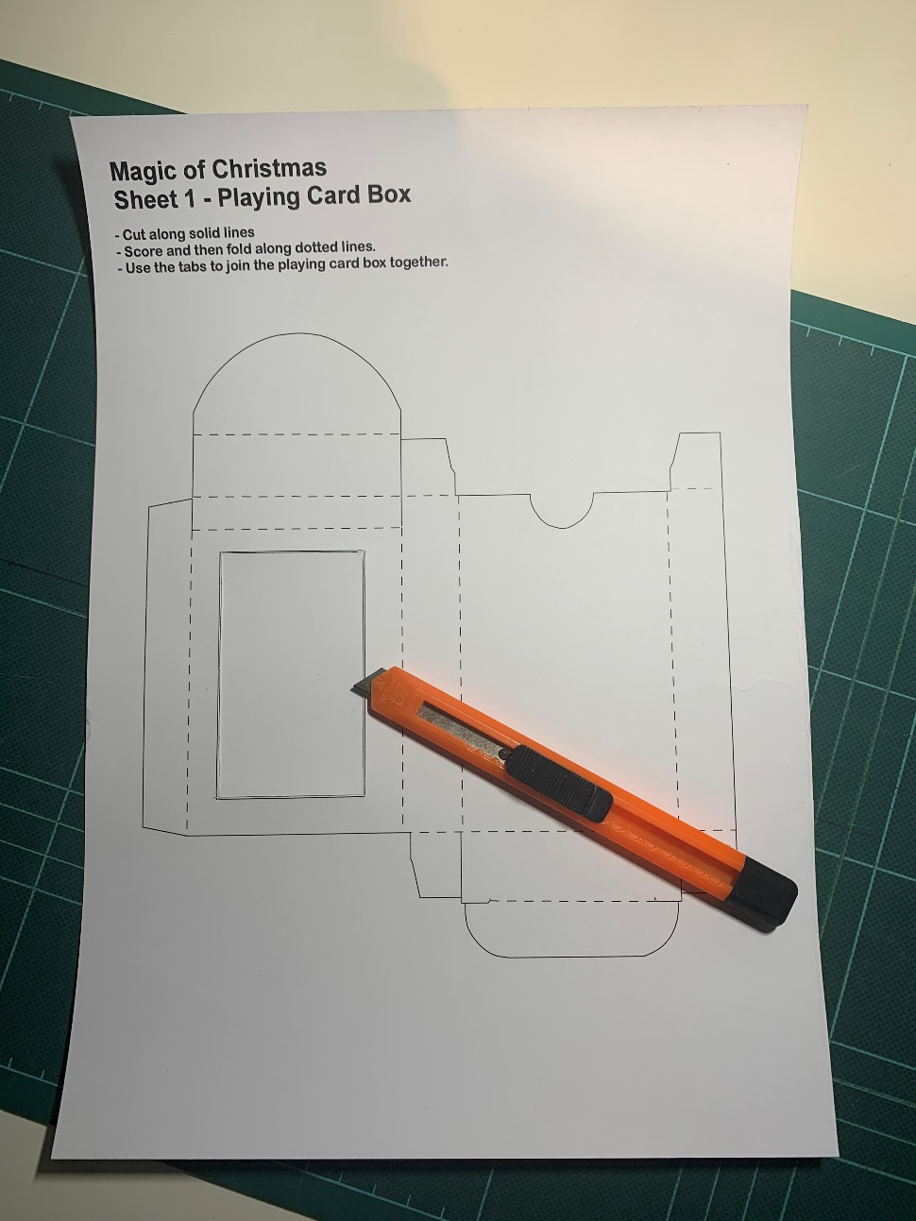
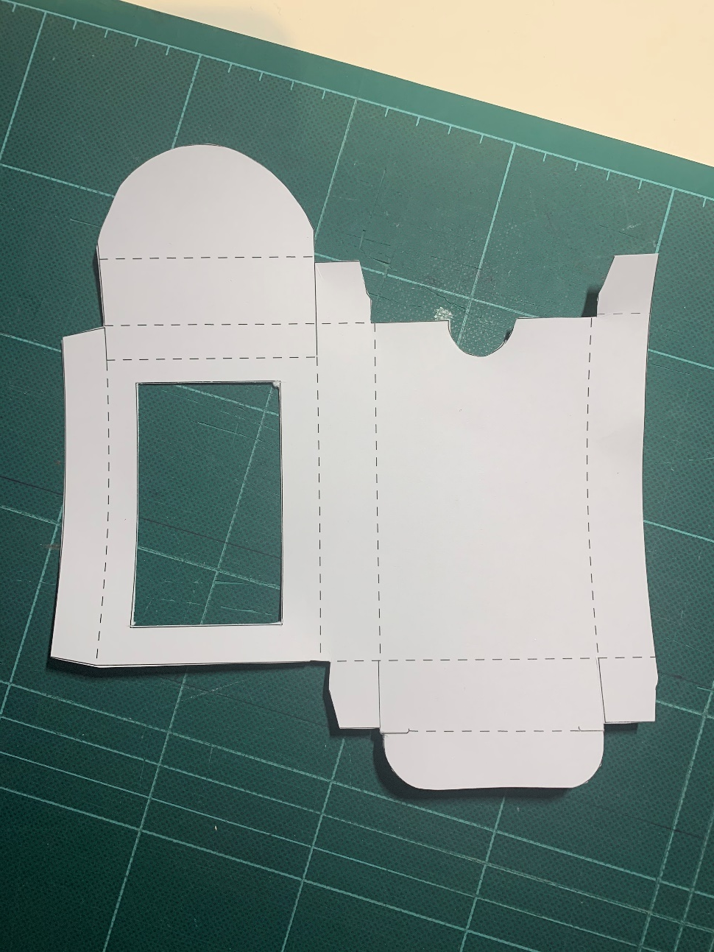
Step 1 – Template sheet 1
Get Sheet 1
⚠ Cut of the window
⚠ Cut out the template

Slide 5
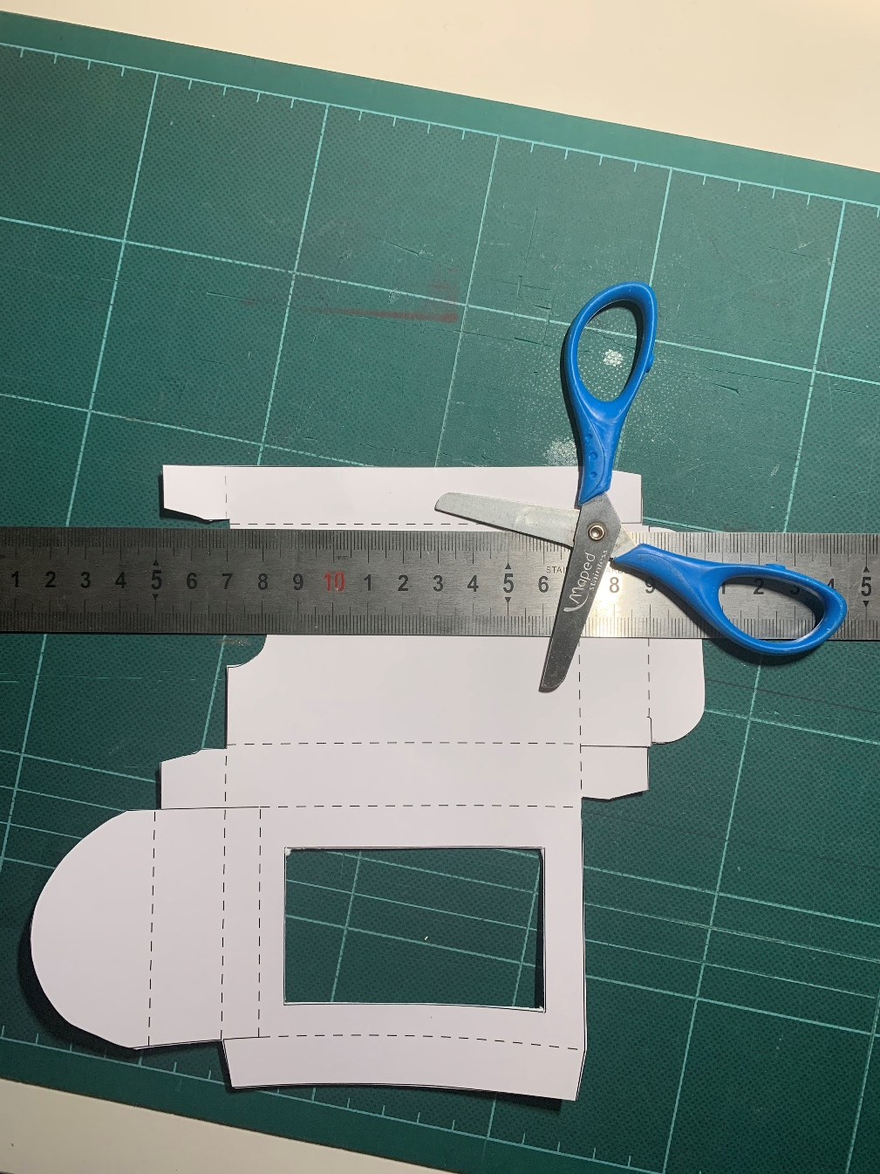
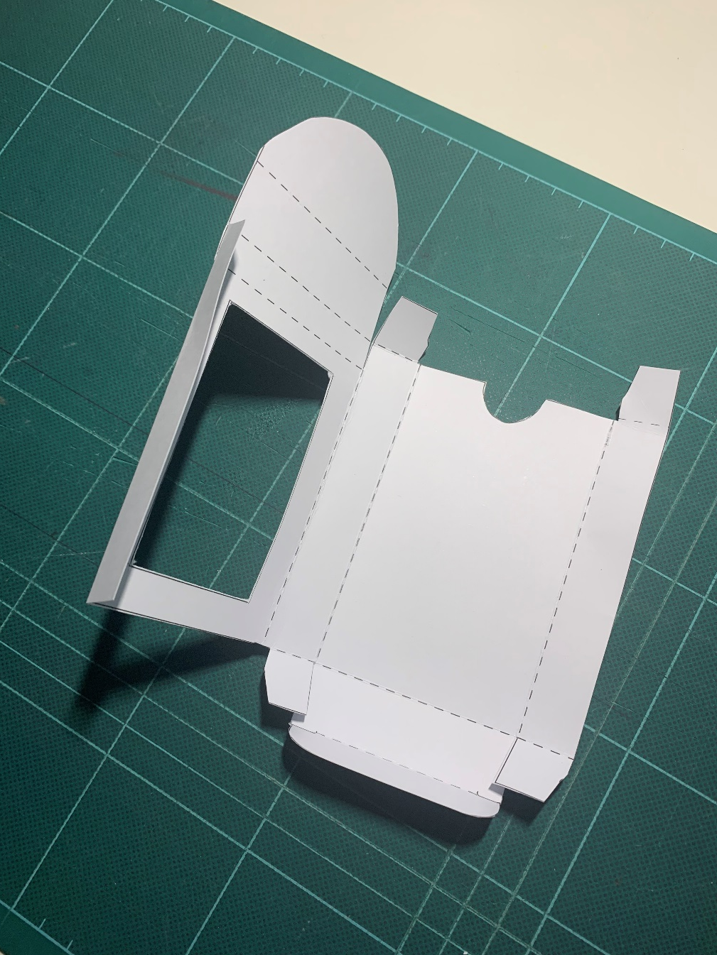
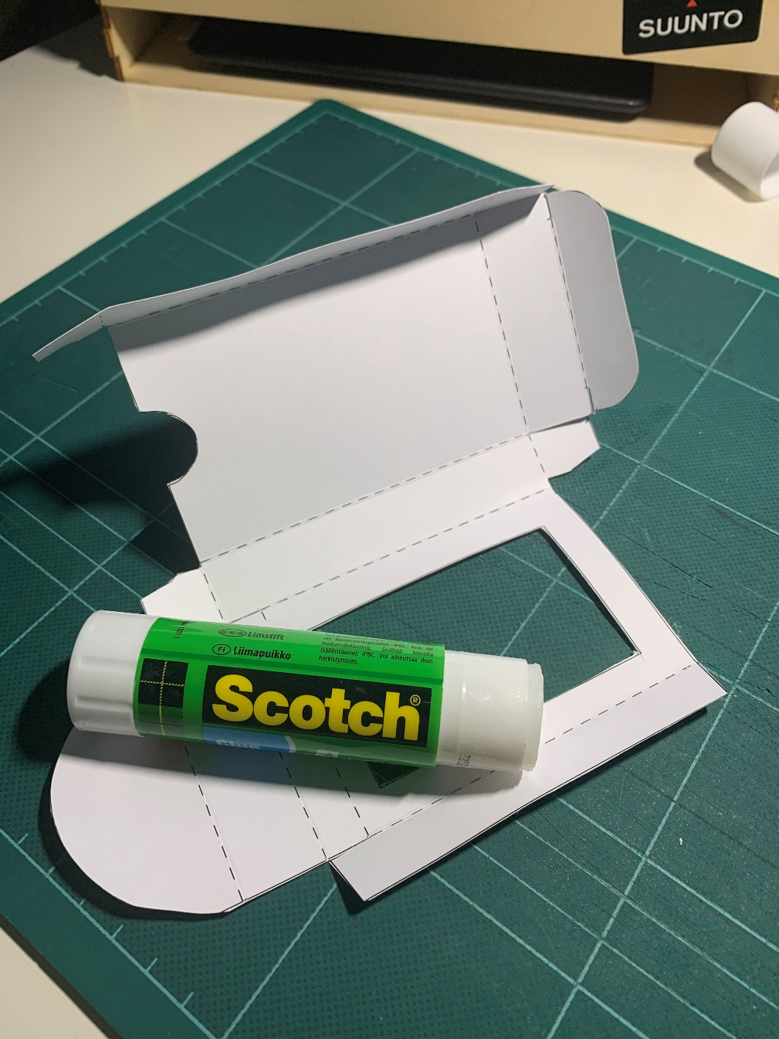
Step 2 – Template sheet 1
Playing Card Box
⚠ Score the dotted lines
Fold the dotted lines
Fold and glue the side tab

Slide 6
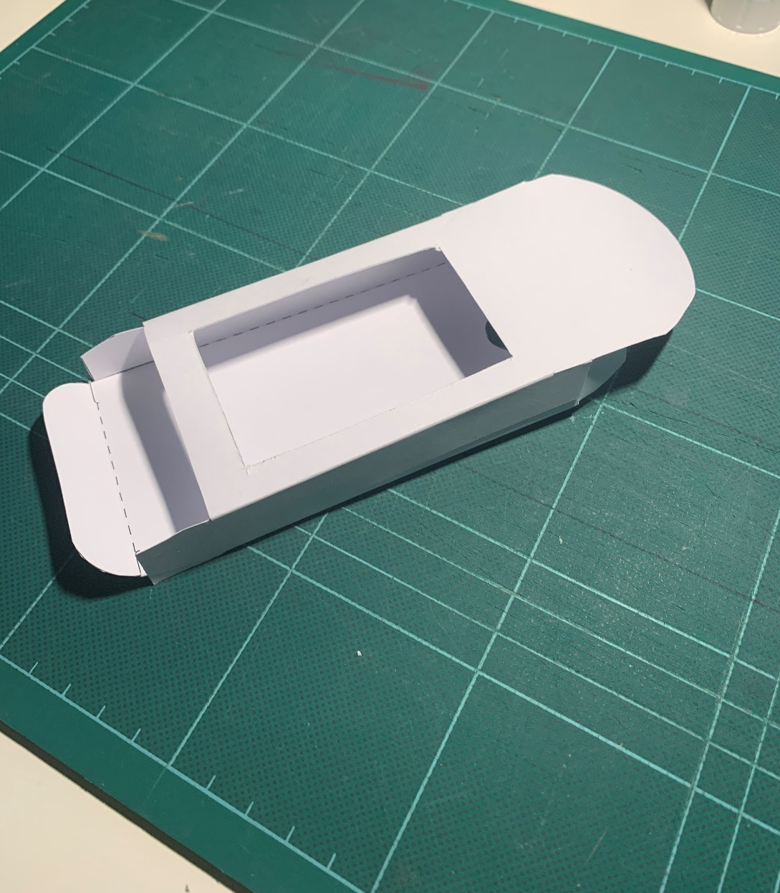
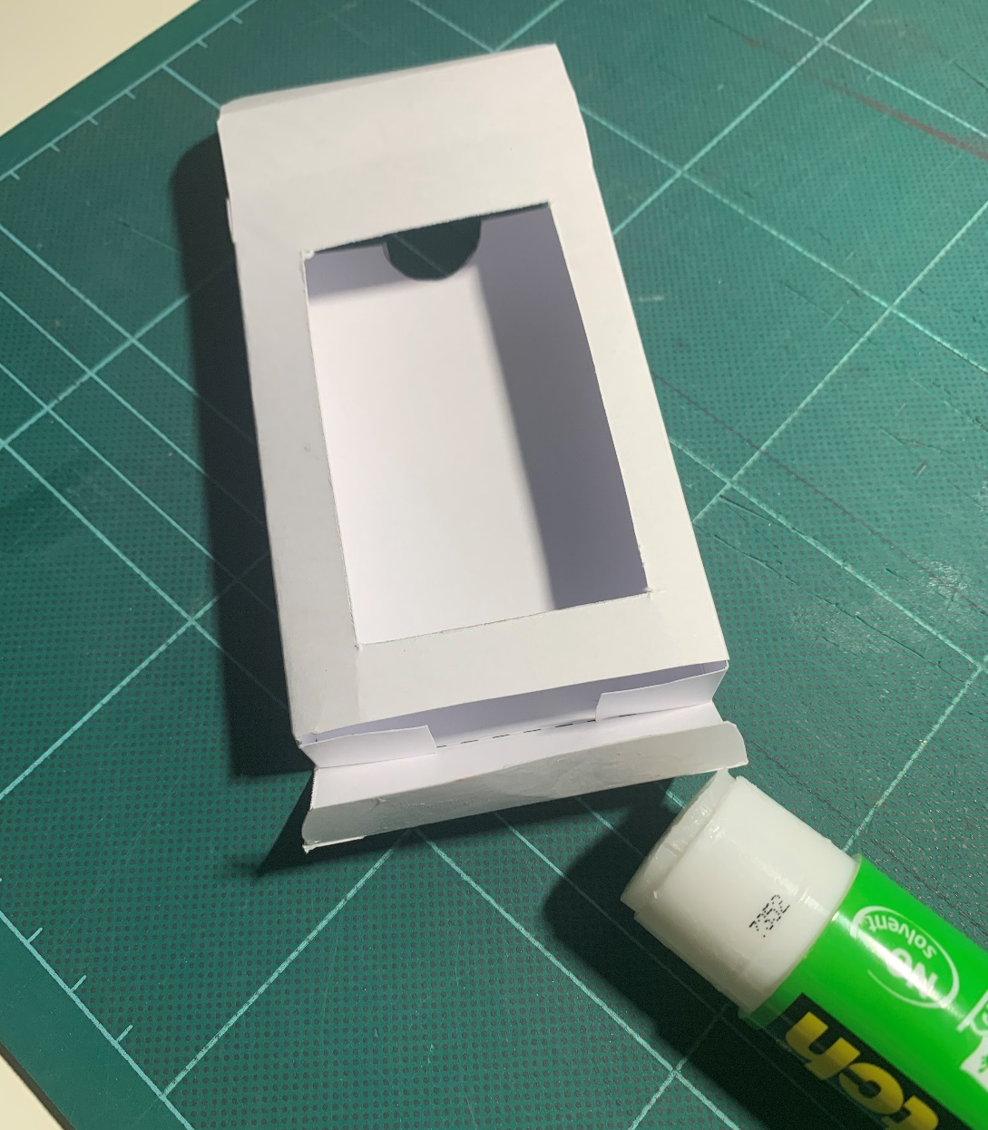
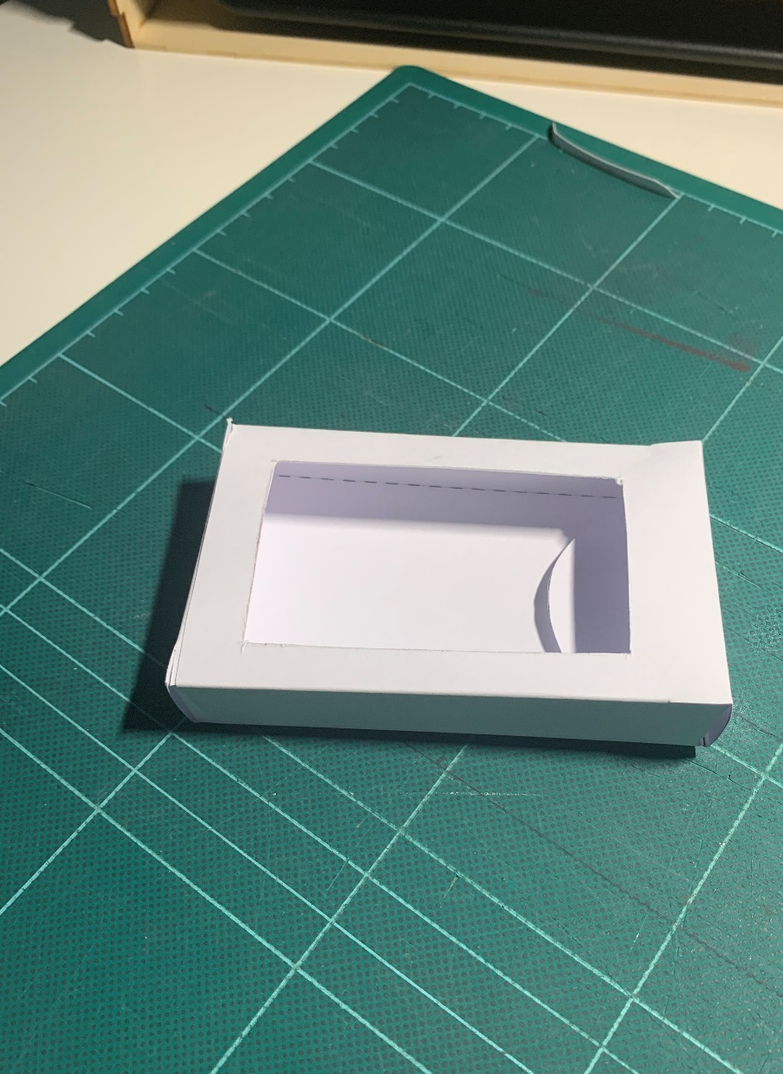
Step 3 – Template sheet 1
Playing Card Box
Fold the top tab in to complete the box
Side tab glued in place
Glue the base tab

Slide 7
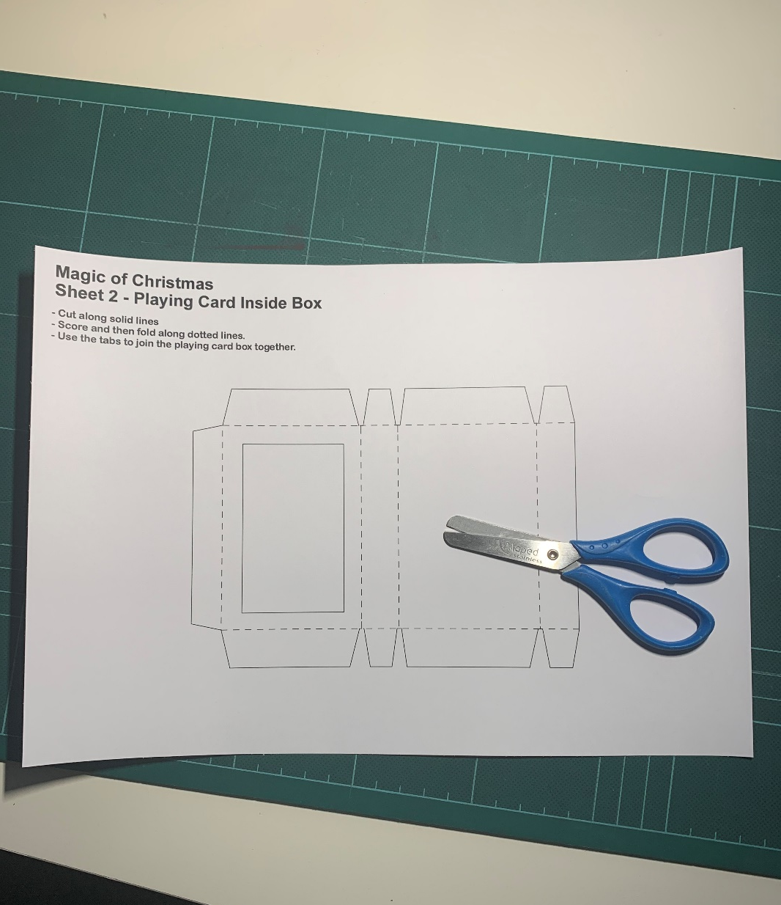
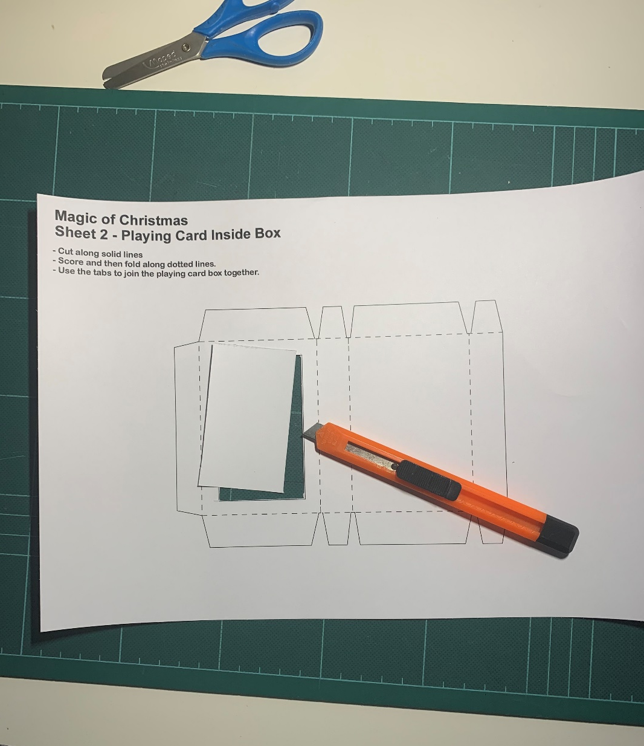
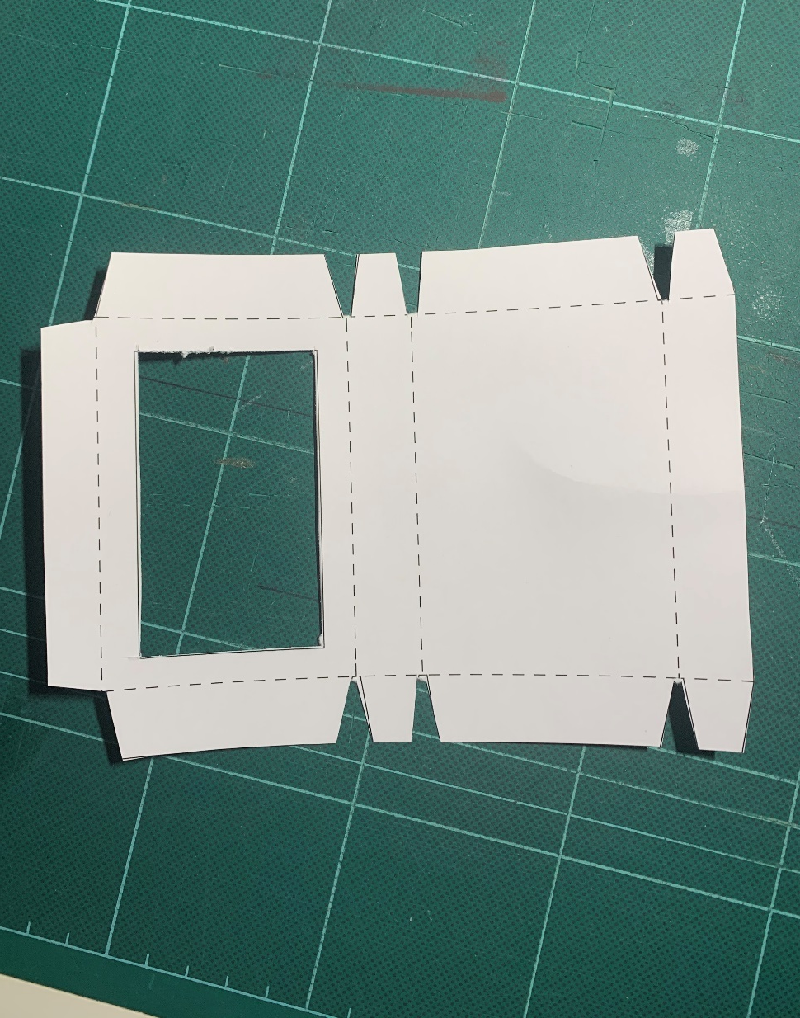
Step 4 – Template sheet 2
Playing Card inside Box
⚠ Cut out the template
Get Sheet 2
⚠ Cut of the window

Slide 8
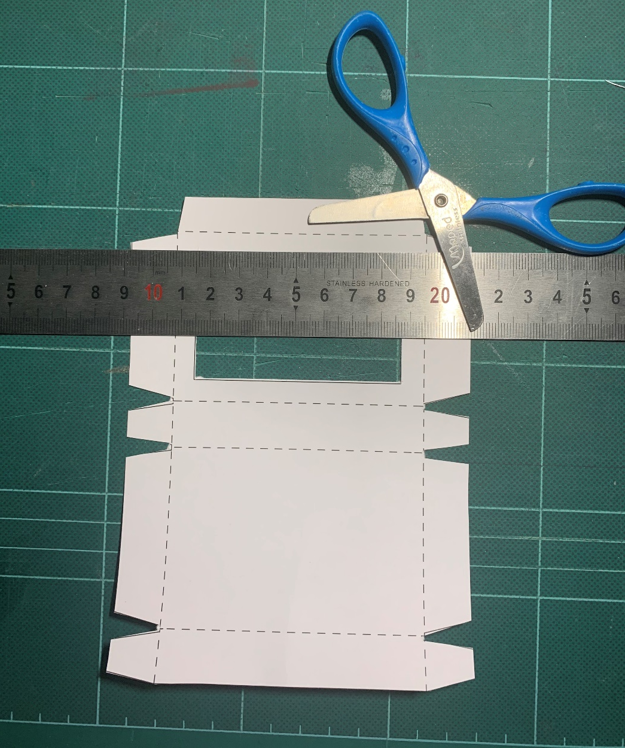
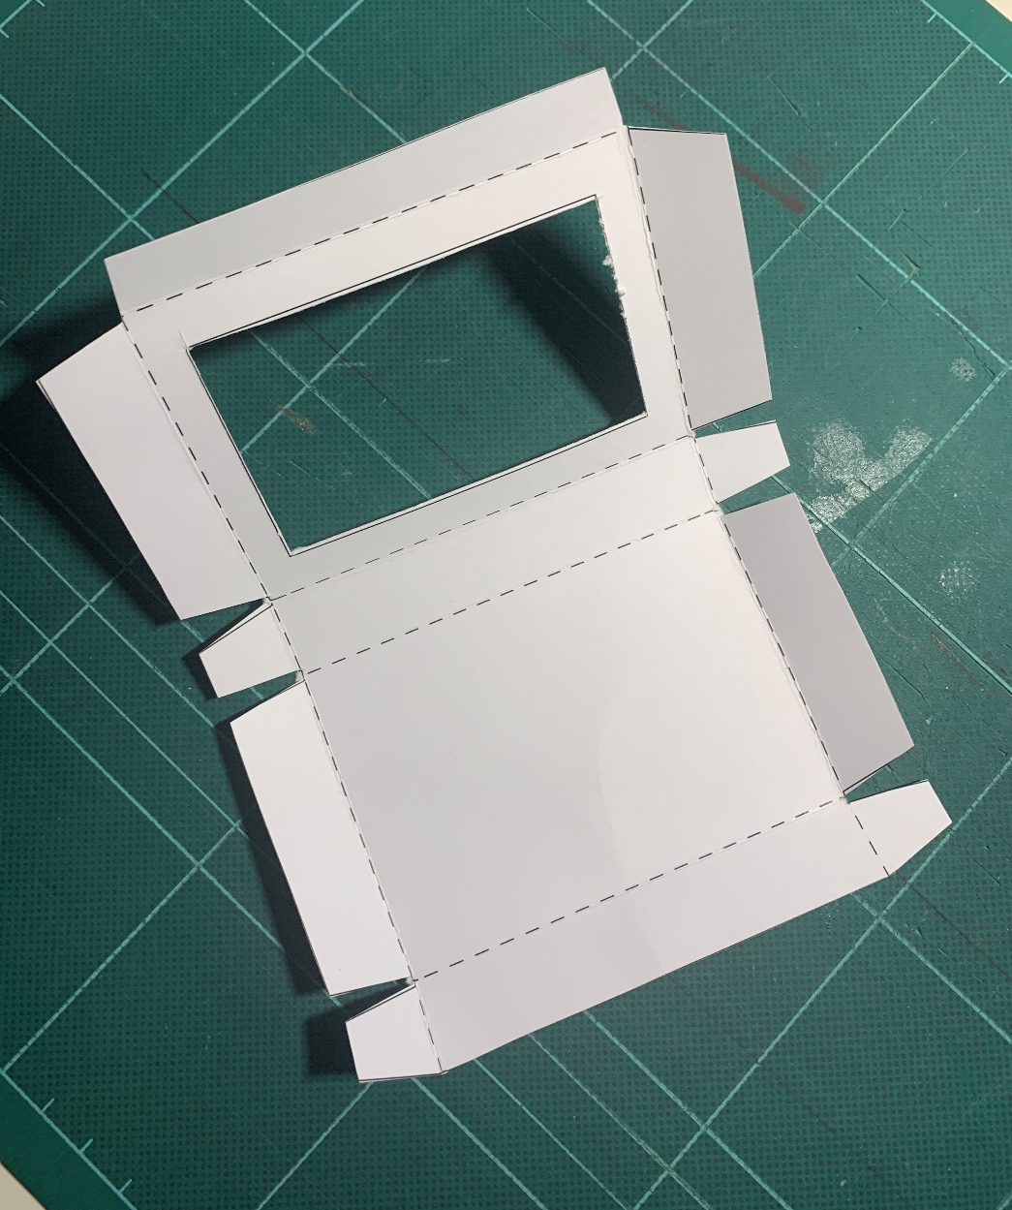
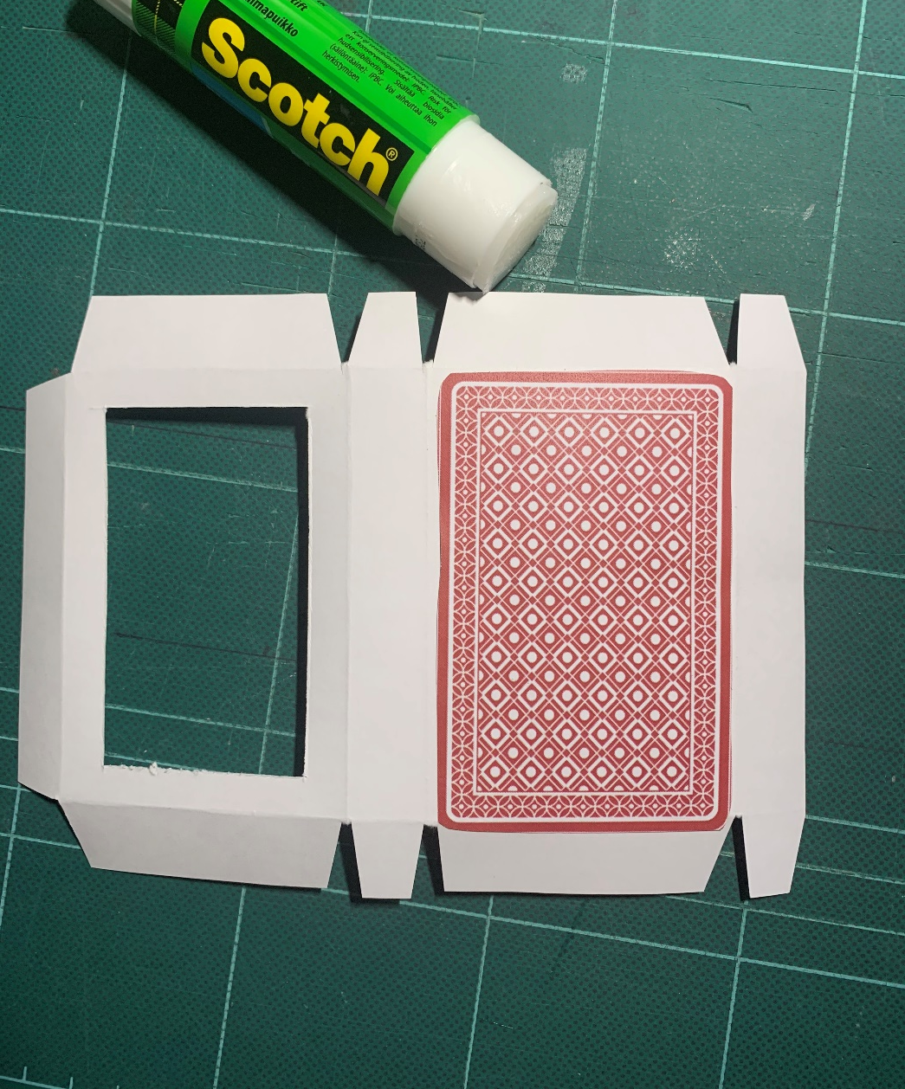
Step 5 – Template sheet 2
Playing Card inside Box
Glue the colour card back to the back of the template
⚠ Score the dotted lines
Fold the dotted lines

Slide 9
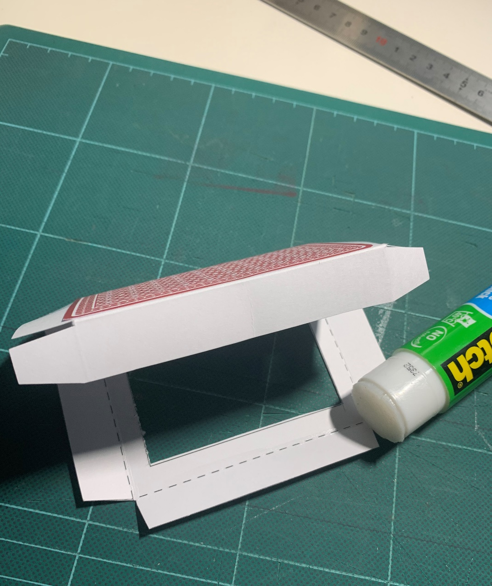
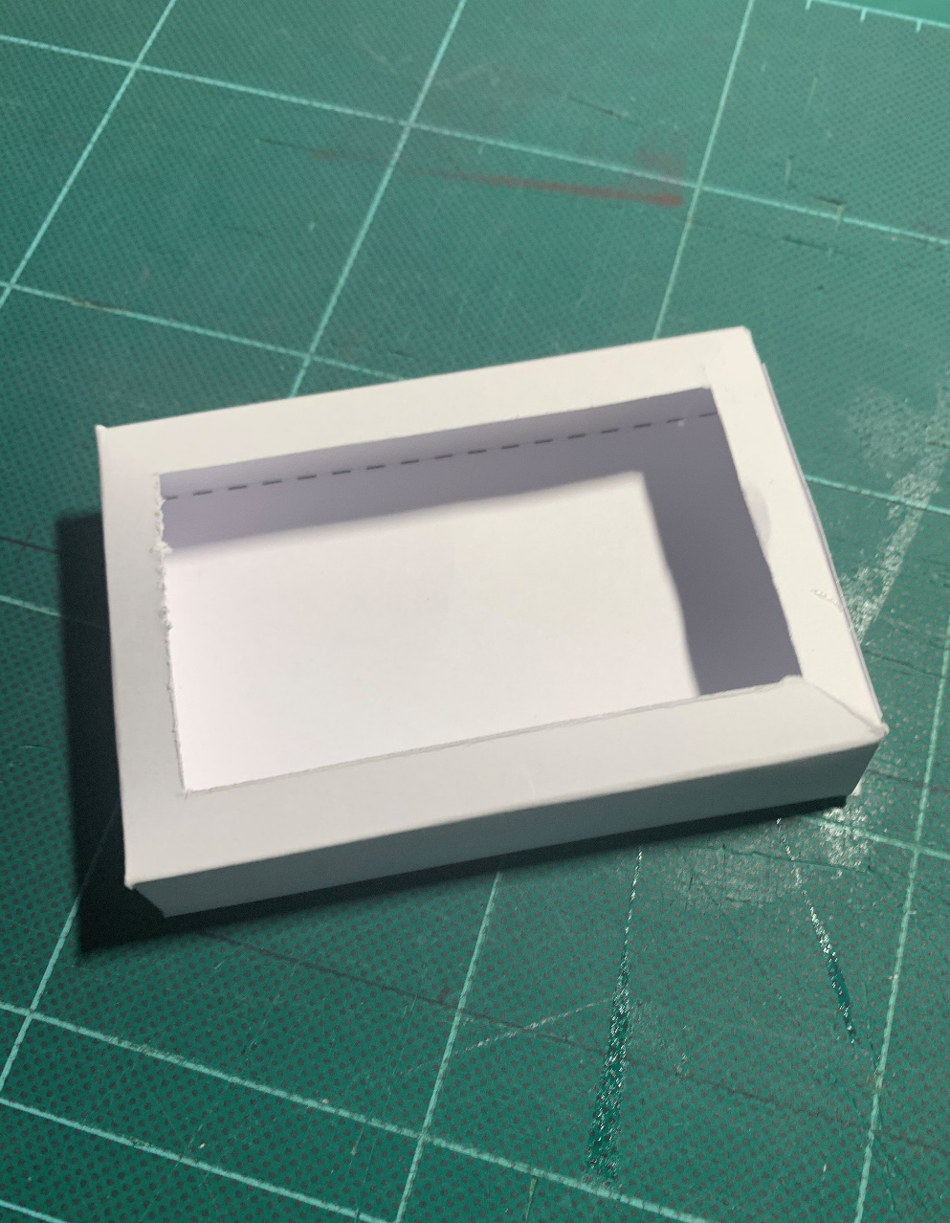
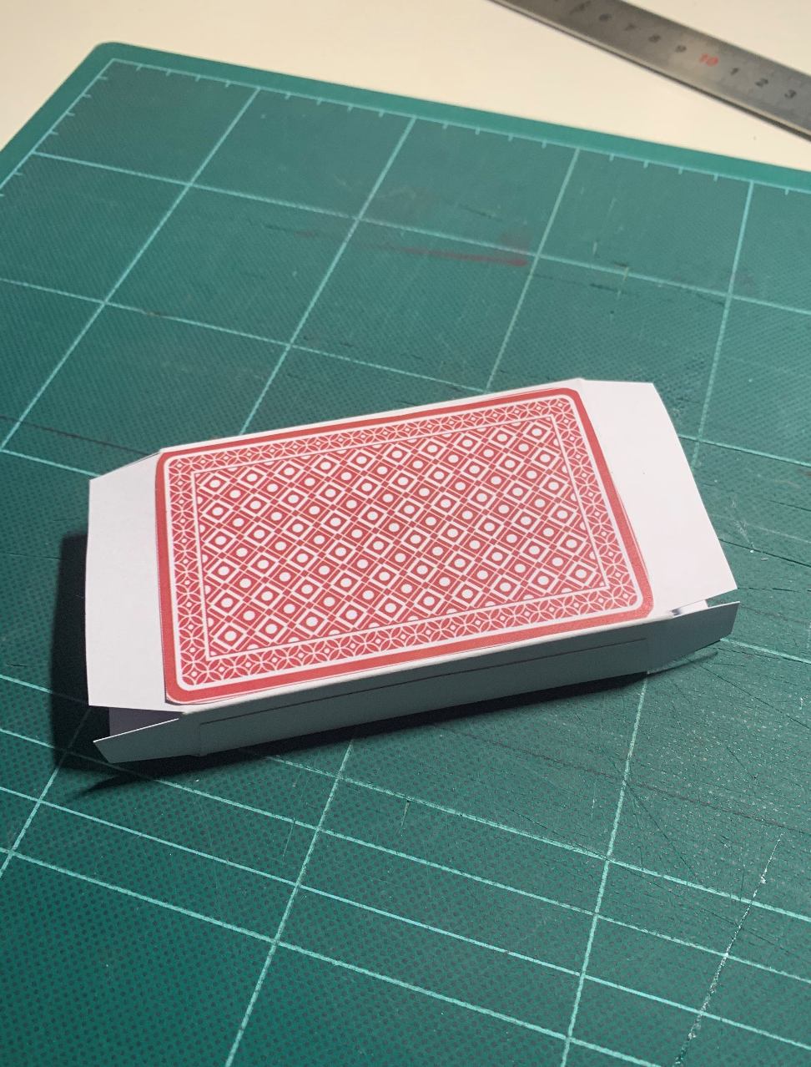
Step 6– Template sheet 2
Playing Card inside Box
Fold and glue the side tab
Fold and glue the end tabs
Completed inside box

Slide 10
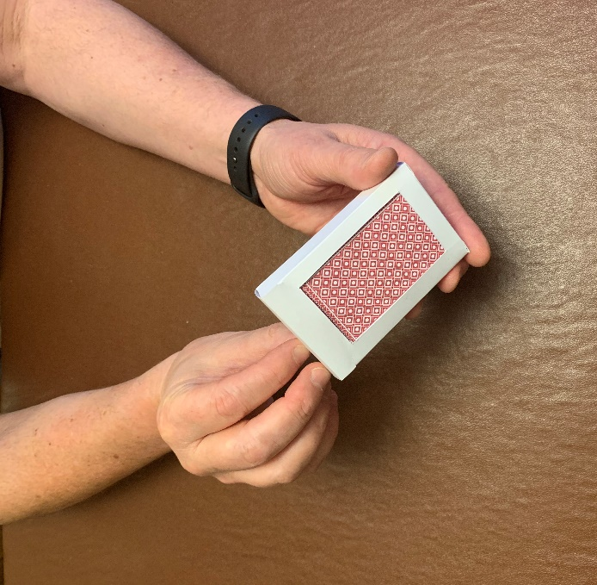
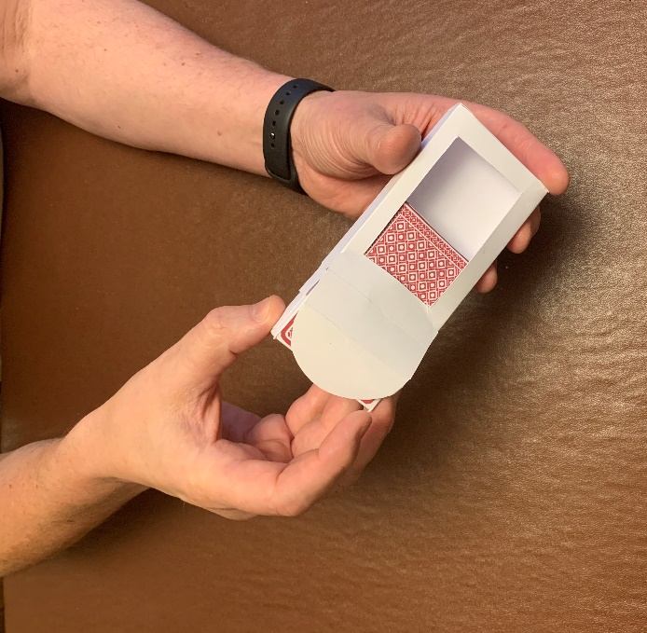
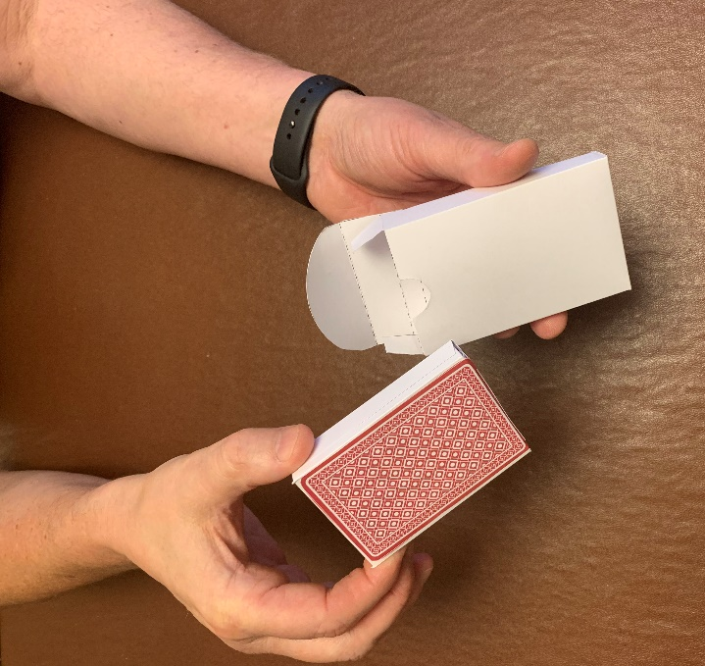
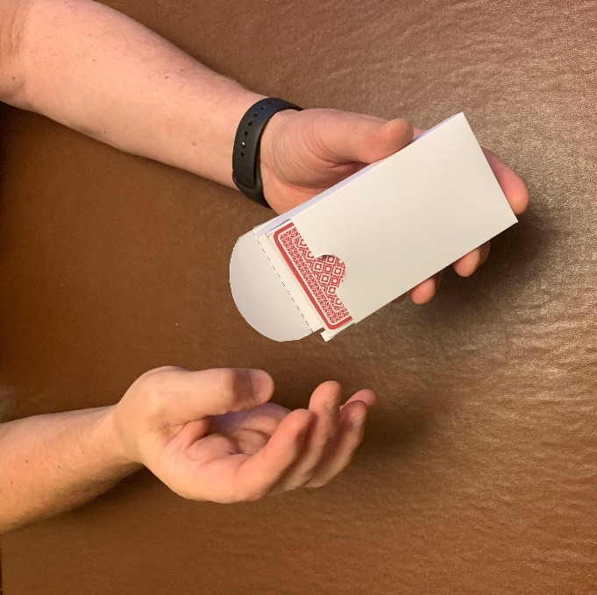
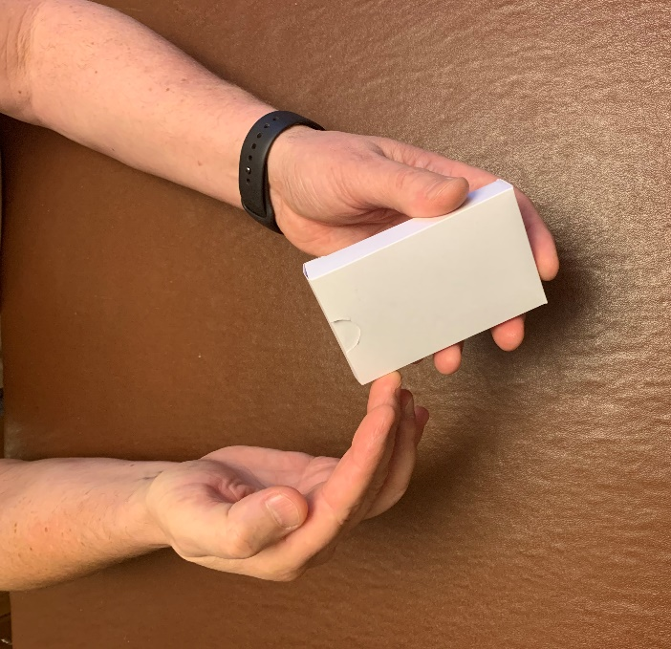
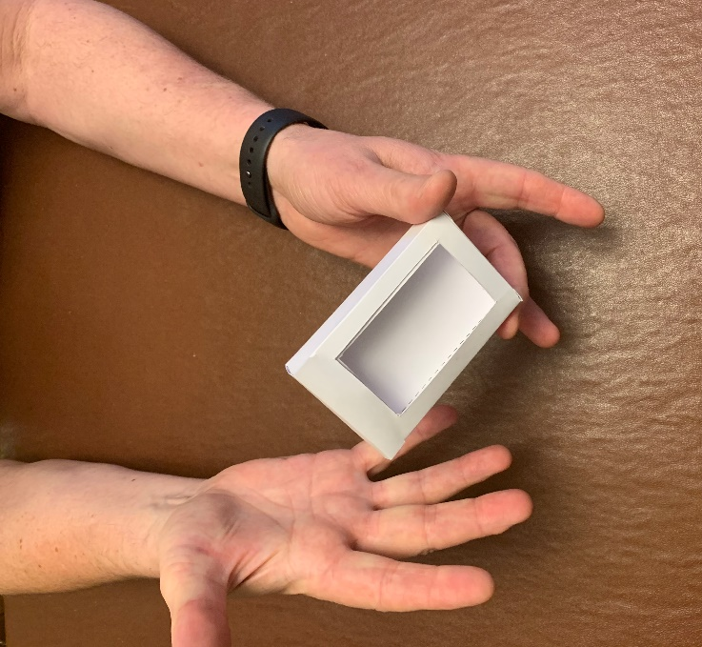
How to do the magic trick
1. Tell your audience you have a pack of cards – show them the coloured back through the open window on the card box
2. Carefully take out the inside box and say “you will now make the cards disappear”
3. Turn the card box around so the window is at the rear
4. Re-insert the ‘pack’ into the box
5. Close the card box and say a magic word
6. Turn the card box around to amaze your audience

