Slide 1
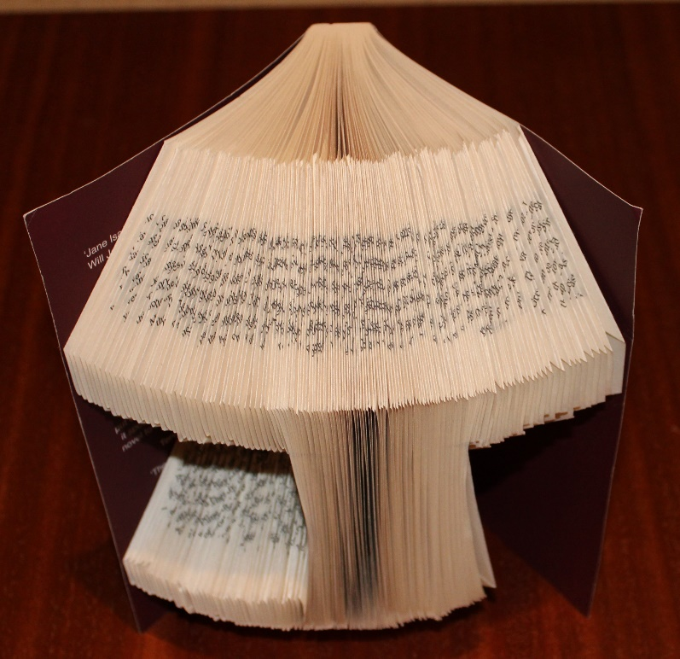
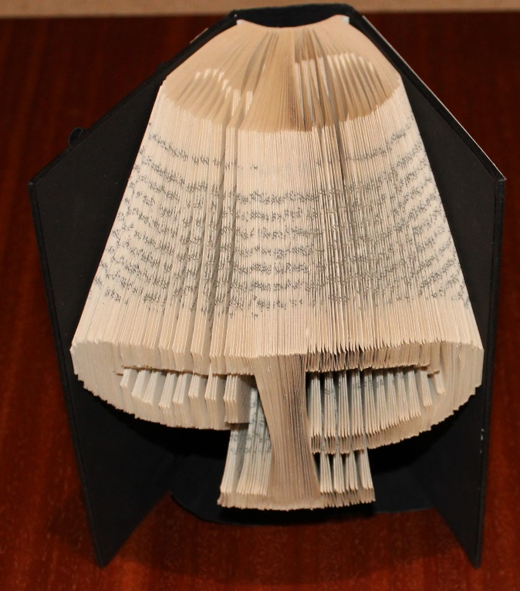
Folded book art
Turning a book into an artistic present!

Slide 2
Stay safe
Whether you are a scientist researching a new medicine or an engineer solving climate change, safety always comes first. An adult must always be around and supervising when doing this activity. You are responsible for:
• ensuring that any equipment used for this activity is in good working condition
• behaving sensibly and following any safety instructions so as not to hurt or injure yourself or others
Please note that in the absence of any negligence or other breach of duty by us, this activity is carried out at your own risk. It is important to take extra care at the stages marked with this symbol: ⚠

Slide 3
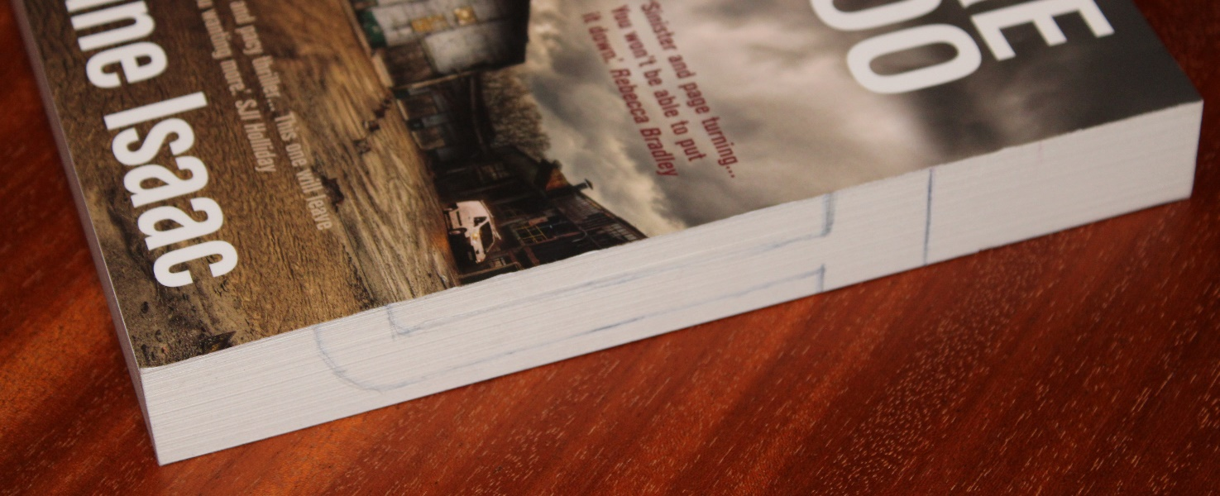
Step 1 – Sketch your shape
Sketch your shape or letter on the edge with the pages in pencil
Remember – the shape will be at least twice as wide after it is finished
Sketched shape

Slide 4
Types of feature
Open features run from the end of the book to the shape
Enclosed features don’t touch the ends – these are more tricky
Enclosed feature
Open feature
Open feature

Slide 5
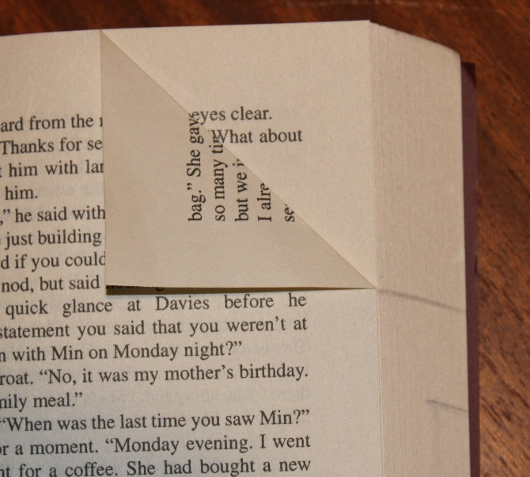
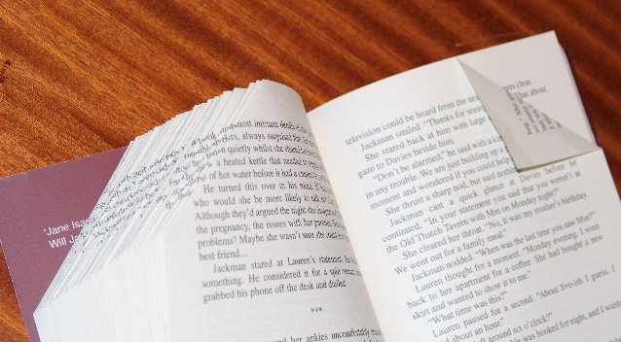
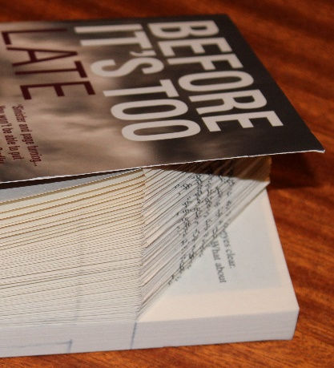
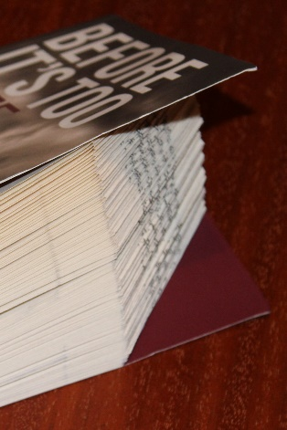
Step 2 – Fold the first line
Start with an open feature
Fold over the first corner so the bottom of the fold touches the top of your shape
Repeat – until all the folds are done for that line
Keep each fold the same size/shape
Done
Line
Part way through

Slide 6
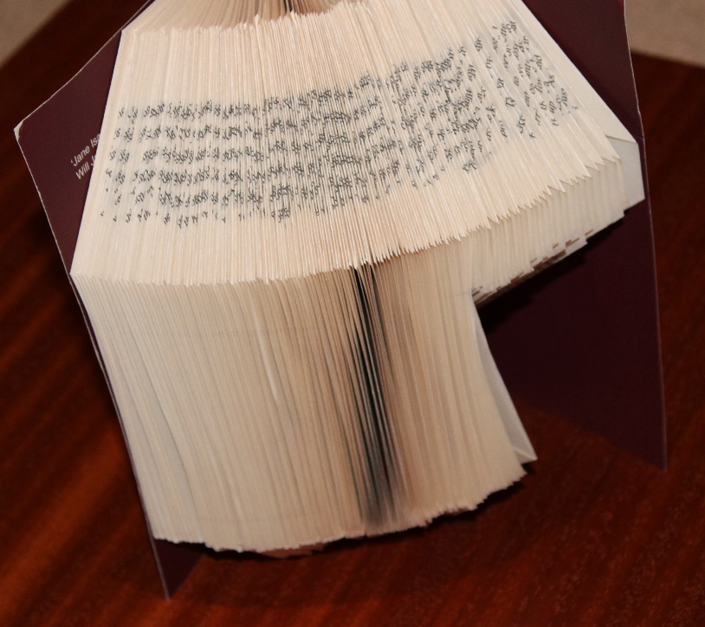
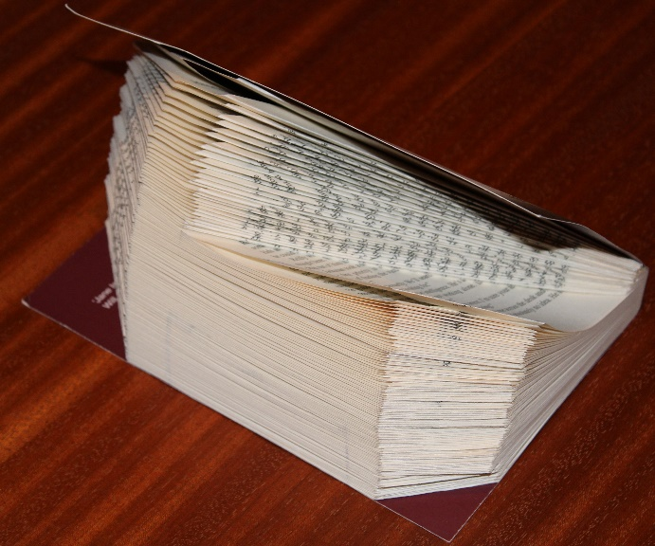
Step 3 – Fold the other open features
Repeat for other lines at the top or bottom
What it looks like with the book lying down
Second fold line
Third fold line

Slide 7
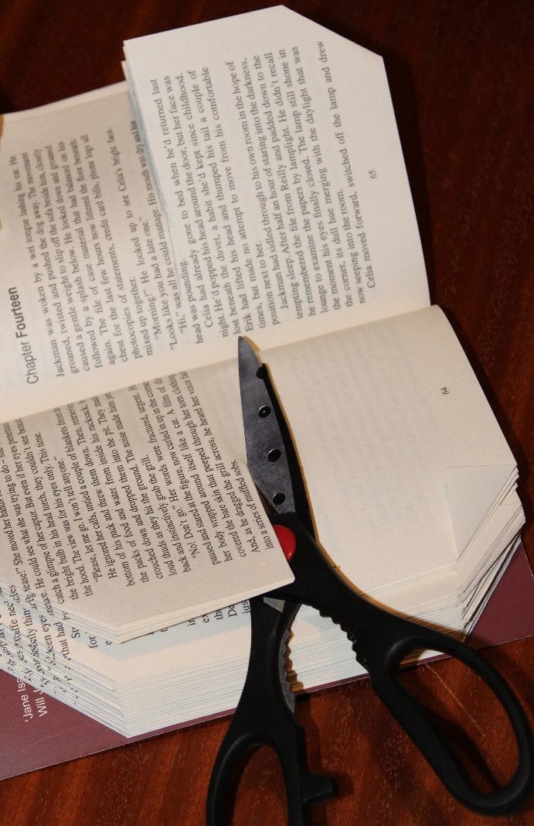
Step 4 – Enclosed features
You need to cut halfway along the width of the enclosed feature
⚠ Be careful not to cut too deep
Then fold as though the cut was the edge of the paper, folding away on both sides
On this feature, cut where the red line is

Slide 8
The end result
Another book with a different design

Slide 9
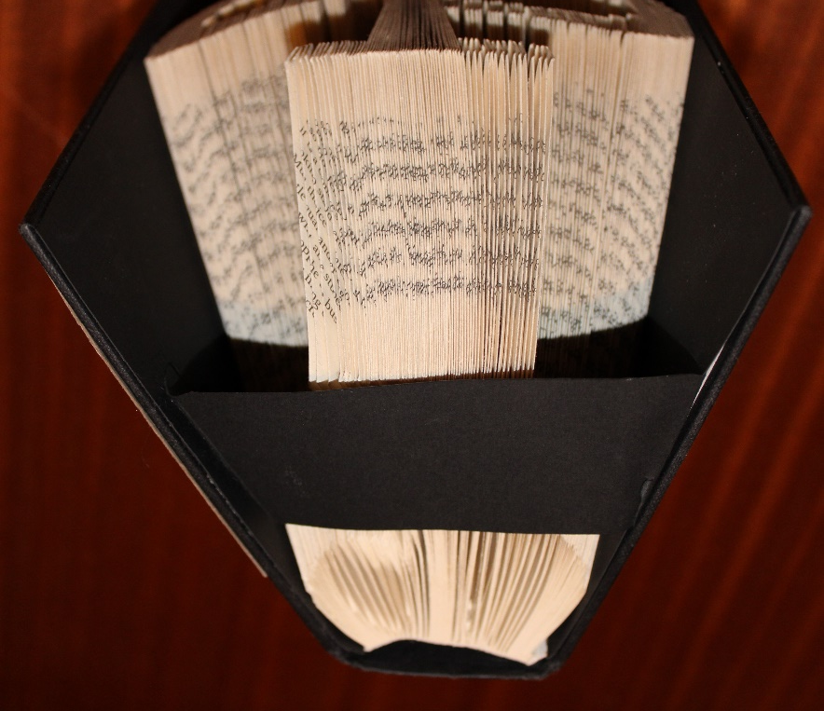
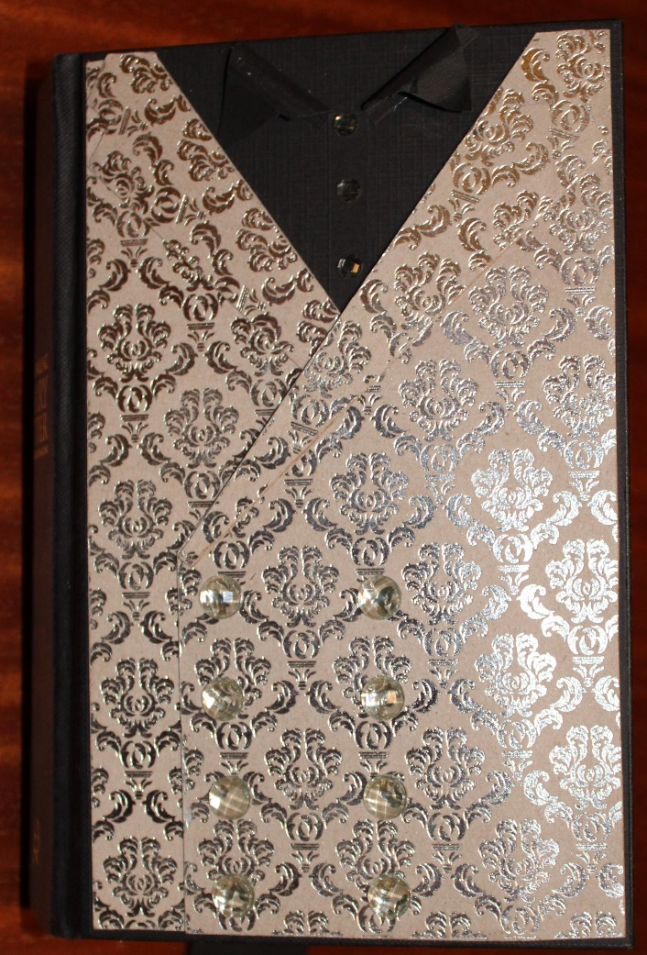
Other Things You Could do
You could use coloured and patterned paper to add designs to the outside of the book – this one also has plastic jewels and buttons glued on, to make it look like a waistcoat and shirt
Glue a paper strip across the bottom, attached to the inside of the covers – this will help the book stand up

Slide 10
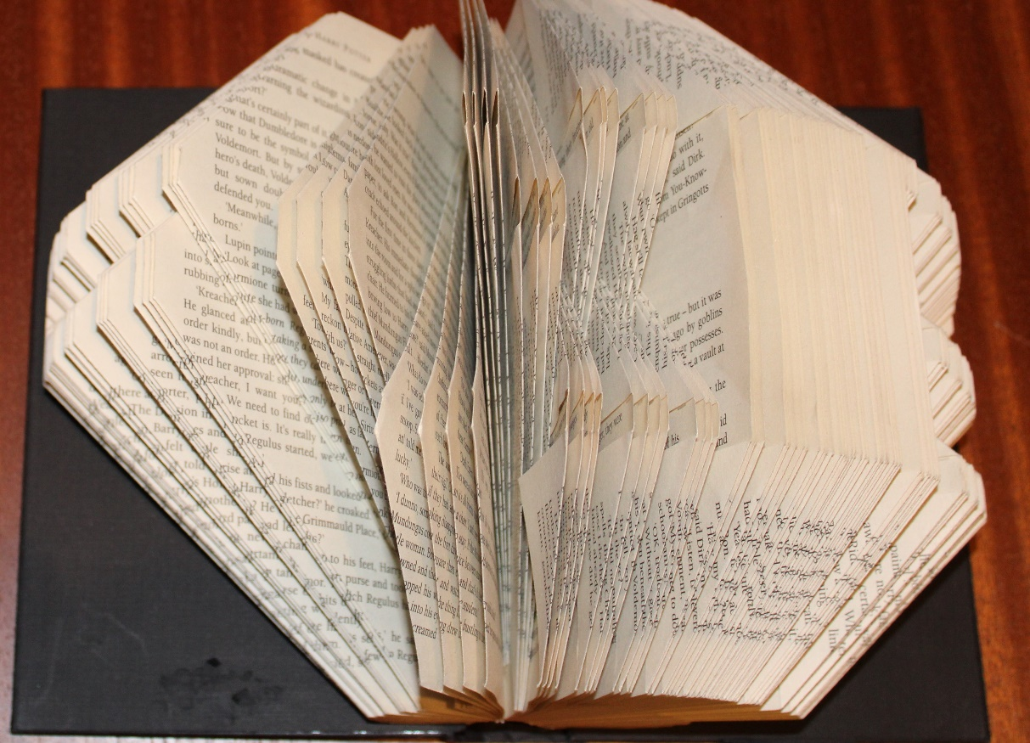
Alternative method for enclosed features
This is what these folds look like when the book is opened out
Enclosed features can be made without cutting
This is done by folding small groups of pages all the way to the edge, with alternate groups folded to opposite edges

