Slide 1
Santa’s suit replacement
Designing a high-tech replacement for Santa’s suit

Slide 2
Stay safe
Whether you are a scientist researching a new medicine or an engineer solving climate change, safety always comes first. An adult must always be around and supervising when doing this activity. You are responsible for:
ensuring that any equipment used for this activity is in good working condition
behaving sensibly and following any safety instructions so as not to hurt or injure yourself or others
Please note that in the absence of any negligence or other breach of duty by us, this activity is carried out at your own risk. It is important to take extra care at the stages marked with this symbol: ⚠

Slide 3
Background
Santa has worn his current suit since the 1870’s when it was designed by American cartoonist Thomas Nast.
There have been lots of developments in technology since then – he thinks it’s time he benefited from some of these!

Slide 4
Examples of Some New Technologies
Smart materials like D3O, that stiffen to resist impact
Materials that can change colour
Hoverboards and jetpacks
Wearable electronic devices
Augmented reality glasses and helmets

Slide 5
Context
Santa’s clothes have a challenging life:
they have to resist wear and tear from sliding down chimneys
they must resist soot marks and stains spilled drinks left for him by grateful children
they have to keep him warm in freezing temperatures
they must protect him when he falls off roofs
they have to give him camouflage when naughty children try to stay awake to see him!

Slide 6
Design Criteria
The new clothes must:
protect Santa from knocks and falls.
give some form of camouflage.
keep Santa warm.
be fashionable and aesthetically appealing – Santa needs to be stylish!
include some new technologies to make his job easier.

Slide 7
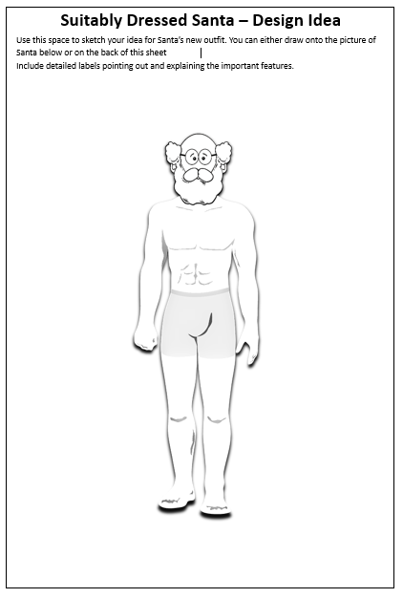
Santa’s suit replacement – Design Idea
Design a new outfit for Santa that meets the design criteria
You can either draw onto the picture of Santa or on the back of this sheet
Include detailed labels pointing out and explaining the important features.

Slide 8
Design Criteria
The new clothes must:
protect Santa from knocks and falls.
give some form of camouflage.
keep Santa warm.
be fashionable and aesthetically appealing – Santa needs to be stylish!
include some new technologies to make his job easier.

Slide 9
Peer Review
Share your designs with another person.
Identify one good thing from their design that you could use.
Use this idea to update your design.

Slide 10
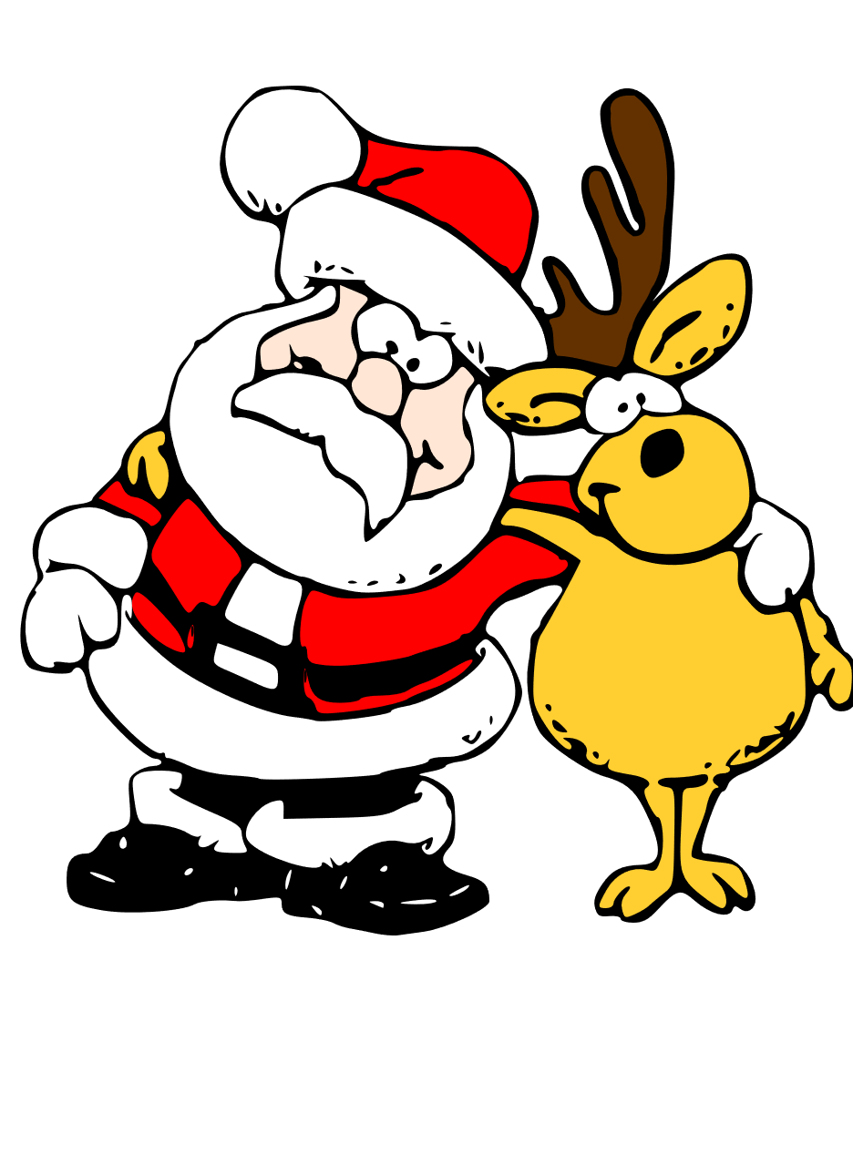
Extension
Design uniforms that could be worn by Santa’s reindeer
Consider other potential uses of the technologies you have used in Santa’s new clothes

