Slide 1
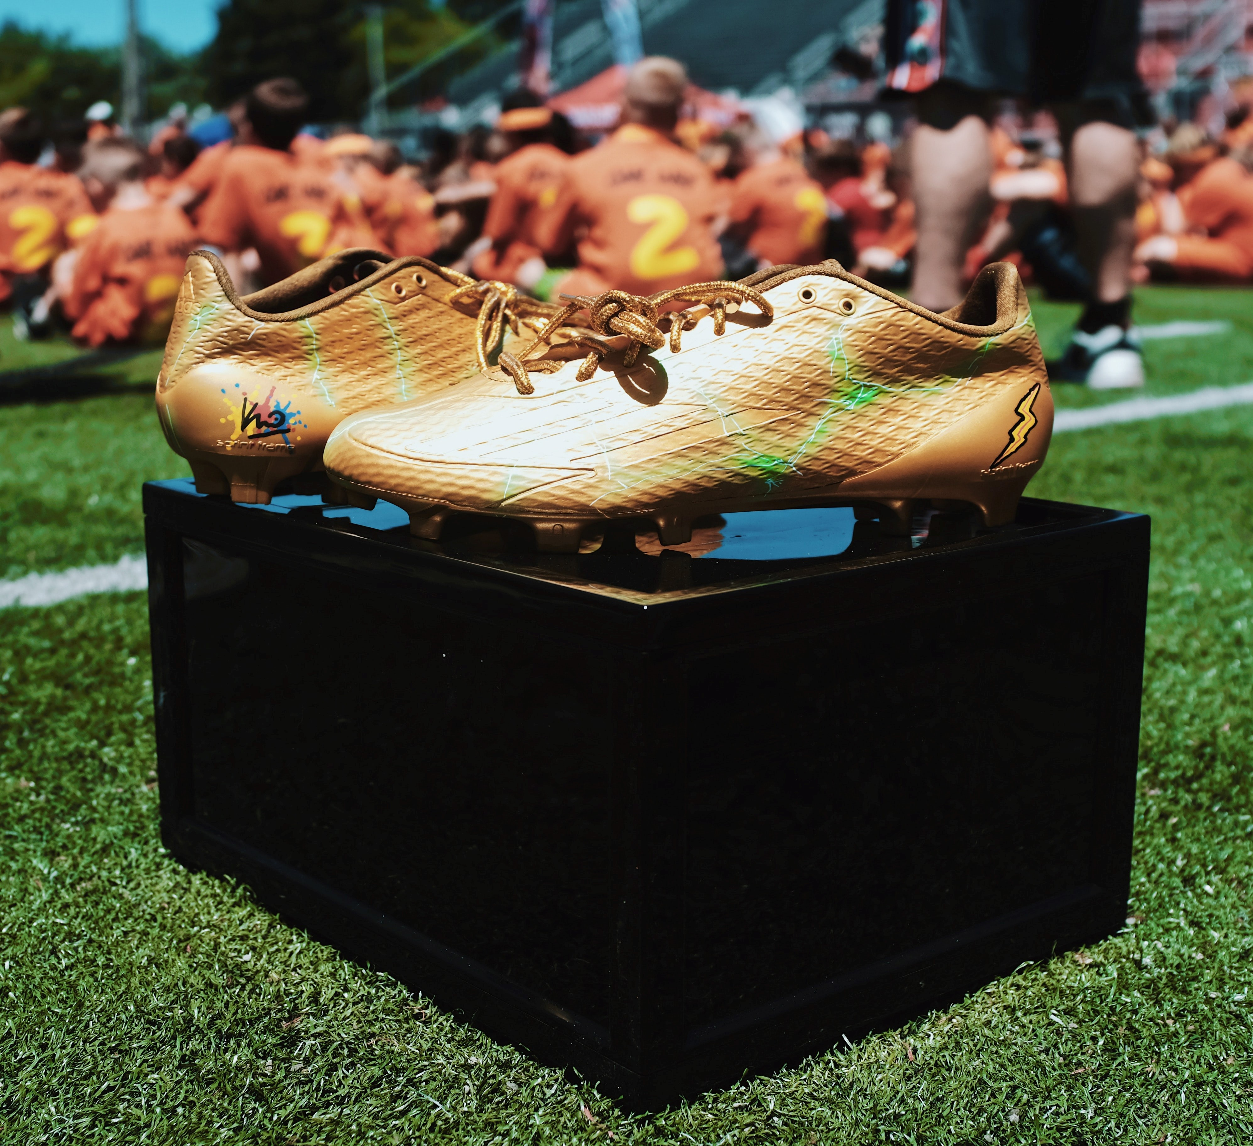
Selecting the Golden Boot recipient
Use fractions, percentages and averages to decide the best footballer

Slide 2
What makes a good footballer?

Slide 3
The statistics
Name | Position | Home country | International caps | International goals | Height | Date of birth | Pace | Shooting | Defending
Alexia Putellas | Midfielder | Spain | 100 | 27 | 1.73m | 04.02.1994 | 78 | 81 | 70
Bruno Fernandes | Midfielder | Portugal | 46 | 8 | 1.79m | 08.09.1994 | 84 | 93 | 77
Cristiano Ronaldo | Forward | Portugal | 189 | 117 | 1.87m | 05.02.1985 | 87 | 93 | 34
Erling Haaland | Forward | Norway | 21 | 20 | 1.95m | 21.07.2000 | 89 | 91 | 45
Harry Kane | Forward | England | 73 | 50 | 1.88m | 28.07.1993 | 70 | 91 | 47
Jan Oblak | Goalkeeper | Slovenia | 50 | 0 | 1.88m | 07.01.1993 | 60 | 78 | 90
Joshua Kimmich | Midfielder | Germany | 68 | 5 | 1.77m | 08.02.1995 | 70 | 73 | 83
Karim Benzema | Forward | France | 97 | 37 | 1.85m | 19.12.1987 | 76 | 86 | 39
Kevin De Bruyne | Midfielder | Belgium | 91 | 24 | 1.81m | 28.06.1991 | 76 | 86 | 64
Kylian Mbappe | Forward | France | 57 | 27 | 1.78m | 20.12.1998 | 97 | 88 | 36

Slide 4
The best footballer
“From the data, I think that ___ is the best player because they …”
… have the highest …
… have the lowest …
… have the most …
… are the …

Slide 5
The best footballer
“From the data, I think that ___ is the best player because they …”
… have the highest …
… have the lowest …
… have the most …
… are the …
… have the best …
What else could we do with the data to come up with a way of measuring their success?

Slide 6
Who has the best strategy?
Jo says: For each player, I compared the number of international caps with the number of goals scored. The smallest difference was ‘the best’.
Sam says: I divided the number of goals scored by the number of matches to give a scoring rate. The biggest number was ‘the best’.
George says: I found the mean average of their Pace, Shooting and Defending scores. The highest average was ‘the best’.

Slide 7
Fantasy Football
Pick a team
You must include a goalkeeper
The total average score of all your players must be < 850
Have you got a balanced team?

Slide 8
Please do share your learning highlights and final creations with us so we can display it for other students to see.
Share them with us on social media @IETeducation or send them via email to IETEducation@theiet.org

