Slide 1
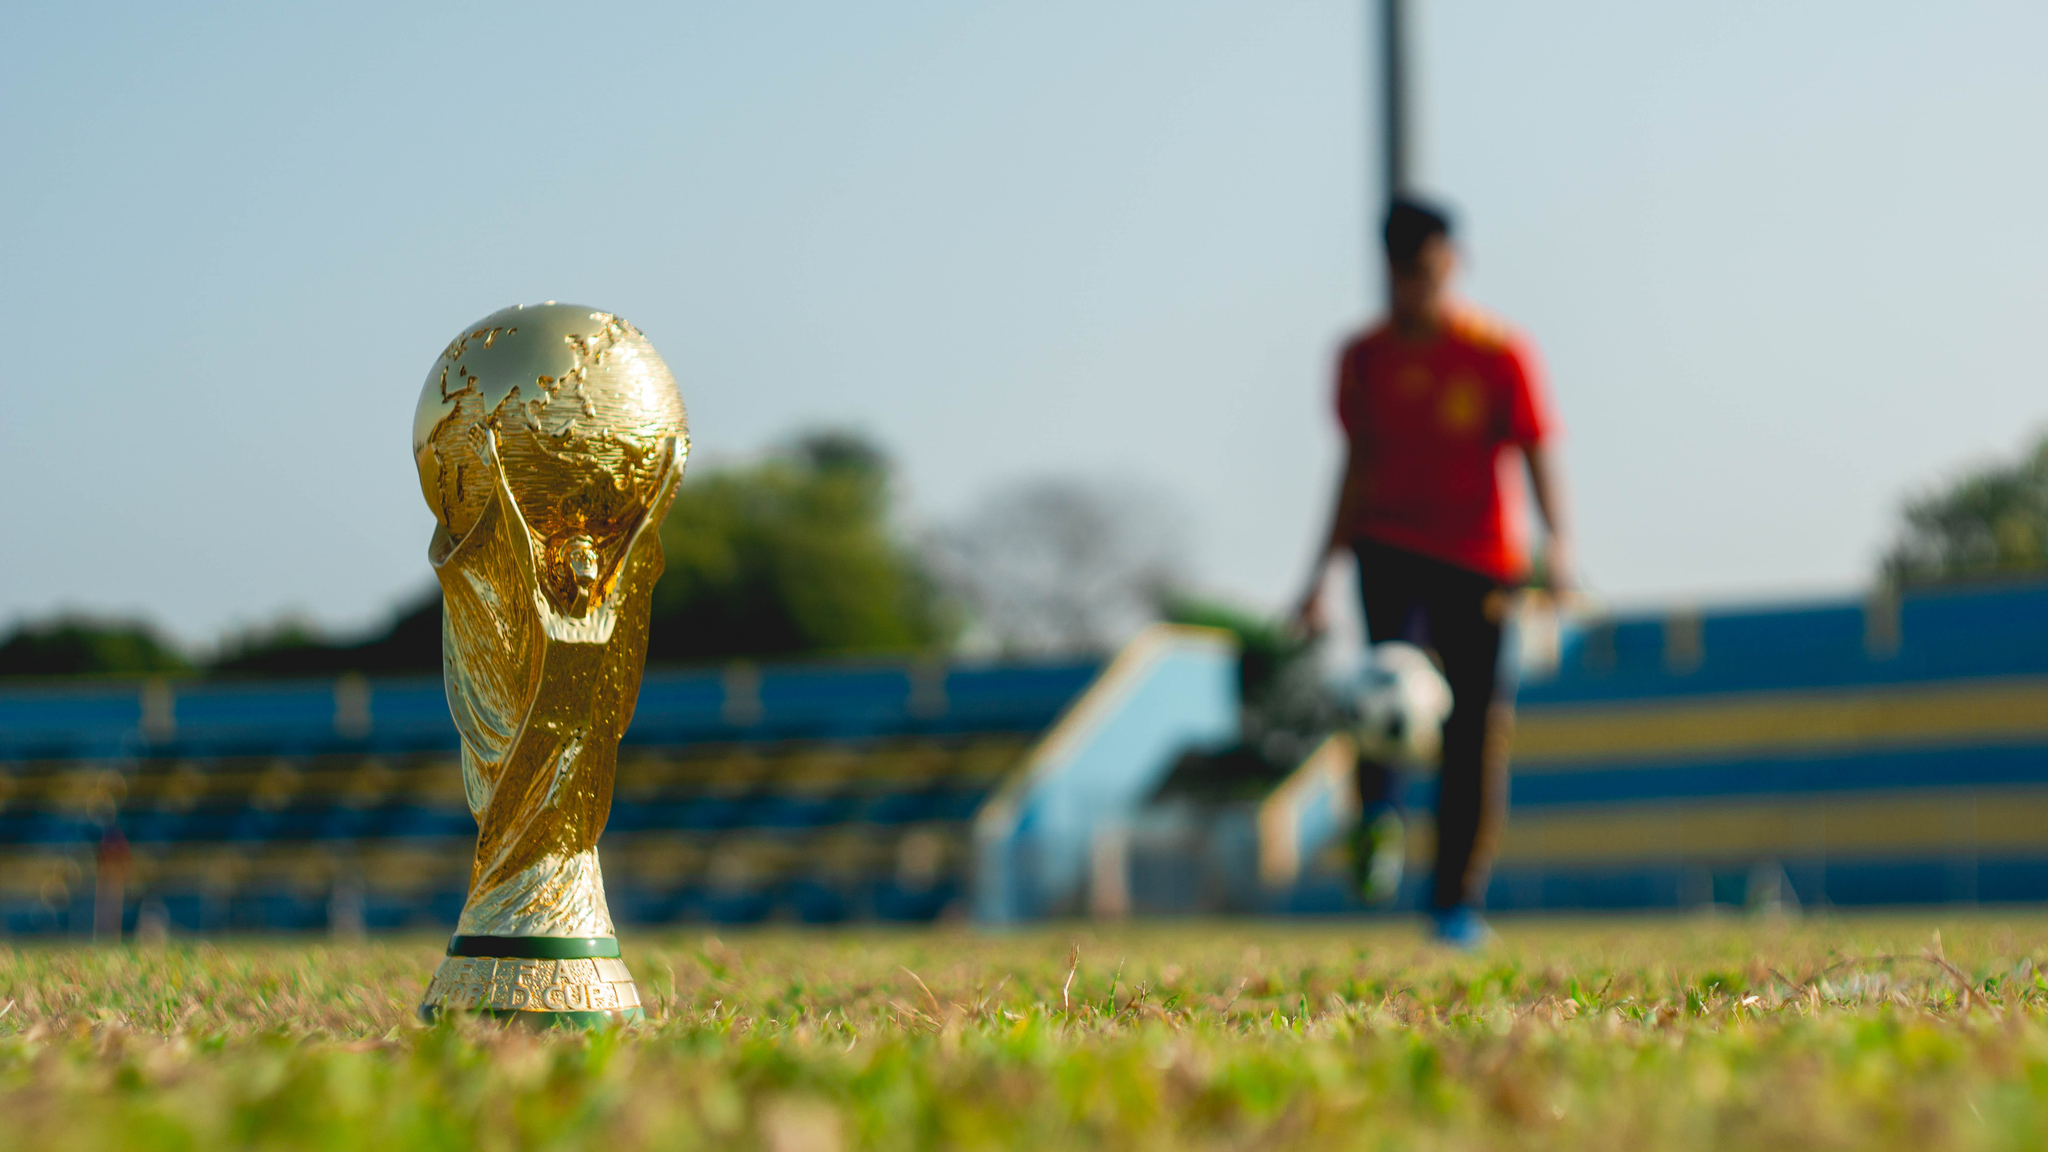
Design and create a
pewter cast medal
Make your own medal for the World Cup

Slide 2
Stay safe
Whether you are a scientist researching a new medicine or an engineer solving climate change, safety always comes first. An adult must always be around and supervising when doing this activity. You are responsible for:
ensuring that any equipment used for this activity is in good working condition
behaving sensibly and following any safety instructions so as not to hurt or injure yourself or others
Please note that in the absence of any negligence or other breach of duty by us, this activity is carried out at your own risk. It is important to take extra care at the stages marked with this symbol: ⚠

Slide 3
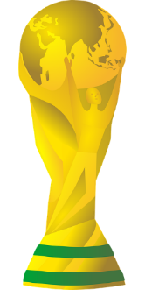
Brief
The men’s 2022 football World Cup is to be played in November and December 2022 in Qatar
Your task is to design and make a medal to commemorate the competition

Slide 4
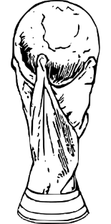
The Men’s Football World Cup 2022 in Qatar
On November 20th 2022 Qatar will host the FIFA World Cup, it will be the first time it has ever been in the Winter!
Quick Start
Where is Qatar?
What climate does Qatar have?
How many countries in the World Cup can you name?
World cup soundtrack: https://www.youtube.com/watch?v=vyDjFVZgJoo
Notes:
Quick Start
Where is Qatar? ANSWER ON SLIDE 5
What climate does Qatar have? ANSWER ON SLIDE 5
How many countries in the World Cup can you name? ANSWER ON SLIDE 6
Official world cup soundtrack: https://www.youtube.com/watch?v=vyDjFVZgJoo

Slide 5
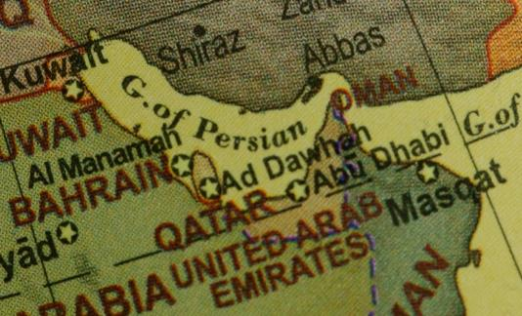
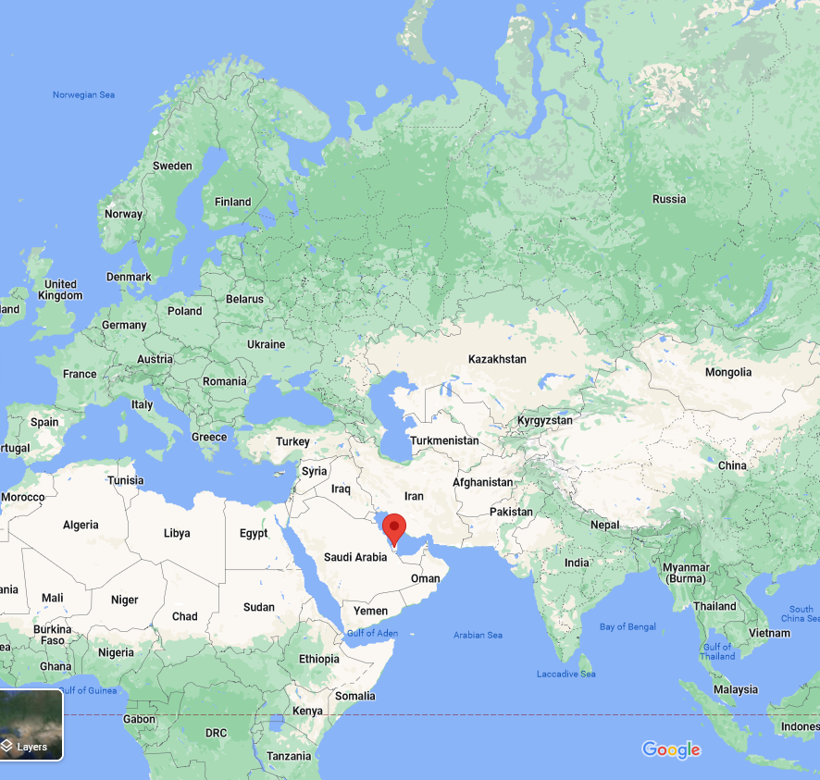
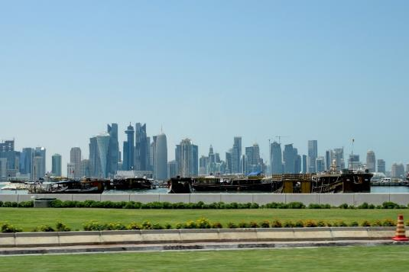
Notes:
Qatar is located in the Middle East. Qatar is bordered by the Gulf of Bahrain to the west, the Persian Gulf to the east, and Saudi Arabia to the south.
The 2022 World Cup is taking place in Qatar in the winter months rather than the usual summer ones, due to the heat. Qatar has a desert climate. The country experiences long summers from May to September characterised by intense dry heat, with temperatures rising above 45°C. Winter temperatures are mild but may fall below 5°C.

Slide 6
There are 32 countries in the World Cup 2022 in Qatar:
Group A: Qatar, Ecuador, Senegal, Netherlands
Group B: England, Iran, USA, Wales
Group C: Argentina, Saudi Arabia, Mexico, Poland
Group D: France, Australia, Denmark, Tunisia
Group E: Spain, Costa Rica, Germany, Japan
Group F: Belgium, Canada, Morocco, Croatia
Group G: Brazil, Serbia, Switzerland, Cameroon
Group H: Portugal, Ghana, Uruguay, South Korea

Slide 7
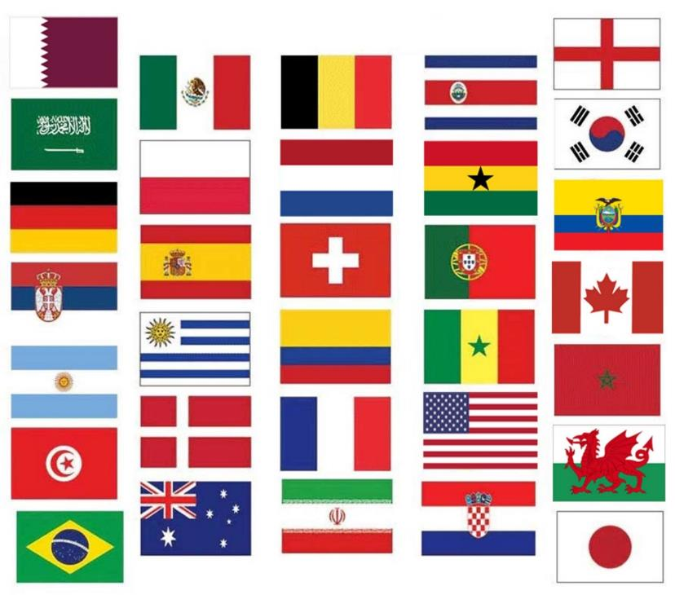
Each country has its own flag and national colours:
What is a flag?
What are the national colours of your country?
Notes:
A flag: a piece of cloth or similar material, typically oblong or square, attachable by one edge to a pole or rope and used as the symbol or emblem of a country.
All the flags above are of the 32 countries in the FIFA World Cup

Slide 8
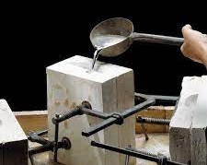
What is a Pewter casting?
Pewter casting is a common activity in many schools
It involves melting metal and pouring it into a mould
Pewter is made mainly of tin, antimony, copper, bismuth, and sometimes silver
It has a low melting point: 170–230 °C, depending on the exact mixture of metals
Health and Safety must be considered when working with molten metal

Slide 9
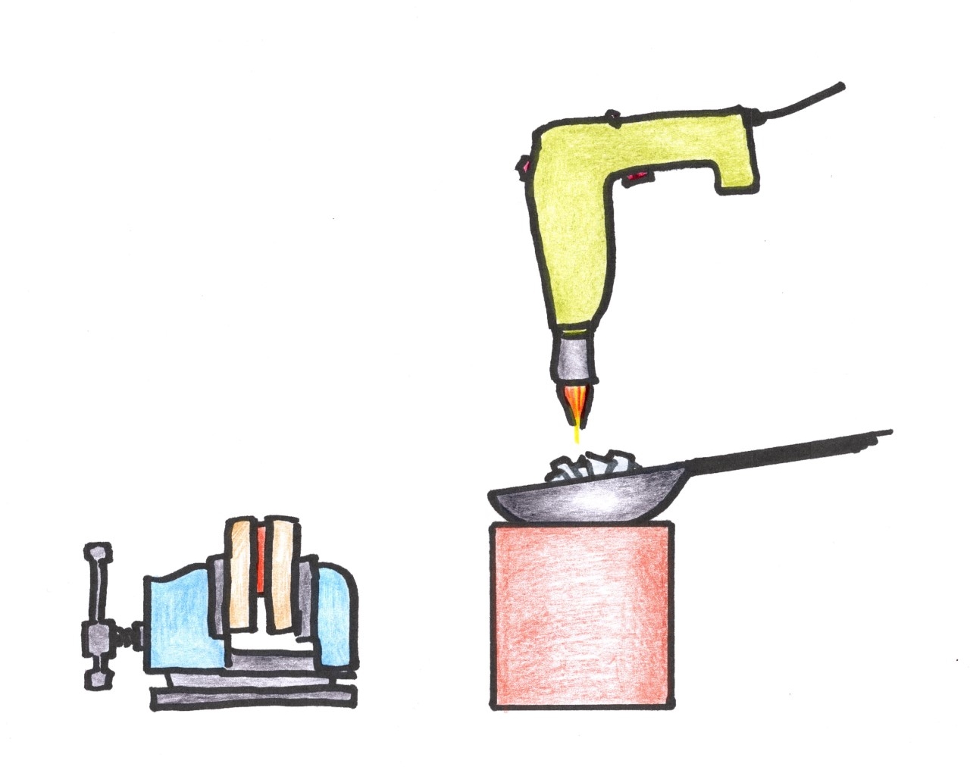
How Pewter is Cast, part 1
Heat gun to melt pewter
Small strips of Pewter are heated in a ladle, using a heat gun or flame
Fire bricks can be used to reflect the heat
This will turn the pewter to a molten state ready for pouring
MDF mould in vice
Pewter in ladle
Fire bricks to reflect heat

Slide 10
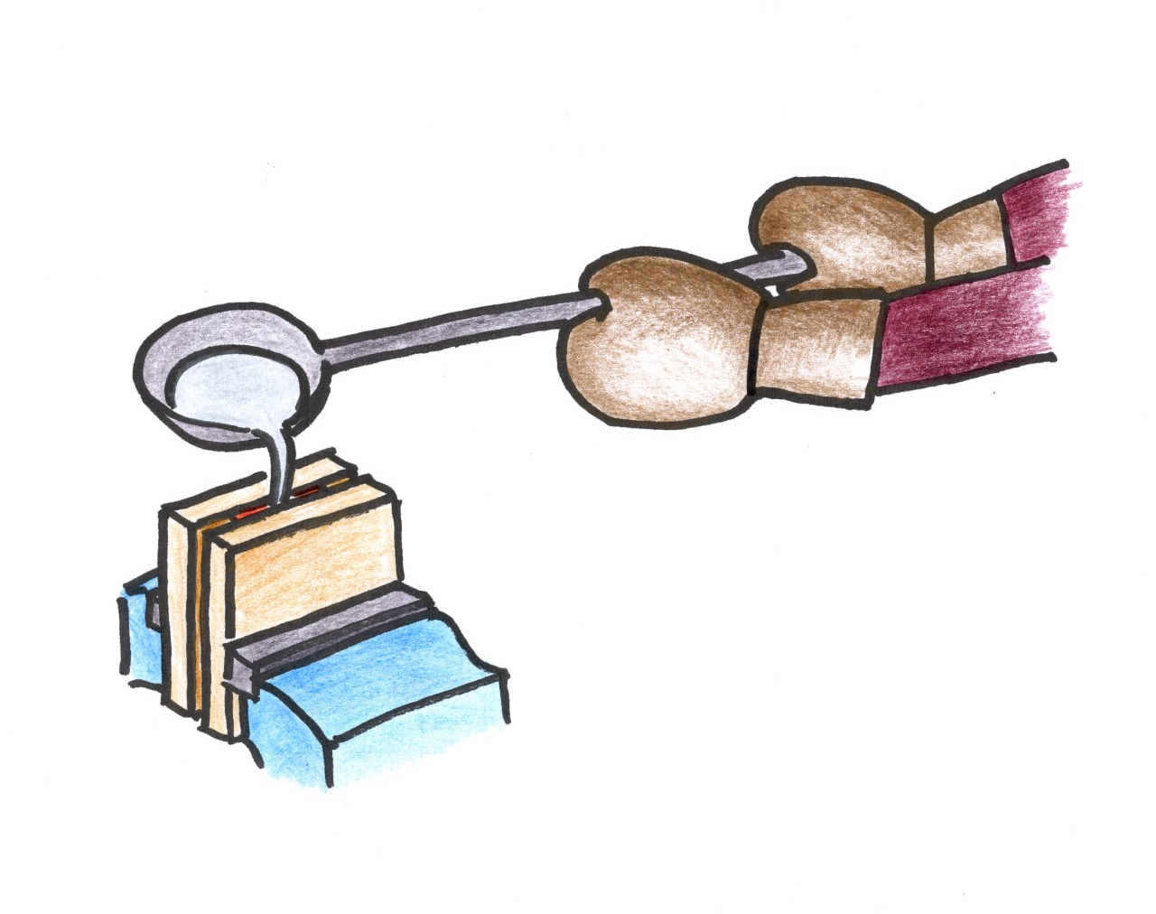
How Pewter is Cast, part 2
Gauntlets to protect hands from heat
Ensure the mould is moisture free – pre-heat it if possible
Pewter is poured into the mould, which is held in a vice
This will protect users in case of spills
Full face visor and heat resistant gloves and apron must be worn
After the metal has solidified and cooled, the MDF mould can be removed
Ladle holding molten pewter
MDF mould being held securely and safely in vice

Slide 11
Resources and equipment
You will need (resources):
You will need (equipment):
4mm MDF sheet
CAD drawing package
Pewter
G Cramp
Acrylic for insert
Pewter casting facility
Aluminium file
Wet and dry paper

Slide 12
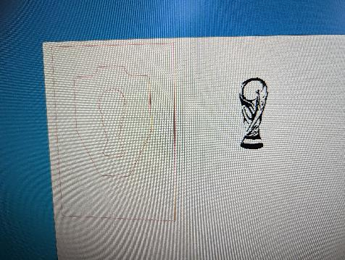
Design the medal
Using the World Cup medal hand out, create 4 initial design ideas
Think about the shape and whether you want to include acrylic parts for extra detail
Take the best parts from these to create a final design
Using a 2D CAD package, draw an outline for your medal and any inserted acrylic parts
Remember to add a sprue, so you can pour the metal in!

Slide 13
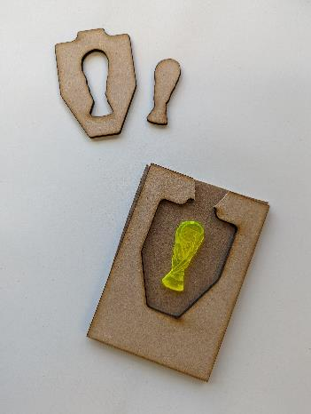
Laser Cut
Cut out your design on a laser cutter
The outside of the laser cut pieces are needed – labelled ‘1’
An acrylic insert can be added for contrasting detail ‘2’
Two side pieces are needed to sandwich the laser cut piece
2
1

Slide 14
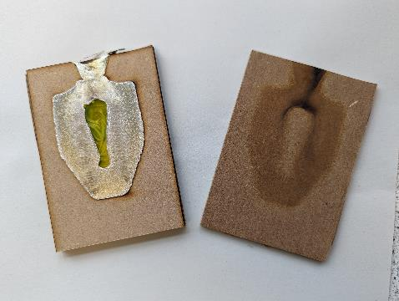
Pour the pewter ⚠
Clamp MDF pieces together
This will create a cavity inside
Carefully pour the pewter in to the mould
Wait until cooled before touching or opening – at least 20 minutes

Slide 15
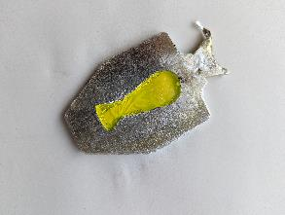
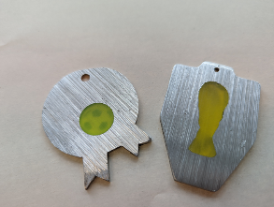
Remove and fettle ⚠
Remove the casting from the MDF mould
Cut off the sprue using a hacksaw
Clean up using a file (aluminium file called a ‘dreadnaught’ – a process called ‘fettling’
When smooth, use rough wet and dry paper
Work down to very fine – you can use this with water and a drop of hand soap added to aid smoothing

Slide 16
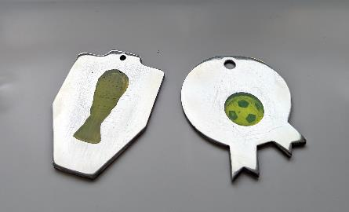
Finish!
When finished the aluminium should shine and acrylic should be polished and free from scratches
Drill a small hole Ø4 mm at the top where the ribbon will be attached
Notes:
Thanks to Trinity Academy Halifax for their assistance in developing this resource

Slide 17
Please do share your learning highlights and final creations with us so we can display it for other students to see.
Share them with us on social media @IETeducation or send them via email to IETEducation@theiet.org

