Slide 1
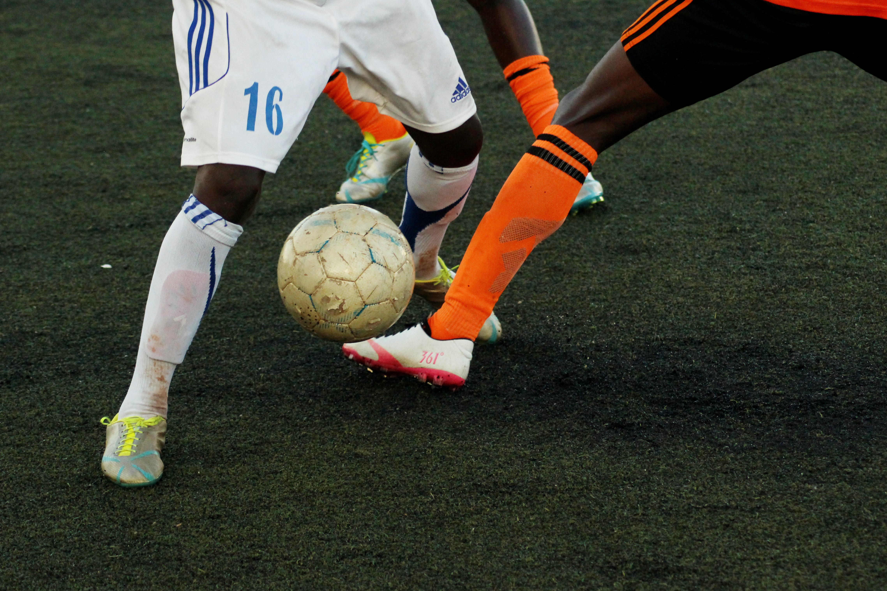
Design a kit for a national sports team
Consider smart or modern textile technologies when making a kit
Notes:
Stylish sports - designing a kit for a football team. Would include both graphics elements and consideration of new materials.
This presentation can be amended for any football based activity once the FIFA World Cup 2022 in Qatar is over.

Slide 2
Stay safe
Whether you are a scientist researching a new medicine or an engineer solving climate change, safety always comes first. An adult must always be around and supervising when doing this activity. You are responsible for:
ensuring that any equipment used for this activity is in good working condition
behaving sensibly and following any safety instructions so as not to hurt or injure yourself or others
Please note that in the absence of any negligence or other breach of duty by us, this activity is carried out at your own risk. It is important to take extra care at the stages marked with this symbol: ⚠

Slide 3
Design brief
The men’s 2022 football World Cup is to be played in November and December 2022 in Qatar
Your task is to design a kit for a national football team

Slide 4
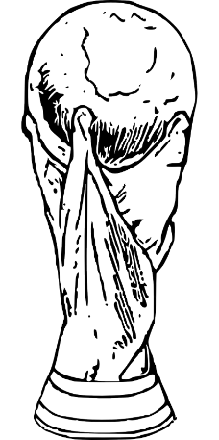
The Men’s Football World Cup 2022 in Qatar
On November 20th 2022 Qatar will host the FIFA World Cup, it will be the first time it has ever been in the Winter!
Quick Start
Where is Qatar?
What climate does Qatar have?
How many countries in the World Cup can you name?
Notes:
Quick Start
Where is Qatar? ANSWER ON SLIDE 5
What climate does Qatar have? ANSWER ON SLIDE 5
How many countries in the World Cup can you name? ANSWER ON SLIDE 6
Official world cup soundtrack: https://www.youtube.com/watch?v=vyDjFVZgJoo

Slide 5
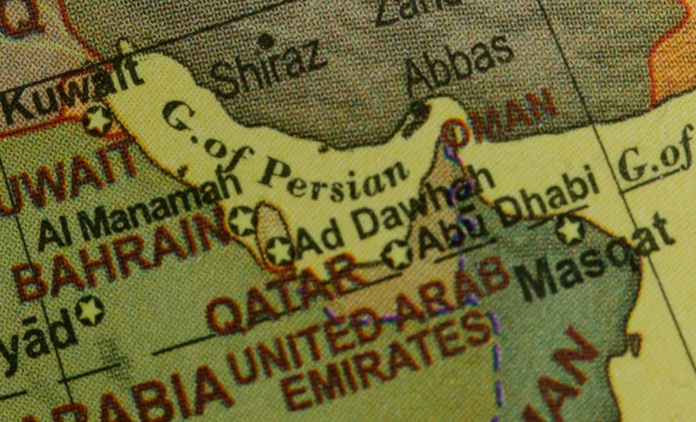
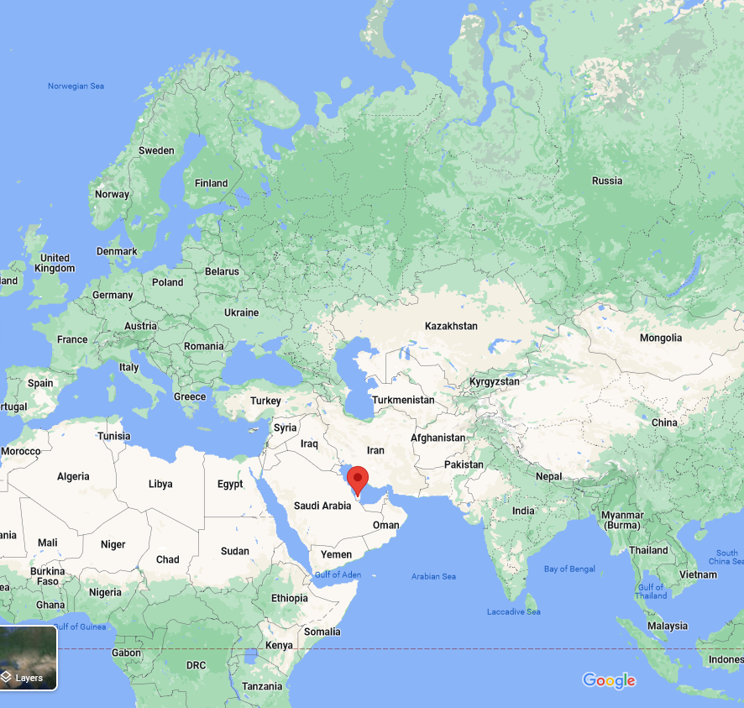
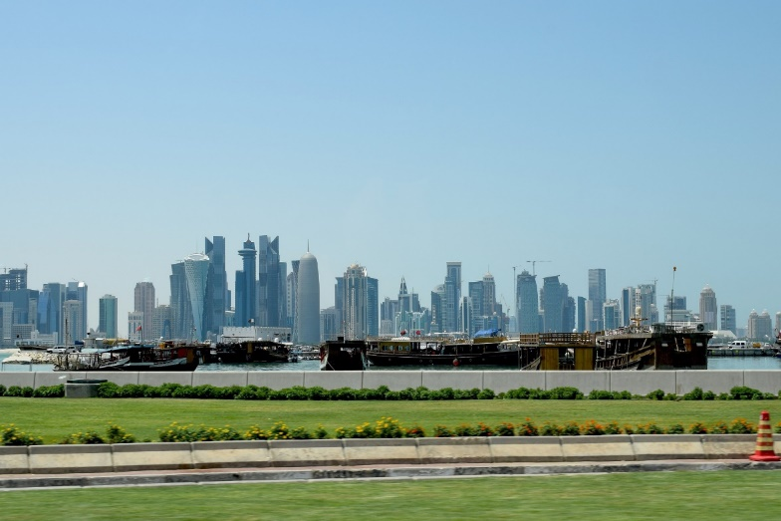
Notes:
Qatar is located in the Middle East. Qatar is bordered by the Gulf of Bahrain to the west, the Persian Gulf to the east, and Saudi Arabia to the south.
The 2022 World Cup is taking place in Qatar in the winter months rather than the usual summer ones, due to the heat. Qatar has a desert climate. The country experiences long summers from May to September characterised by intense dry heat, with temperatures rising above 45°C. Winter temperatures are mild but may fall below 5°C.

Slide 6
There are 32 countries in the World Cup 2022 in Qatar:
Group A: Qatar, Ecuador, Senegal, Netherlands
Group B: England, Iran, USA, Wales
Group C: Argentina, Saudi Arabia, Mexico, Poland
Group D: France, Australia, Denmark, Tunisia
Group E: Spain, Costa Rica, Germany, Japan
Group F: Belgium, Canada, Morocco, Croatia
Group G: Brazil, Serbia, Switzerland, Cameroon
Group H: Portugal, Ghana, Uruguay, South Korea
Notes:
Countries – allow the students to select their own from the 32 teams, or assign to each student (e.g. lucky dip).

Slide 7
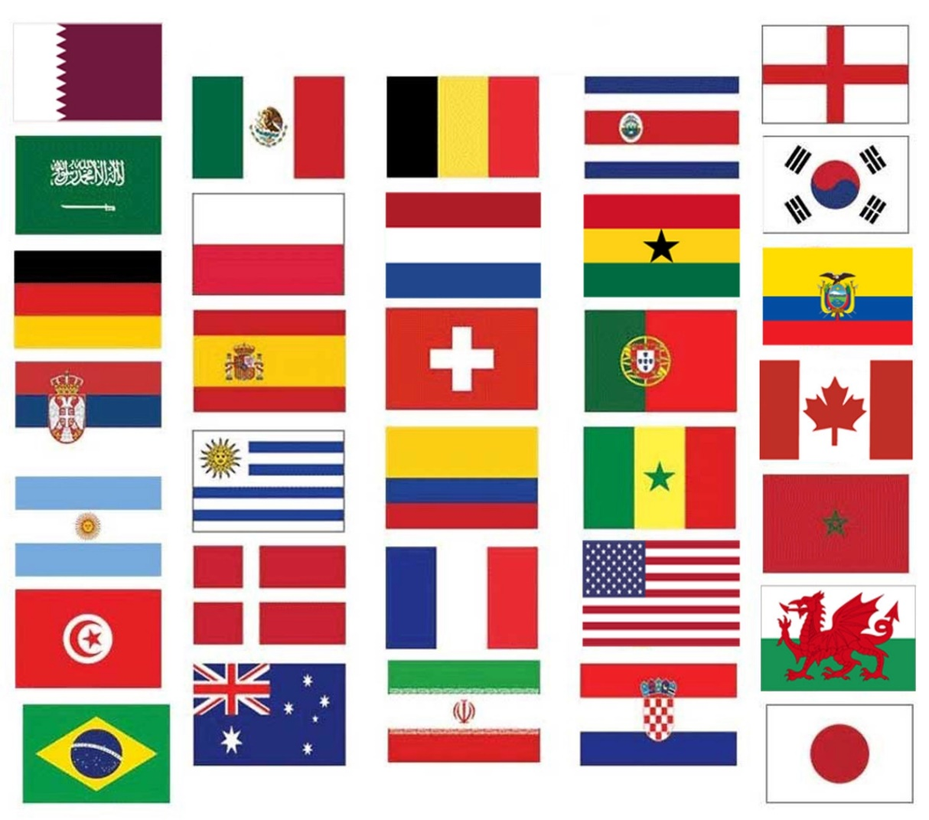
Each country has its own flag and national colours:
What is a flag?
What are the national colours of your country?
Notes:
A flag: a piece of cloth or similar material, typically oblong or square, attachable by one edge to a pole or rope and used as the symbol or emblem of a country.
All the flags above are of the 32 countries in the FIFA World Cup

Slide 8
Smart and modern textiles
Modern textiles can be made to have many properties, such as additional strength or resistance to fire, water and even dirt. These are called smart textiles.
Microencapsulation
To stop you having smelly feet!
Rhovyl
‘Wicks’ away moisture
Notes:
Microencapsulation
This involves encapsulating liquid or solid substances in tiny thin-walled bubbles. These gradually release active agents when rubbed, which rupture the thin-walled membrane. This can cover body odours in sports clothing. A similar technology is used in the scratch and sniff perfume and aftershave samples in magazines. Microencapsulation in fibres can help to absorb, store and release body heat, keeping the user more comfortable. It is also used in ski wear, military uniforms, gloves and footwear for other purposes, for example: fragrances added to socks to disguise smelly feet.
Rhovyl
‘Wicks’ quickly moving (or wicking) sweat to the fabric’s outer surface.
An antibacterial material that has antibacterial agents integrated into the fibre itself. This prevents the formation of bacteria and does not wash out. It is used in bedding, children’s clothes, sportswear and underwear, and has many properties:
thermal insulation and natural fire retardancy
wicks away moisture
resistant to mildew, fungi and chemicals
It also dries rapidly so that your sweat doesn’t saturate the fabric. The result is that you’re more comfortable because your body can regulate its temperature efficiently and the fabric touching your skin has a dry, nonsticky feel.
GCSE Bitesize SMART Textiles https://www.bbc.co.uk/bitesize/guides/znd48mn/revision/4
What are SMART textiles? https://youtu.be/kdNVAIRKEEw
Streetwear Changes Colour With Heat https://youtu.be/RYyyPAH58Vk
Discuss with learners:
How can you use these in your designs?
What will they help the clothing do?
Why would people like wearing them?
What other technologies can they add in to their kits?
Light up soles? (LEDs in the soles)
Tops that change colour in the heat? Colour Changing Temperature Activated Heat Sensitive Thermochromic Fabric Paint or ChroMorphous fabric (colour changing t-shirts of the 1990s).
Electronics to read the sports persons heart rate/breathing/other stats instead of wearing monitors (Biometrics).
Interactive textiles allow small electronic components such as batteries or lights to be embedded inside them and can then function as an electronic device or sensor. These include circuits that can
be integrated into fabrics, such as heart rate monitors.

Slide 9
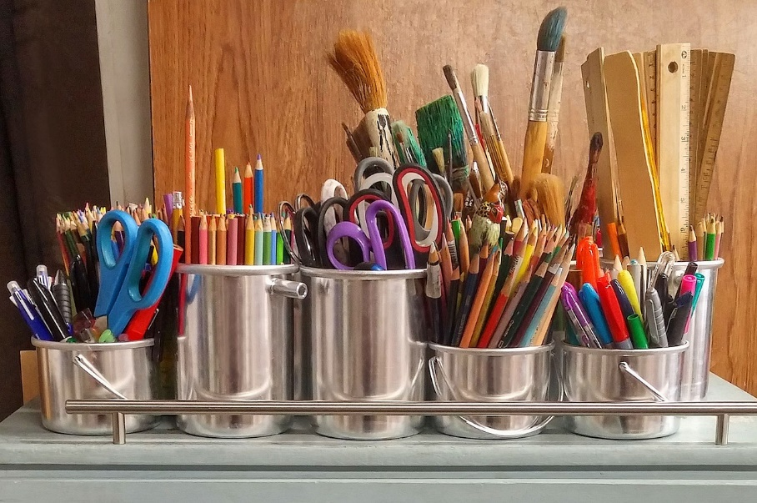
Resources and equipment
Templates
Pens/pencils/colours
Scissors

Slide 10
Design brief
The men’s 2022 football World Cup is to be played in November and December 2022 in Qatar
Your task is to design a new kit for one of the teams involved
It must use the team’s national colours
It must include smart or modern textiles
Notes:
Questions to ask learners:
Which country will you design the kit for?
What colours do you need to use?
Which smart textiles are you going to use?

Slide 11
Notes:
This template can be resized for additional needs on to A3 or bigger and printed on card or paper.
When each student has coloured/designed their ‘kit’ this sheet can be photocopied/photographed before they cut it out – so they can make notes/annotations on the design about why they have picked the colour/textiles, other interesting facts.

Slide 12
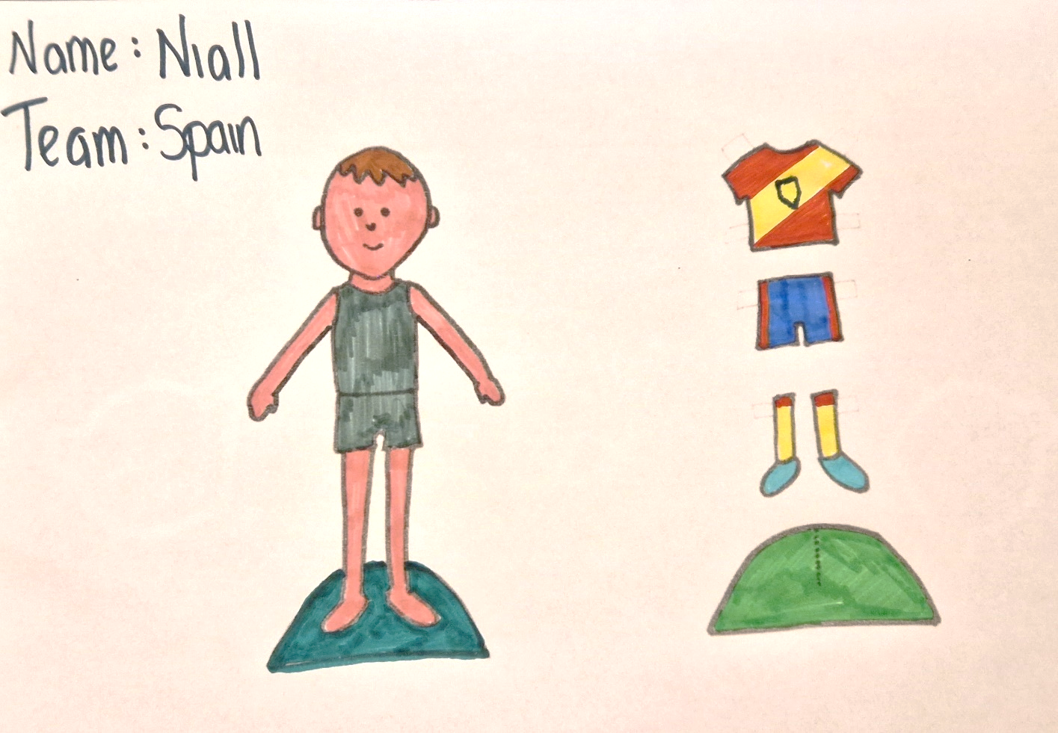
Step 1 – Design the kit
Notes:
Design your kit:
What colours do you need?
Is it going to look like the flag?
Which SMART textiles are you going to use? Why?
***Photograph/photocopy the students work so that they can do the next step before cutting out.

Slide 13
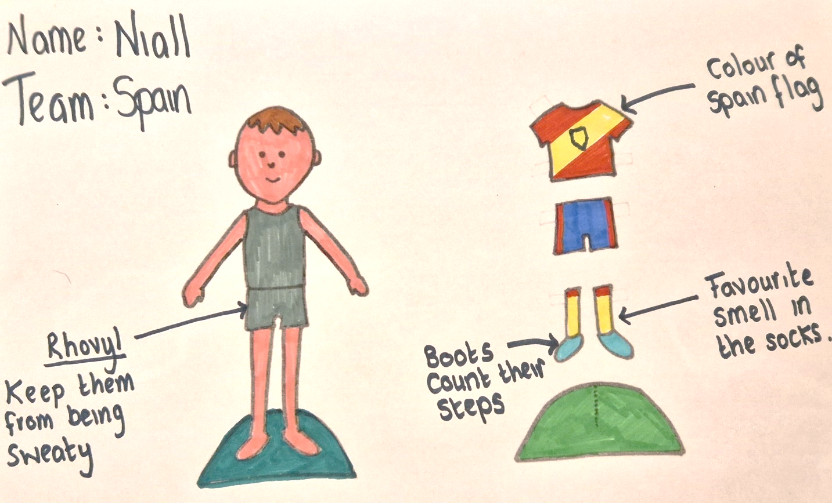
Step 2 – Label the kit
Why have you chosen this design?

Slide 14
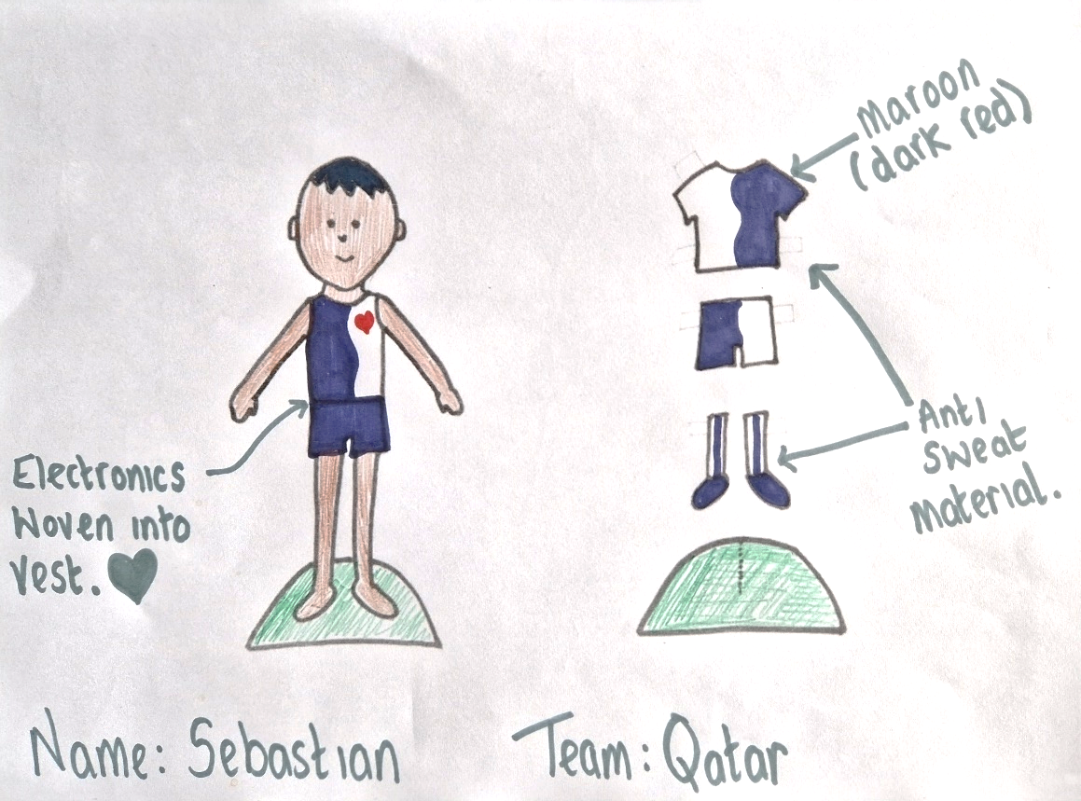
Step 2 – Label the kit
Why have you chosen this design?

Slide 15
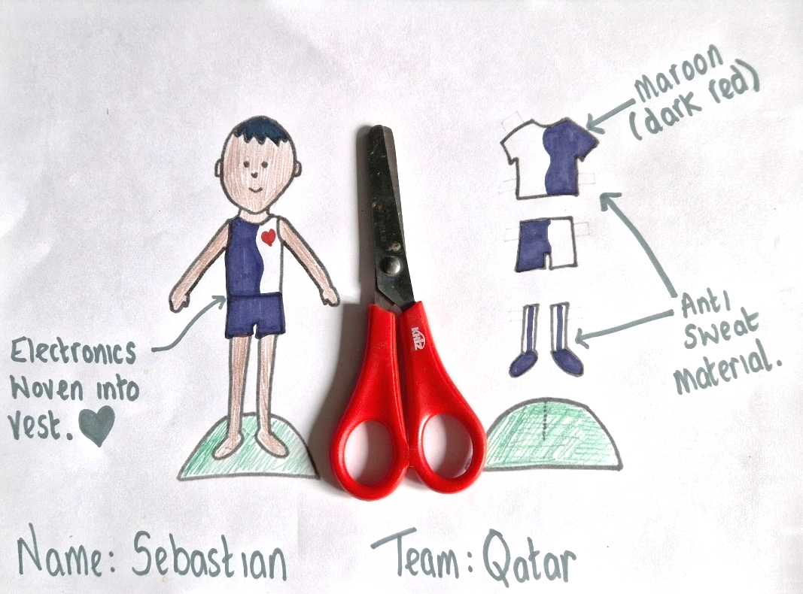
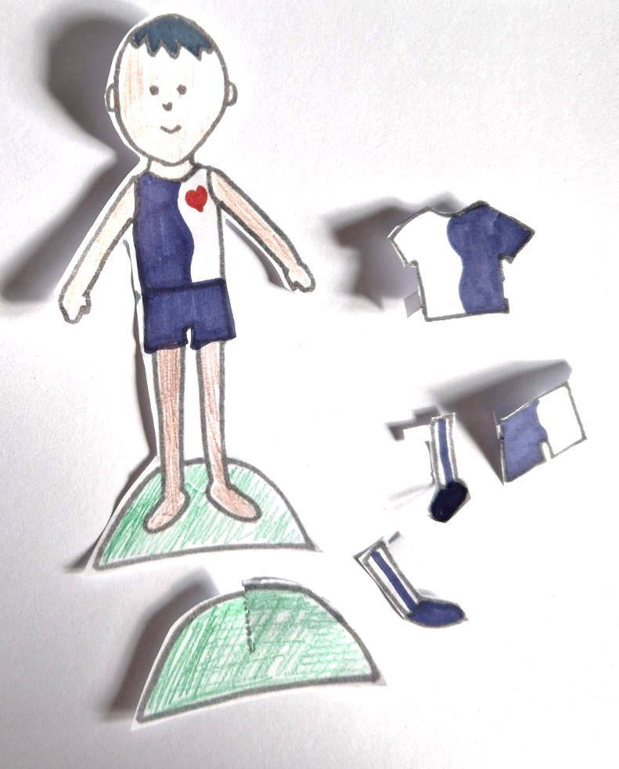
Step 3 – Cut out your kit and make the stand ⚠
Notes:
Take care when using scissors.

Slide 16
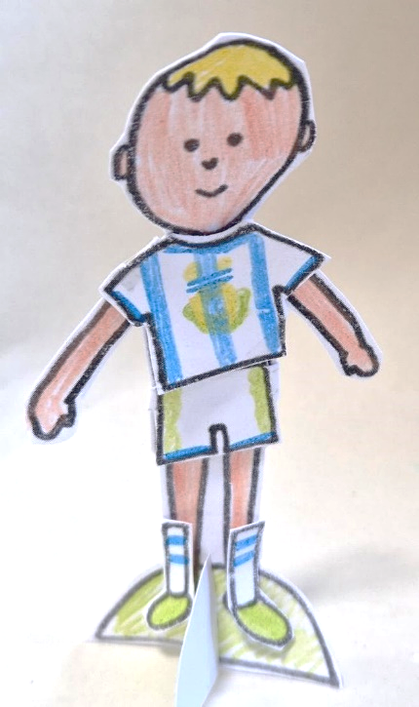
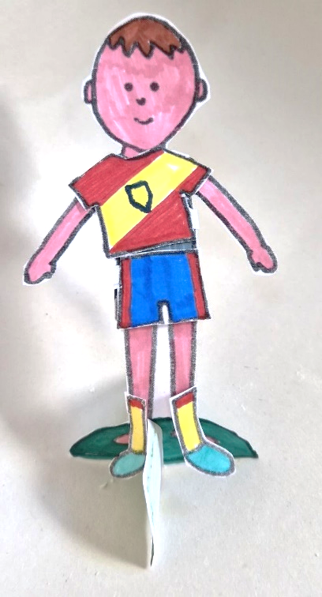
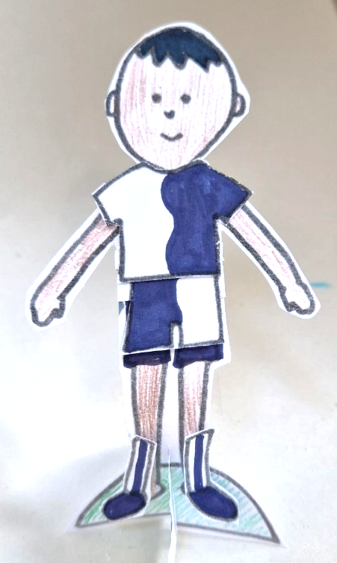
Final kit examples
Argentina Spain Qatar
Notes:
Create a ‘team’ on the tables with students ‘kits’ making two teams on a makeshift pitch on a desk.
Could you make a display with all the kits for the duration of the World Cup?
Each student has a different team who they support during the tournament

Slide 17
Evaluation
Which country did you design for?
What did you like the most about your design?
What did you like the least about your design?
Did the colours you used match the countries colours? If not, why not?
Which SMART textile did you choose to use in your design? How did it benefit the wearer?
What would you change about your design?

Slide 18
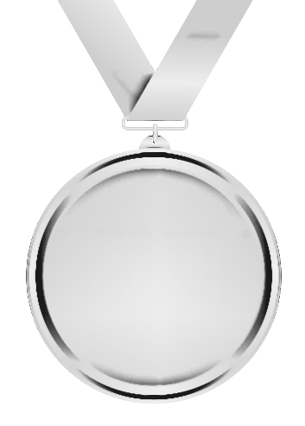
Extension activities
Now that you have designed your kit, in detail create
A ‘2nd’ kit for the team
A hoodie for supporters of your team to wear
A winners medal for the World Cup 2022
The football to be used in all the games
Notes:
A ‘2nd’ kit for the team - Each team with a ‘Home’ and ‘Away’ kit, create the other kit using their national colours.
A hoodie for supporters of your team to wear - A catchy slogan, character to encourage their team on/a hoodie that ALL supporters could wear e.g. general merchandise.
A winners medal for the World Cup 2022 - What needs to be on the medal? Can they use the internet to search for the official images or make up their own. What is it made of?
The football to be used in all the games.
What are the colours of the 2022 World Cup?

Slide 19
Away Kit
Notes:
A ‘2nd’ kit for the team - Each team has a ‘Home’ and ‘Away’ kit, create the other kit using their national colours.

Slide 20
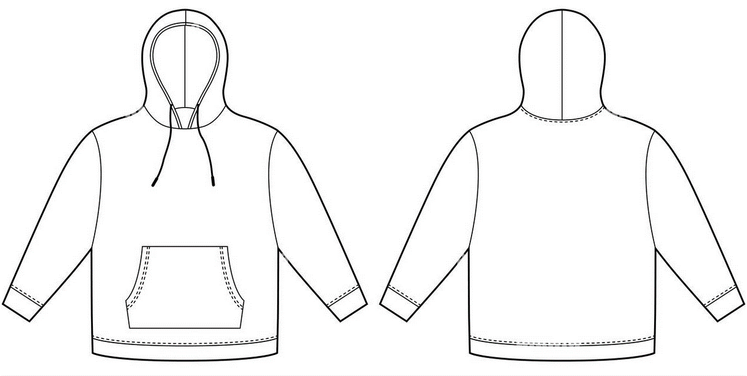
Supporters Hoodie
Notes:
A hoodie for supporters of your team to wear
A catchy slogan, character to encourage their team on/a hoodie that ALL supporters could wear e.g. general merchandise.

Slide 21
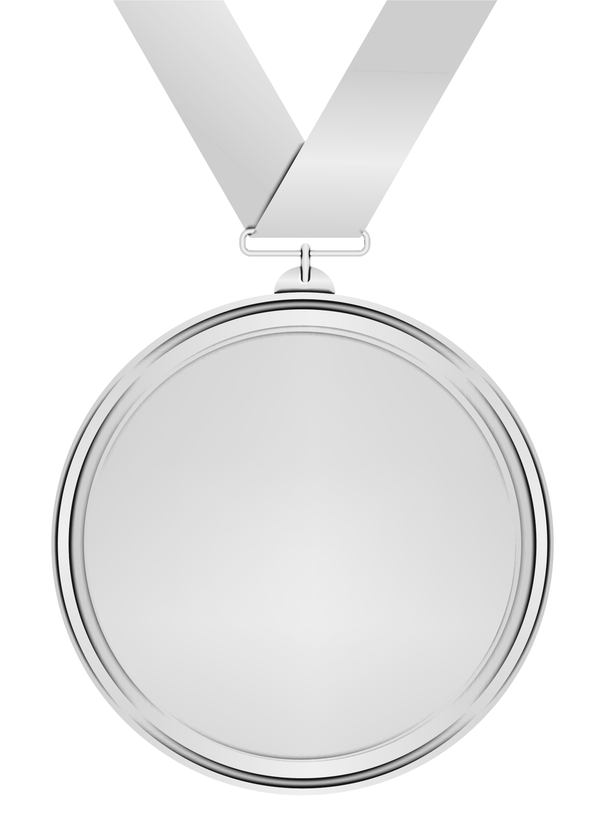
Winners Medal
Notes:
A winners medal for the World Cup 2022
What needs to be on the medal? Can they use the internet to search for the official images or make up their own. What is it made of?

Slide 22
Match Ball
Notes:
The football to be used in all the games.
What are the colours of the 2022 World Cup?

Slide 23
Notes:
This template can be resized for additional needs on to A3 or bigger and printed on card or paper.
When each student has coloured/designed their ‘kit’ this sheet can be photocopied/photographed before they cut it out – so they can make notes/annotations on the design about why they have picked the colour/textiles, other interesting facts.

Slide 24
Please do share your learning highlights and final creations with us so we can display it for other students to see.
Share them with us on social media @IETeducation or send them via email to IETEducation@theiet.org

