Slide 1
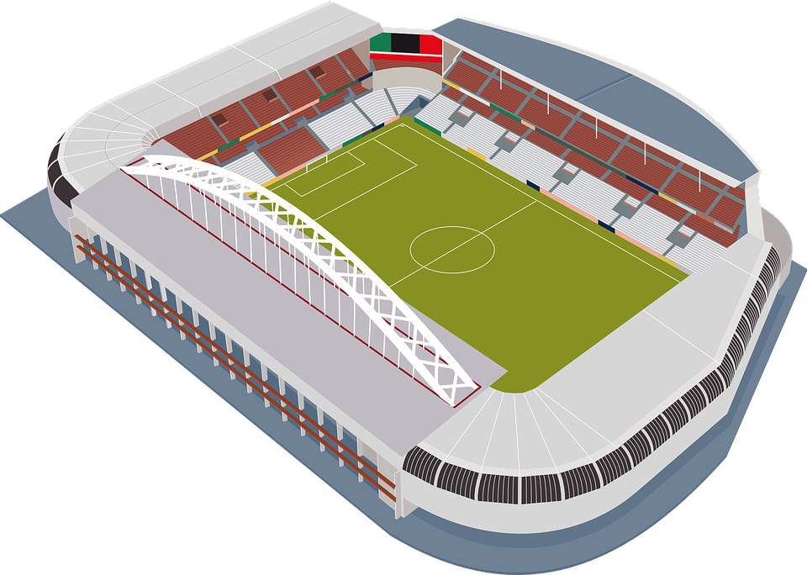
Engineering a Stadium
Designing the sports stadium of the future

Slide 2
Stay safe
Whether you are a scientist researching a new medicine or an engineer solving climate change, safety always comes first. An adult must always be around and supervising when doing this activity. You are responsible for:
ensuring that any equipment used for this activity is in good working condition
behaving sensibly and following any safety instructions so as not to hurt or injure yourself or others
Please note that in the absence of any negligence or other breach of duty by us, this activity is carried out at your own risk. It is important to take extra care at the stages marked with this symbol: ⚠

Slide 3
Design brief
The men’s 2022 football World Cup is to be played in November and December 2022 in Qatar
The country has had to design a range of new stadia for the event
Your task is to design a new stadium for the 2022 World Cup and the future
You must label your design to explain the main features
Notes:
Explain how legacy is very important for a world cup – i.e. what the stadia will be used for afterwards.

Slide 4
The Men’s Football World Cup 2022 in Qatar
On November 20th 2022 Qatar will host the FIFA World Cup, it will be the first time it has ever been in the Winter!
Quick Start
Where is Qatar?
What climate does Qatar have?
How many countries in the World Cup can you name?
World cup soundtrack: https://www.youtube.com/watch?v=vyDjFVZgJoo
Notes:
Quick Start
Where is Qatar? ANSWER ON SLIDE 5
What climate does Qatar have? ANSWER ON SLIDE 5
How many countries in the World Cup can you name? ANSWER ON SLIDE 6
Official world cup soundtrack: https://www.youtube.com/watch?v=vyDjFVZgJoo

Slide 5
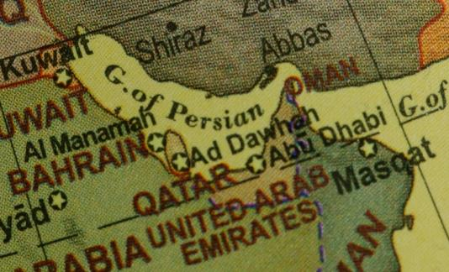
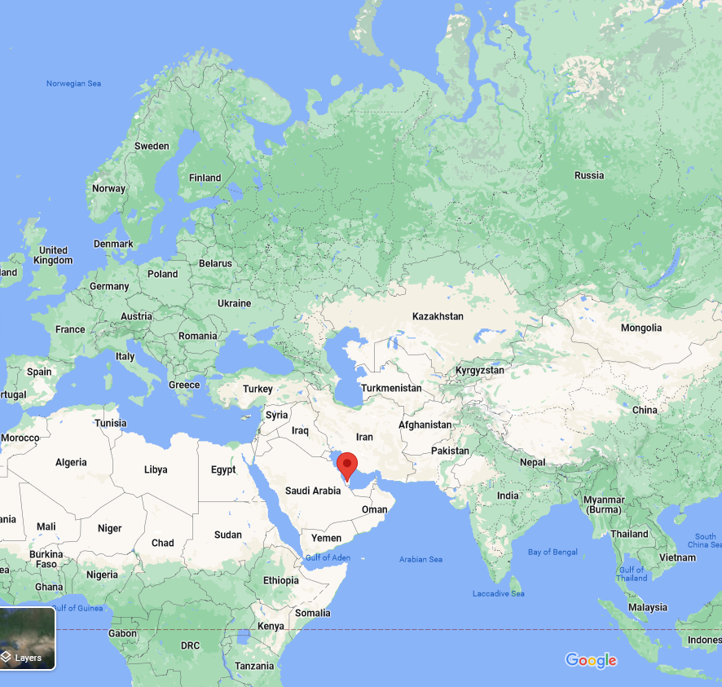
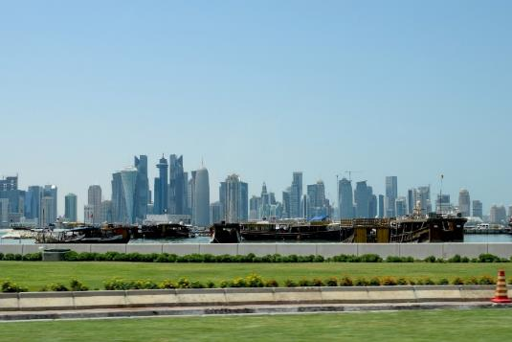
Notes:
Qatar is located in the Middle East. Qatar is bordered by the Gulf of Bahrain to the west, the Persian Gulf to the east, and Saudi Arabia to the south.
The 2022 World Cup is taking place in Qatar in the winter months rather than the usual summer ones, due to the heat. Qatar has a desert climate. The country experiences long summers from May to September characterised by intense dry heat, with temperatures rising above 45°C. Winter temperatures are mild but may fall below 5°C.

Slide 6
There are 32 countries in the World Cup 2022 in Qatar:
Group A: Qatar, Ecuador, Senegal, Netherlands
Group B: England, Iran, USA, Wales
Group C: Argentina, Saudi Arabia, Mexico, Poland
Group D: France, Australia, Denmark, Tunisia
Group E: Spain, Costa Rica, Germany, Japan
Group F: Belgium, Canada, Morocco, Croatia
Group G: Brazil, Serbia, Switzerland, Cameroon
Group H: Portugal, Ghana, Uruguay, South Korea

Slide 7
Things to think about
How many people does your stadium need to hold?
How will you make it look visually appealing, both inside and outside?
Where will the dressing rooms and players’ tunnel go?
What food and drink outlets will your stadium have?
How will the fans be kept dry and comfortable when seated?
How will you make sure they have a good view of the game?
How can you make sure it is environmentally friendly?
Notes:
Discuss the issues that should be considered when producing the design. Learners could make a mind map or fishbone diagram of their thoughts. Can they think of any more design considerations? E.g. Qatar will be very hot, even in Winter, so is air conditioning needed?

Slide 8
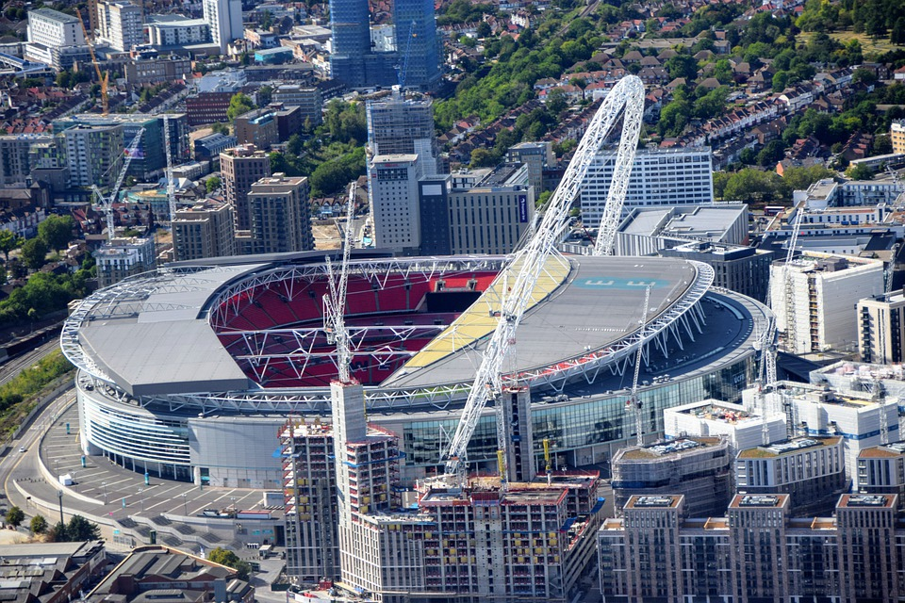
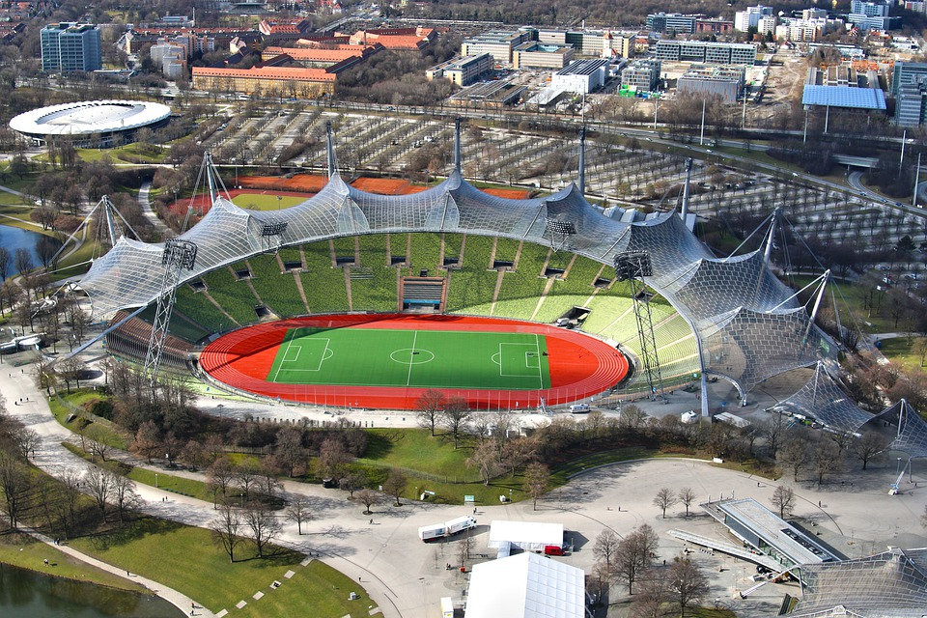
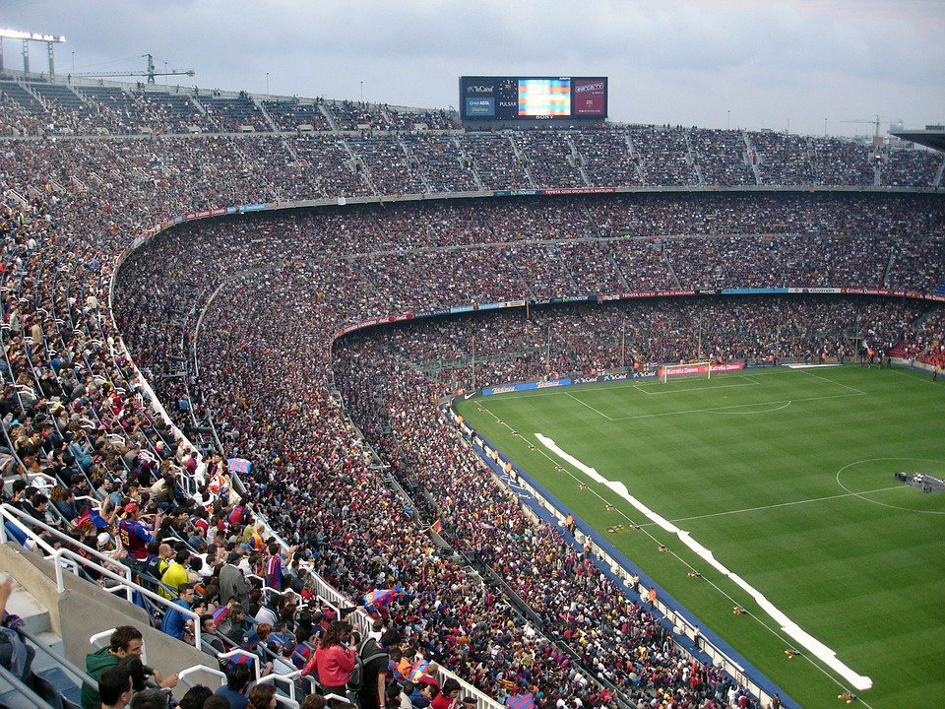
Examples of existing stadiums
What is good about these stadiums?
How could they be improved?
Notes:
From L-R – Wembley Stadium (London, England), Nou Camp (Barcelona, Spain), Olympic Stadium (Munich, Germany).
Discuss the main defining features of each and where they could be modernised or improved. E.g. for Nou Camp – iconic venue and holds a lot of people, but outdated facilities and not much cover from the weather.

Slide 9
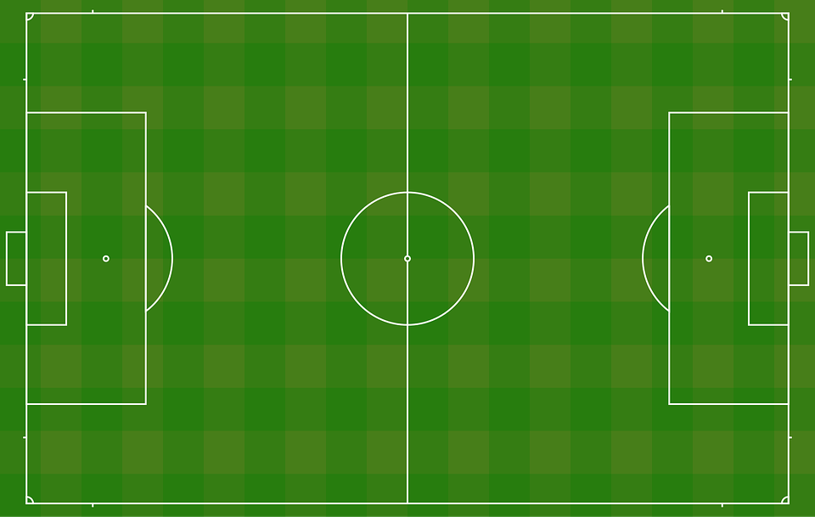
Stadium design worksheet
Notes:
Learners could sketch their design around the football pitch given on this slide (available as a handout).

Slide 10
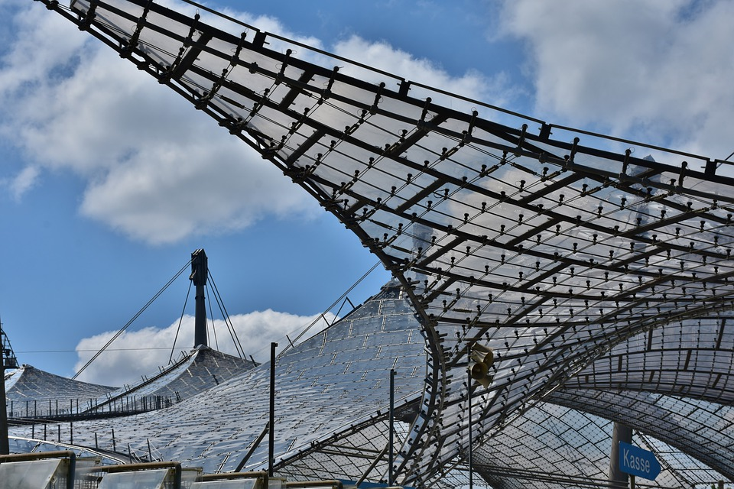
Extension 1
Design a method of holding up the roof structure of your stadium
Think about how to avoid having pillars that would spoil the view from the seats

Slide 11
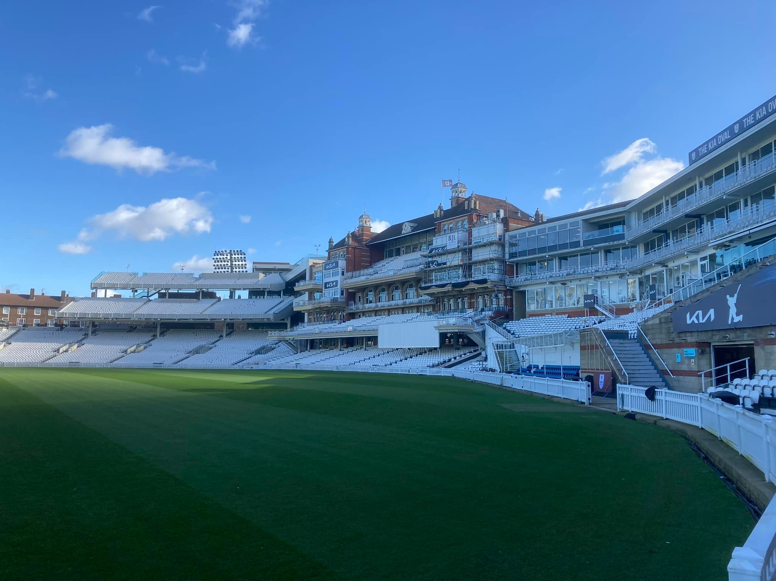
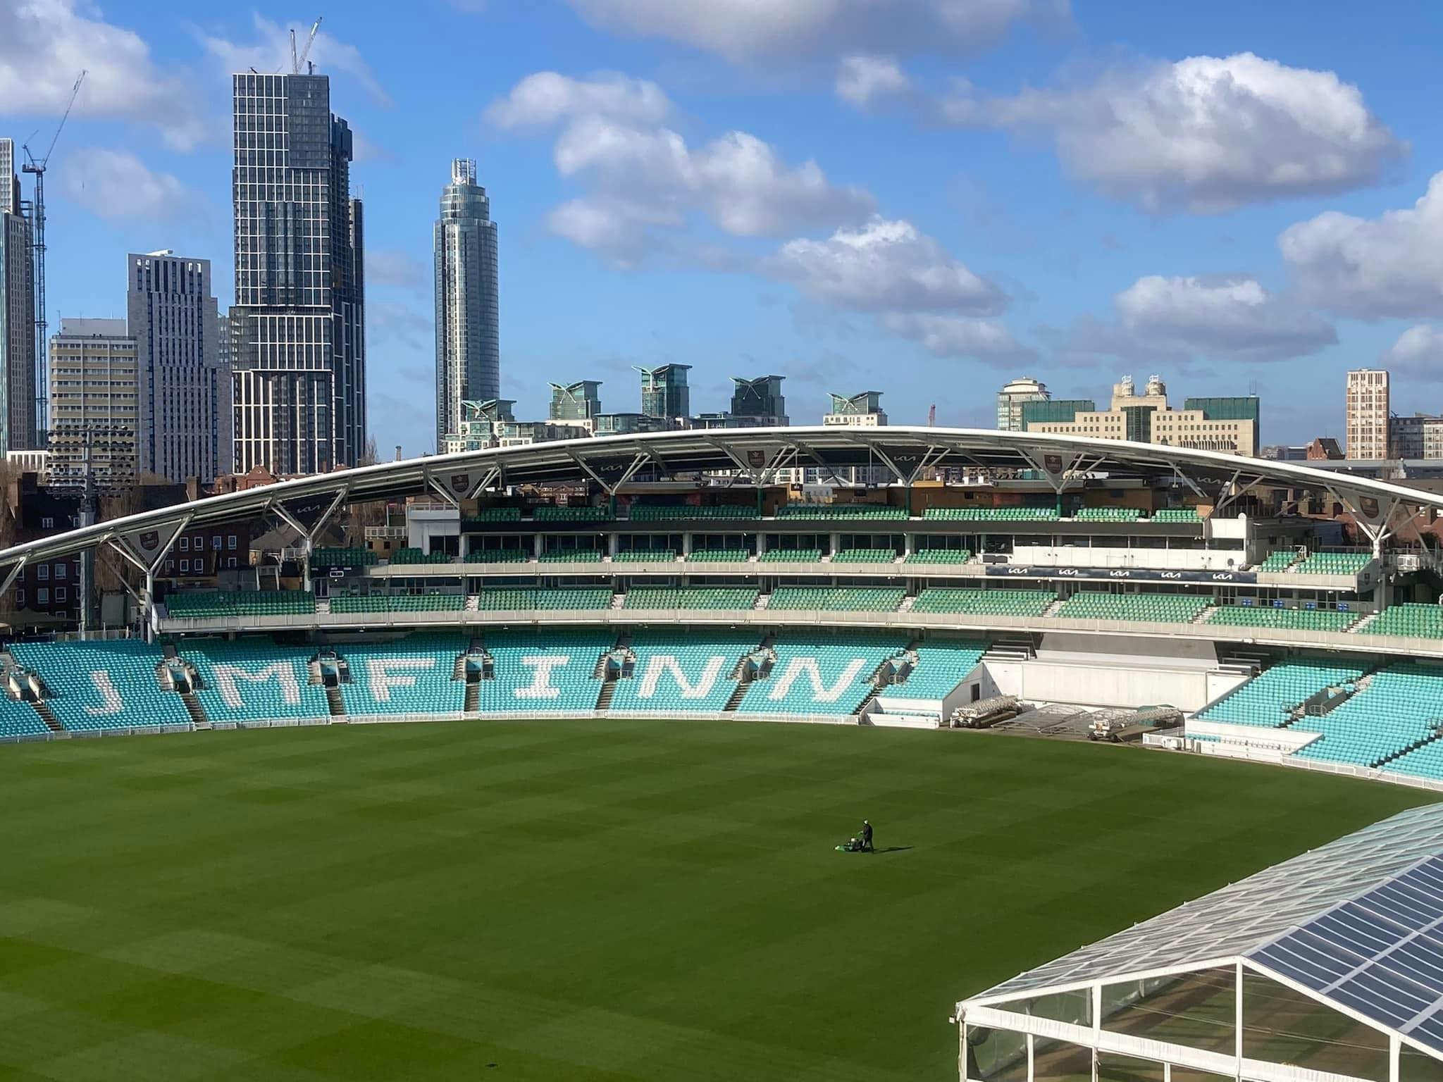
Extension 2
Design a new stadium for another sport. For example:
Cricket
Rugby
Athletics
Tennis
Hockey
Basketball
Baseball
Or a sport of your choice
Notes:
Images show the Oval Cricket Ground, London.
Learners should think about what would be needed that is different for this sport to football. E.g. a cricket ground should have a pavilion for the players to change and watch from.

Slide 12
Please do share your learning highlights and final creations with us so we can display it for other students to see.
Share them with us on social media @IETeducation or send them via email to IETEducation@theiet.org

