Slide 1
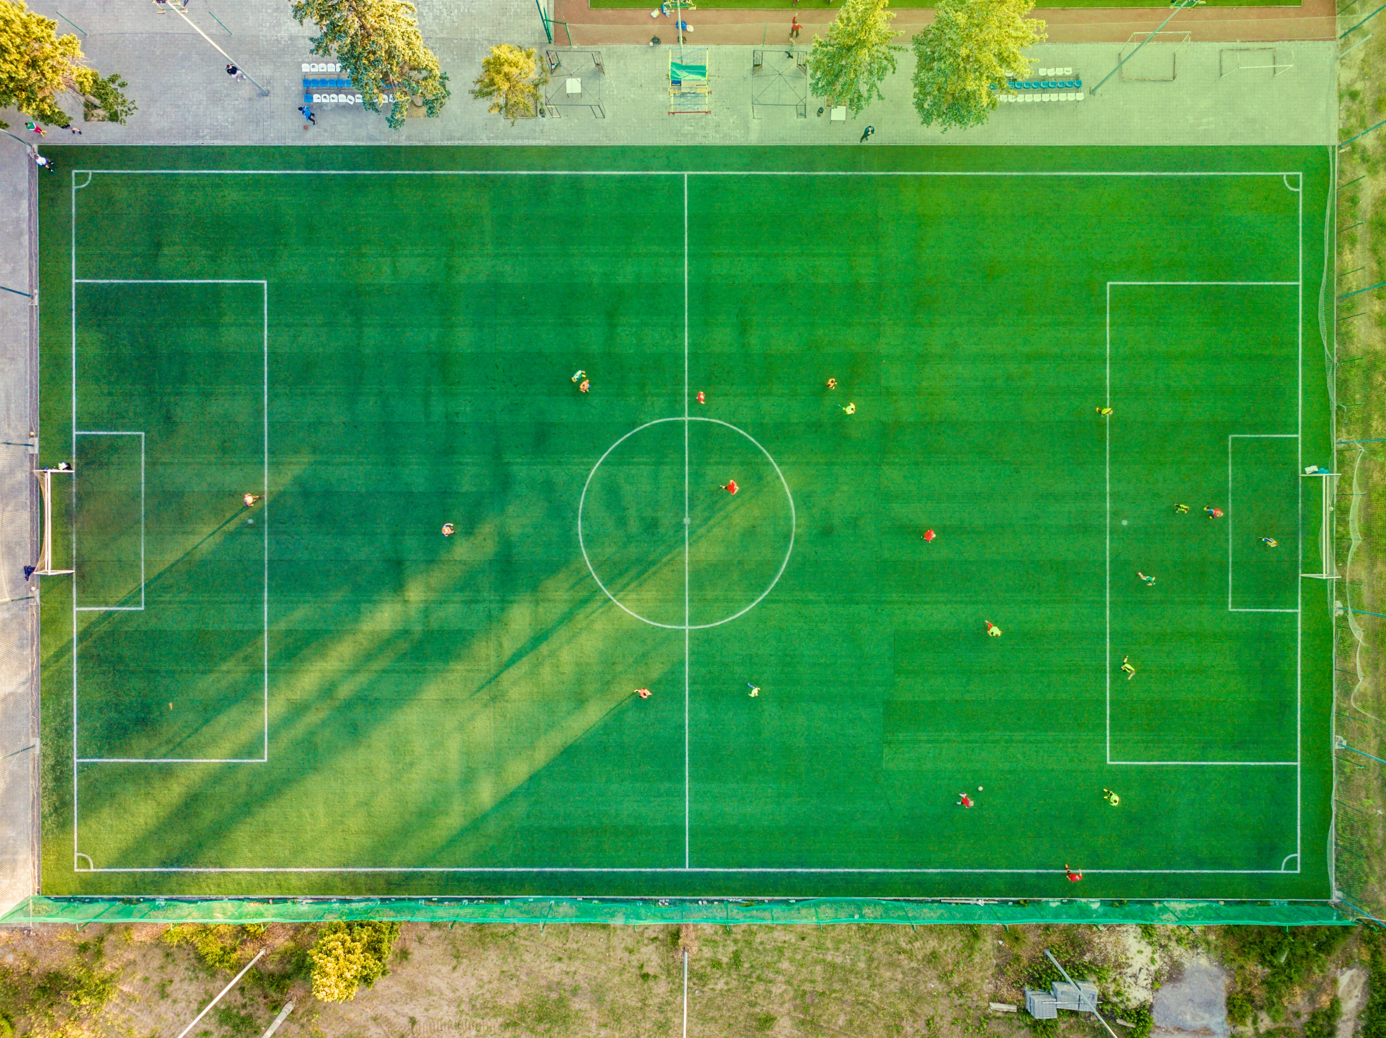
Fractions of the squad
Describing your squad and team using fractions and percentages

Slide 2
How is the squad made up?

Slide 3
Fikayo Tomori | Defender | AC Milan
Bukayo Saka | Forward | Arsenal
Aaron Ramsdale | Goalkeeper | Arsenal
Jude Bellingham | Midfielder | Borussia Dortmund
Nick Pope | Goalkeeper | Burnley
Mason Mount | Midfielder | Chelsea
Marc Guehi | Defender | Crystal Palace
Reece James | Defender | Crystal Palace
Conor Gallagher | Midfielder | Crystal Palace (Chelsea)
Jordan Pickford | Goalkeeper | Everton
Kalvin Phillips | Midfielder | Leeds United
James Justin | Defender | Leicester City
Trent Alexander-Arnold | Defender | Liverpool
The Squad

Slide 4
John Stones | Defender | Manchester City
Kyle Walker | Defender | Manchester City
Jack Grealish | Forward | Manchester City
Phil Foden | Forward | Manchester City
Raheem Sterling | Forward | Manchester City
Harry Maguire | Defender | Manchester United
Kieran Tripper | Defender | Newcastle United
Tammy Abraham | Forward | Roma
James Ward-Prowse | Midfielder | Southampton
Harry Kane | Forward | Tottenham Hotspur
Jarrod Bowen | Forward | West Ham United
Declan Rice | Midfielder | West Ham United
Conor Coady | Defender | Wolverhampton Wanderers
The Squad

Slide 5
What are these fractions describing?
$\frac{3}{26}$
$\frac{7}{26}$
$\frac{1}{2}$
$\frac{10}{26}$
$\frac{3}{13}$
___ of the squad are ___
Notes:
Fractions on Slide 4 relate to:
$\frac{3}{26}$ of the squad are goalkeepers
$\frac{3}{13}$ of the squad are midfielders
$\frac{1}{2}$ of the squad are defenders and goalkeepers or midfielders and forwards
$\frac{10}{26}$ of the squad are defenders
$\frac{7}{26}$ of the squad are forwards

Slide 6
What are these fractions describing?
$\frac{3}{26}$
$\frac{7}{26}$
Could you replace any of these fractions with a percentage %?
$\frac{10}{26}$
$\frac{3}{13}$
$\frac{1}{2}$

Slide 7
Is this enough information to work out which 12 players I have picked?
$\frac{1}{3}$ of my midfielders plays abroad
My midfielders all play from different teams
$\frac{1}{6}$ of my team play together at Arsenal
$\frac{1}{3}$ of my team are from the same club. $\frac{1}{2}$ of them play forward and $\frac{1}{2}$ in defence.
$\frac{2}{3}$ of my defenders play for the same team
25% of my team play for Crystal Palace. Of these, $\frac{2}{3}$ of them play in defence and the other $\frac{1}{3}$ is a midfielder.
100% of the forwards play for English clubs and of them, $\frac{1}{3}$ play for Chelsea
$\frac{1}{12}$ of the team plays for Southampton but he might not get the chance to play!
$\frac{1}{3}$ of my team have no-one else from their home team.

Slide 8
The team
Position | Name | Home Team
Goalkeeper | Aaron Ramsdale | Arsenal
Forward | Bukayo Saka | Arsenal
Forward | Jack Grealish | Manchester City
Forward | Raheem Sterling | Manchester City
Midfielder | Mason Mount | Chelsea
Midfielder | Conor Gallagher | Crystal Palace
Midfielder | Jude Bellingham | Borussia Dortmund
Defender | Reece James | Crystal Palace
Defender | Marc Guehi | Crystal Palace
Defender | John Stones | Manchester City
Defender | Kyle Walker | Manchester City
Substitute | James Ward-Prowse | Southampton

Slide 9
Please do share your learning highlights and final creations with us so we can display it for other students to see.
Share them with us on social media @IETeducation or send them via email to IETEducation@theiet.org

