Slide 1
Goal! Create a podcast for
a sporting event
Making a podcast for the men’s football World Cup or an event at school

Slide 2
Stay safe
Whether you are a scientist researching a new medicine or an engineer solving climate change, safety always comes first. An adult must always be around and supervising when doing this activity. You are responsible for:
ensuring that any equipment used for this activity is in good working condition
behaving sensibly and following any safety instructions so as not to hurt or injure yourself or others
Please note that in the absence of any negligence or other breach of duty by us, this activity is carried out at your own risk. It is important to take extra care at the stages marked with this symbol: ⚠

Slide 3
Design brief
The men’s 2022 football World Cup is to be played in November and December 2022 in Qatar
Your task is to create a podcast about a team or game at the World Cup

Slide 4
The Men’s Football World Cup 2022 in Qatar
On November 20th 2022 Qatar will host the FIFA World Cup, it will be the first time it has ever been in the Winter!
Quick Start
Where is Qatar?
What climate does Qatar have?
How many countries in the World Cup can you name?
World cup soundtrack: https://www.youtube.com/watch?v=vyDjFVZgJoo
Notes:
Quick Start
Where is Qatar? ANSWER ON SLIDE 5
What climate does Qatar have? ANSWER ON SLIDE 5
How many countries in the World Cup can you name? ANSWER ON SLIDE 6
Official world cup soundtrack: https://www.youtube.com/watch?v=vyDjFVZgJoo

Slide 5
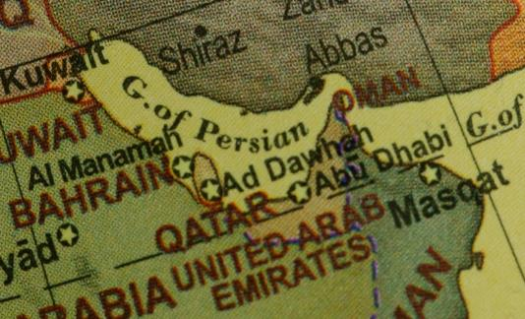
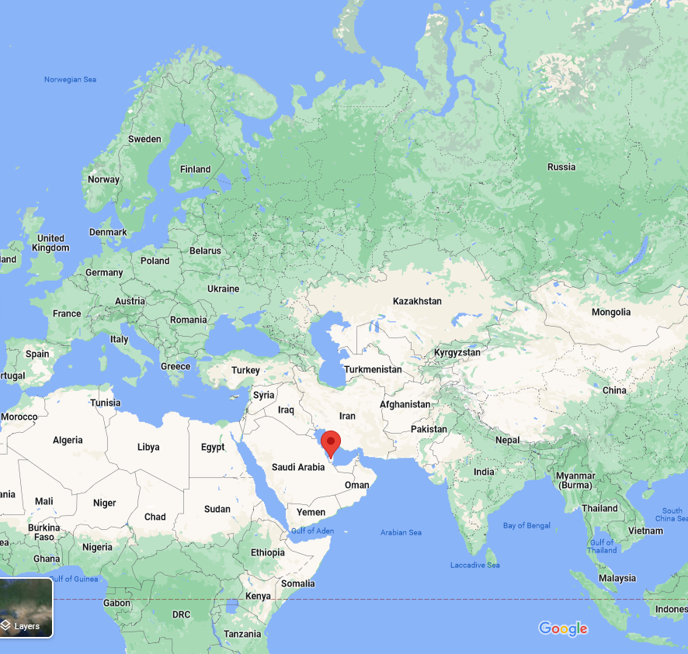
Notes:
Qatar is located in the Middle East. Qatar is bordered by the Gulf of Bahrain to the west, the Persian Gulf to the east, and Saudi Arabia to the south.
The 2022 World Cup is taking place in Qatar in the winter months rather than the usual summer ones, due to the heat. Qatar has a desert climate. The country experiences long summers from May to September characterised by intense dry heat, with temperatures rising above 45°C. Winter temperatures are mild but may fall below 5°C.

Slide 6
There are 32 countries in the World Cup 2022 in Qatar:
Group A: Qatar, Ecuador, Senegal, Netherlands
Group B: England, Iran, USA, Wales
Group C: Argentina, Saudi Arabia, Mexico, Poland
Group D: France, Australia, Denmark, Tunisia
Group E: Spain, Costa Rica, Germany, Japan
Group F: Belgium, Canada, Morocco, Croatia
Group G: Brazil, Serbia, Switzerland, Cameroon
Group H: Portugal, Ghana, Uruguay, South Korea

Slide 7
What is a podcast?
Definition – “Podcast”
a broadcast that is placed on the internet for anyone who wants to listen to or watch it
A podcast is like a radio show
But instead of being broadcast live, a podcast is recorded and then put onto the internet
You can then choose when to listen to it
There are thousands of podcasts available

Slide 8
Choose the audience and topic
What will you be creating the podcast for?
What questions do you want to find answers to?
What will grab the viewers attention?
Notes:
As an alternative to the World Cup, learners could prepare a podcast for a school activity or another sports event

Slide 9
Introduction
In your introduction you need to:
Create interest in your show by starting with a strong statement or language feature
State the name of your show, your name and the topic you are discussing
Give a brief outline of what you will be talking about

Slide 10
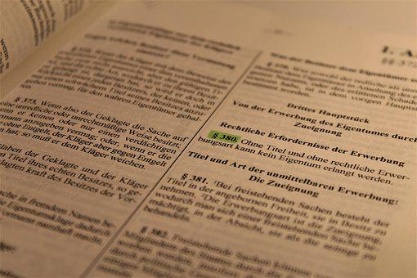
Main body
Use your handout sheet to help structure your podcast
You need 9 ‘things’ you want to talk about
Put these into an order you are happy to talk through
It should “flow” – there should be a sensible link from one to the next

Slide 11
Conclusion
In your conclusion you need to:
Sum up your main ideas
Re-state the name of your show, your name and the topic you have discussed
Finish with a strong statement that gives the audience something to think about

Slide 12
Featured language
Language features are a great way to make a podcast more interesting.
Statistics
Facts or data that support the point you are trying to make
Anecdote
A funny or interesting story that engages the reader by personalizing the topic

Slide 13
Featured language
Rhetorical question
A question that makes the audience think
Reference to authority
Quoting an expert who agrees with you, making your point seem more legitimate

Slide 14
How long?
As a rough guide – 1 side of paper takes a minute to read through

Slide 15
How do I make a podcast?
You will need to:
Select and research the topic
Choose your audience
Plan your speech
Think about music/sounds
Complete ‘Running Order’
Record it!

Slide 16
Now record it…
Use a package to record your podcast
Audacity lets you record and export as an MP3 file – and it’s free!
Use software such as eJay (PC) or Garageband (Mac) to create jingles
These can be used to introduce features to the show

Slide 17
Please do share your learning highlights and final creations with us so we can display it for other students to see.
Share them with us on social media @IETeducation or send them via email to IETEducation@theiet.org

